Slide 1
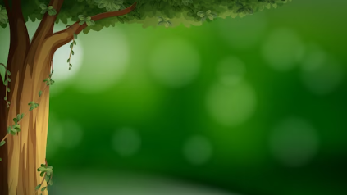

Our Eco Journey
Cila Primary School

Slide 2
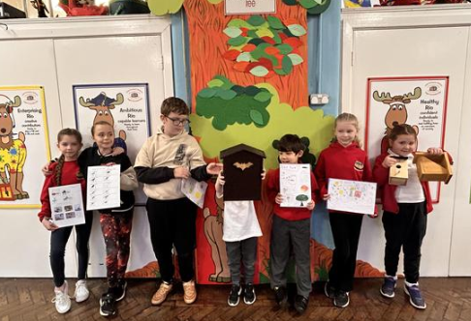
School Grounds Tiroedd yr Ysgol
Our school Eco committee took an assembly to share the importance of collecting data for the big school and garden bird watch.
What we did:
. Survey sheets and looking at
historical data.
. Homework task explained - get counting!
. Looked at bird boxes and bat boxes for our school garden.

Slide 3
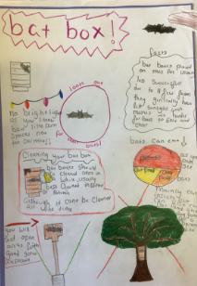
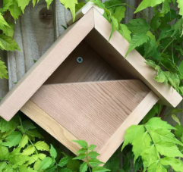
Bats and Birds
To encourage bats, we have researched the correct environment needed for bats and bat boxes. Bat boxes need to be put up high but not in a tree where there is less sunlight, which makes it harder for bats to enter and exit. The boxes also needed to be near water. Bats mainly eat insects. You can clean the boxes once a year during winter.
We have also put up a robin box.

Slide 4
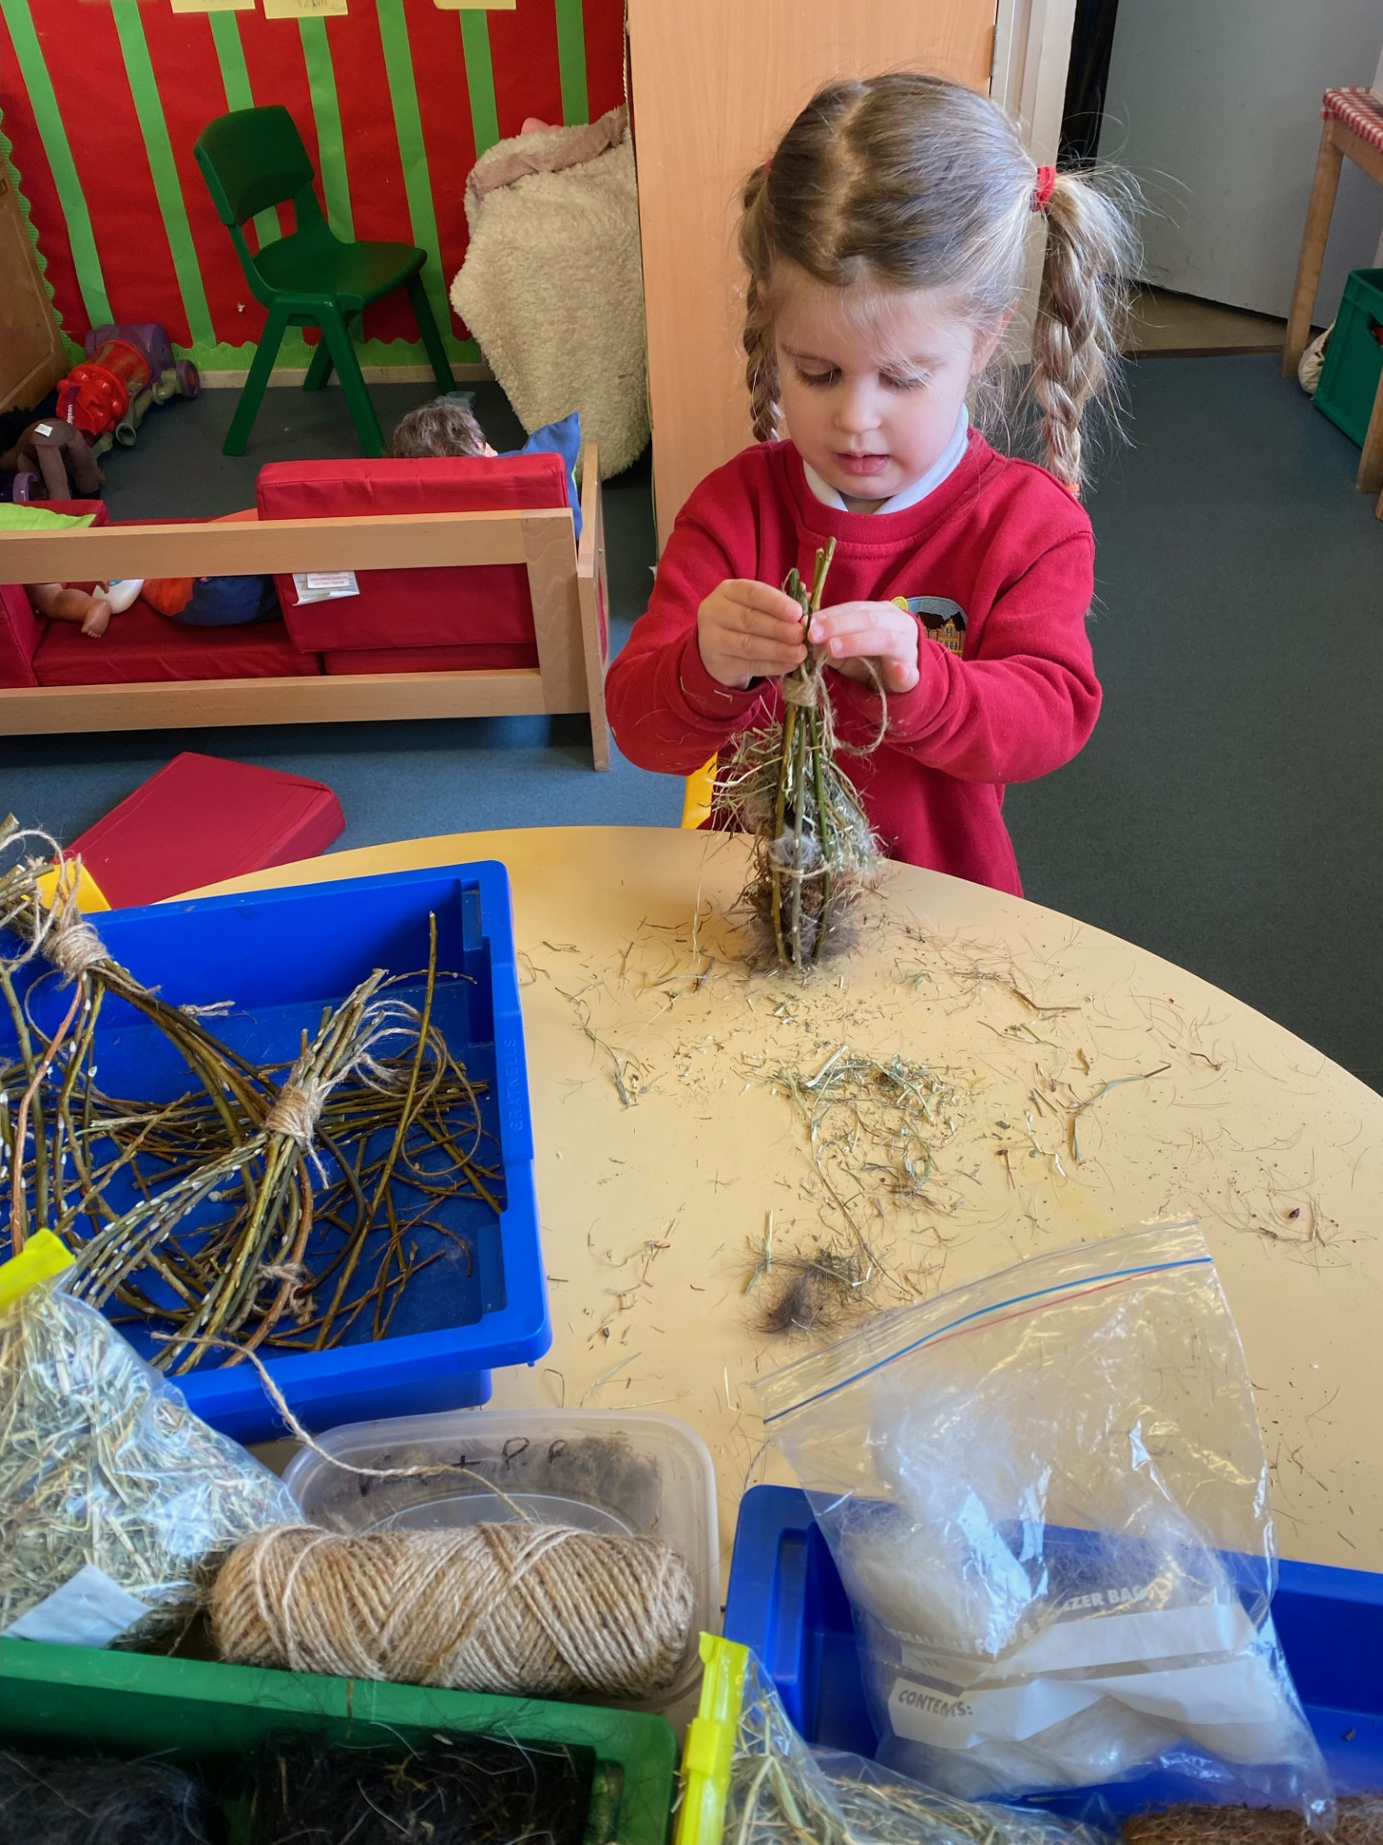
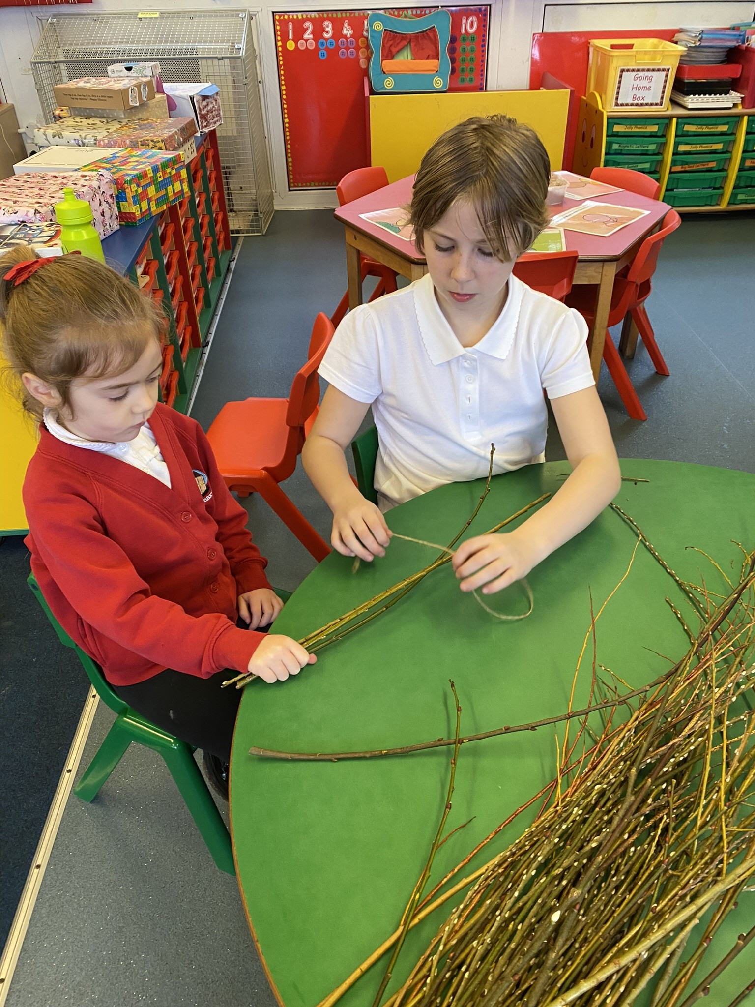
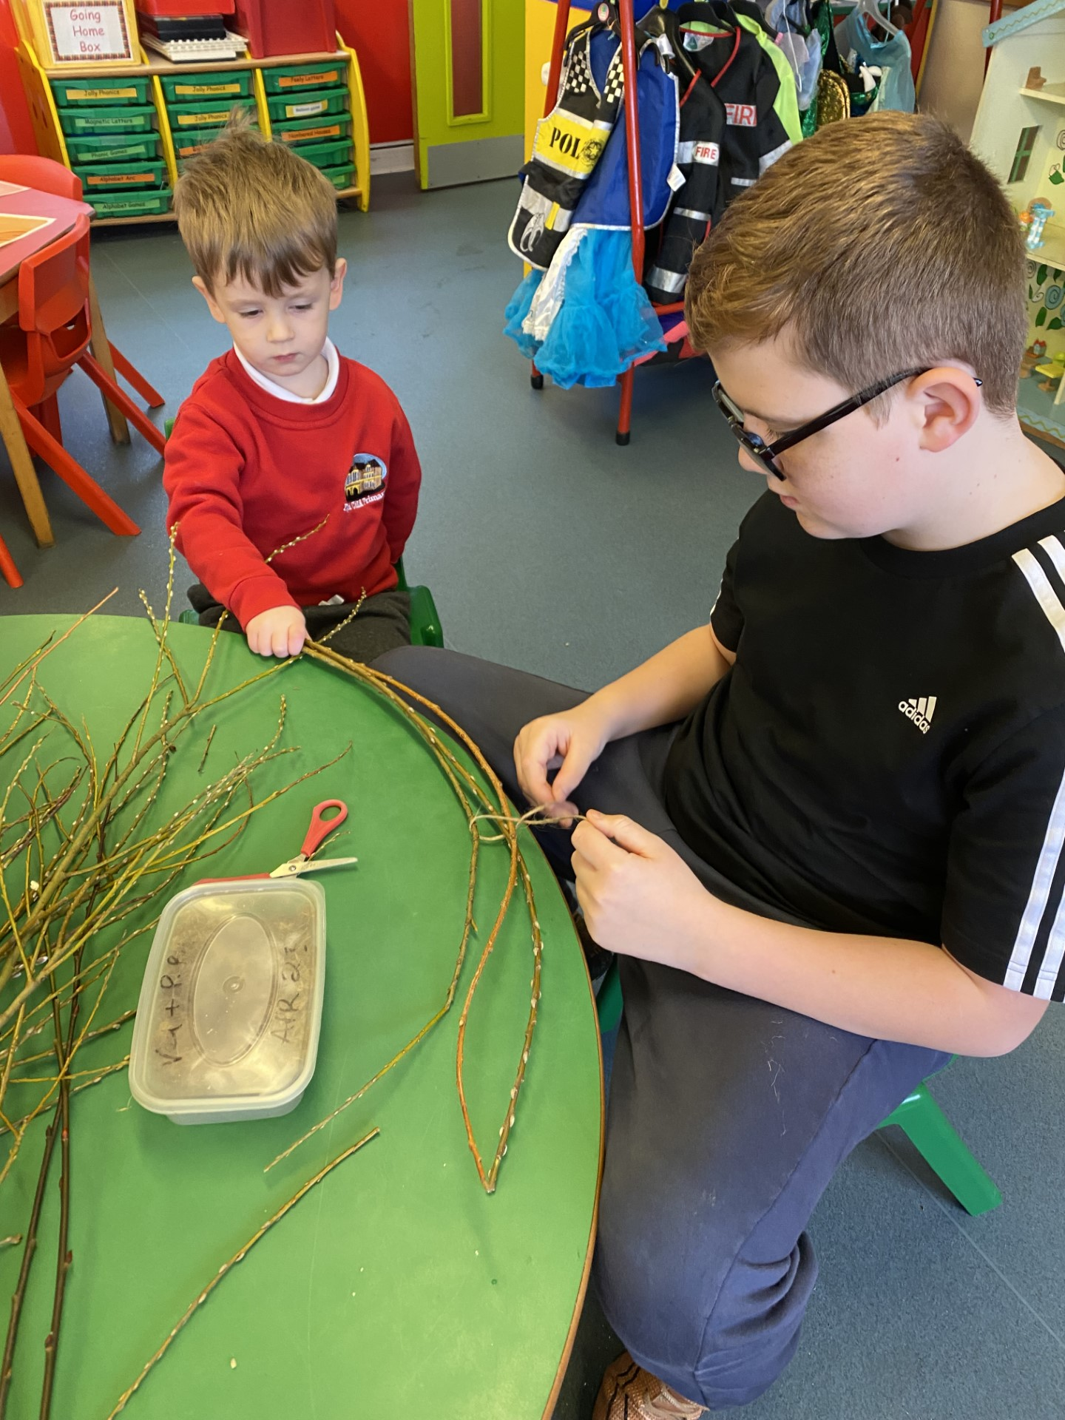
Nursery's Bird Nesters
We used:
Willow branches
Coconut hair liners
Dog hair
Horse hair
Twigs
Alpaca wool
Hay

Slide 5
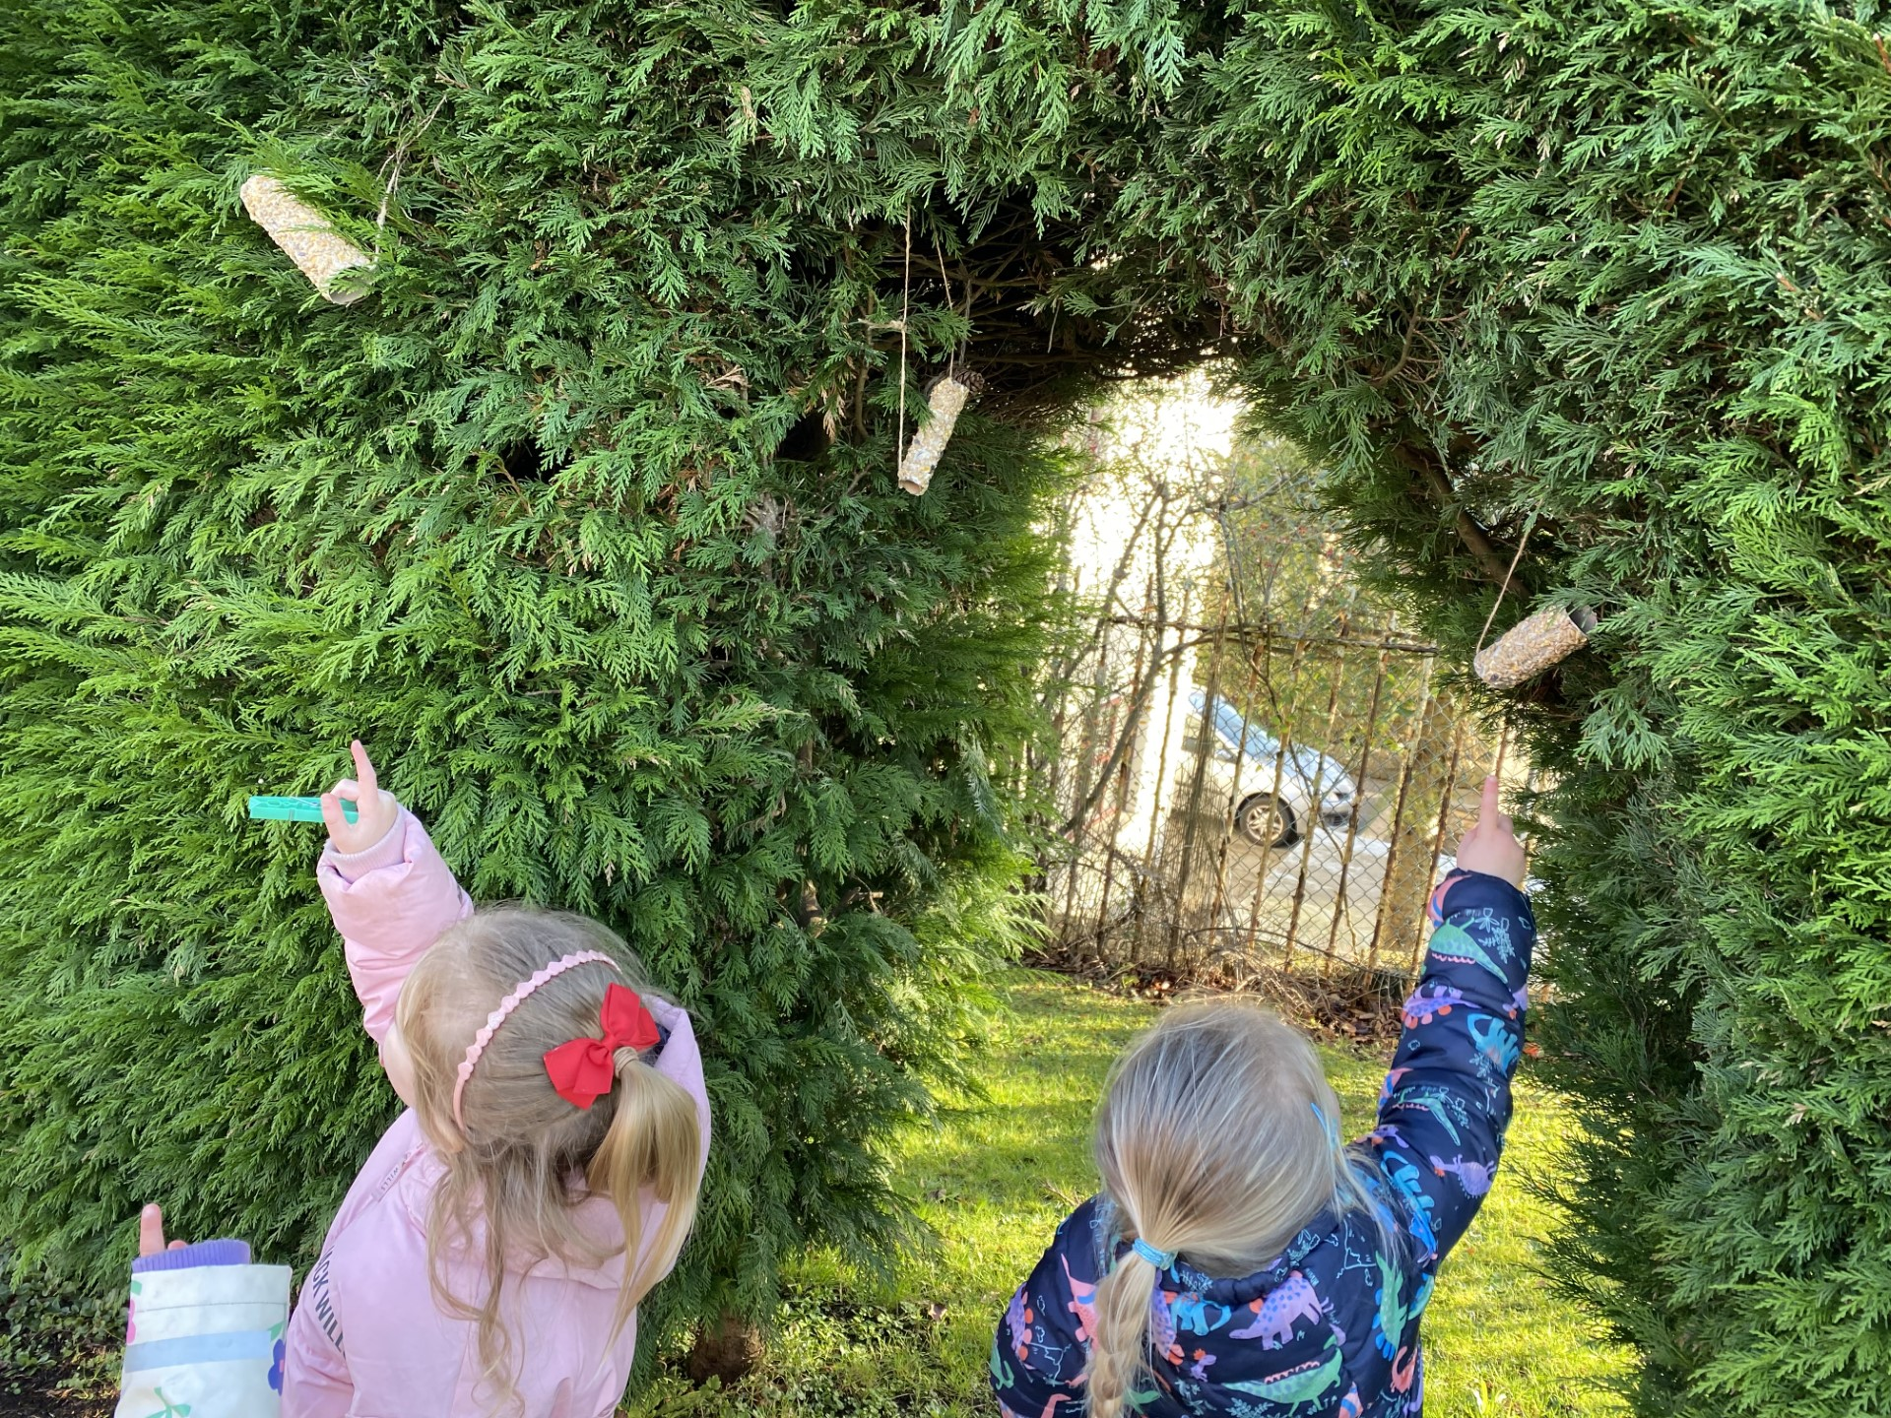
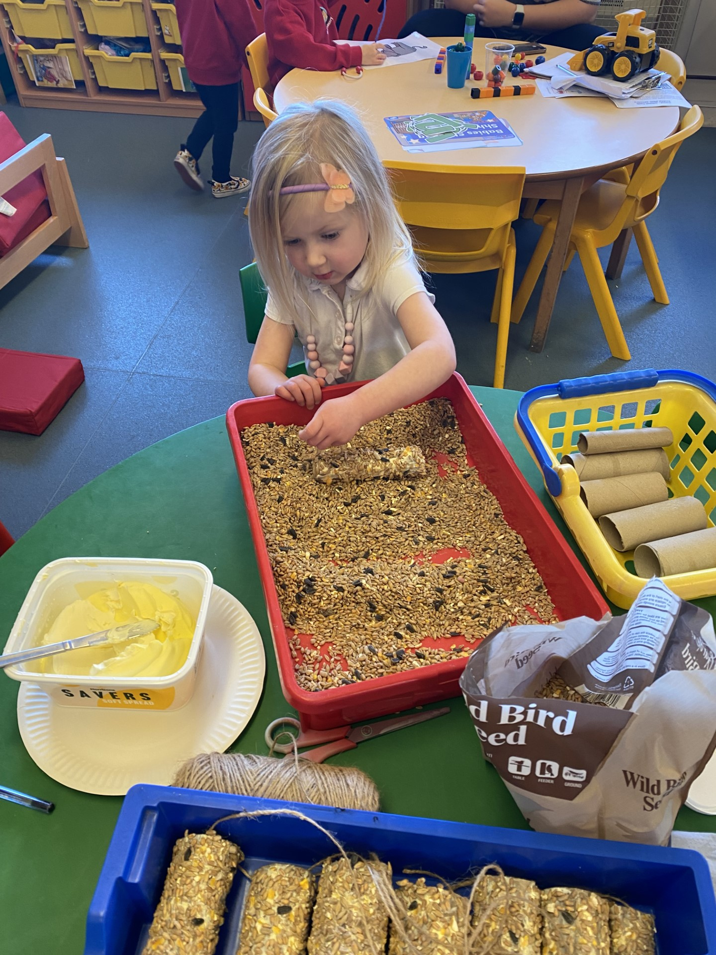
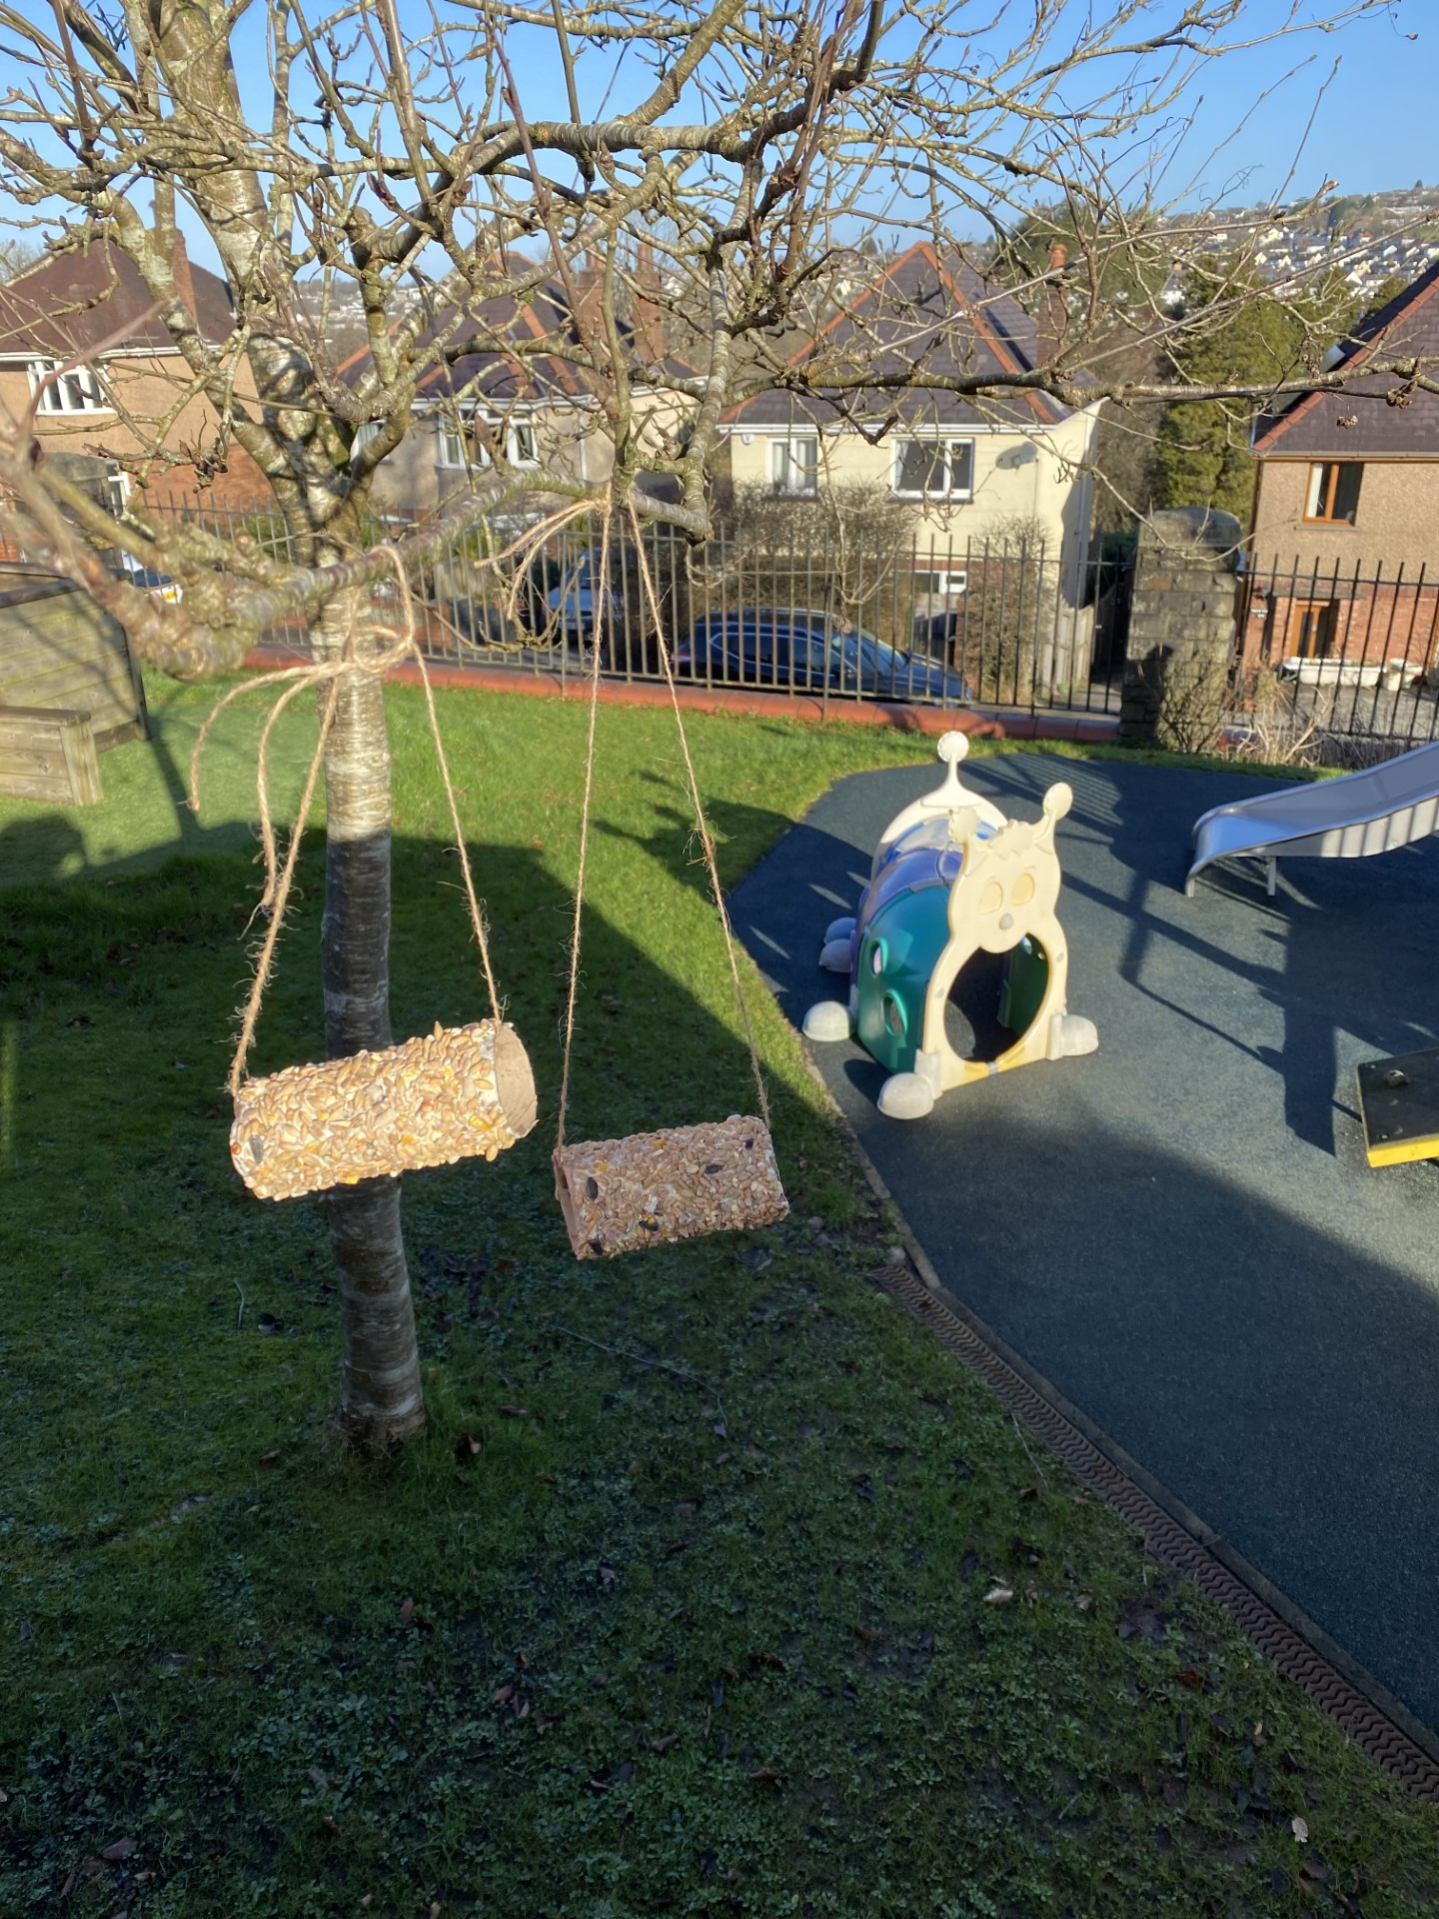
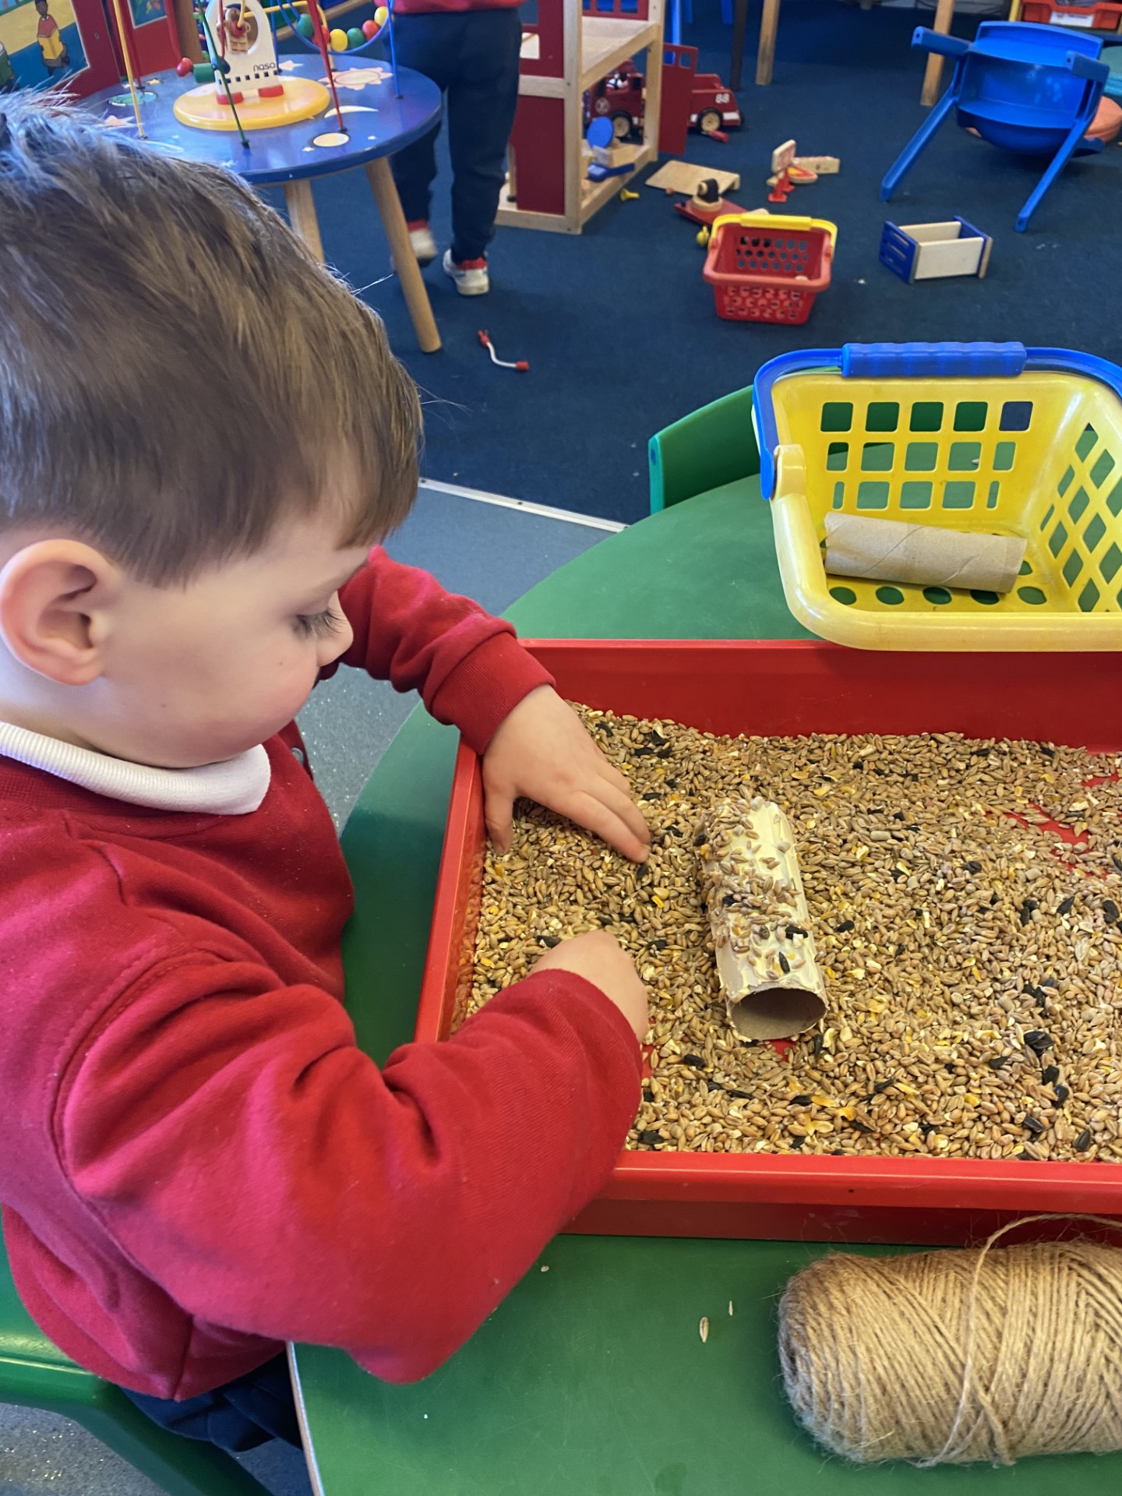
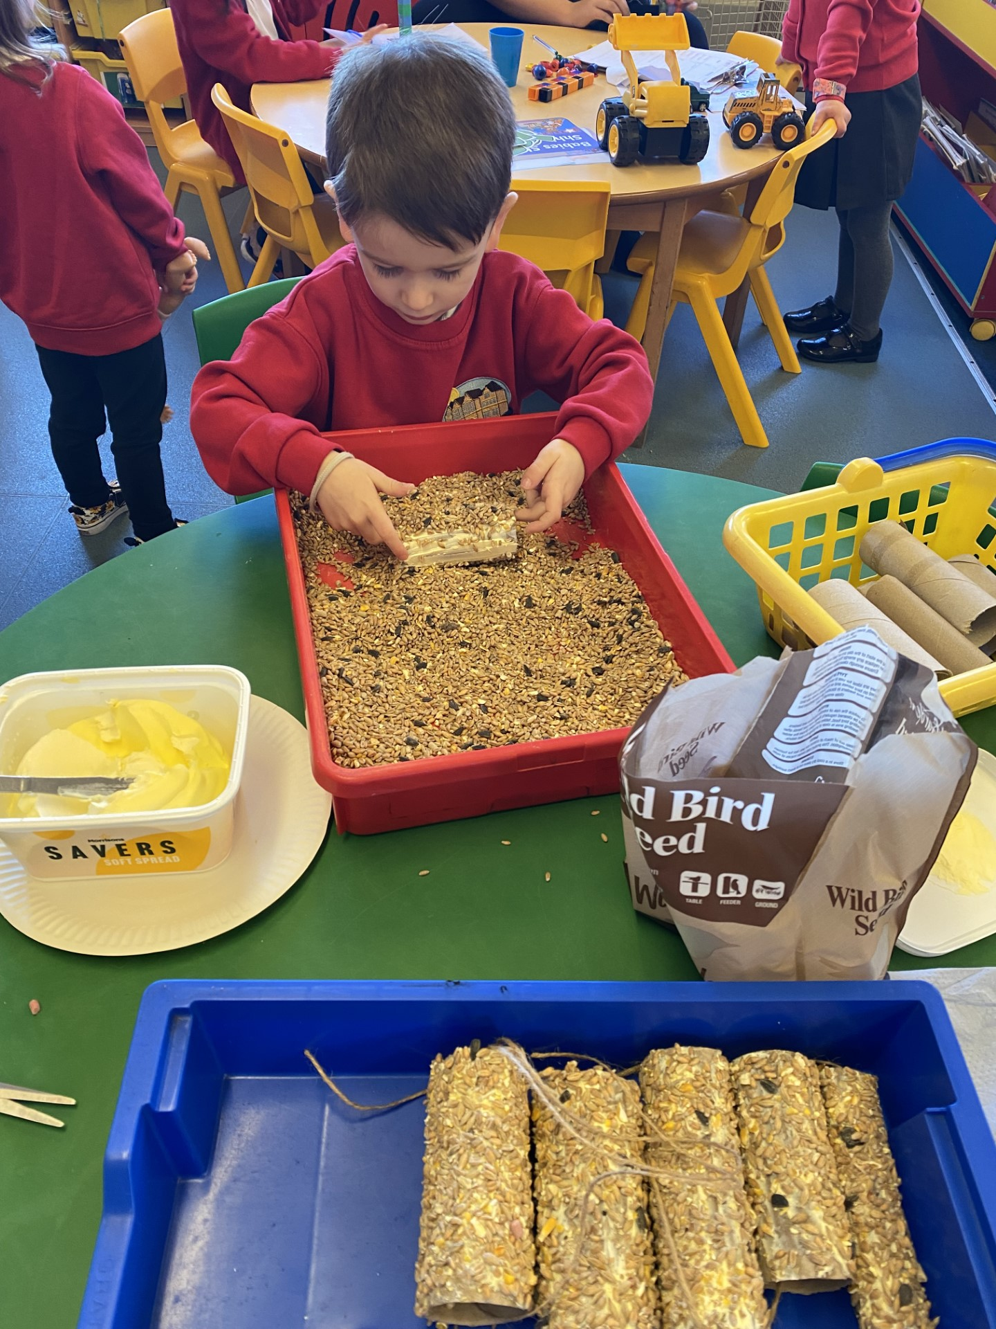
Nursery's Bird Feeders
Nursery pupils made bird feeders for the nursery garden.
We used cardboard rolls, margarine, bird seed and string. We hung them in the nursery garden and the birds loved them.

Slide 6
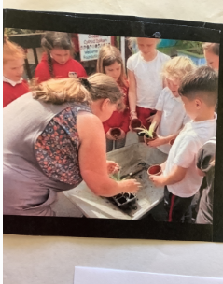
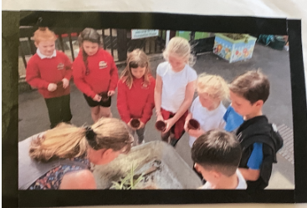
Plant Sale
The Eco committee potted up plants ready for a plant sale with Mrs Rees our caretaker. We made £71 from selling plants to parents!

Slide 7
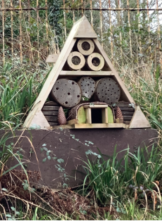
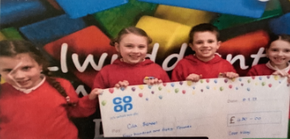
Critter Cabin
Co-op Community Fund
We have been lucky enough to recieve a co-op community fund grant for £450 to purchase a critter cabin. We are trying to attract more insects to our school garden to support bio-divevstiy and
pollination.

Slide 8
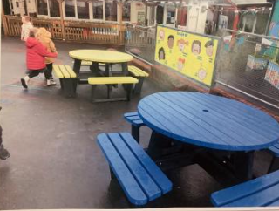
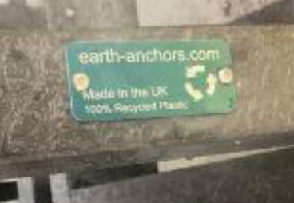
Recycled Seating Areas.
In our school grounds we have seating areas made out of 100% recycled plastic, as seen in the pictures.

Slide 9
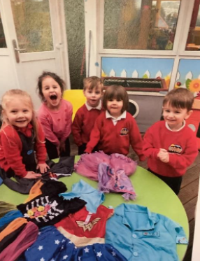
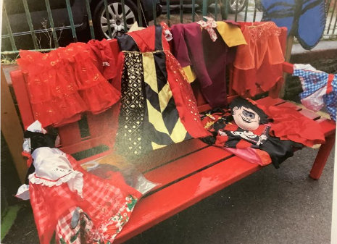
Swap Shop Siop Cyfnewid
Dressing up clothes were donated to Cila by parents, We decided to offer the clothes to school pupils which encouraged them to recycle and re-use.

Slide 10
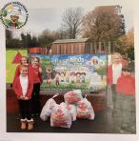
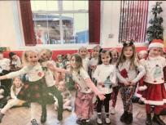
Rags to riches...
We designed Christmas jumpers out of recycled clothes.

Slide 11
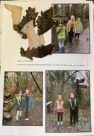
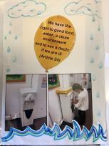
Health and Wellbeing
Iechyd a Lles
We had a children's mental health focus week –it included:
Outdoor time-A walk on the wild side!
'Choose day'-Learning new skills and mixing things up!
Pupil 2 Pupil-y6 Pupils take the lead.
Express Yourself Day-dressing up/I am unique
Also
-We encourage pupils to bring their own water bottles to fill up at the water fountain.
-Billy's Bunker is a new building on the school yard where pupils can immerse themselves in nature helping to support emotional wellbeing.
-Y6's worked with nursery pupils to create nature art
(it was amazing!)

Slide 12
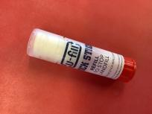
Waste Minimisation
Lleihau Gwastraff
We use refills of stick glue to reuse the original containers.
We reuse our display/backing paper and only replace when absolutely necessary.
Paperless school Newsletters to parents (website). We have saved 15,228 pieces of paper since March 2020!
We order paper products that use recycled paper whenever possible.

Slide 13
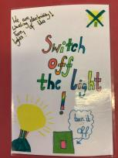
Energy
Egni
80% of the schools lighting has been replaced with LED lighting-using 90% less energy than conventional halogen lights.
Look at the graph in our portfolio comparing Energy Sparks usage!
We are doing so well!
We are now using Sigma Energy and we are going to monitor our gas and electricity usage.

Slide 14
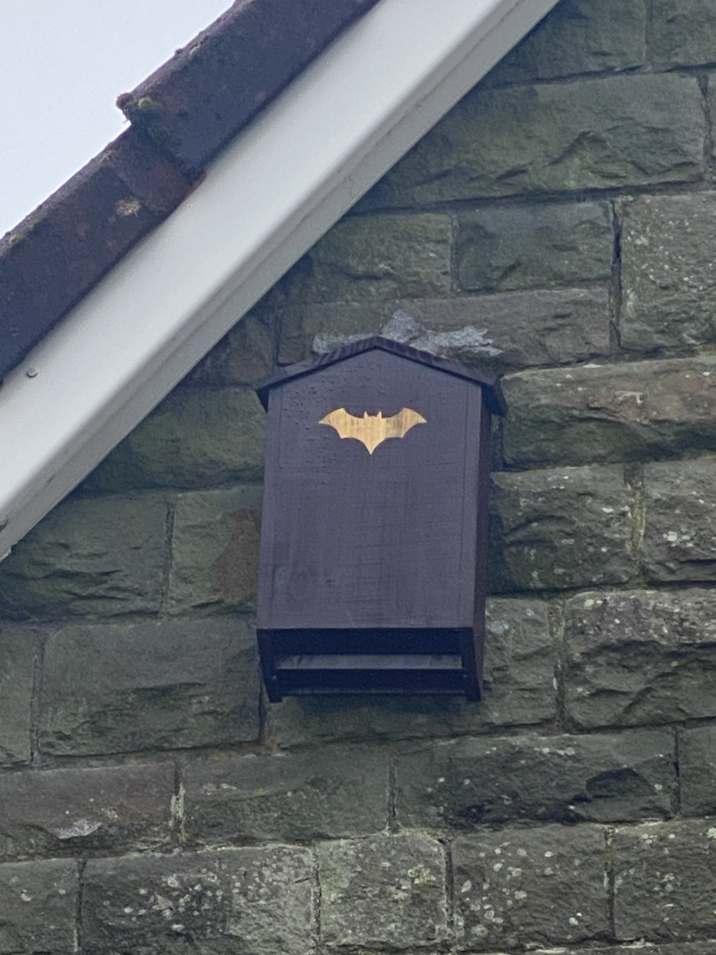
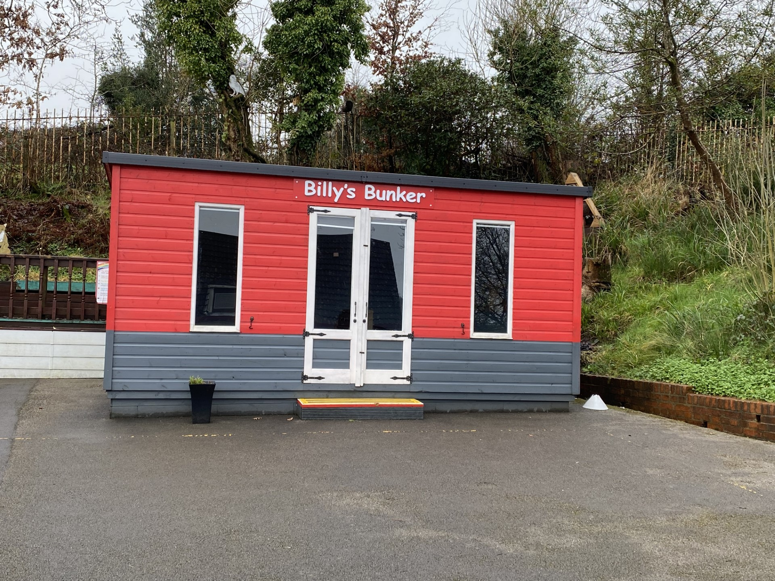
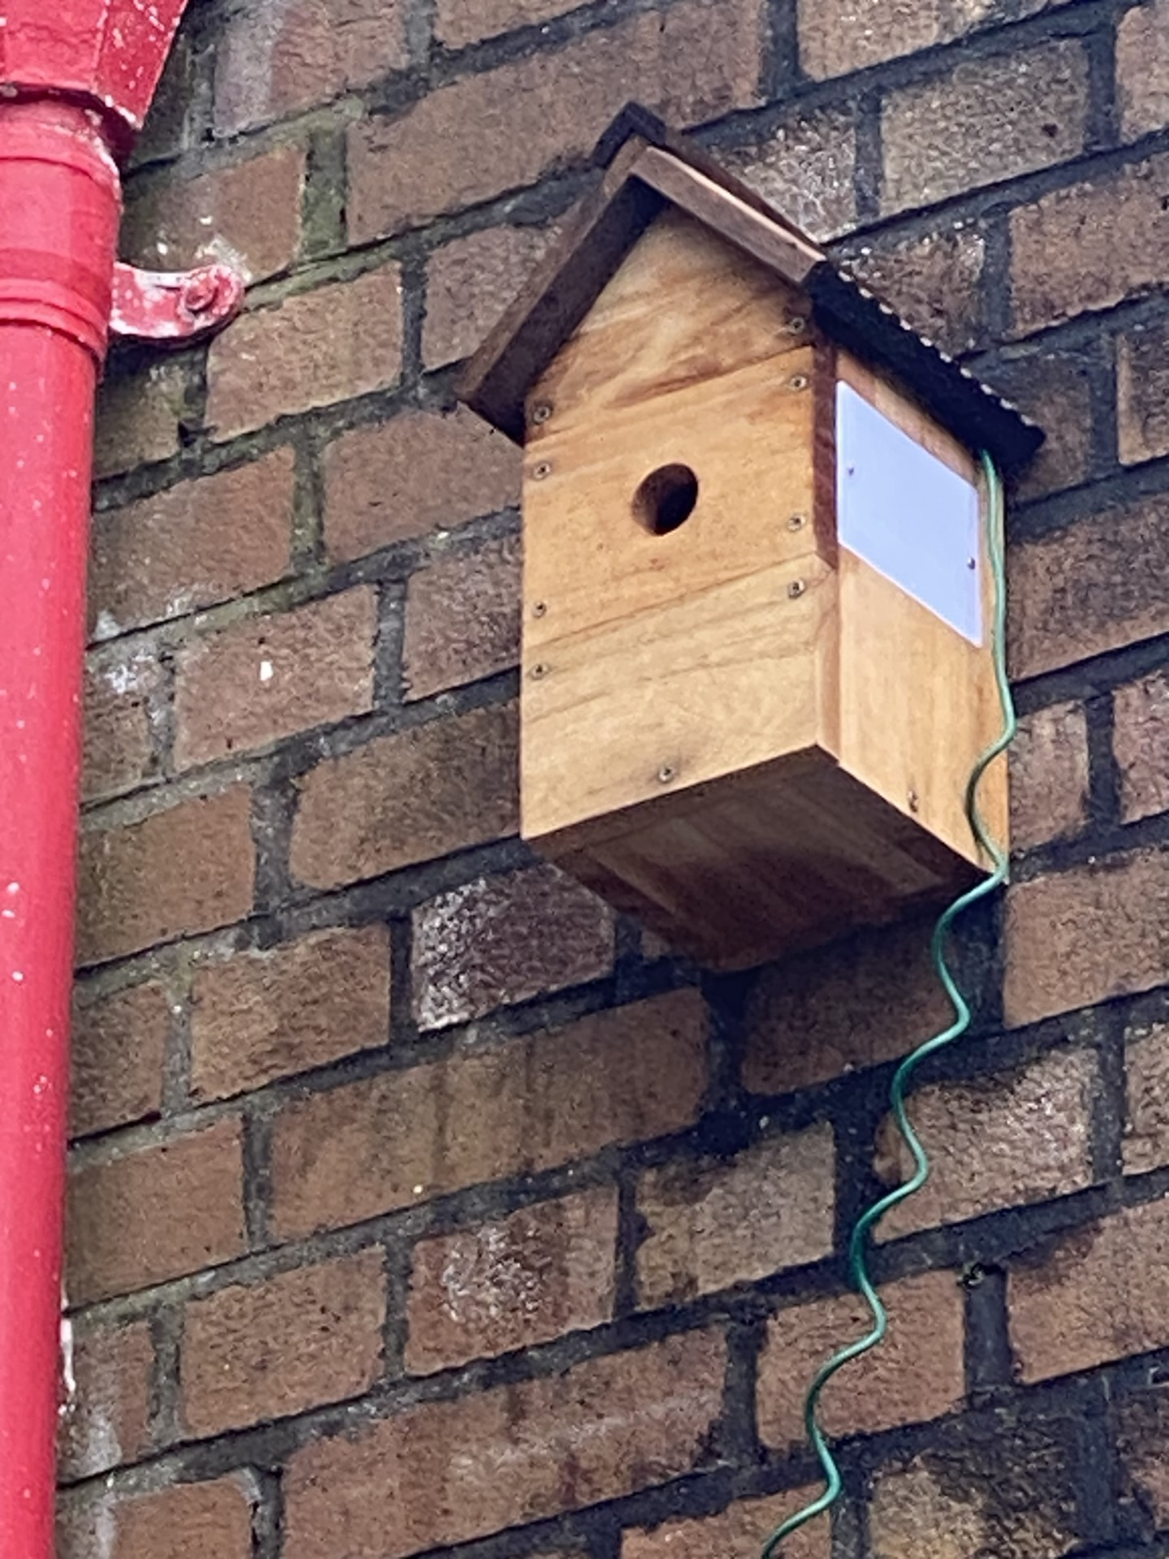
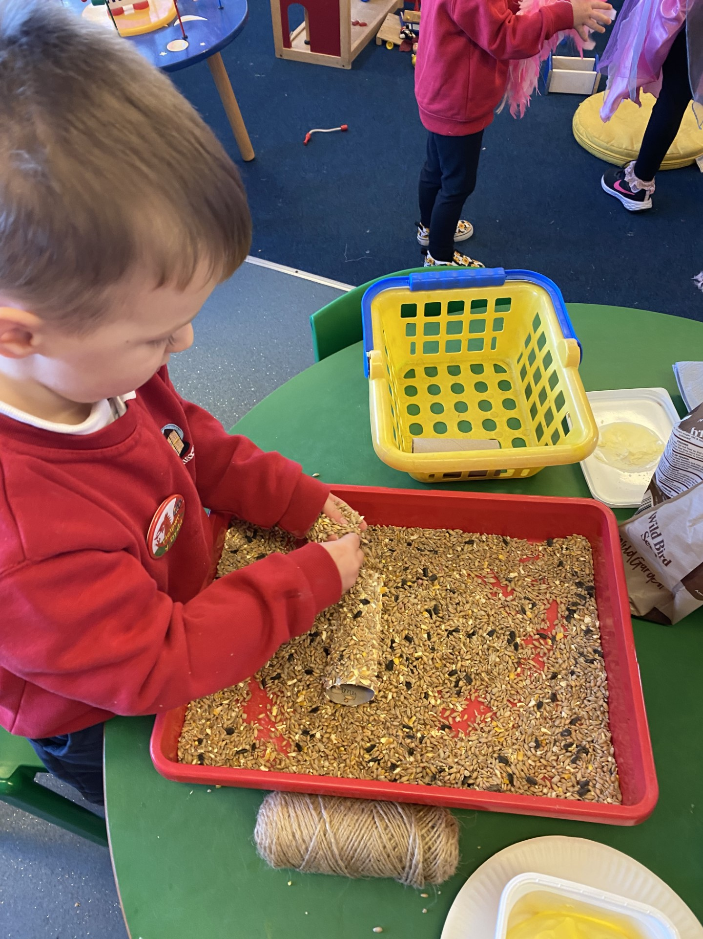
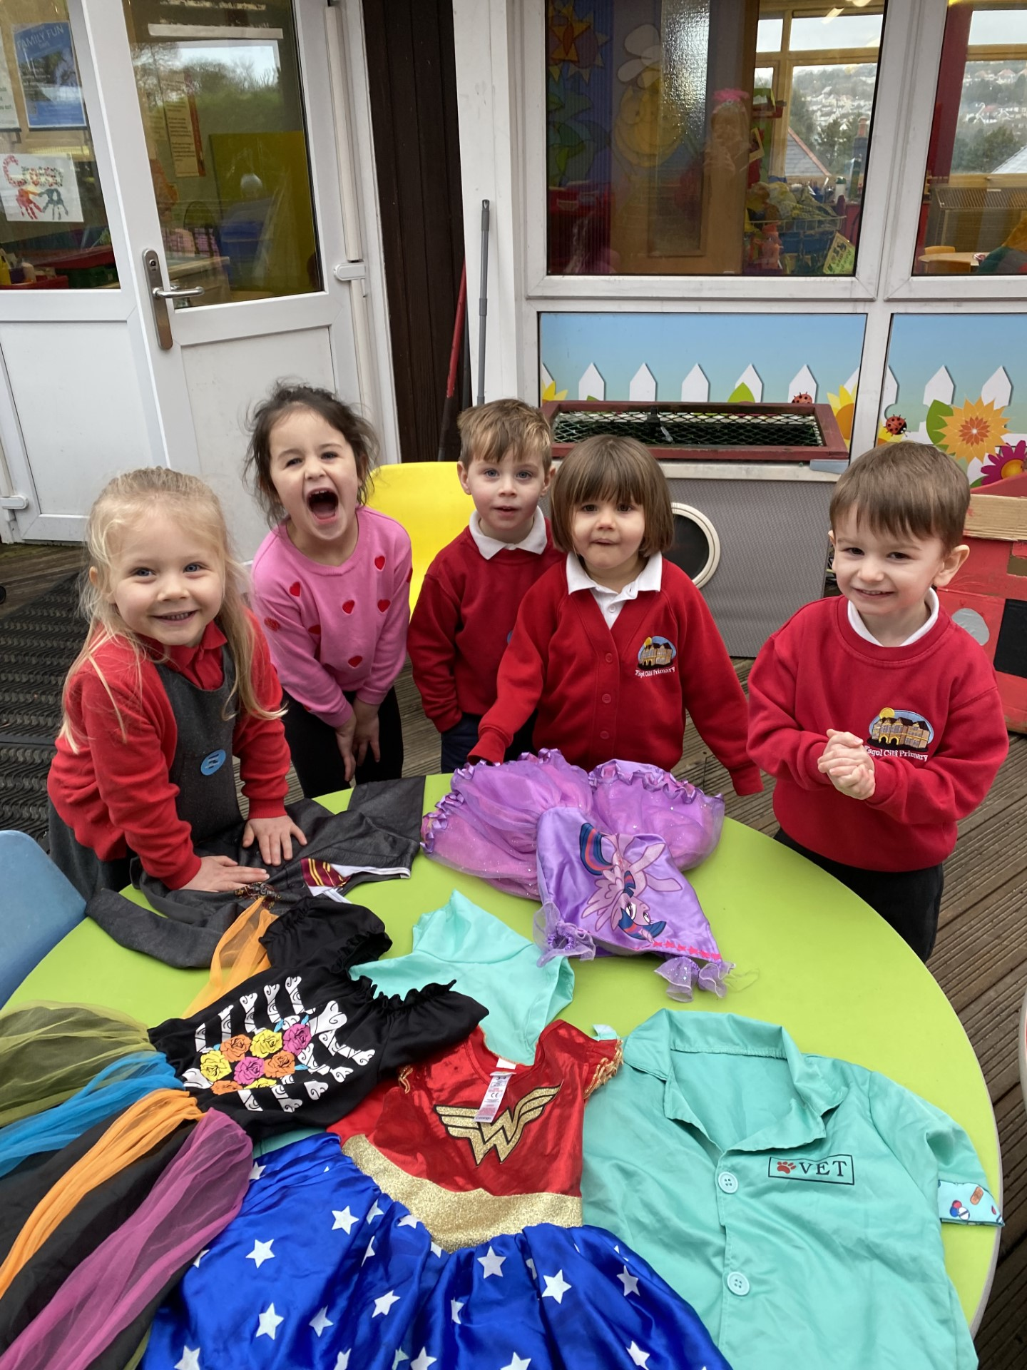
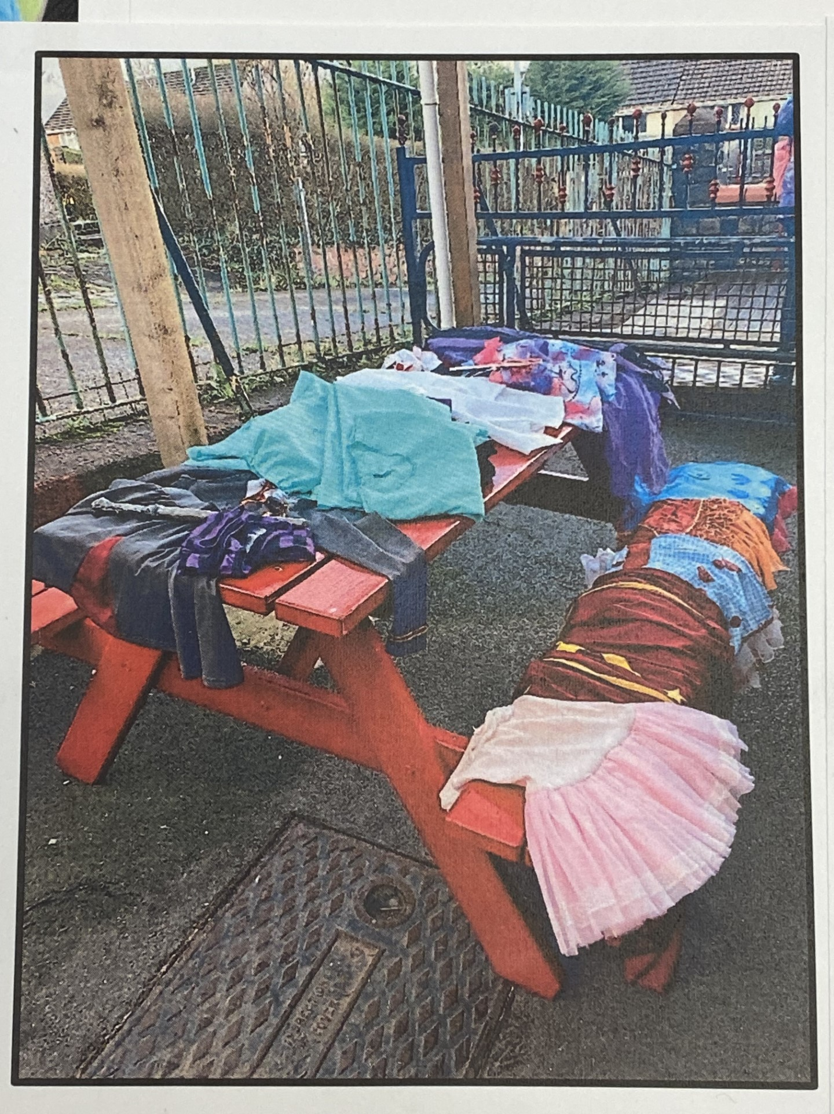
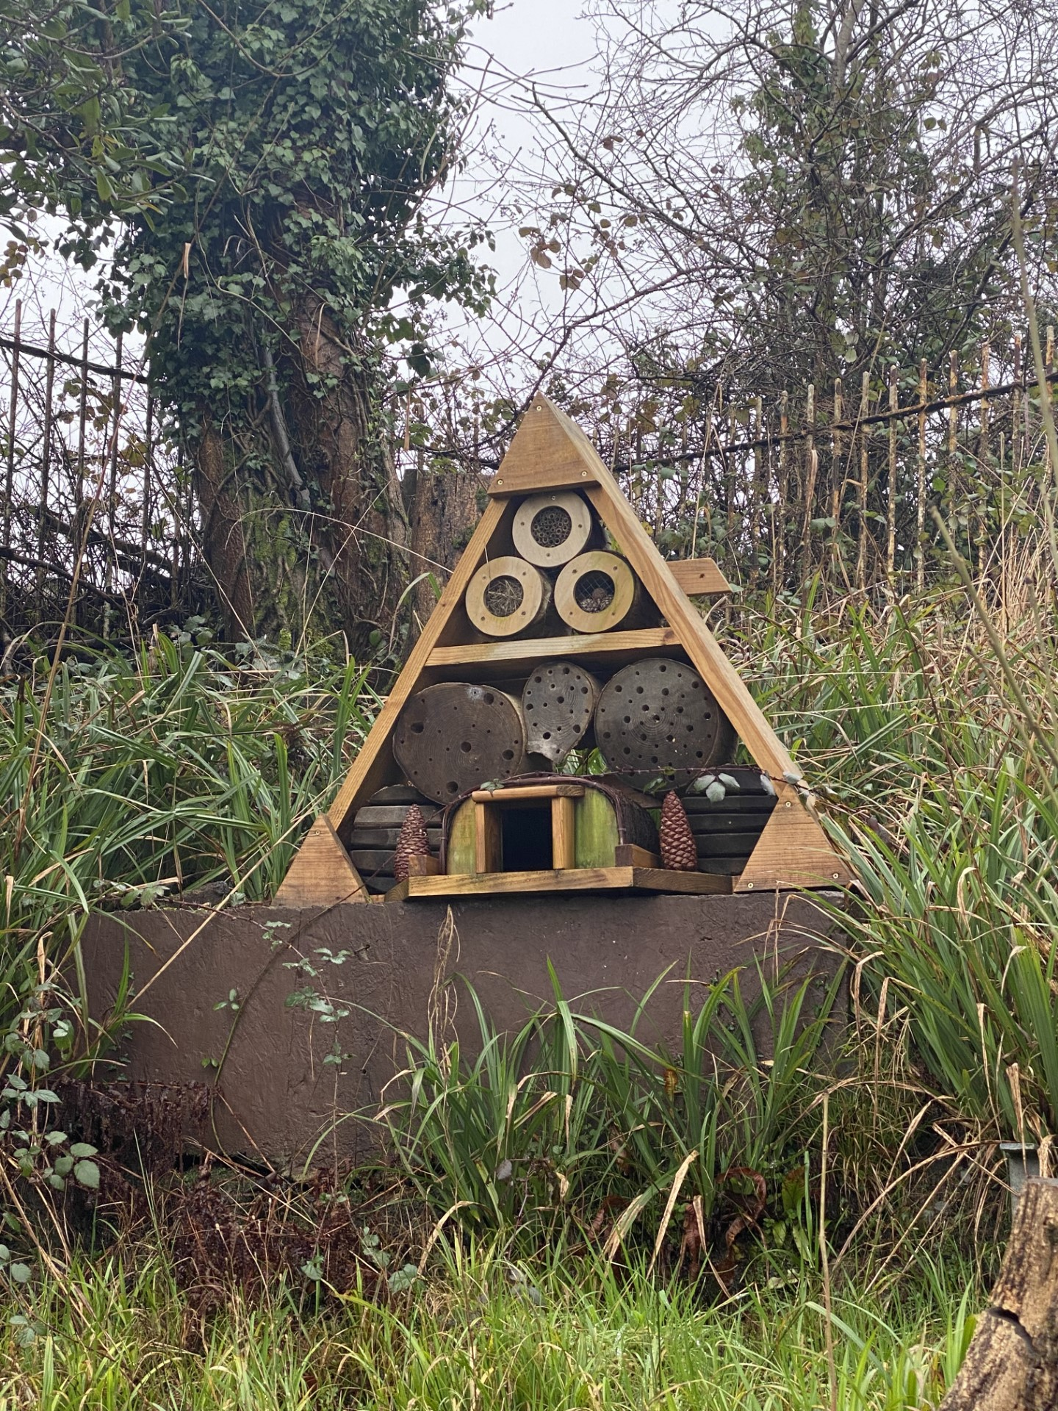
Thank you for listening!
Diolch yn gwrando!

