Slide 1
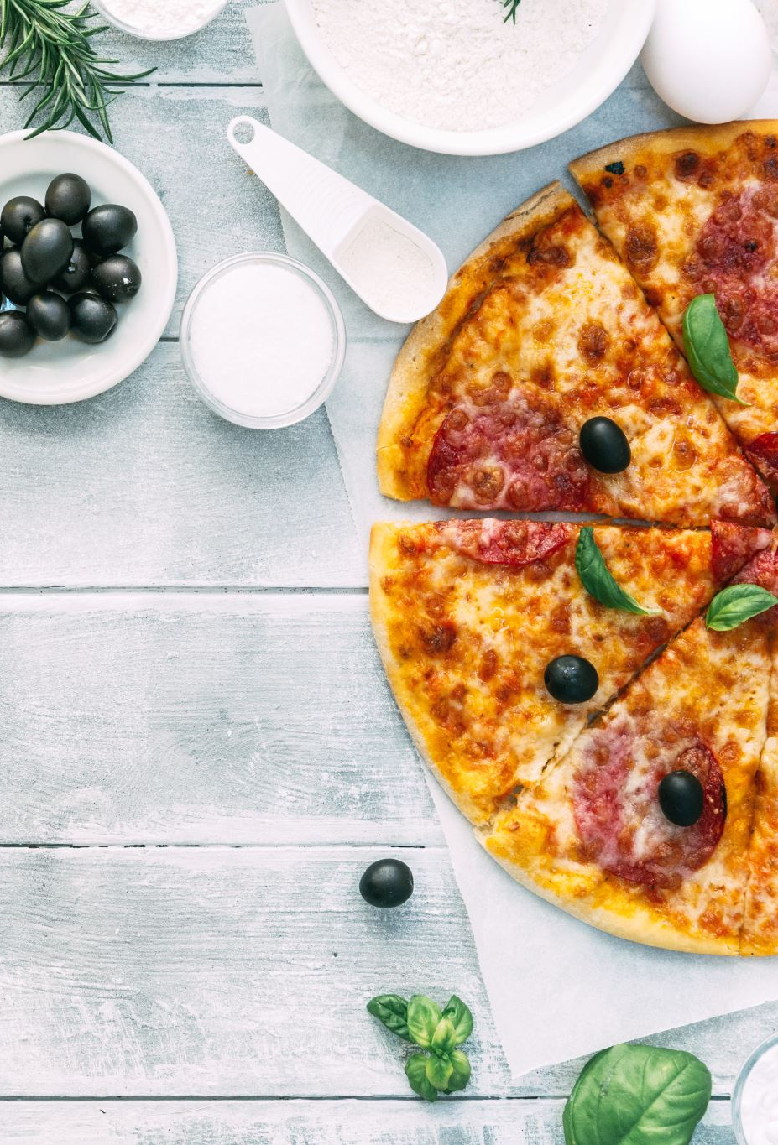
Pizza maker

Slide 2
Pizza recipe
Dough
188 grams of flour
A pinch of salt
100 ml of water
2 tbls olive oil
Toppings
Tomato sauce (you chose the type!)
Pizza cheese
Sweetcorn
veggie peperoni (optional)
oregano

Slide 3
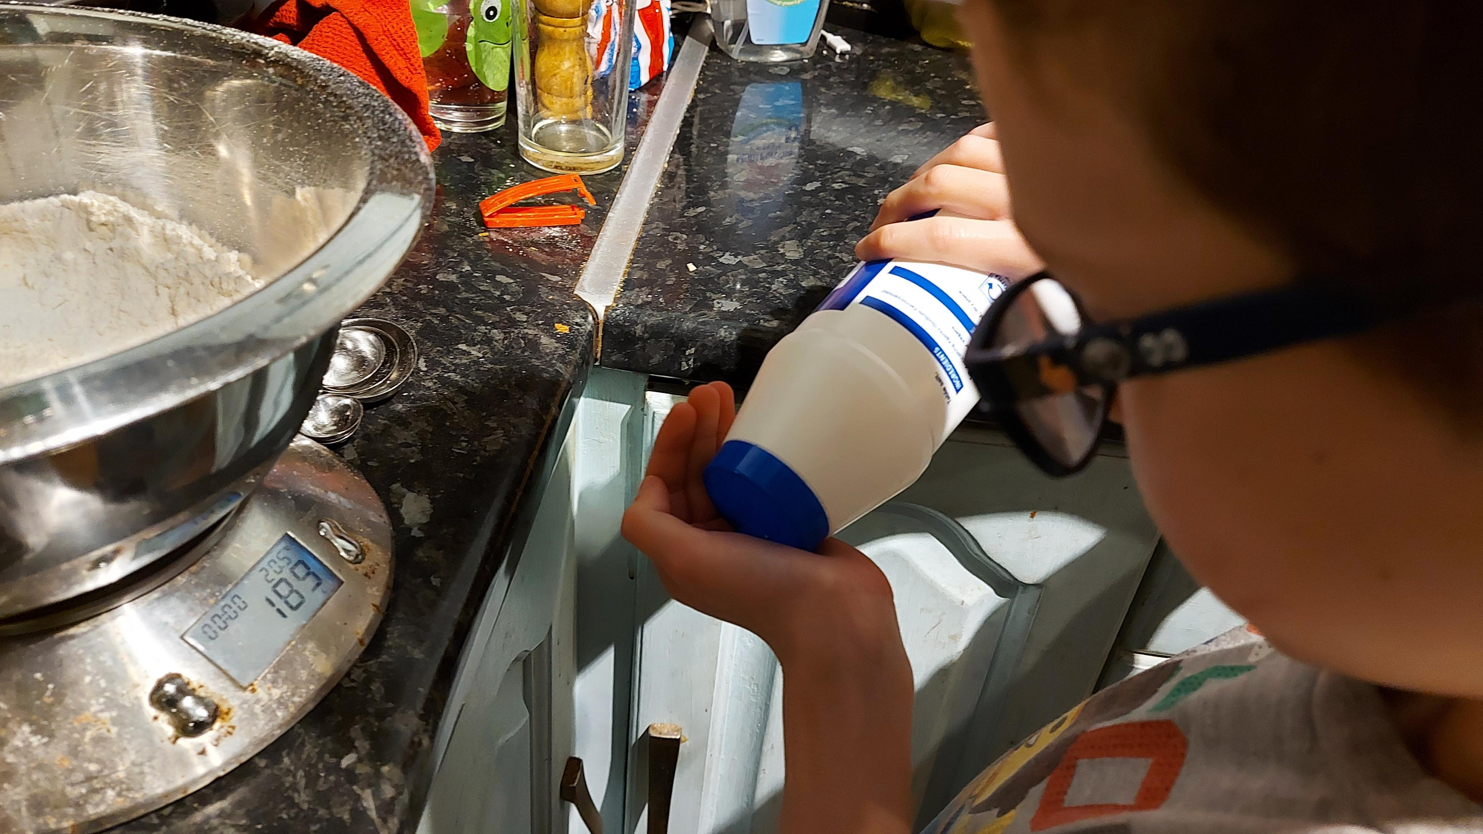
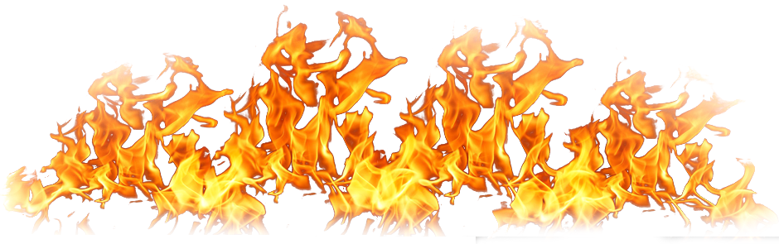
This is how I made my pizza.
First, I put the ingredients in a mixing bowl.

Slide 4
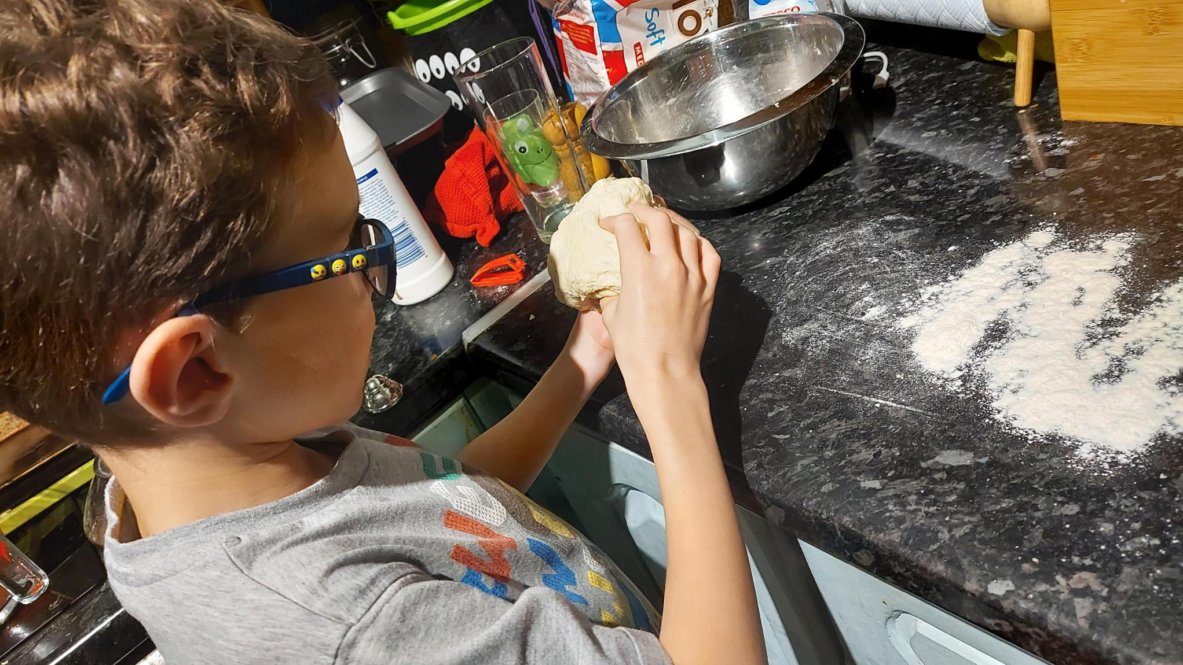
Next, I rolled the dough

Slide 5
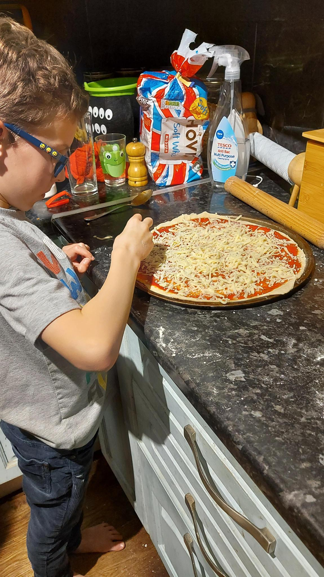
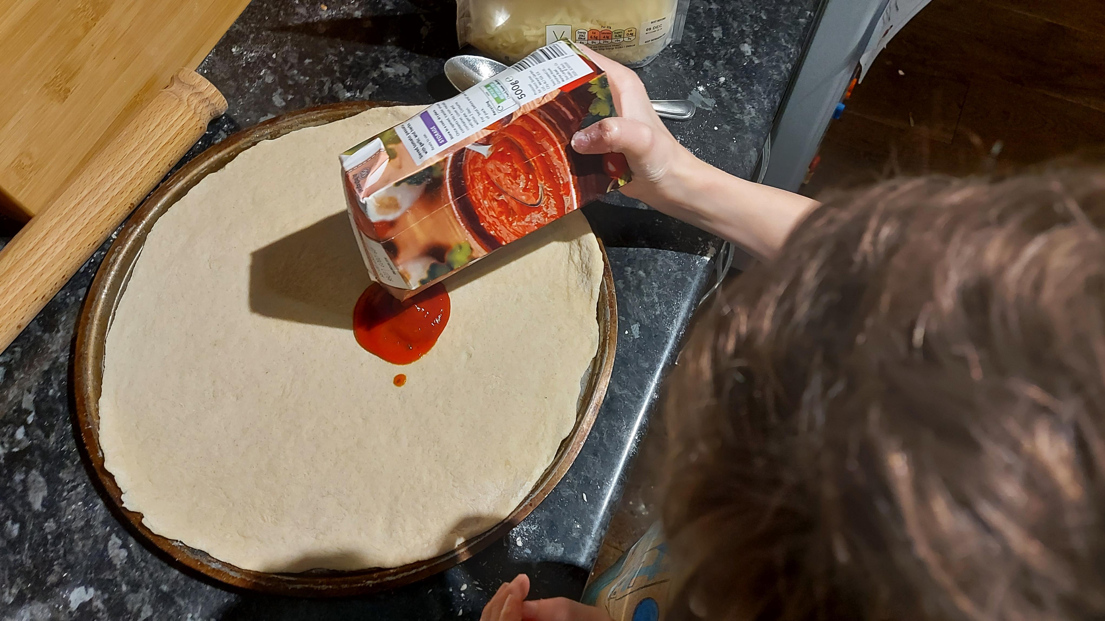







Then, I put on toppings
Cheesey cheese!!!
Tomato sauce time!!!

Slide 6
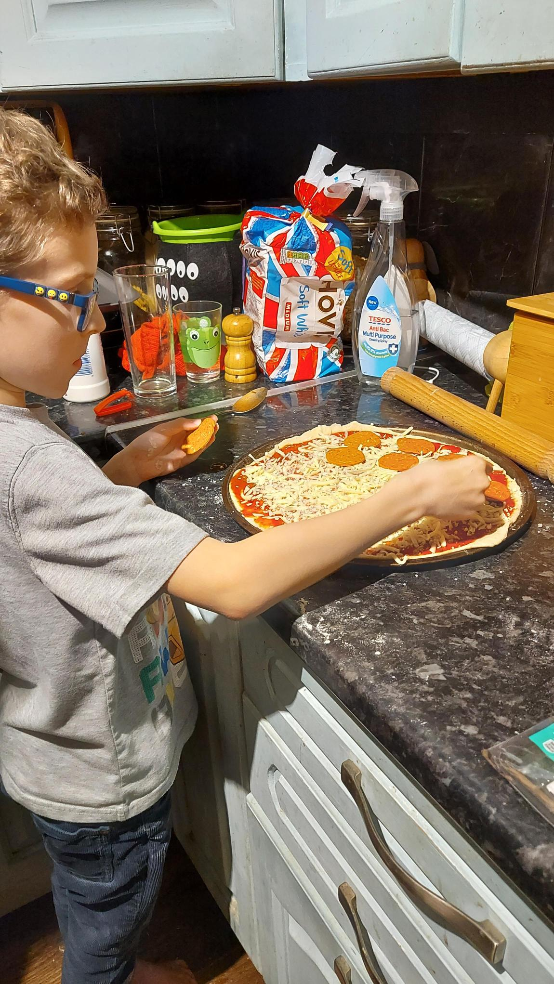
Still more toppings *sigh*

Slide 7

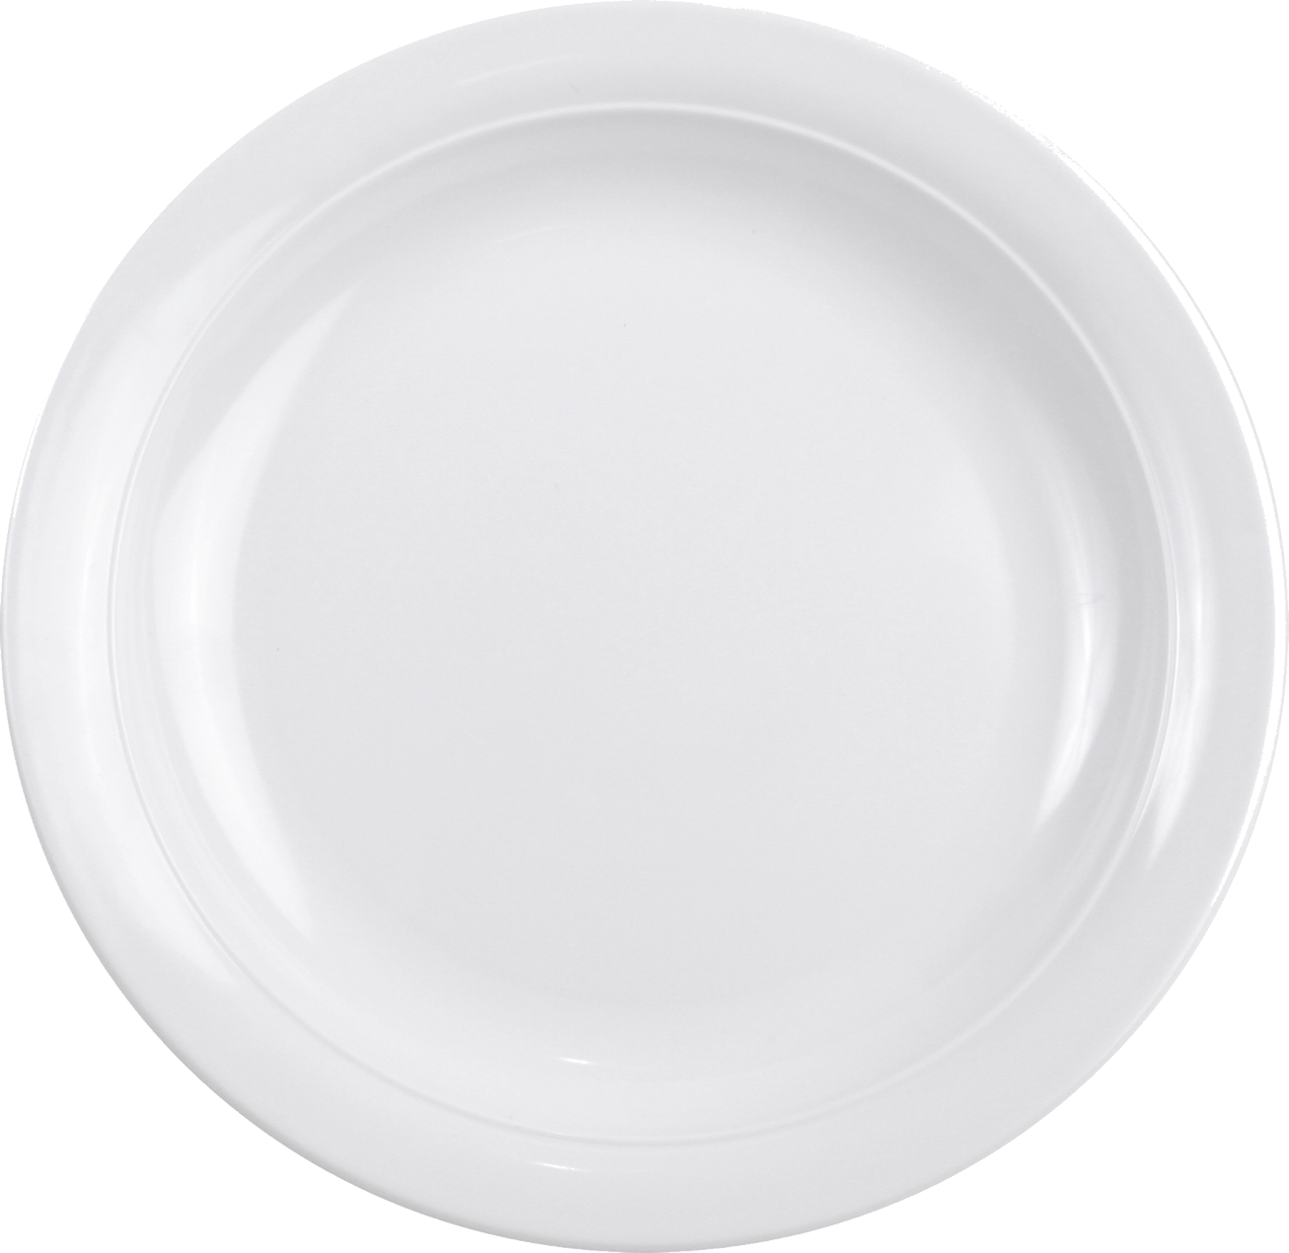
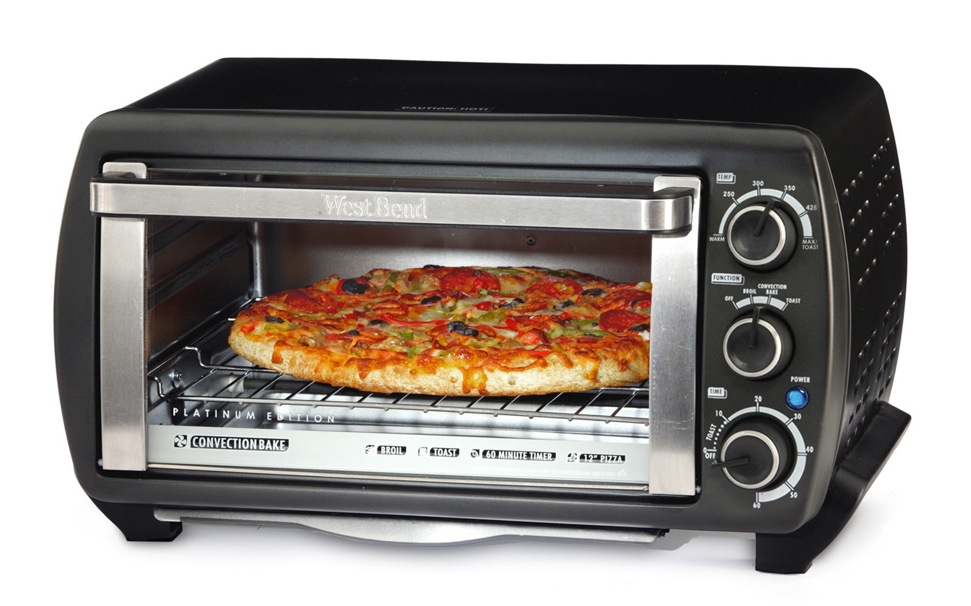



Cook then EAT!!!!!!!

