Slide 1
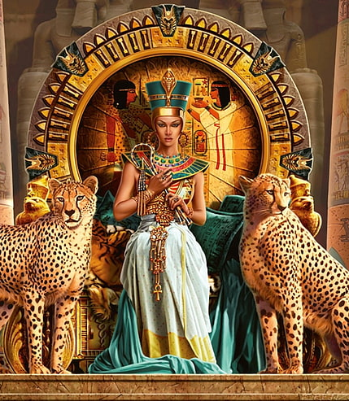
Inspirational Leaders
Cleopatra
By Mali, Eilis, Seren and Tallulah

Slide 2
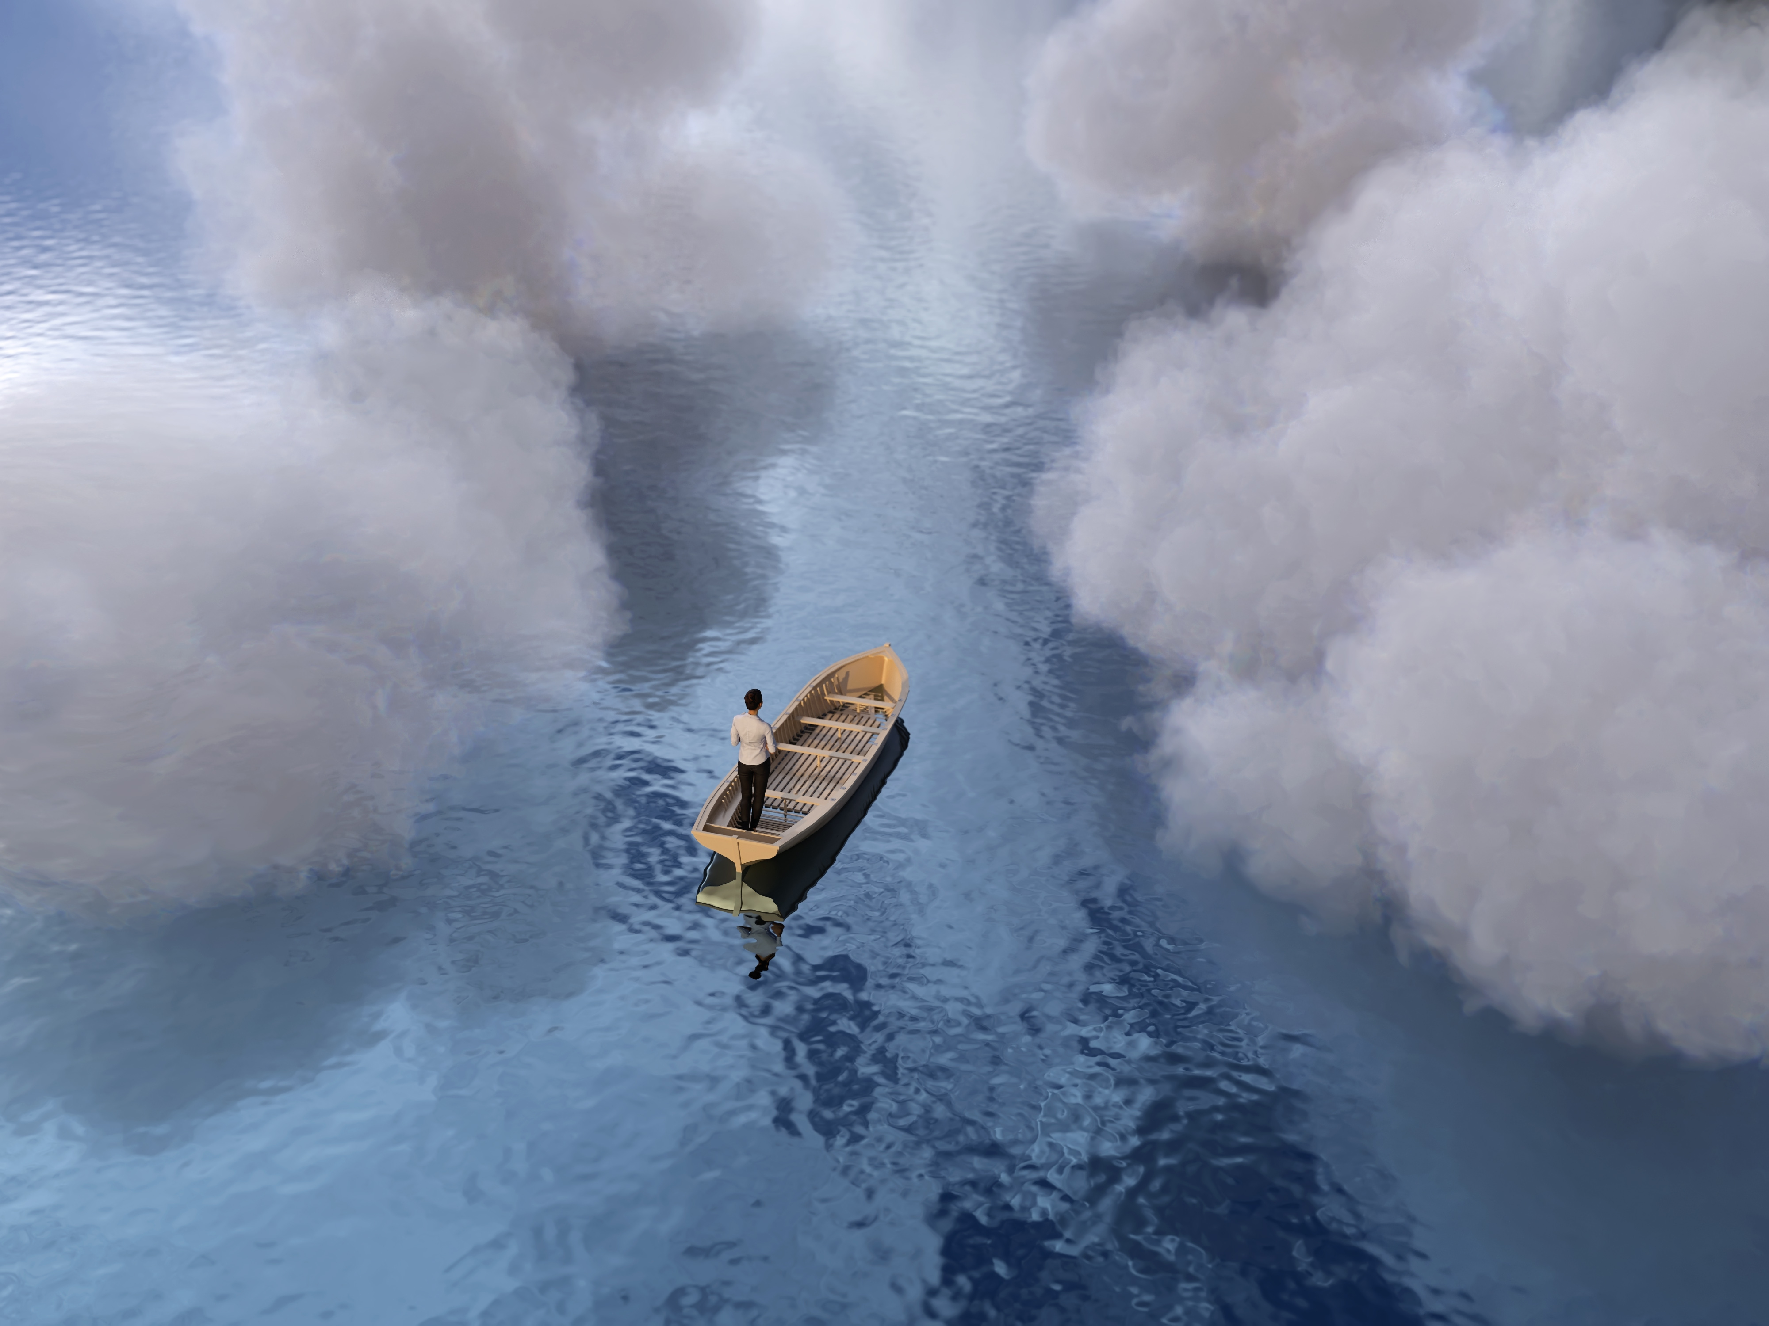
What is an inspirational leader?
An inspirational leader is someone who inspires you to do something and tries to make the world a better place
People follow them because they do good things and give good speeches
Like Queen Elizabth or the prime minister

Slide 3
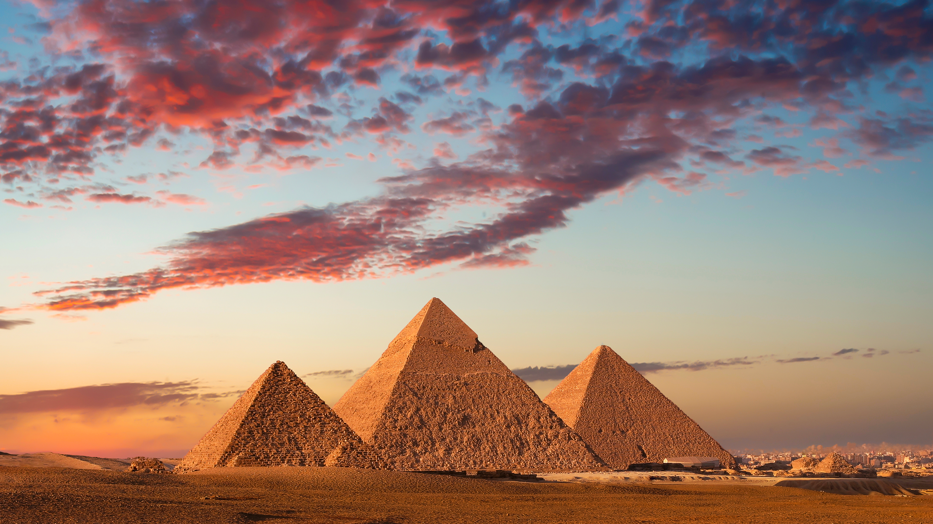
Why is she a insperatoinal Leader?
She was a risk-taker and made the world better

Slide 4
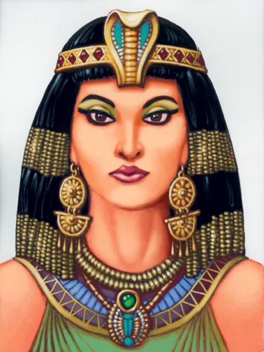
What she did?
What she did?
Actively influenced roman polices at a crucial period and was especially known for her relation ships with julius caeser and mark antony

Slide 5
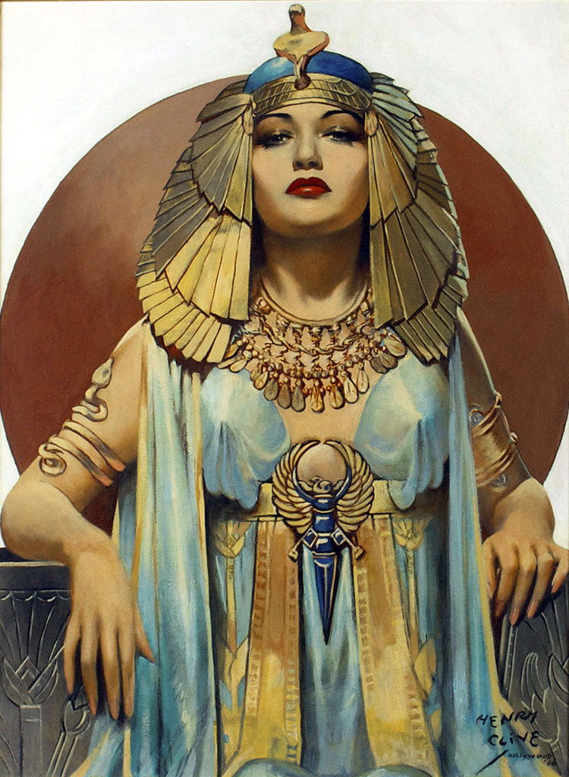
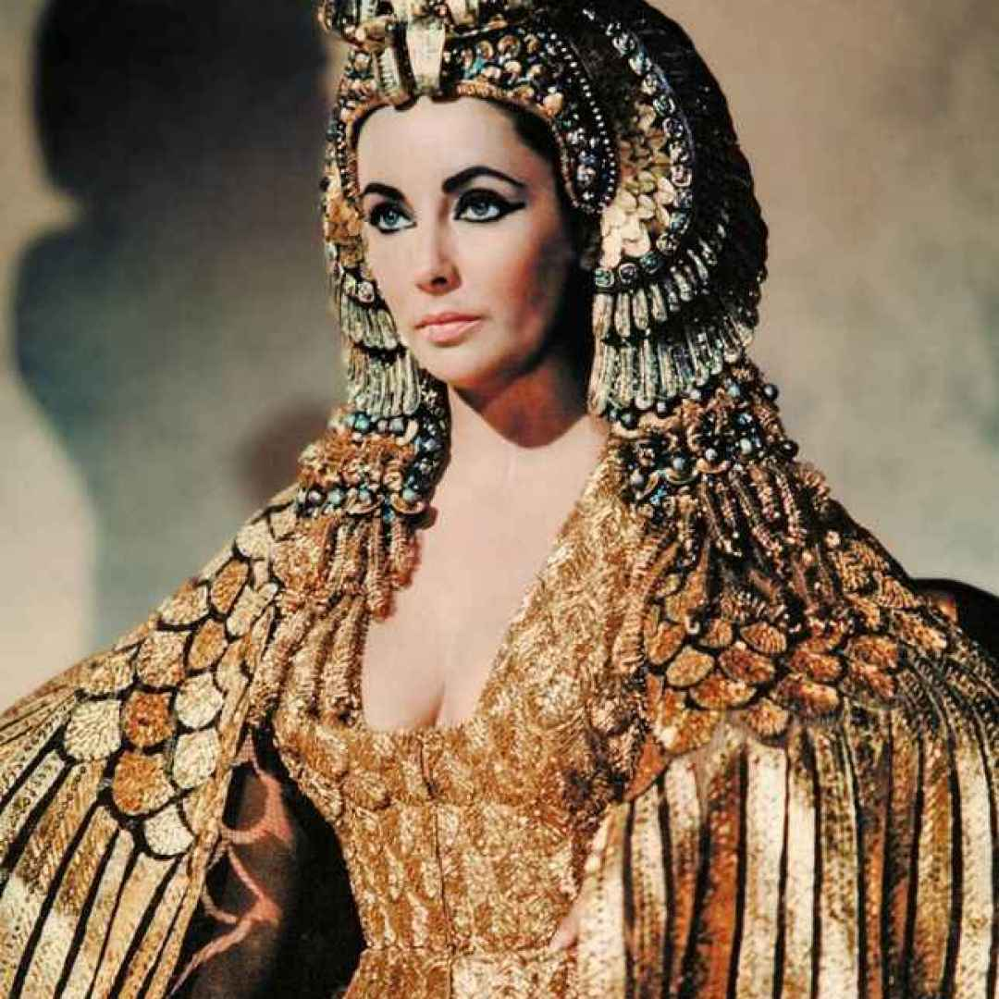
Background
She had two brothers, mother and father.
She was 38 when she was queen.
She died at 12 August 31 BC and was born at january 69 BC.

Slide 6
Fun facts!
Cleopatra wasn’t Egyptian.
Cleopatra was about 5 ft tall
Cleopatra died because commiting suicide

Slide 7

The end
by Mali Eilis, Tallulah and Seren

