Slide 1
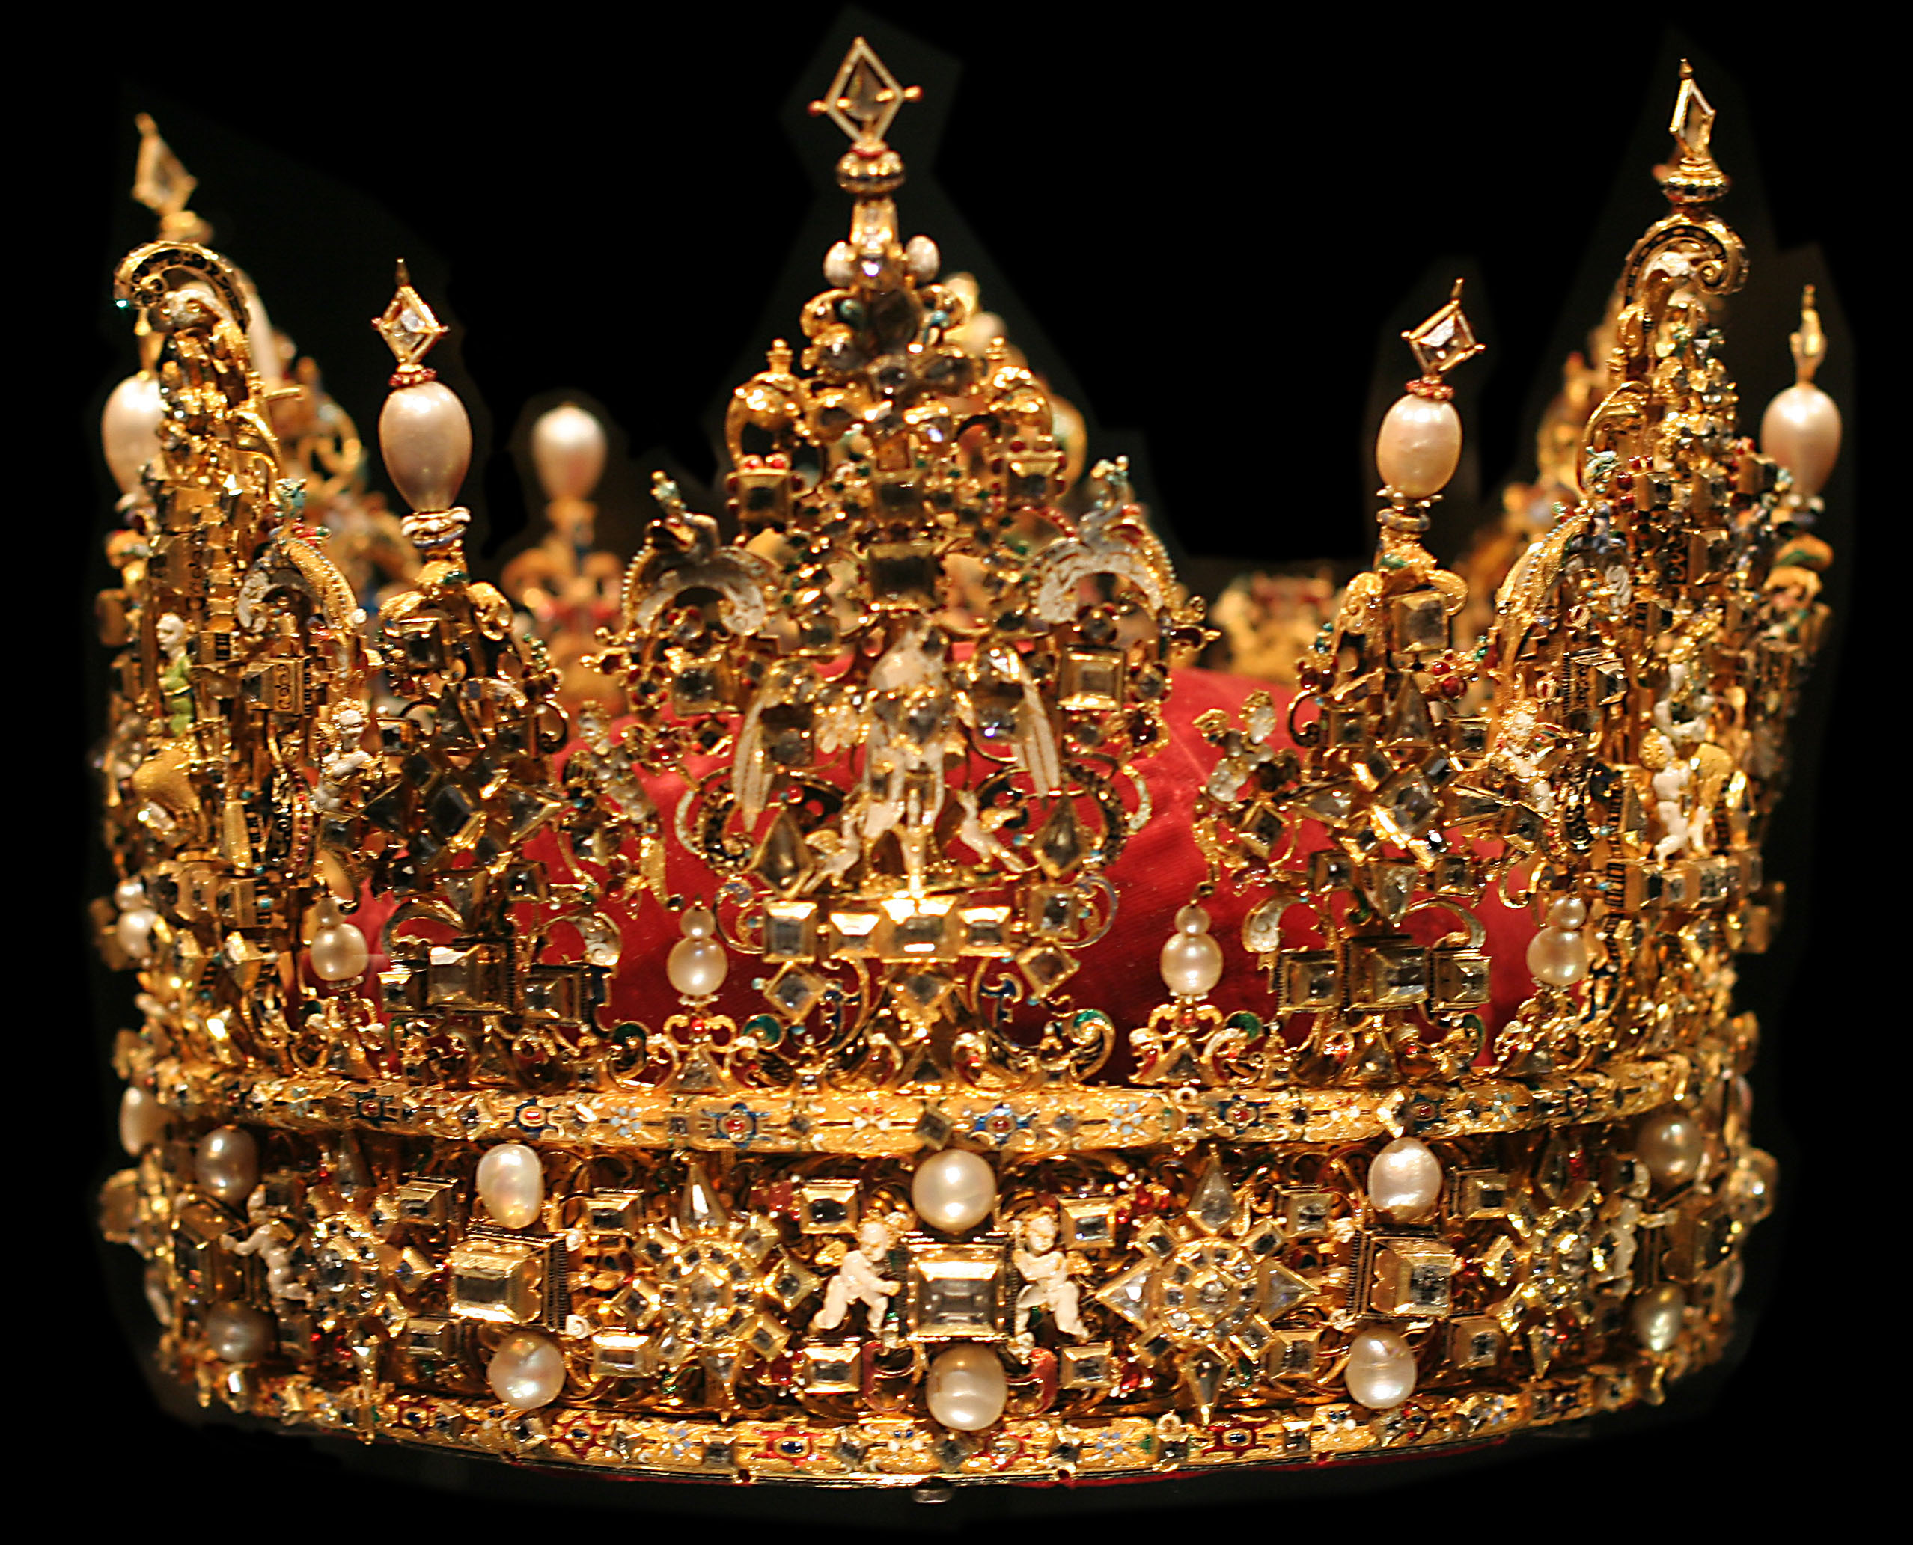
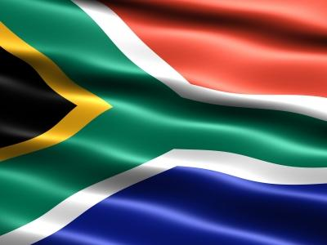
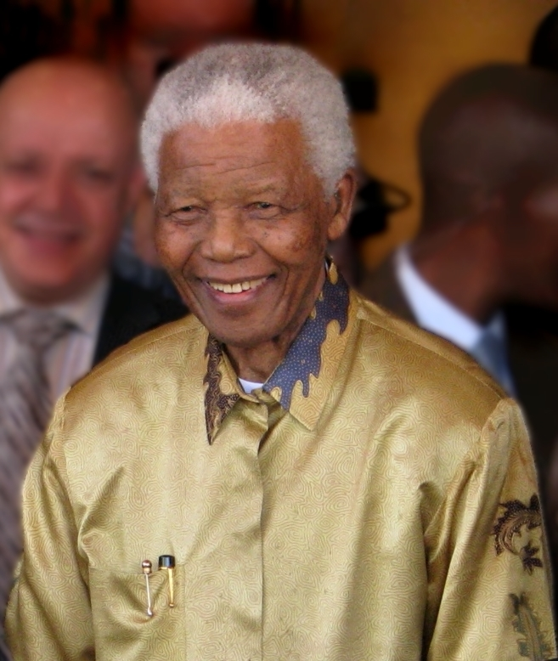
All about Nelson mandela
ThePhoto by PhotoAuthor is licensed under CCYYSA.
Leo ronnie Marlie Cobyn iona
ThePhoto by PhotoAuthor is licensed under CCYYSA.
ThePhoto by PhotoAuthor is licensed under CCYYSA.

Slide 2
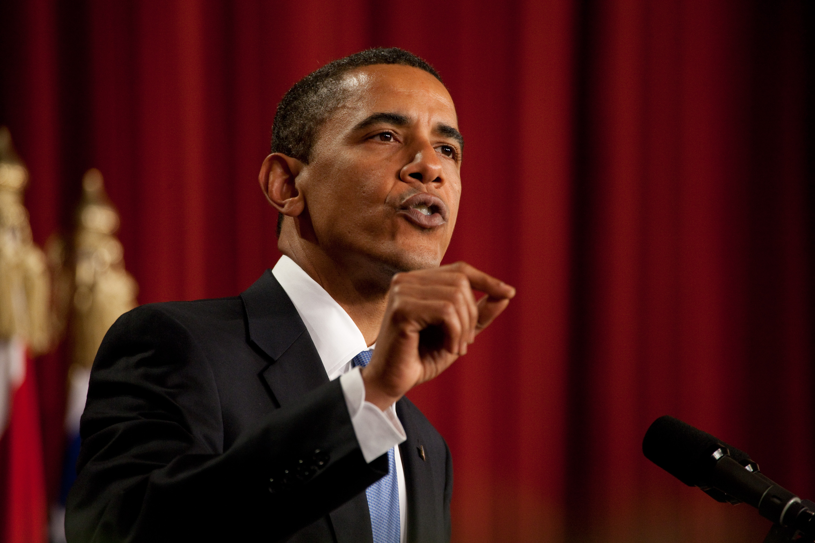
What is a inspiraional leader?
A inspirational leader motivate others to achieve challenging goals through their words and actions
ThePhoto by PhotoAuthor is licensed under CCYYSA.

Slide 3
When was he born and where?
He was born in July 18 ,1918
He was from mvezo south Arica
ThePhoto by PhotoAuthor is licensed under CCYYSA.

Slide 4
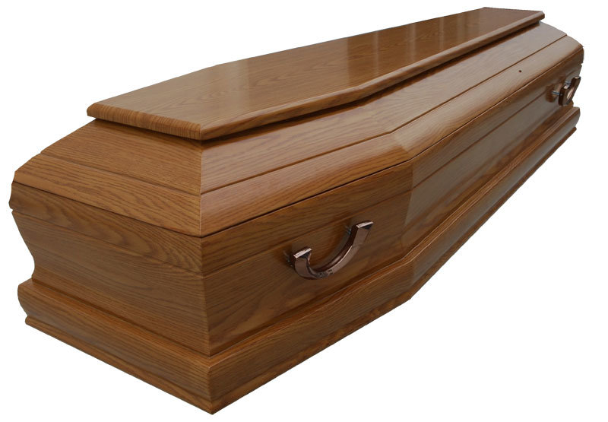
When did he die
He died in December 5,2013
ThePhoto by PhotoAuthor is licensed under CCYYSA.

Slide 5
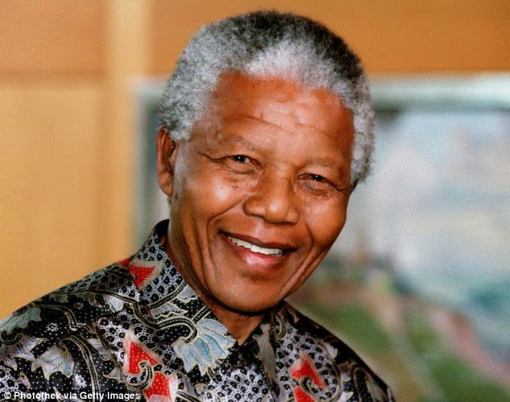
Why is Nelson Mandela inspirational
Example of courage and compassion, and his commtiment to social justice and a culture of freedom
ThePhoto by PhotoAuthor is licensed under CCYYSA.

Slide 6
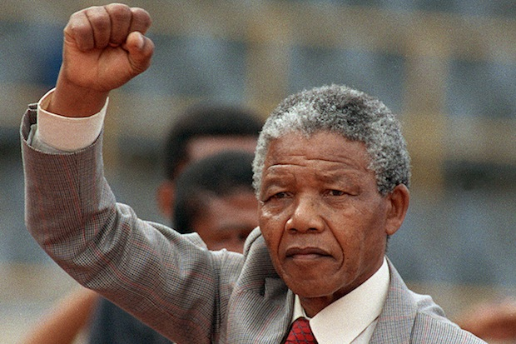
A quote that Nelson Mandela said
Do not judge me by my successes, judge👩‍⚖️ me by how many
Times I fell down and got back up again.
ThePhoto by PhotoAuthor is licensed under CCYYSA.

Slide 7
Fun facts
He lived up to his name
Nelson had 6 children and 17 grandchildren
He had 27 years in prison
He was married 3 times
He loved sports

