Slide 1
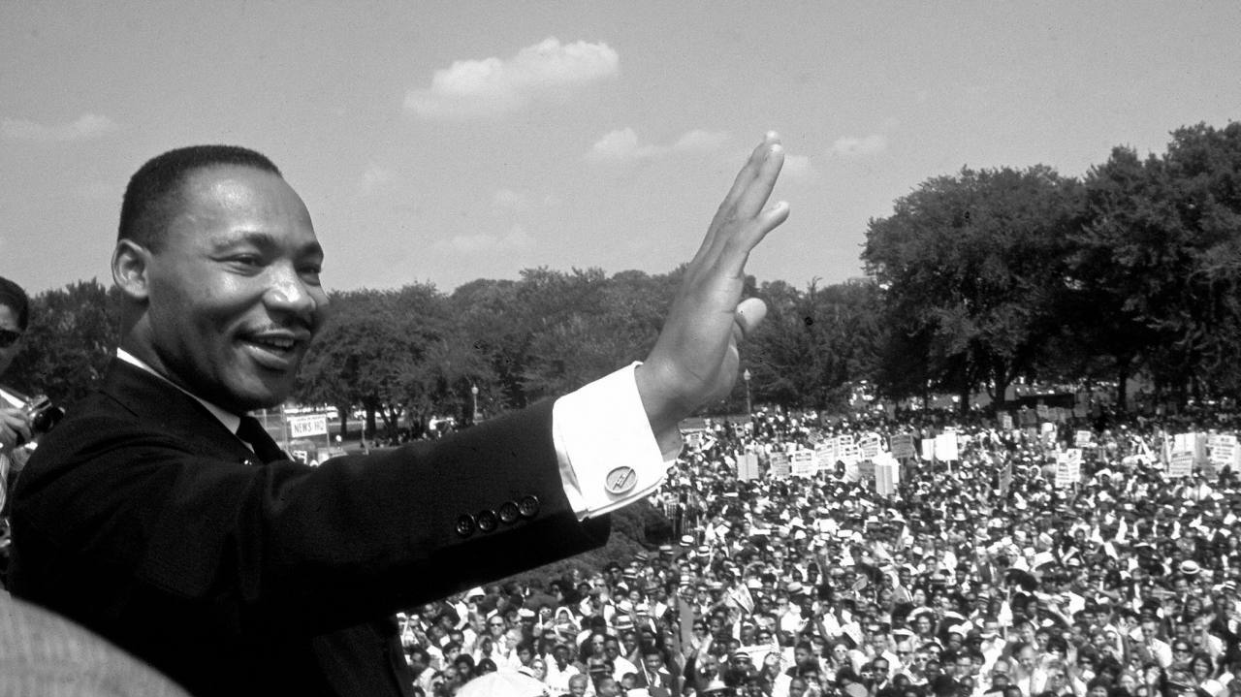
Martin Luther King Jr
By Nia Lexi Bee Indiana.
ThePhoto by PhotoAuthor is licensed under CCYYSA.

Slide 2
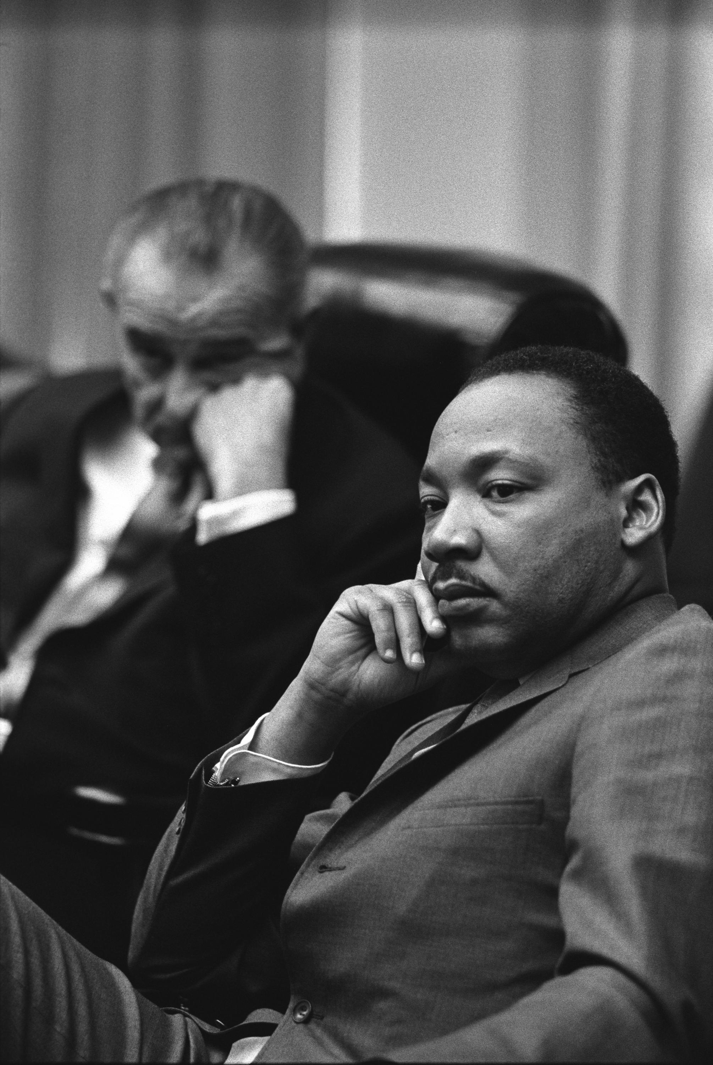
What is an inspirational leader
An inspirational leader is someone who inspires people and help people and also is like a king.
ThePhoto by PhotoAuthor is licensed under CCYYSA.

Slide 3
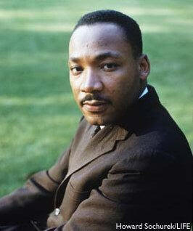
Why he is inspirational.
Because he made a speech I have a dream and made black peple have the same rights.
ThePhoto by PhotoAuthor is licensed under CCYYSA.

Slide 4
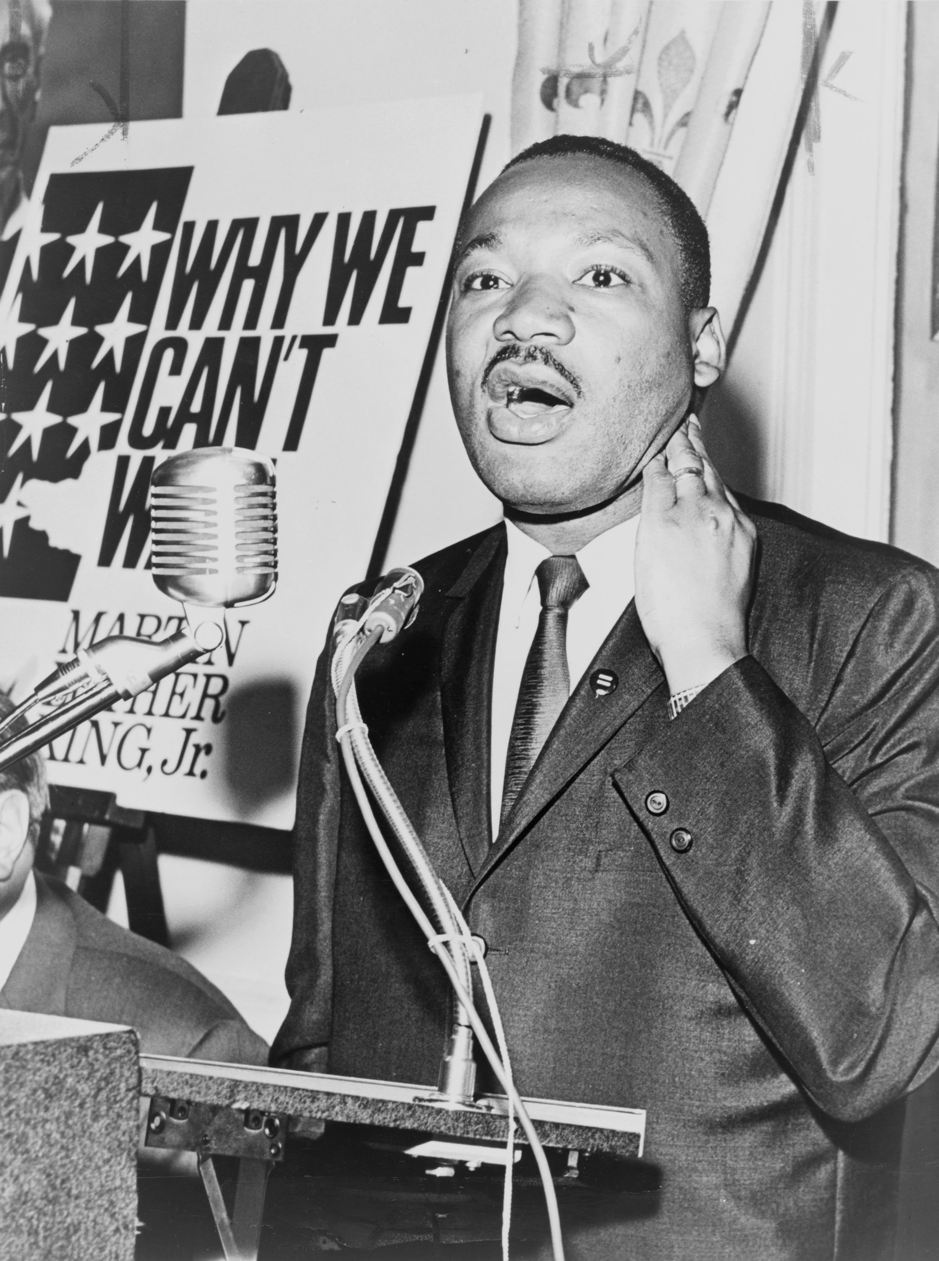
Fun facts.
He was born in 15th 1929 and died in April 4th 1968. He got arrested 29 times. He had children called yolnda and Dexter
ThePhoto by PhotoAuthor is licensed under CCYYSA.

Slide 5
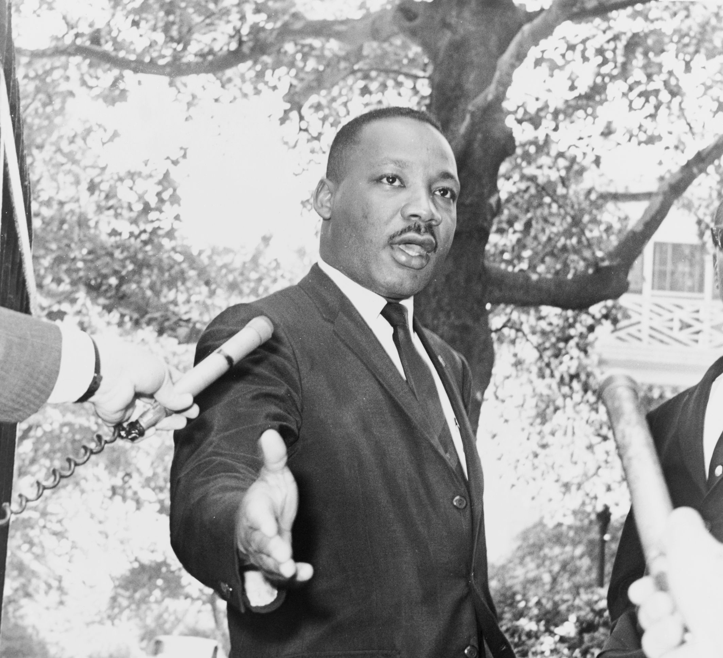
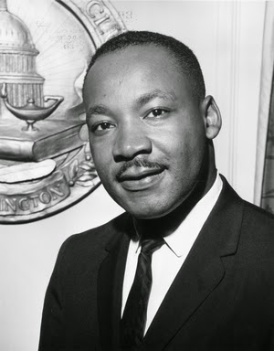
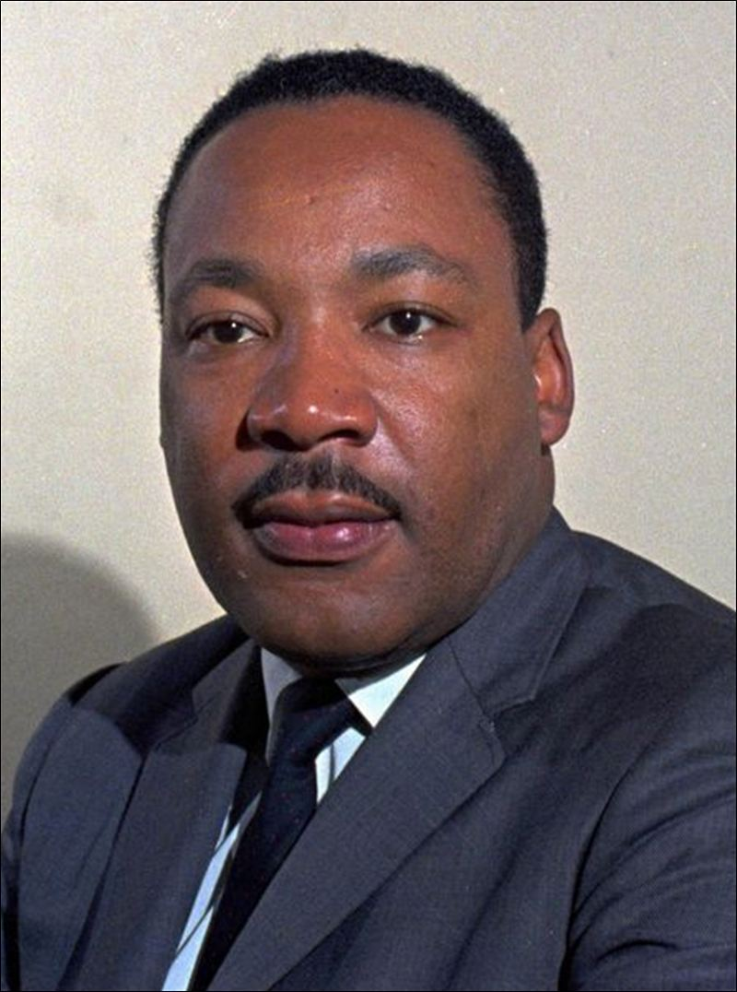
This is Martin Luther king jr
.
ThePhoto by PhotoAuthor is licensed under CCYYSA.
ThePhoto by PhotoAuthor is licensed under CCYYSA.

Slide 6
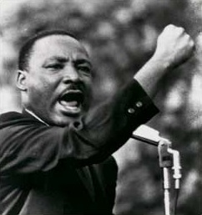
I have a dream speech
I have a dream. I have a dream that one day every valley shall be exalted every hill and mountain shall be made low, the rough places will be made plain, and the crooked places will be made straight, and the glory of the lord shall be revealed, and all flesh shall see it together.
ThePhoto by PhotoAuthor is licensed under CCYYSA.

