Slide 1
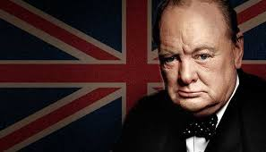
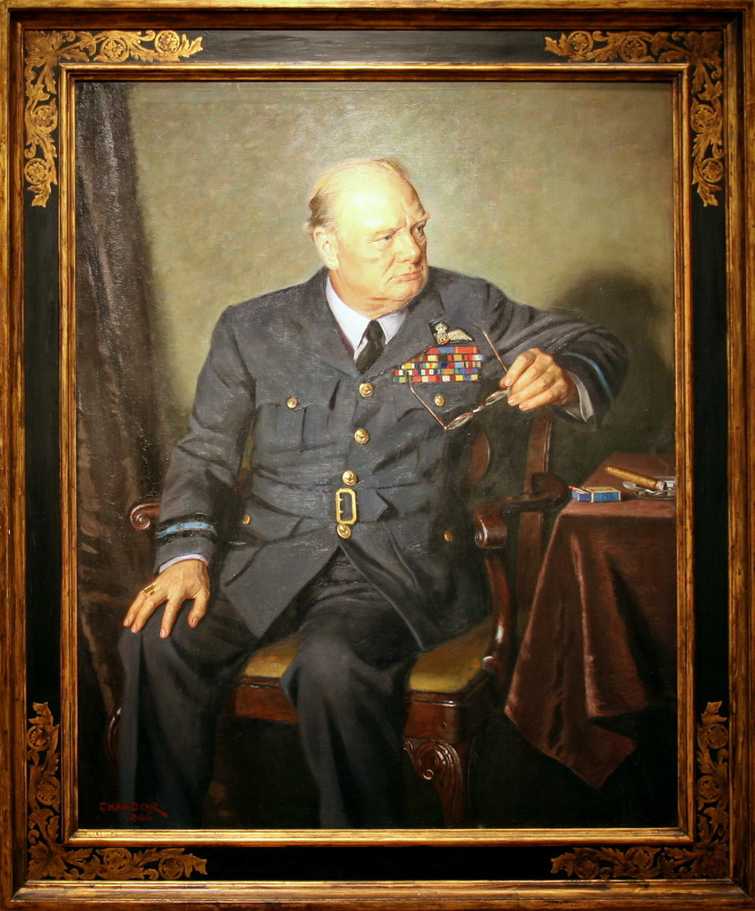
Inspirational leaders
Winston Churchill
By Lowri, felix, Amelie and Evelyn
ThePhoto by PhotoAuthor is licensed under CCYYSA.
ThePhoto by PhotoAuthor is licensed under CCYYSA.

Slide 2
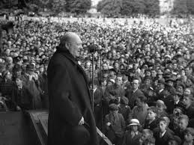
What is an inspirational leader
they are people who inspire to do better things in the world
They protect the country and people
They are good at leading because they are smart and want to change the world

Slide 3
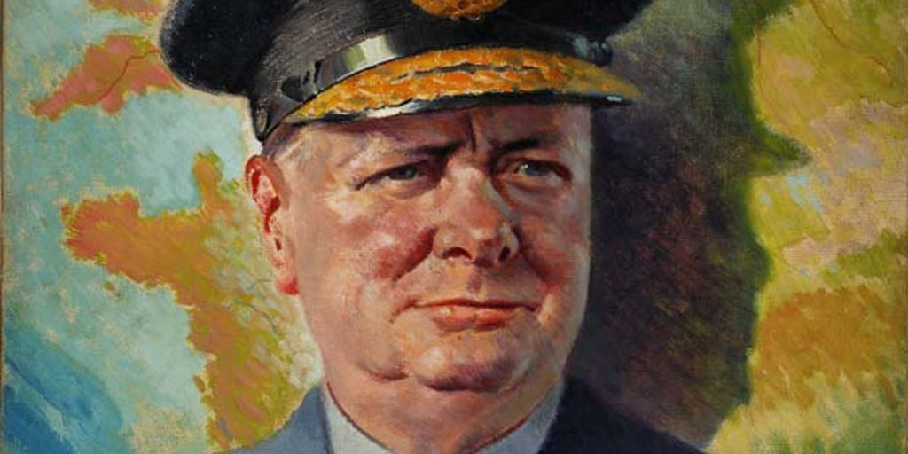
Background
When he was born 30 November 1874
When did he died
24 januwery 1965

Slide 4
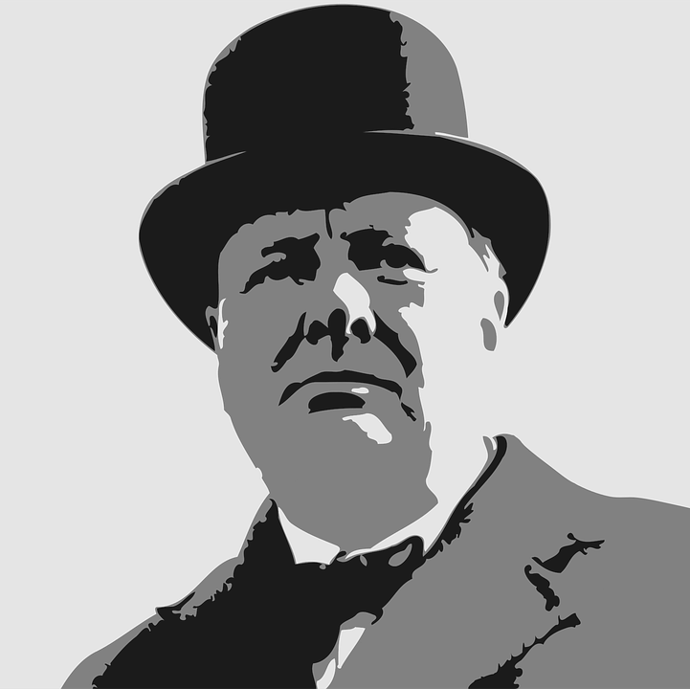
Why is he inspirational?
Because he won world war 2
In 1945
Introduced measures to reduce poverty.

Slide 5
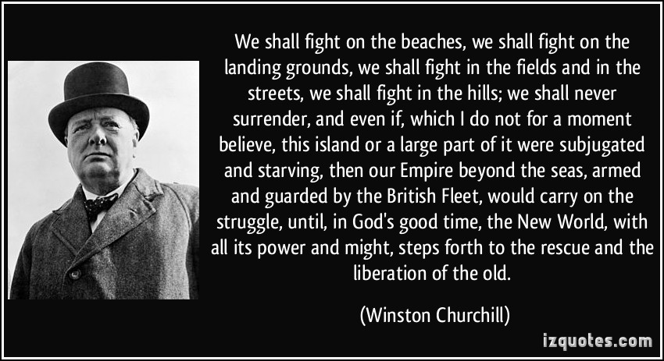
Fun facts
He got hit by a car.
He has a brother and a wife
He lived in Great britain
ThePhoto by PhotoAuthor is licensed under CCYYSA.

