Slide 1

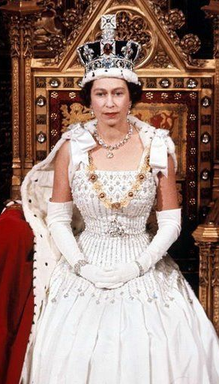
All about Elizabeth II by Isaac lucie will Eyad and Robyn.
ThePhoto by PhotoAuthor is licensed under CCYYSA.

Slide 2
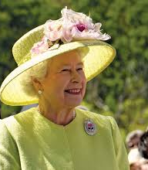
Background
Sh​e was born on the 21st of April 1926.
She died on the 8th September 2022.
She was crownd February 26th 1952 and reigned for 70 years
She married prince phillip
She had 4 children

Slide 3

What is an inspirational leader?
They inspire people to do good
They are important because they make a lot of change
They lead because people like them and listen to what they say

Slide 4
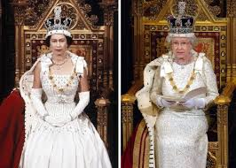
Why are they inspirational?
Her faith was extremely strong and she took her role very seriously
Through her reign she oversaw many changes across the world, social, economical and technological
She loves her country and cares about the people

Slide 5
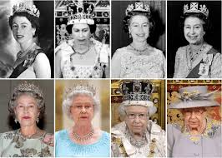
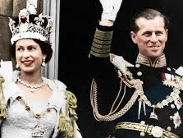
Fun facts
She's loves wildlife and animals
Bucnim palis had over 775 rooms

