Slide 1

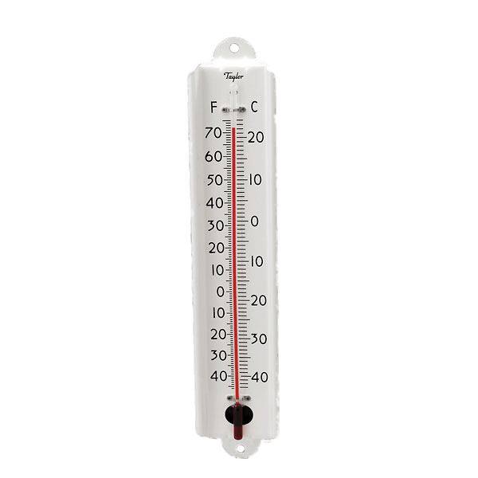
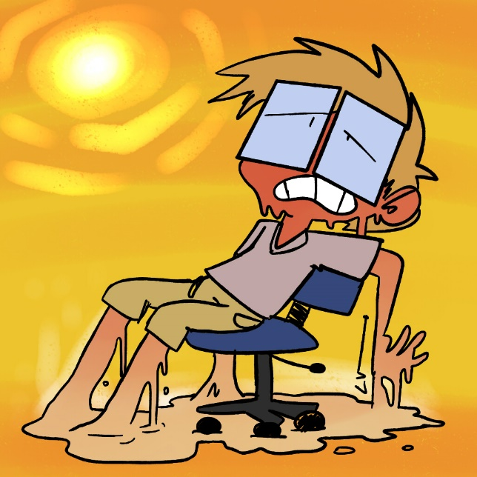
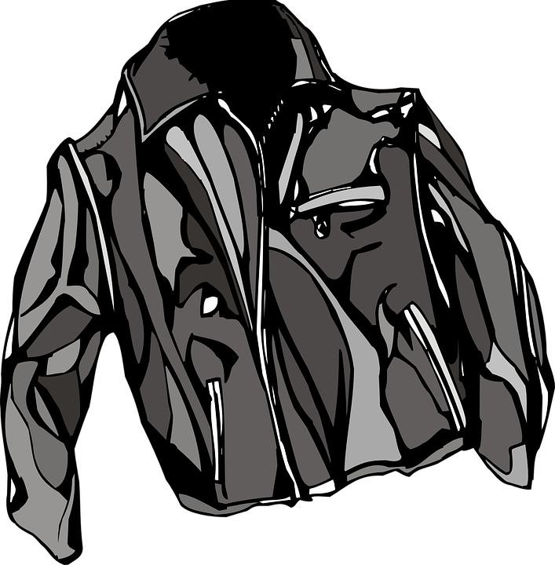
Insulation Investigation
What did you find out?

Slide 2
Look carefully at the results of your investigation into insulation
Do your results look as you expected?
Are there any you want to repeat to check?

Slide 3
In your Topic book, write the L.O: To analyse the results of an investigation
Write the subheading,
My findings:
Then, explain what you can tell from the results of your investigation. Consider things like; how different your temperature was with / without the coat. Explain what happened to your temperature when you took the coat off.

Slide 4
Write the subheading,
Graph of my results:
Using a piece of the squared paper, a ruler, and a pencil, draw two axis and label them, like the ones below. Plot the your temperature before the coat, during the coat, and after taking the coat off, to see how your temperature changed, then join the dots together to create a line graph.
*Do not include the temperatures of just your coat*
When you have completed your graph, stick it in your
book.
40
30
20
10
0
Temp before
Temp during
Temp after

Slide 5
Write the subheading,
My conclusion:
Below it, write down what you have learnt about your coat by doing this investigation. Were you surprised by the results? Is it what you predicted would happen? Is your coat a good insulator? How could you tell? What materials is your coat made from? If you were going to do this investigation again, what would you do differently? Are there any other materials/ clothes that you would like to test to see whether they are effective insulators?

