Slide 2




What Is an Influential Musician?
Musicians are people who play a musical instrument, such as a guitar, a saxophone or the drums. Some musicians use their voice as their instrument. An influential musician is a musician whose work has an impact on what people do or what happens in a situation.
There are many influential musicians who come from all different parts of the globe. This presentation focuses on five influential musicians who all use their voice as their instrument.

Slide 3
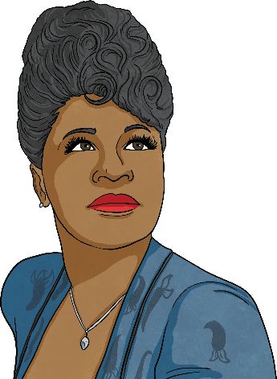
Ella Fitzgerald
Ella Fitzgerald was an American jazz singer who became world-famous for her voice. Her incredible singing career spanned six decades.
Ella Jane Fitzgerald was born in Virginia, USA on 25th April 1917. When she was young, it wasn’t Ella’s intention to be a singer. As a child, she aspired to be a dancer but, at a competition in New York, she panicked and sang a song instead of performing her dance. Ella won first prize and from then on pursued singing, joining a jazz band and singing and recording songs with them.
Ella performed in concert halls all over the world and became known as the ‘First Lady of Jazz’ and the ‘First Lady of Song’. She also appeared in films and recorded live concert albums, becoming one of the best-selling vocal recording jazz artists in history. She was the first woman to perform this type of music to a wide audience all around the world. Ella was recognised and respected by a diverse audience, who loved her lyrics, vocal expression and wide range of notes.

Slide 4
Ella Fitzgerald’s Achievements
Ella was a particularly successful ballad singer and, throughout her career, was given many awards and titles. She won 13 Grammy Awards and sold over 40 million albums. She was also the first woman to achieve the prestigious Grammy Lifetime Achievement Award.
During Ella’s life, she faced discrimination because she was Black. Ella’s manager felt very strongly about civil rights and always demanded equal treatment for his musicians. Marilyn Monroe, a famous White actress, model and singer of the time, used her influence in a positive way to help Ella get the recognition that she deserved for her singing. Marilyn sat at the front row of the Mocambo club each time Ella sang and brought with her a following of photographers from the press. Ella got so much attention that she never sang in small venues again. In 1993, Ella started The Ella Fitzgerald Charitable Foundation to use her fame to help others - particularly young children and adults - of all races, cultures and beliefs to have better life opportunities.

Slide 5
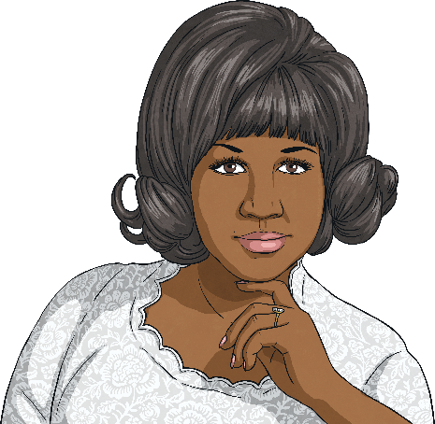
Aretha Franklin
Aretha was an American singer, known around the world as the ‘Queen of Soul’. She is believed by many people to be the greatest soul singer in the history of R & B music.
Aretha Louise Franklin was born in Memphis, USA on 25th March 1942. She came from a musical family; her mother was a gospel singer and pianist and her father was a singer and a church minister. Aretha showed obvious musical talent from an early age. She taught herself the piano and started to perform in front of her father’s congregation. She had such a powerful voice that she was recognised as a vocal prodigy.
At the age of 18 years old, with her father’s blessing, Aretha switched from sacred music to secular music. She moved to New York and started recording songs for albums in a variety of genres, including ballads, R & B, pop, gospel and jazz.

Slide 6
Aretha Franklin’s Achievements
Aretha achieved her first number one in the pop and R & B charts in 1967 when she released her single ‘RESPECT’. The song was a powerful anthem and led Aretha to be recognised as a symbol for feminism and civil rights.
She received her first two awards for the song.
In 1987, Aretha became the first woman to be inducted to the Rock and Roll Hall of Fame. This was a huge achievement and was official recognition for her contribution to the music industry.
During her career, Aretha won 20 awards, including one for lifetime achievement. She won 18 Grammy Awards, making her one of the most honoured singers in Grammy history.
Aretha was also a civil rights activist. She used her fame and influence to raise awareness of important causes, such as healthcare and the environment.

Slide 7
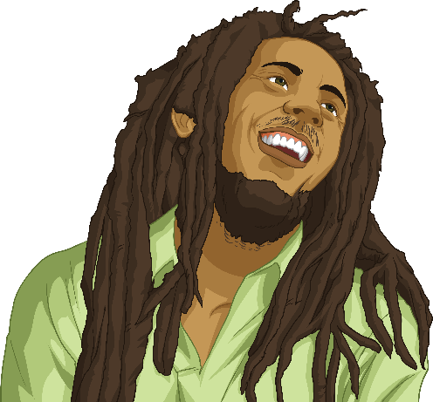
Bob Marley
Bob Marley was a Jamaican musician who is seen as a cultural icon and one of the 20th century’s most charismatic performers. Bob Marley’s music has had a huge influence on society today.
Born as Robert Nesta Marley on 6th February 1945, he started early life with his parents in the mountainous area of St Ann, Jamaica. However, Bob’s father came from a White family who did not approve of him marrying Bob’s mother because she was Black. At the age of 5, Bob was taken by his father from the rural area of St Ann to live with a family member and go to school. When Bob’s mother later found out that Bob wasn’t in fact attending school and was living with an elderly couple instead, she moved him back with her.
In his early teens, Bob moved to Trench Town in West Kingston, Jamaica, which was a very poor slum area. He attended school and had an apprenticeship to be a welder but he was interested in music. He listened to ska, jazz and folk-calypso and his musical talents were recognised and nurtured. He formed a band called the Wailers, who made reggae music.

Slide 8
Bob Marley’s Achievements
Bob Marley and the Wailers toured many parts of the world, including Europe, America and Africa and delivered messages through song. Bob used music to share his beliefs, challenge people’s opinions and address the inequality in societies around the world.
Many people continue to be influenced by his song lyrics. For example, the song ‘Get Up, Stand Up’ asks people to stand up for their rights and what they believe in – it has been played by many seeking change.
Bob Marley wasn’t given awards for his music until a long time after it was made. He received a Grammy Lifetime Achievement Award in 2001, 20 years after he died.
Bob was a political figure and he always worked to find peace in Jamaica. He performed as the headliner in Jamaica’s ‘One Love’ peace concert in 1978 and the Jamaican government awarded him the Order of Merit for his political work.

Slide 9
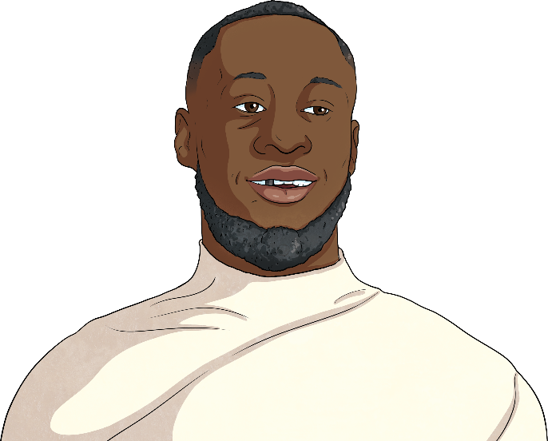
Stormzy
Stormzy is a British rapper who makes music in the grime genre.
Michael Omari, otherwise known as Stormzy, was born on 26th July 1993 in Thornton Heath, London. He began rapping at the age of eleven.
Stormzy gained 6 A* GCSEs and his teachers wanted him to go on to study at a top university but he wanted to focus on his music. Stormzy posted freestyle rap videos online and gained a large amount of followers. Although he started performing hip-hop songs, Stormzy became famous for his grime music. This genre of music originated in London but it is now very popular in other countries, including Denmark, Sweden and Australia.
In 2014, he released his first song and record companies were keen to sign him. He won a MOBO award for the Best Grime Act in 2014 and in 2015 became the first freestyler to reach the top 40 in the UK charts.

Slide 10
Stormzy’s Achievements
Stormzy’s debut album was the first grime album to reach number one in the British album chart and he won a Brit Award for British Album of the Year in 2018.
In 2019, Stormzy became the first British rapper to headline at the famous British festival, Glastonbury. He was also the first Black British solo artist to headline there. During his performance, he featured a dance group called Ballet Black and played a political speech about the disproportionate number of Black people in the criminal justice system.
In 2018, Stormzy partnered with Penguin Random House to set up a new publisher called #Merky Books. This publisher sought to showcase young writers and be a platform for them to become published authors. In 2019, Stormzy provided funding for two Black students to attend a well-respected British university. He chose to support the students because he said that he wanted to remind young Black people to strive to achieve great things and follow their dreams.

Slide 11
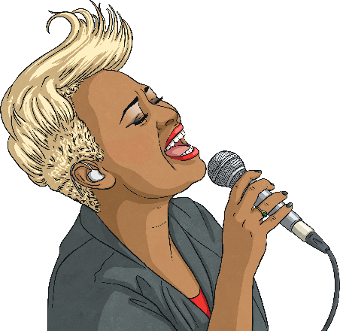
Emeli Sandé
Emeli Sandé is British singer and songwriter who has been awarded several awards, including the highest accolades in the music industry and an MBE for services to music.
Adele Emeli Sandé was born in Tyne and Wear, Britain on 10th March 1987. She grew up with her sister and her Cumbrian mother and Zambian father. At the age of four, Emeli and her family moved to Alford in Scotland and it was at her primary school, aged six, that Emeli showed her natural musical talent. She learnt how to play the ocarina (a small, ceramic, egg-shaped wind instrument) and the recorder and joined the choir. Her music teacher saw her gift for music and asked Emeli to perform the lead role in the school nativity. In this performance, Emeli wowed the audience.
Emeli was influenced by singer-songwriters, such as Nina Simone, and decided she would follow in their footsteps and write and perform her own songs. At the age of 16, Emeli turned down a record deal in order to study medicine at the University of Glasgow. She graduated from university with a degree and her sister, Lucy, entered a video of Emeli into a national singing competition. Emeli won and this marked the start of her professional music career.

Slide 12
Emeli Sandé’s Achievements
Emeli Sandé has achieved many things in her music career since it began professionally in 2009. With the artist Naughty Boy, she has co-written several songs for other singers, such as Tinie Tempah and Cheryl Cole.
In 2011, Emeli released her first solo single ‘Heaven’, which reached number two in the charts and sold over 63 000 copies in the UK. Since then, Emeli has written three albums. Her first, ‘Our Version of Events’, was at number one in the UK album charts for ten non-consecutive weeks.
Emeli has won six Brit Awards, two prestigious Ivor Norvello awards (one of the highest accolades for a musician) and received an MBE for her services to music. In 2012, she had the honour of performing at the opening and closing ceremonies of the London Olympics.
Emeli uses her influence to campaign for several charities around the world and is an ambassador for the Nordoff Robbins Music Therapy Charity which works to improve people’s lives through music therapy.

Slide 13

MOBO Awards
MOBO is an abbreviation of Music of Black Origin and the MOBO Awards were launched over 20 years ago in 1996. They were established as the first Black awards ceremony in Europe, as this didn’t previously exist.
The MOBO Awards were established to show music of Black origins and urban culture. The winners of MOBO Awards are recognised by winning their category, but also rewarded financially to support them in their music careers.

Slide 14
Glossary
back
congregation: A group of people who are gathered together in a church for a religious service, not including the priest and choir.
freestyle rap: A type of rapping whereby rap lyrics are made up on the spot.
Grammy award: An award presented by The Recording Academy to recognise achievements in the music industry.
grime music: A genre of music that started in London in the 2000s. It is mixture of garage, drum’n’bass and dancehall.
headliner: A performer or act that is promoted as the star attraction at a music event.
MOBO award: Music of Black Origin Award.
MBE: Abbreviation of Member of the Order of the British Empire. The special award is decided by the Queen and given to someone for making a positive impact in their line of work.
back
back
back
back
back
back

Slide 15
Glossary
back
prodigy: A young person with exceptional qualities or abilities.
R & B music: Stands for ‘rhythm and blues’ music, which is a genre of popular music that originated in African-American music and mixes blues and jazz.
reggae music: Music that originated from Jamaica and contains elements of calypso, rhythm and blues.
sacred music: Music that is composed or performed with a religious meaning.
secular music: Music that is not specifically religious.
ska music: A popular music form that originates from Jamaica. Ska music is a local interpretation of American soul and R & B.
back
back
back
back
back

