Slide 1
All About William Shakespeare and Elizabethan Life & Society
A collaborative presentation by Year 6 (2024-2025)

Slide 2
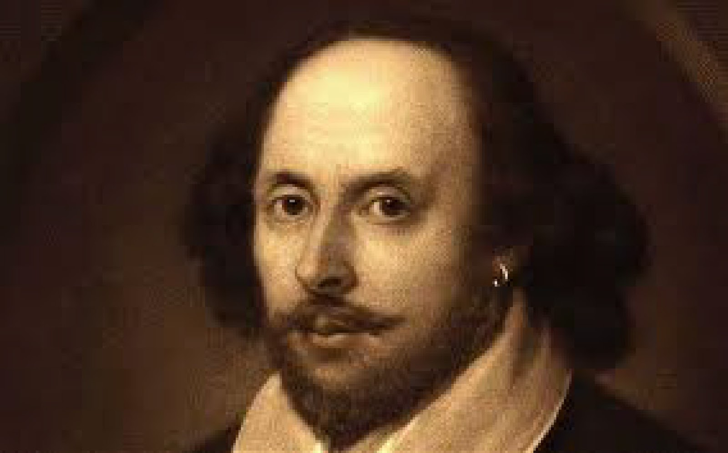
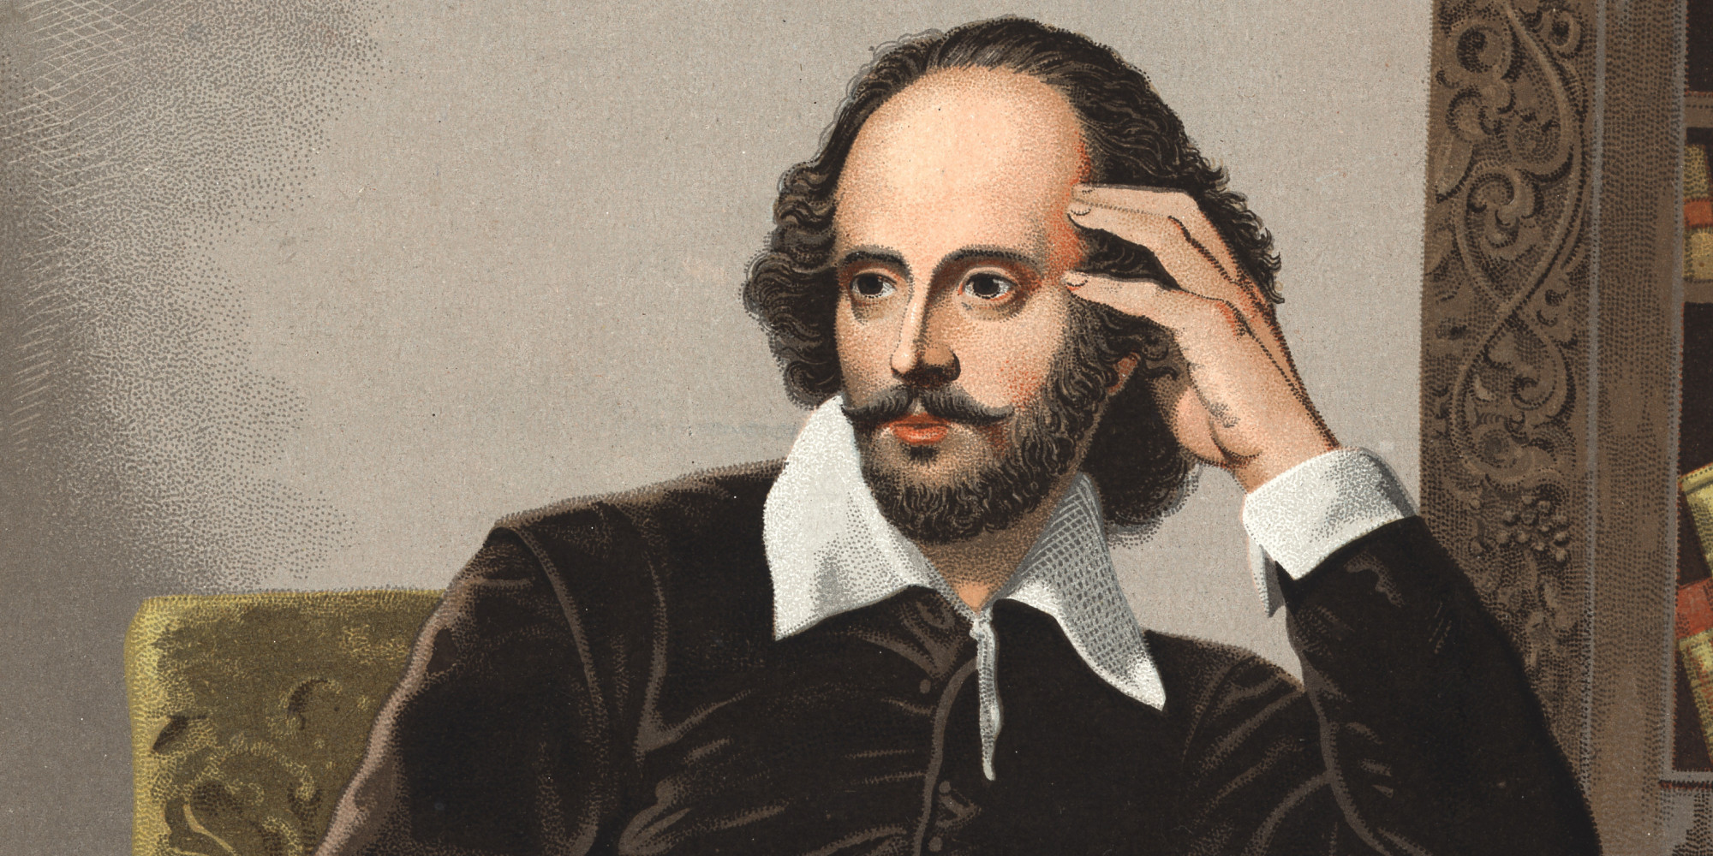
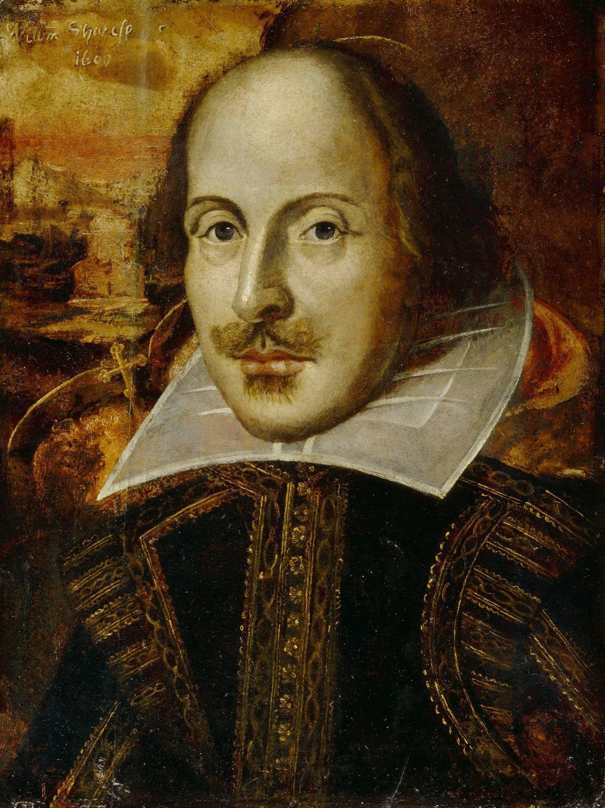
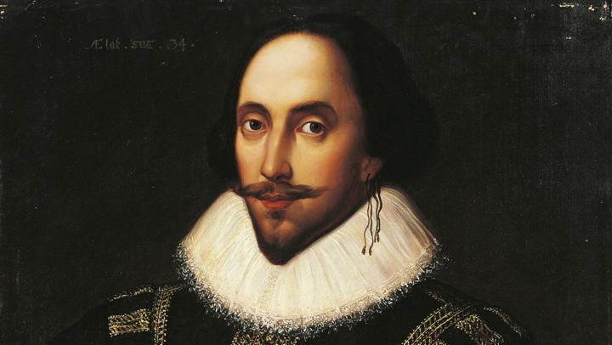
Shakespeare's Life and Family Background
He was born 23rd April 1564 and died on the 23rd April 1616, he was 52 when he died. He was born in the English City of Stratford-Upon-Avon about 100 miles in the northwest of London. His first ever show was Henry the 6th part one.
His last show was The Tempest in 1611.
.

Slide 3
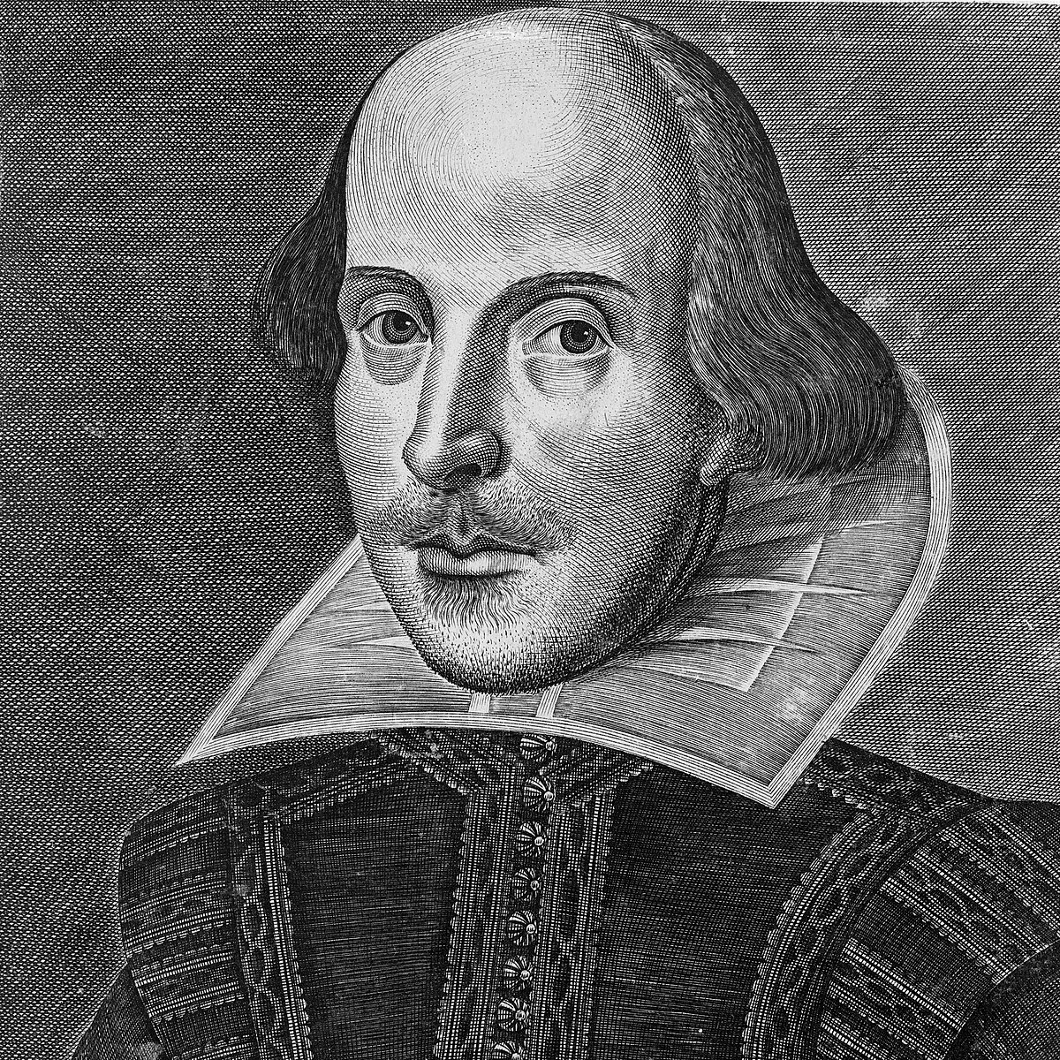
Shakespeare's Life and Family Background
William had 7 siblings, unfortunately two older sisters died
before he was born, he was the oldest in the remaining 5.
Shakespeare lived down Henley Street growing up with his big family, his parents were John Shakespeare and Mary Arden. John worked as a glove-maker and a leather worker, his wife Mary Arden a heiress.
When William turned eighteen, he married Anne Hathaway . Anne was eight years older than Shakespeare when they got married.
They soon had a family including a daughter named Susanna and twins named Hamnet and Judith.

Slide 4
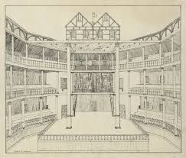
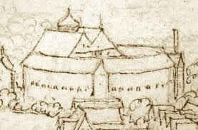
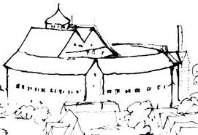
Globe Theatre & Elizabethan Theatre/Drama/Acting and Shows.
The plays in Elizabethan times had to be performed in daylight because unlike modern days they had no electricity for lights.
The original Globe theatre could seat 3,000 people and 1,000 people standing.
William Shakespeare had made plays for the Globe Theatre including Romeo and Juliet , A Midsummer Night's dream, Macbeth, King Lear and Othello.
Plays were only performed by men even if there was a female character.
William Shakespeare's first play for the Globe Theatre was Julius Ceasar.

Slide 5
Globe Theatre & Elizabethan Theatre/Drama/acting and shows
The Globe Theatre is a 20-sided shape also commonly known as an Icosagon.
The Globe Theatre was built in 1955 and destroyed by a fire on the 26 of June 1613 and rebuilt in 1642 on the south side of the River Thames.
The Globe Theatre is open air, so they often have spare coats.
It is called the Globe Theatre after the figure of Hercules carrying the globe on his back.

Slide 6
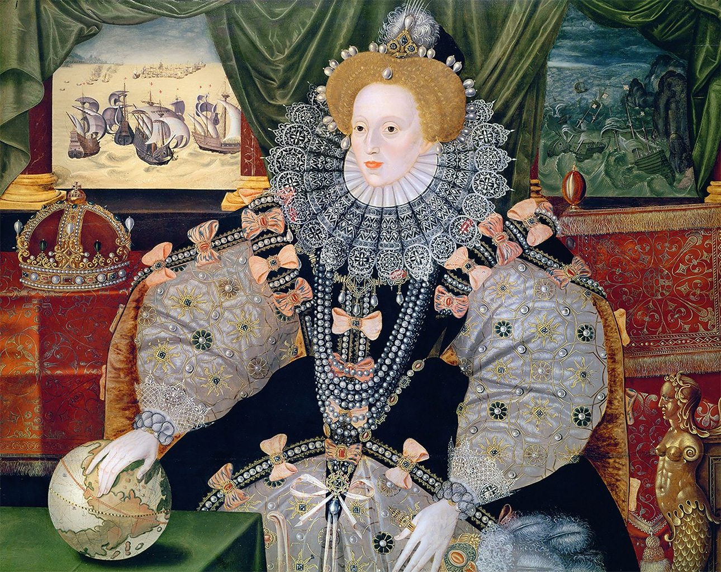
Role of the Monarchy and Politics
In Elizabethan times the queen had some help ruling, from her Parliament and her advisors although she did have most of the power.
Queen Elizabeth had full control over her Parliament and could close it at any time. She also chose when they met (they only met 13 times in 45 years) and they could only talk about what she wanted them to.
The Elizabethan Parliament collected taxes and brought more money to the English throne.
Queen Elizabeth I chose her chief advisors, a small group of men, known as the Privy Council, who's responsibilities were to:
Assist the Queen in making decisions.
Ensure that all political decisions were carried out.

Slide 7
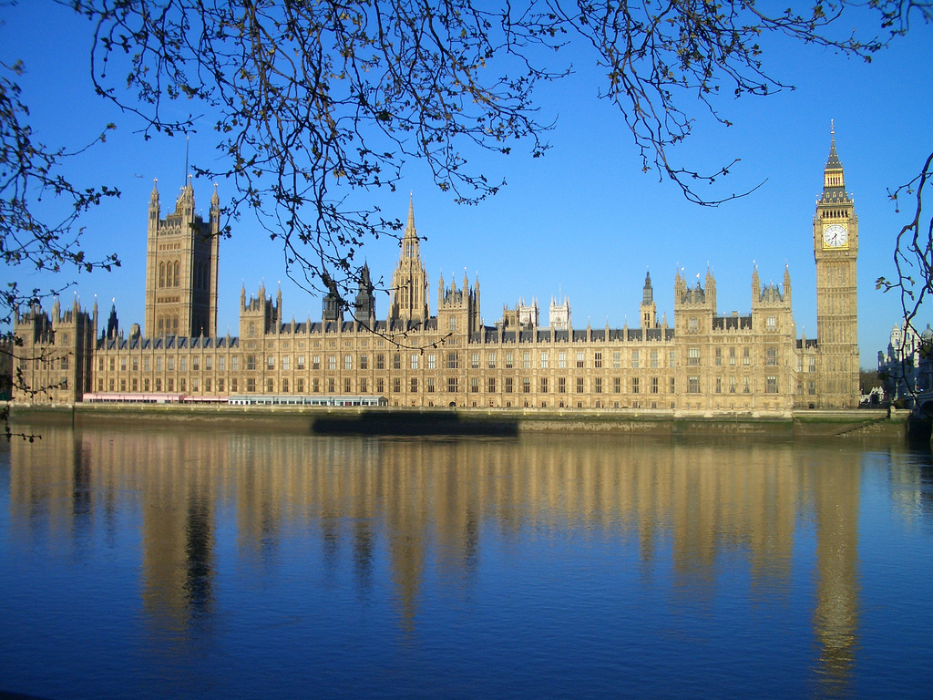
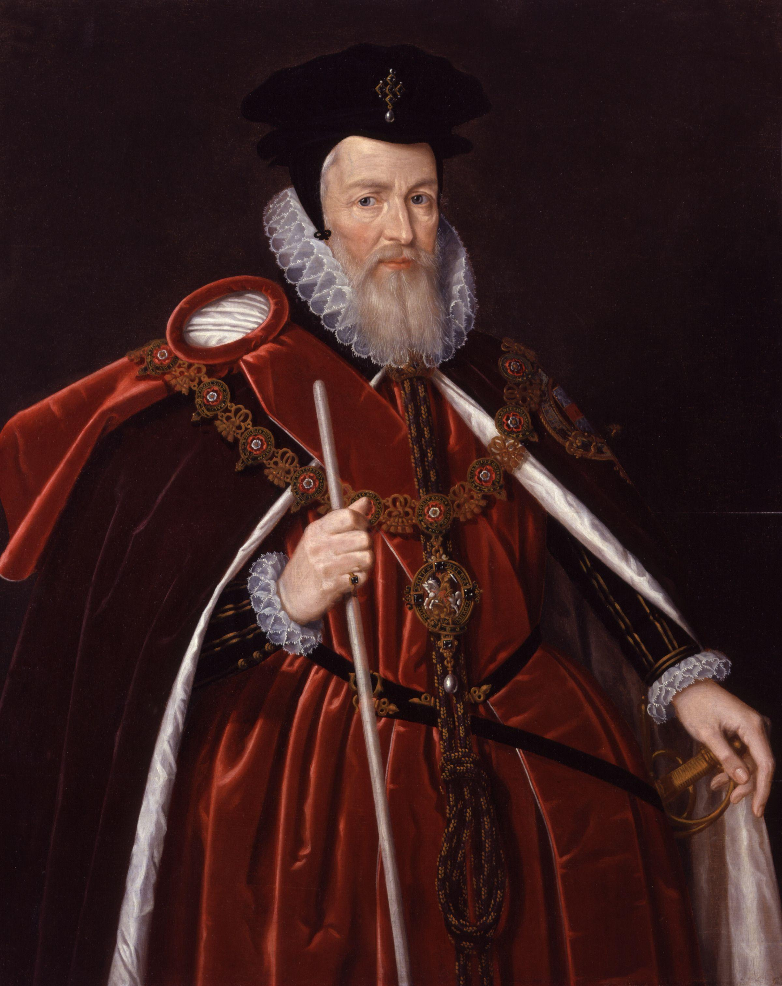
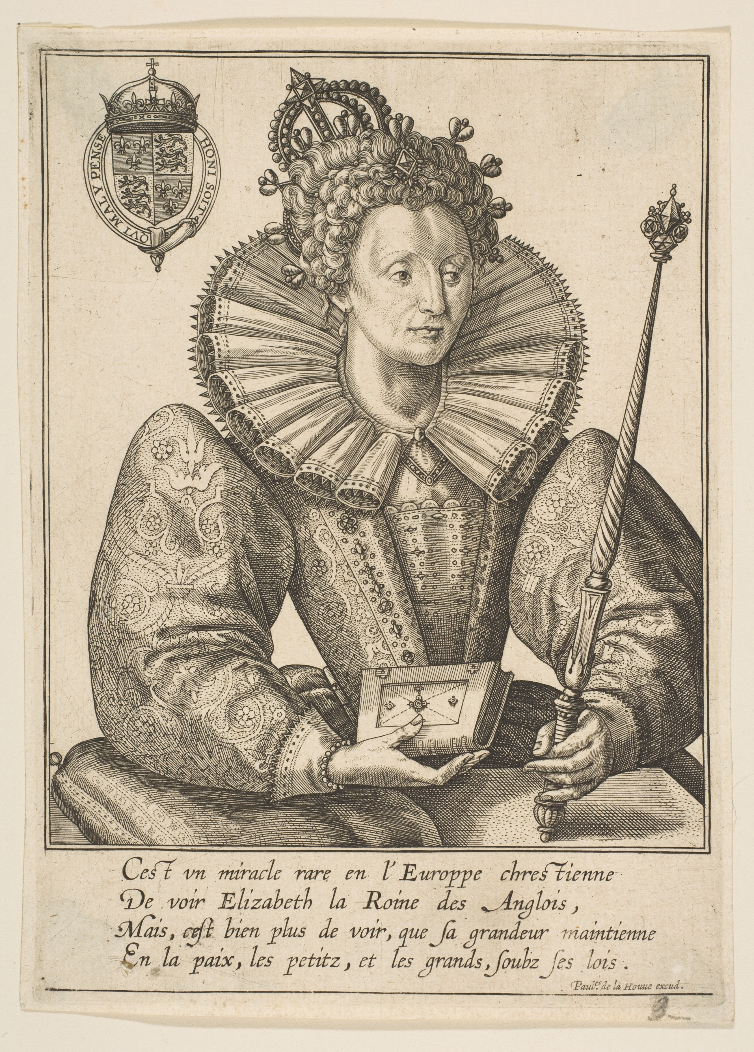
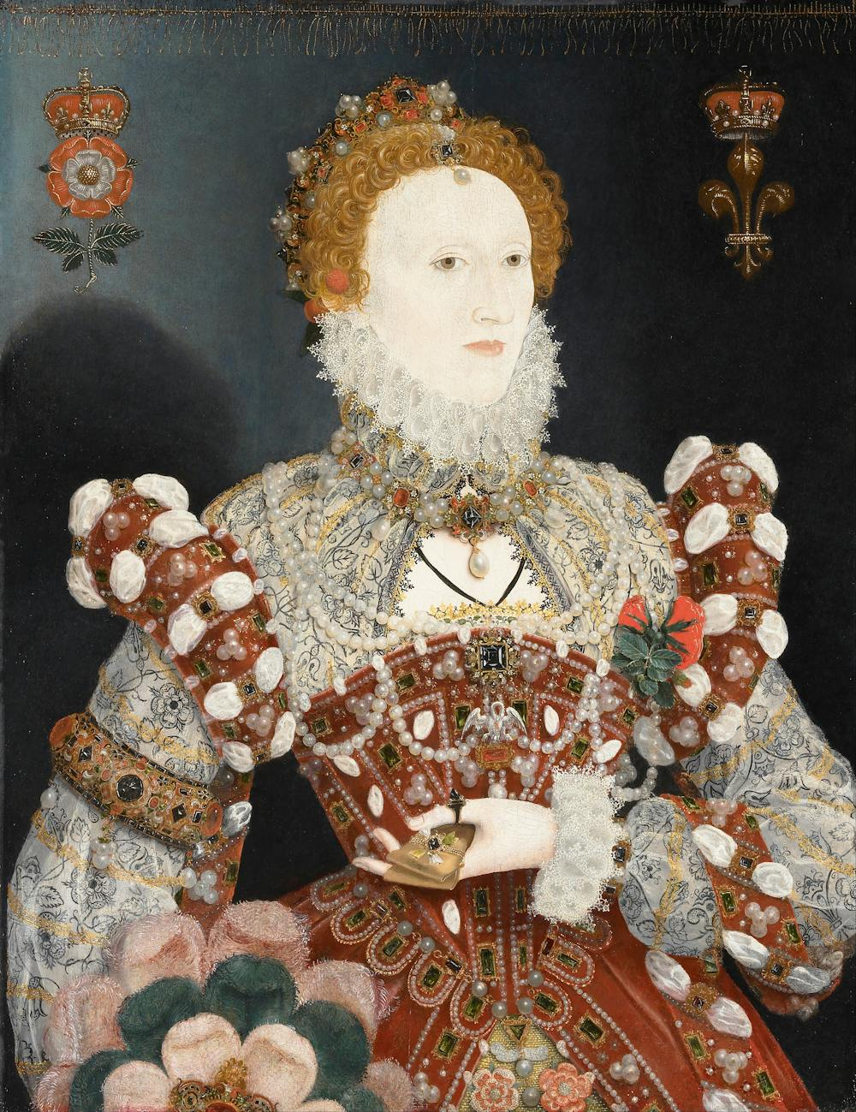
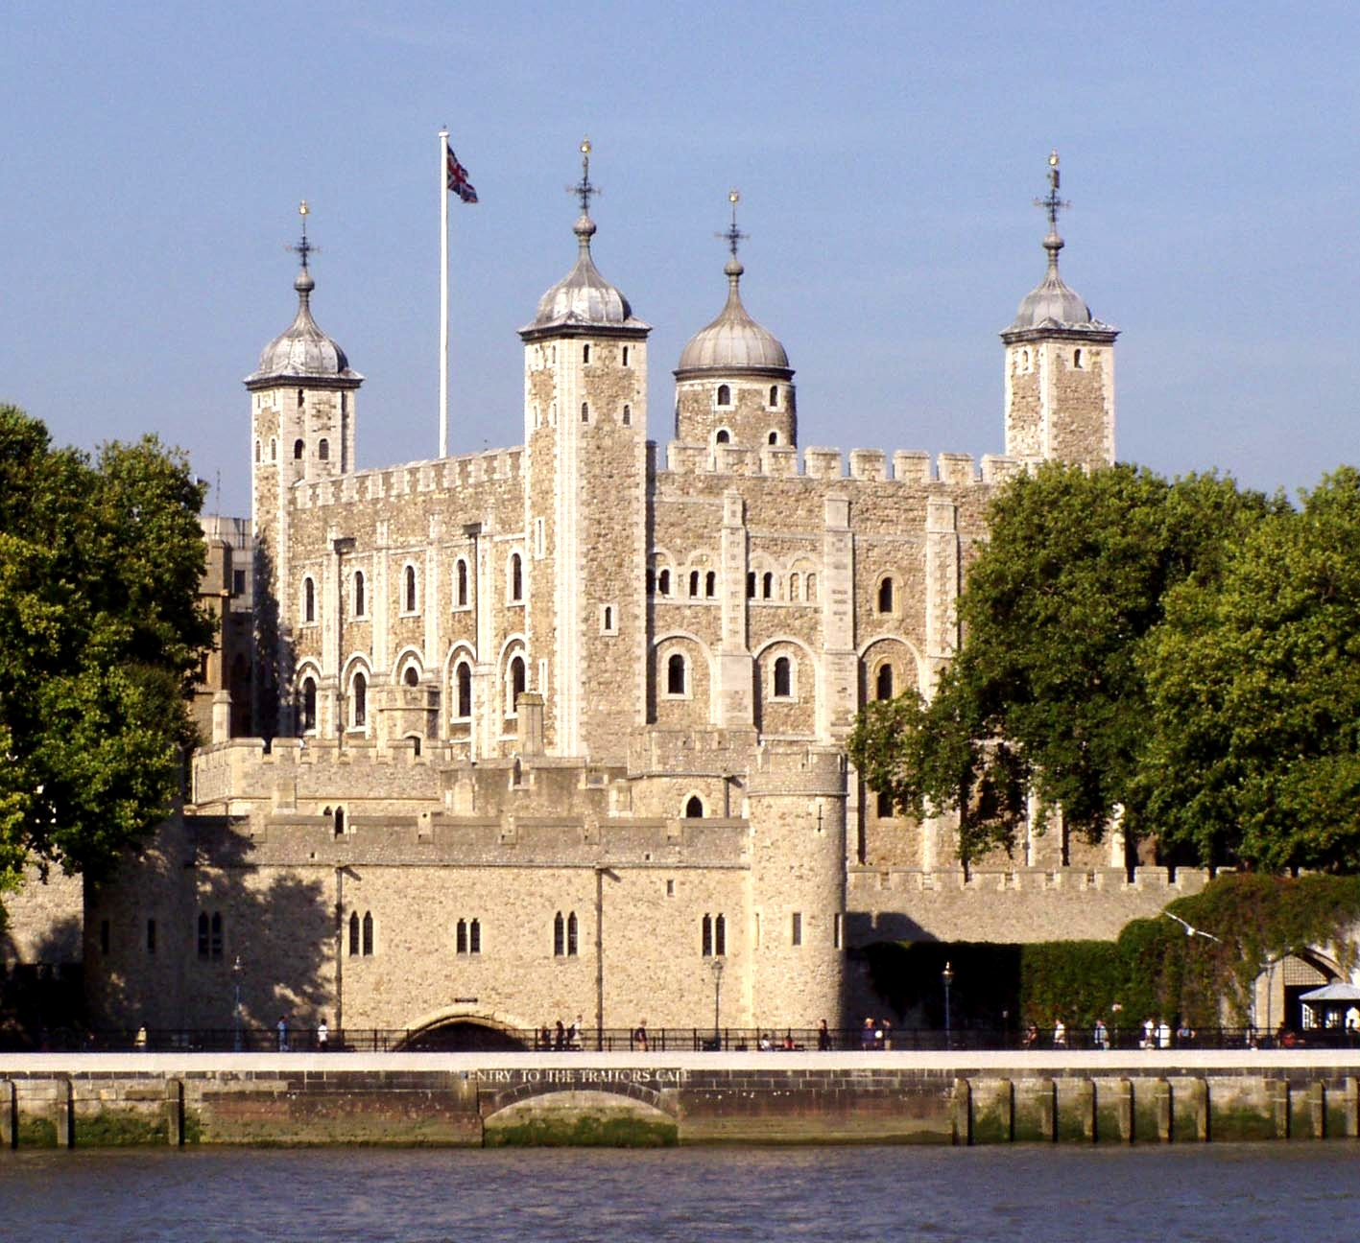
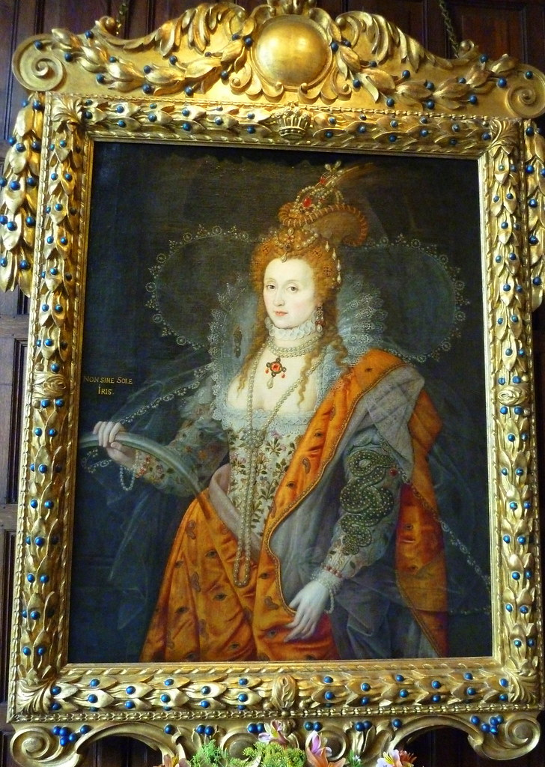
Role of the Monarchy and Politics
The Elizabethan William Cecil was not the main advisor to the queen. Queen Elizabeth I appointed Cecil as secretary of state, he was her most important advisor.
In Elizabethan times the Parliament was much less powerful and not fully representative of the population.

Slide 8
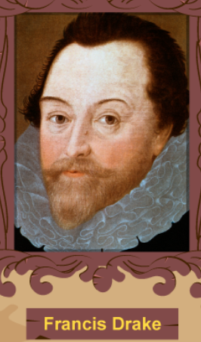
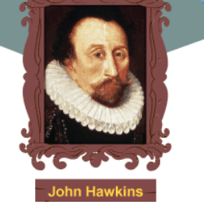
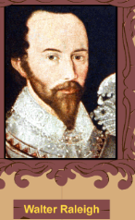
Elizabethan Exploration & Trade
The Elizabethan era saw the rise of brave and skilful seamen.
In the middle ages travel was very rare and uncommon in most places.
Luxuries like spices and silk were imported to England from China and India by over land travel which meant that supplies relied on foreign country.
Elizabethan adventures made a huge difference to English trade.
Sir Francis Drake navigated the globe and helped defeat the Spanish armada.
John Hawkins was an African slave trader and helped defeat the Spanish armada.
Walter Raleigh set up a colony on Roanoke Island.
The first long voyages happened, the compass was invented, and guns were invented.
Walter Raleigh was imprisoned in the Tower of London in June 1592 for marrying one of Elizabeth's ladies in waiting.
When Walter Raleigh was imprisoned, he wrote many poems and a history of the world.

Slide 9
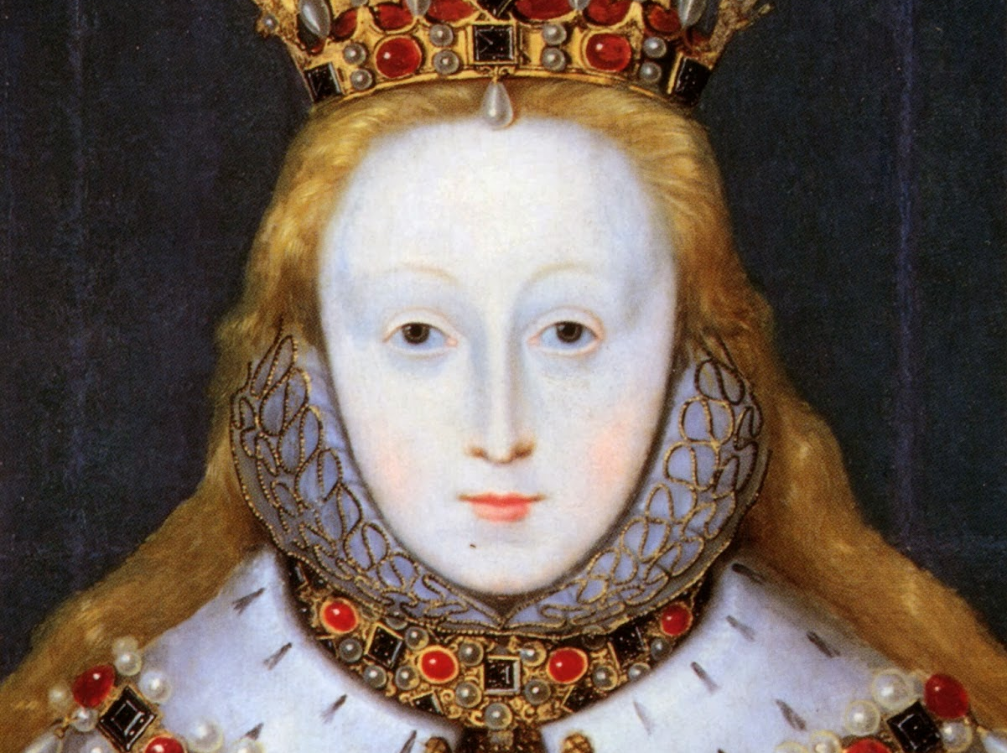
Elizabethan Entertainment
-Banquets - A large celebratory dinner.
-Fairs - A yearly event for people to meet and discuss.
-Plays - (Often made by Shakespear) A group of people being a different person, animals etc. to form a story.
-Festivals - Celebrating church festivals.
-Dancing - Elizabethan dancing enjoyed by the upper class.
-Jousts - A series of tilting matches between knights.
-Games and Sports - Tournaments which included archery, bowling, cards, dice, hammer throwing and skittles.
ThePhoto by PhotoAuthor is licensed under CCYYSA.

Slide 10
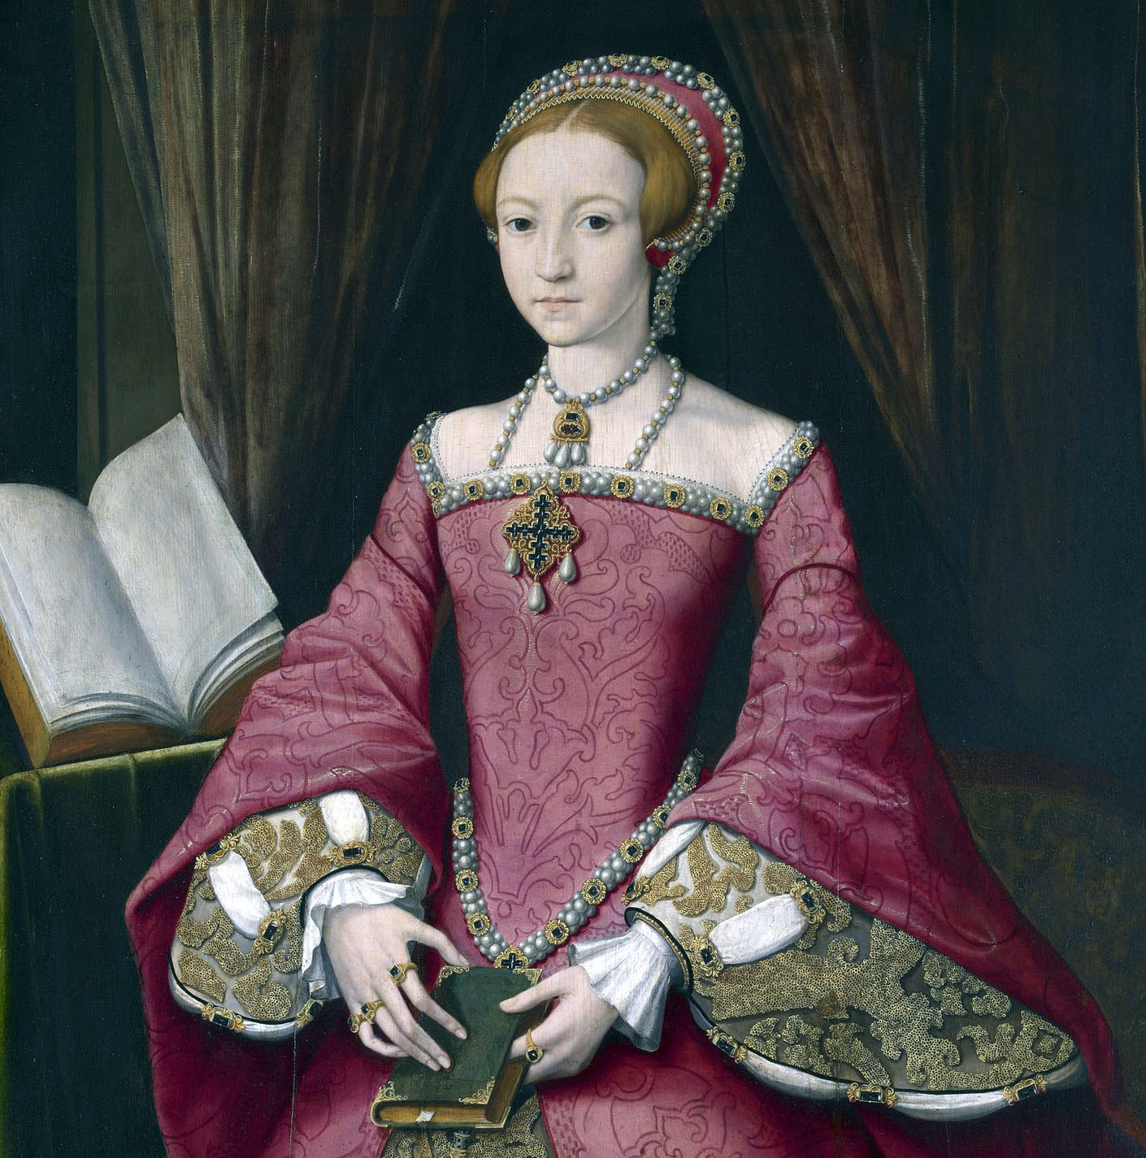
Elizabethan Entertainment
-Animal sports - Including bear, bull baiting and dog fighting.
-Hunting - A group of trained people going into the wild or arena to hunt or catch animals for entertainment or food.
-Hawking - Sport followed by nobility with hawks.
-Jesters - The comedian of Elizabethan times Jester would perform jokes and performances entertain the people and the king.
ThePhoto by PhotoAuthor is licensed under CCYYSA.

Slide 11
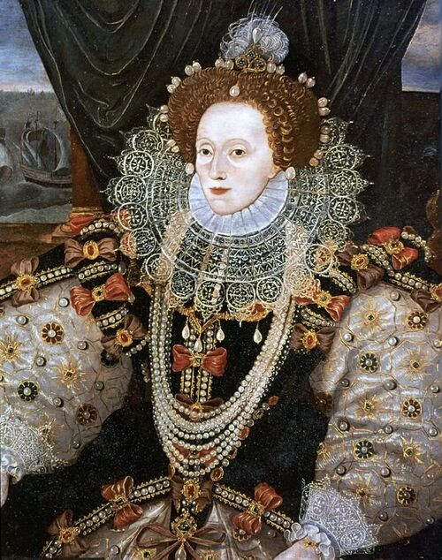
Elizabethan Entertainment
Elizabethan Entertainment
-Mummers-A masked or costumed 'merry maker' or dancer at festivals.
-Troubadours-Travelling musician who sang of country love.
-Acting troupes-Travelling actors.
-Jugglers-Tricksters, deception or fraud.
.
ThePhoto by PhotoAuthor is licensed under CCYYSA.

Slide 12
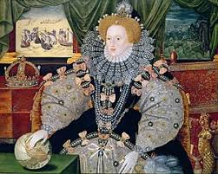
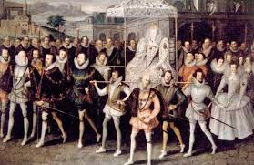
Childhood and Education in Elizabethan Society
Wealthier boys were better educated than ever before.
Boys learnt Latin in rich schools and if they were caught speaking English they would be hit by a wooden stick. But sometimes a very wealthy child could buy a spanking boy who would take the punishment for them.
Poor children didn’t have any education because most poor people could not afford it. And some poor children didn’t know how to read and write.
In Elizabethan England there was no compulsory schooling. Most children lives revolved around the family, the church, the farm and workshop.
Unlike boys, rich woman learnt how to dance and sing they didn’t learn how to cook because most of the time their butler would do it for them.
In fact, around one quarter of children died before they were ten!
By the age 7, they could go to grammar school where they learnt subjects such as Latin, Mathematics , logic and rhetoric.
The most elementary level of education was for boys aged between 5 and 7 what was called petty school.

Slide 13
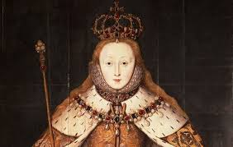
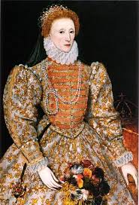
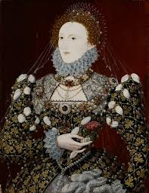
Childhood and Education in Elizabethan Society
For the rich they could eat anything just like meat and fowl such as beef, lamb, pork, deer, peacock, swan and goose. For the poor all they ate was bread, butter, toast and egg also as pottage.
For the upper classes they had a physician, these where doctors who are highly educated and only the rich could afford. The poor had a wise women also known as the witches they helped the poor and helpless.
There was table manners which were eating small morsels chewing properly using a knife and using a napkin.

Slide 14
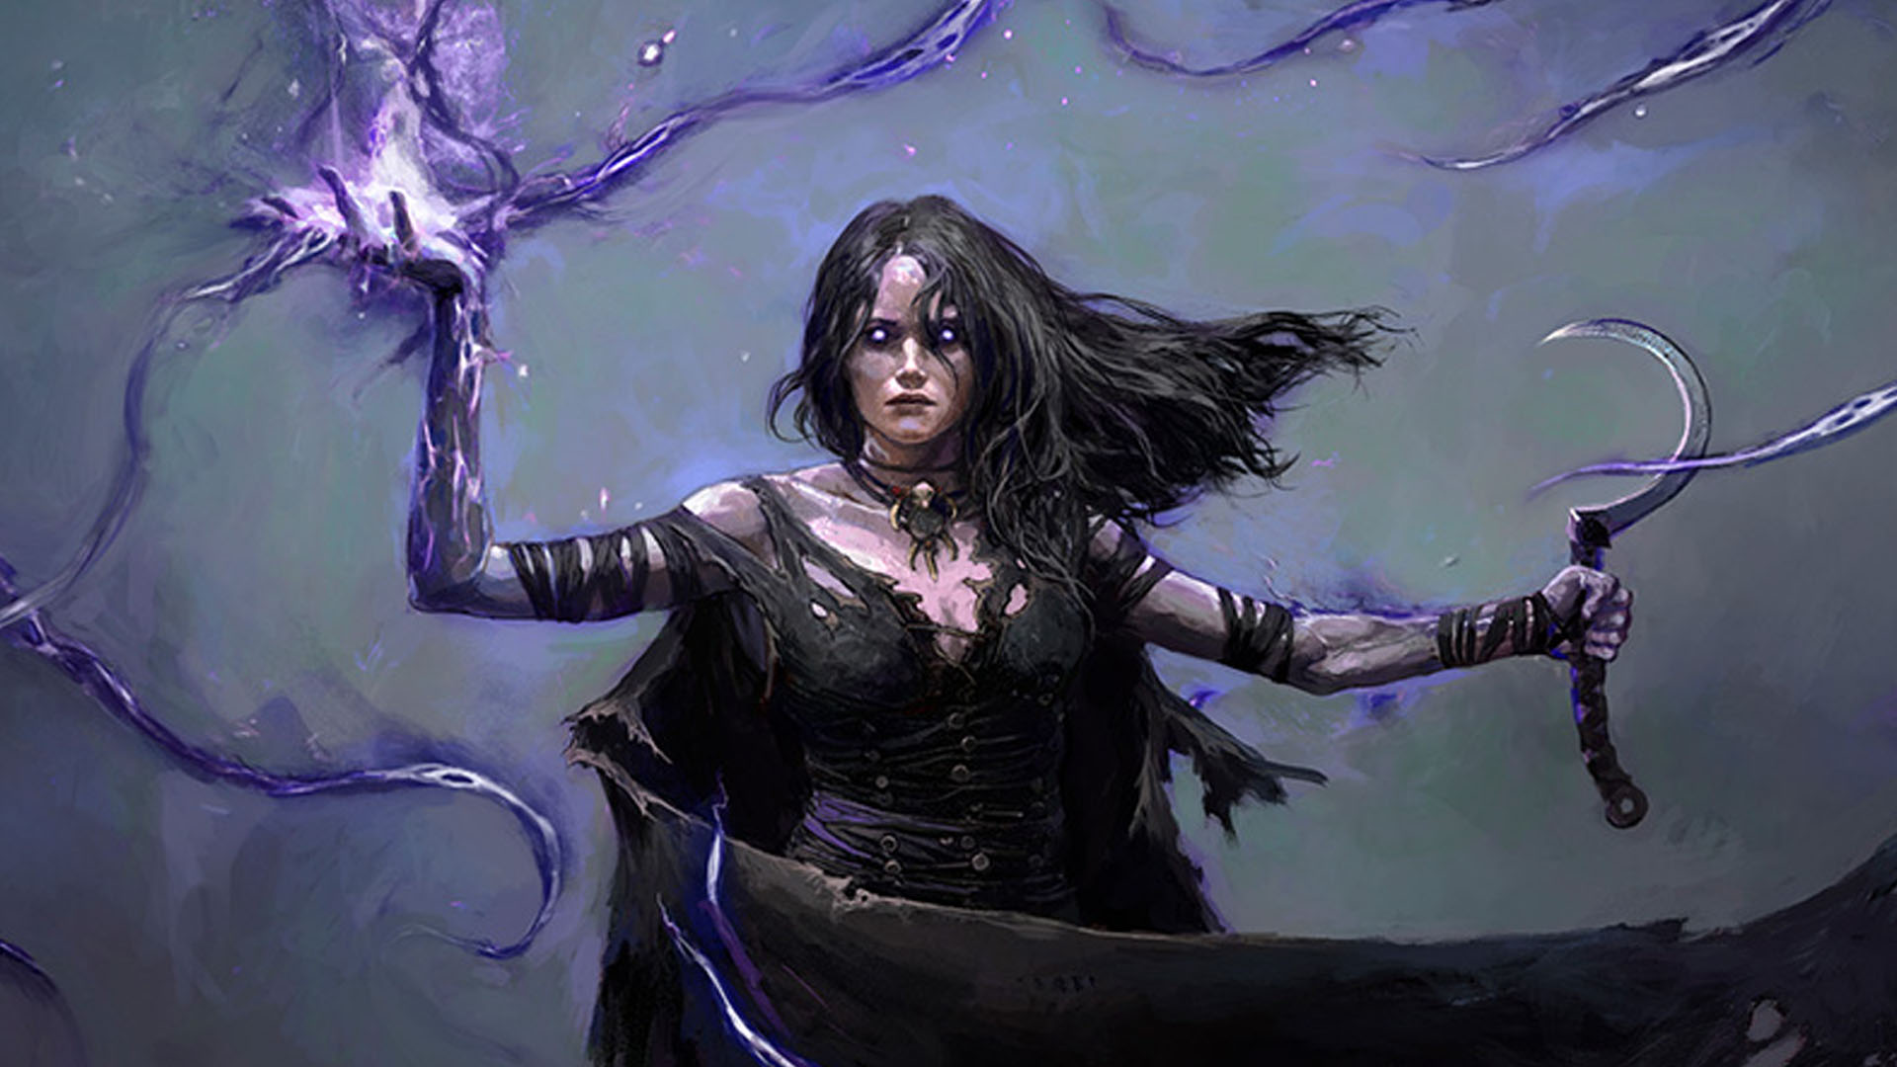
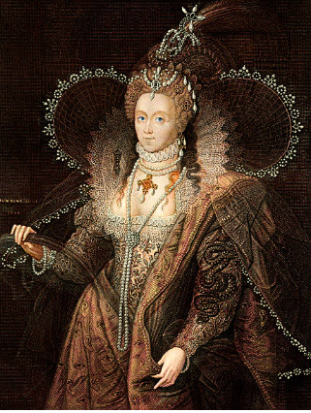
Beliefs and Superstitions in Elizabethan Society
Witches where people with supernatural powers because they made a pact with the Devil. In Shakespeare's time people believed that Witches could turn into animals some of the most common ones were cats and toads
Shakespear's people had a variety of a different beliefs and superstitions, most people where Christian
Shakespear's people believed in astrology, which is the belief that the position of the planets and stars can affect the earth.
folklore is the belief that fairy's and goblins would come out in the night and play tricks on anyone and everyone.
Religion was a very important part of life in Elizabethan times, there was a law stating that if you did not go to church, you would be fined. Shakespeare's dad got fined in 1552

Slide 15
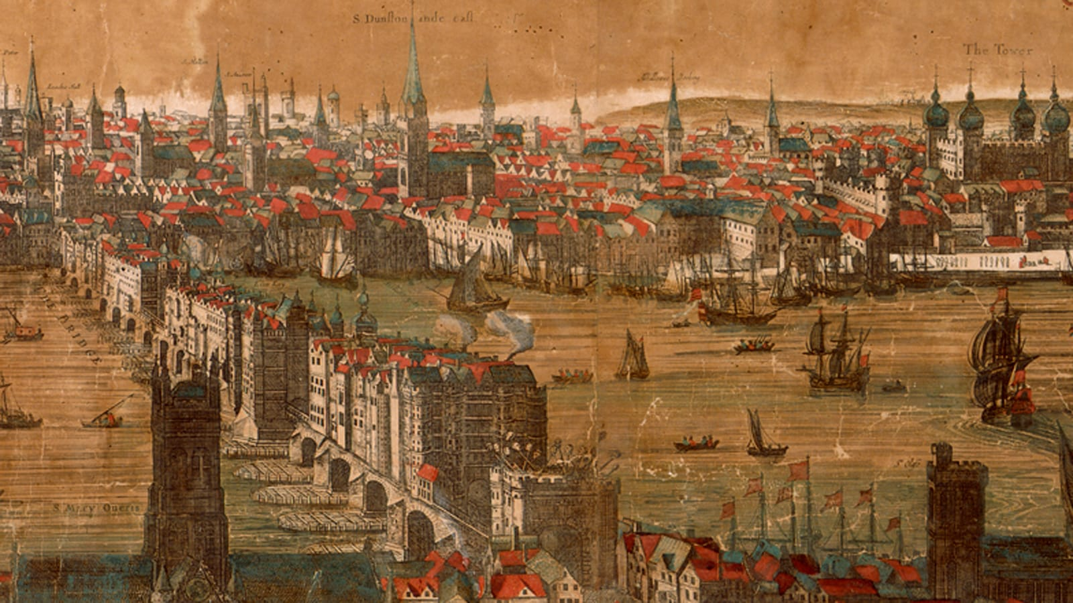
Daily Life in Elizabethan England
Back in the Elizabethan times, multiple storied houses with lots
of glass in the windows were very popular.
Because they didn't have a lot of food orchards and kitchen
gardens would help provide families with fruit and veg,
allowing them to be self-sufficient.
Wrestling and football were popular sports that appeared to
young men. They often cooled off in Thames.
Everyday William Shakespeare tried to think of plays to write and preform.
Work in the town. Middle sorb was made by the tradesmen and craftsmen who ran their own business
The poor ate bread and pottage vegetable soup thickened with oats.
They drank wine and ate fresh food like fruit and veg which came from France and Italy.

Slide 16
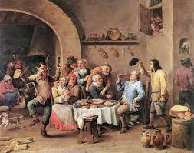
Daily Life in Elizabethan England
Food-yeomen could afford to eat well but did not have a large amount of servants. They would eat meat such as beef, pork, mutton and bread
The queen was a very high monarch. She controlled how much money you had and what your life would be like.
The barbers cut peoples hair but also had the jobs like a dentist and some would blood let.
In the daily life peoples jobs were to make bread which a lot of people ate.
Mint ,sage were used as medication a lot in the Elizabethan
The poor didn't get a chance to get employed if some got lucky enough they would get jobs such as
-Cotter-Hearding pigs
-Gong farmer-Collecting human waste.
If the poor were not lucky enough to get a job they would
have to beg on the streets instead, but lot of other families
there to so they wouldn’t always get money.

Slide 17
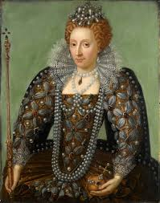
Daily Life in Elizabethan England
The rich wouldn’t have to have a job because they were born into rich families.
The middle class would have jobs like:
-Apothecary- Sold herbs and was a pharmacist
-Baker-Made bread
-Black smith-Repaired weapons
-Bower-made bow and arrows
-Carpenter built furniture
-Physician-Docters for the rich.
-Surgeon and barber-Pulled people's teeth and blood let.
-Wise woman-"Witches" that helped the poor.
-House wife-Would treat minor

