Slide 1

Dyslexia

Slide 2
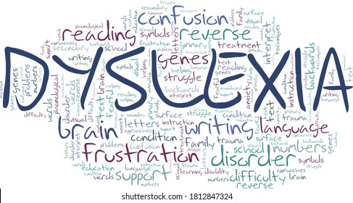
INFORMATION
https://spark.adobe.com/video/IRV8RMRV9Plds

Slide 3

Reading
People with dyslexia struggle to read, because the words can get jumbled up and confused.

Slide 4

How we can support you!
Give them extra support with schoolwork.

Slide 5

How can we make them feel welcome?
We can make them feel welcome by not reading in front of them and try and make friends with them.

Slide 6

Websites
https://www.bbc.co.uk/bitesize/articles/z6mts4j
https://kids.kiddle.co/Dyslexia
https://www.nessy.com/uk/product/nessy-reading-spelling/
https://childmind.org/article/understanding-dyslexia/
Here are some websites about dyslexia.

Slide 7

What is Dyslexia
Dyslexia is a common learning difficulty that can cause problems with reading, writing and spelling!

Slide 8

Bye Bye

