Slide 1



D.C.D
If you have D.C.D and you're going to Cila don't worry!

Slide 2



How we can support you
We can let you use a chrome book if you need to do long pieces of writing

Slide 3


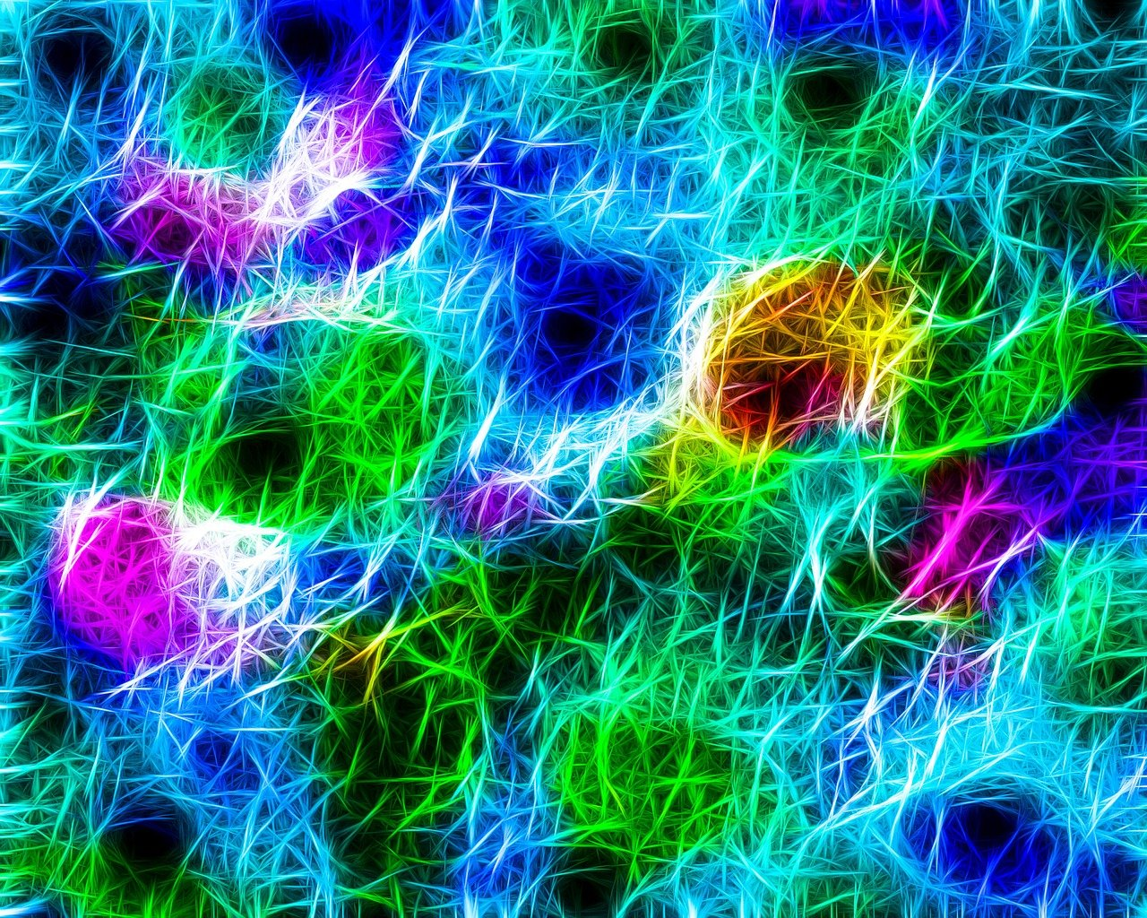
What is D.C.D?
DCD means that your brain is 'wired up' differently. It is a very clever brain that somehow has got 'mixed up' and that means that things to do with moving, learning and perhaps speaking too are harder for you.

Slide 4
How to make them feel welcome
What to do
What not to do
Encourage them
Say there doing very well
Help them
Work with them when they need help
Don't say things like why are taking forever with that writing and why is your handwriting so bad, and why are you using a slope.

Slide 5



Helpful websites
https://www.nhs.uk/conditions/developmental-coordination-disorder-dyspraxia/
https://canchild.ca/en/resources/112-children-with-dcd-at-home-at-school-and-in-the-community-booklet

Slide 6






BYE!!!

