Slide 1
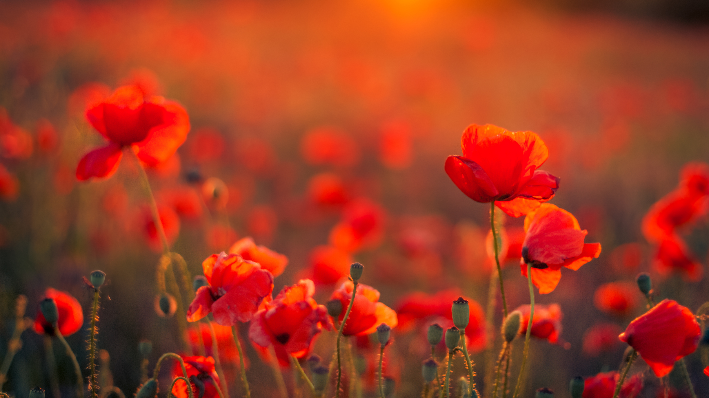
World Remembrance day
By Nia Jones

Slide 2



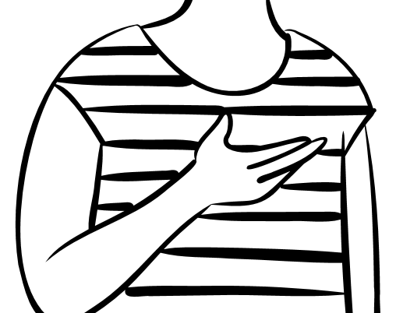
What is world remembrance day ?
I still don’t
Know what
It is.
World remembrance day is when remember all the people who fought for our lives during war.

Slide 3
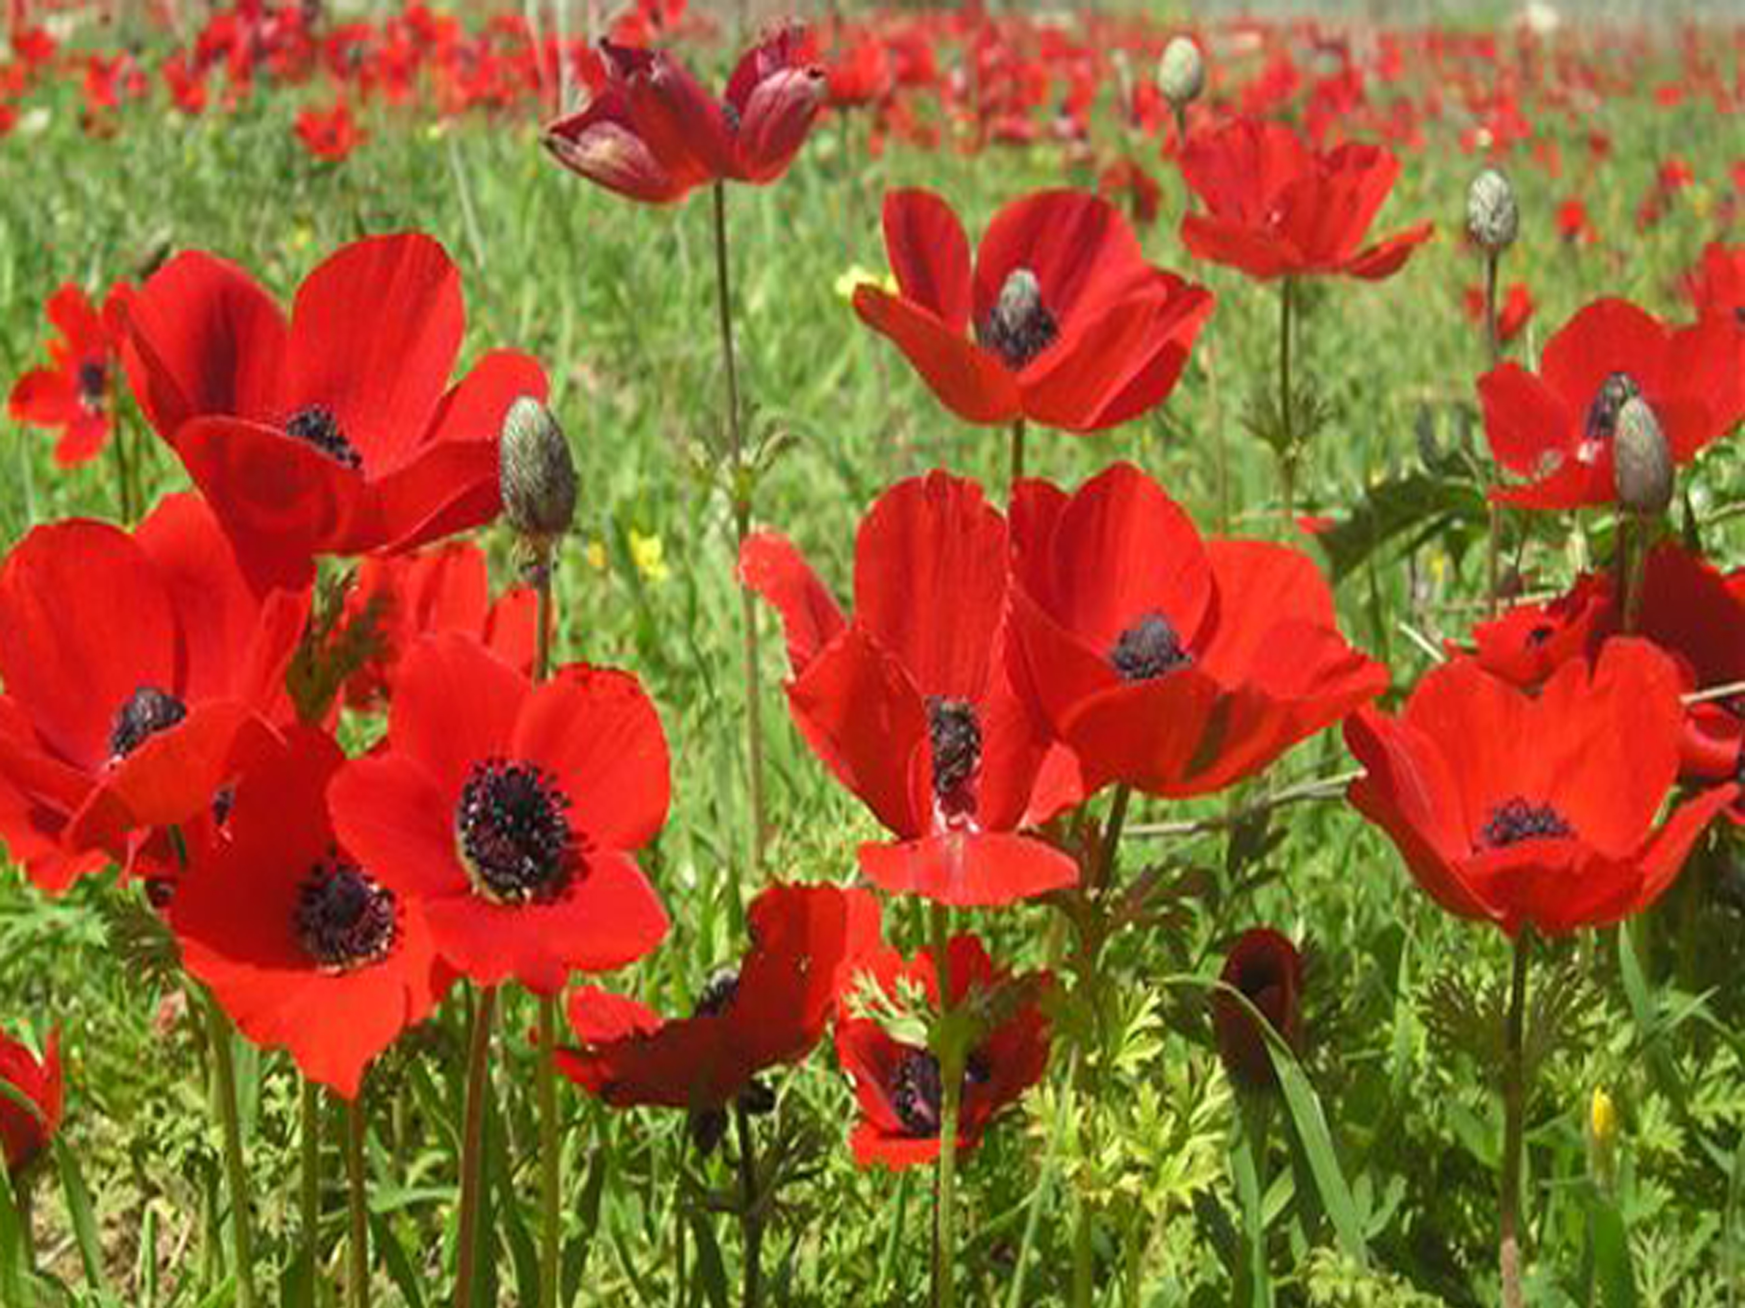
Why poppies are a symbol of remembrance
Poppys are a symbol of remembrance because at the end of world war 1 ,they were the only flowers that grew on the battlefields.

Slide 4
When is remembrance day ?
Remembrance is on the 11th day of the 11th month at 11am.

Slide 5
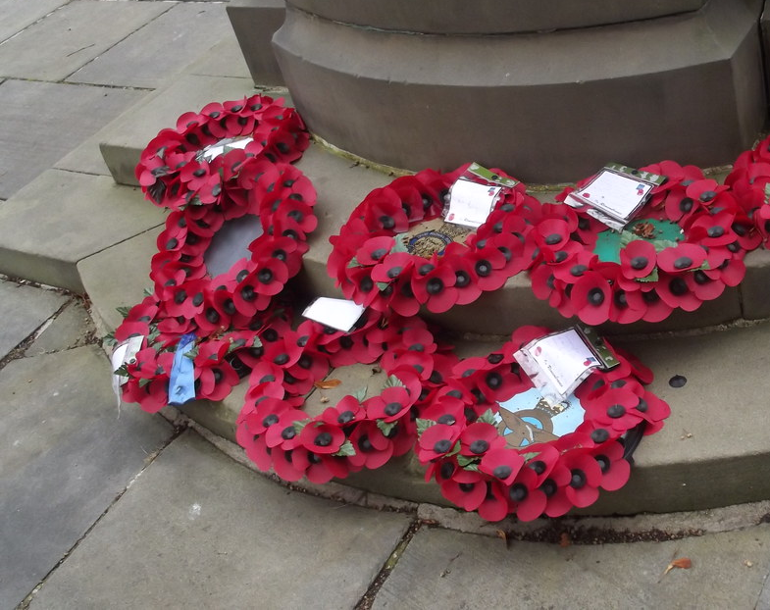
What do we do to celebrate remembrance day ?
We have 2 minutes of silence at 11am , we put poppy wreathes on people's graves and so much more.

Slide 6
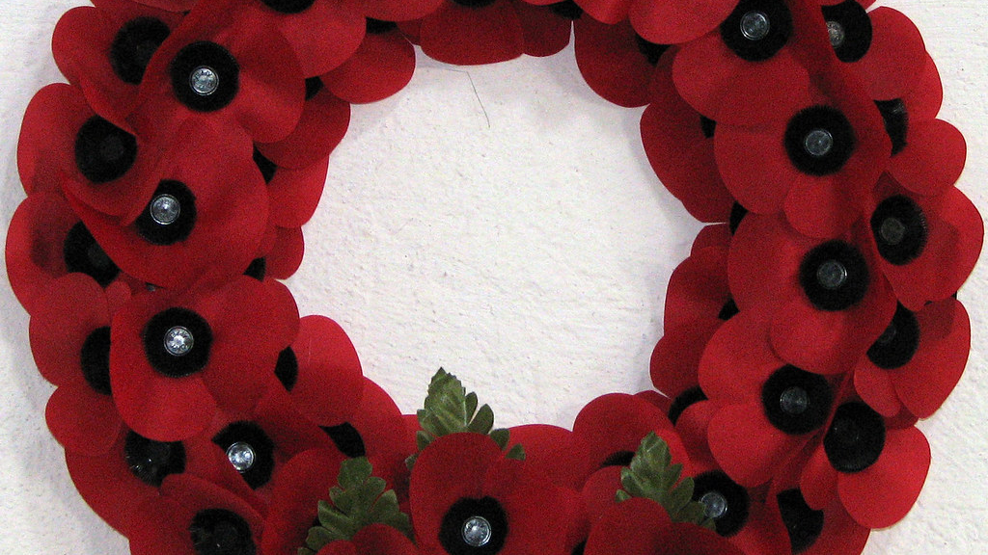
For a Remembrance day craft Insert this link into your typing bar .
https://ohcreativeday.com/diy-poppy-remembrance-wreath/

