Slide 1
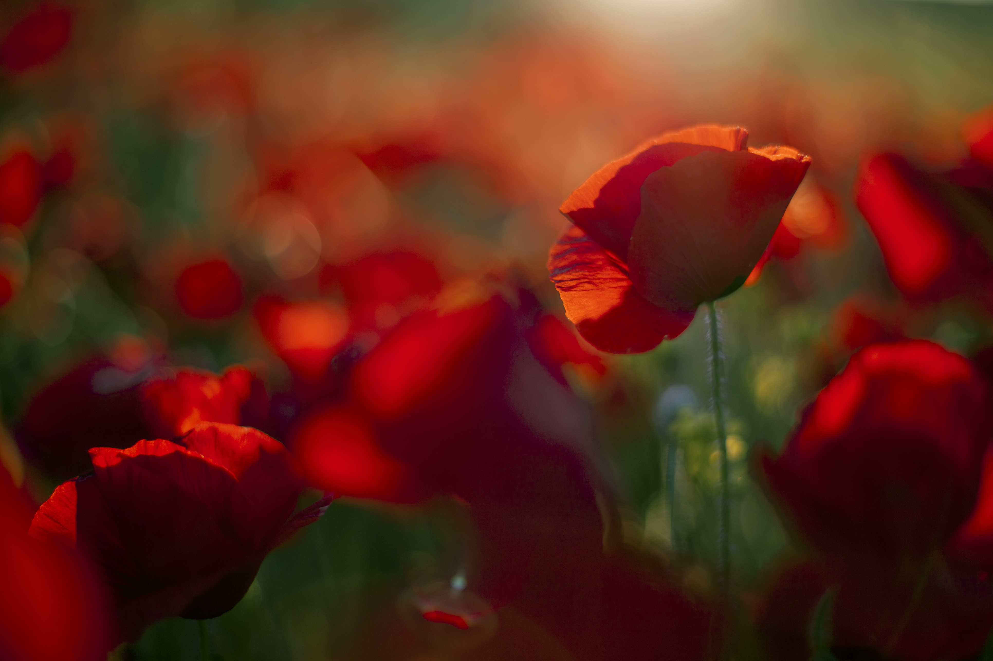
Remembrance day
By deacon

Slide 2
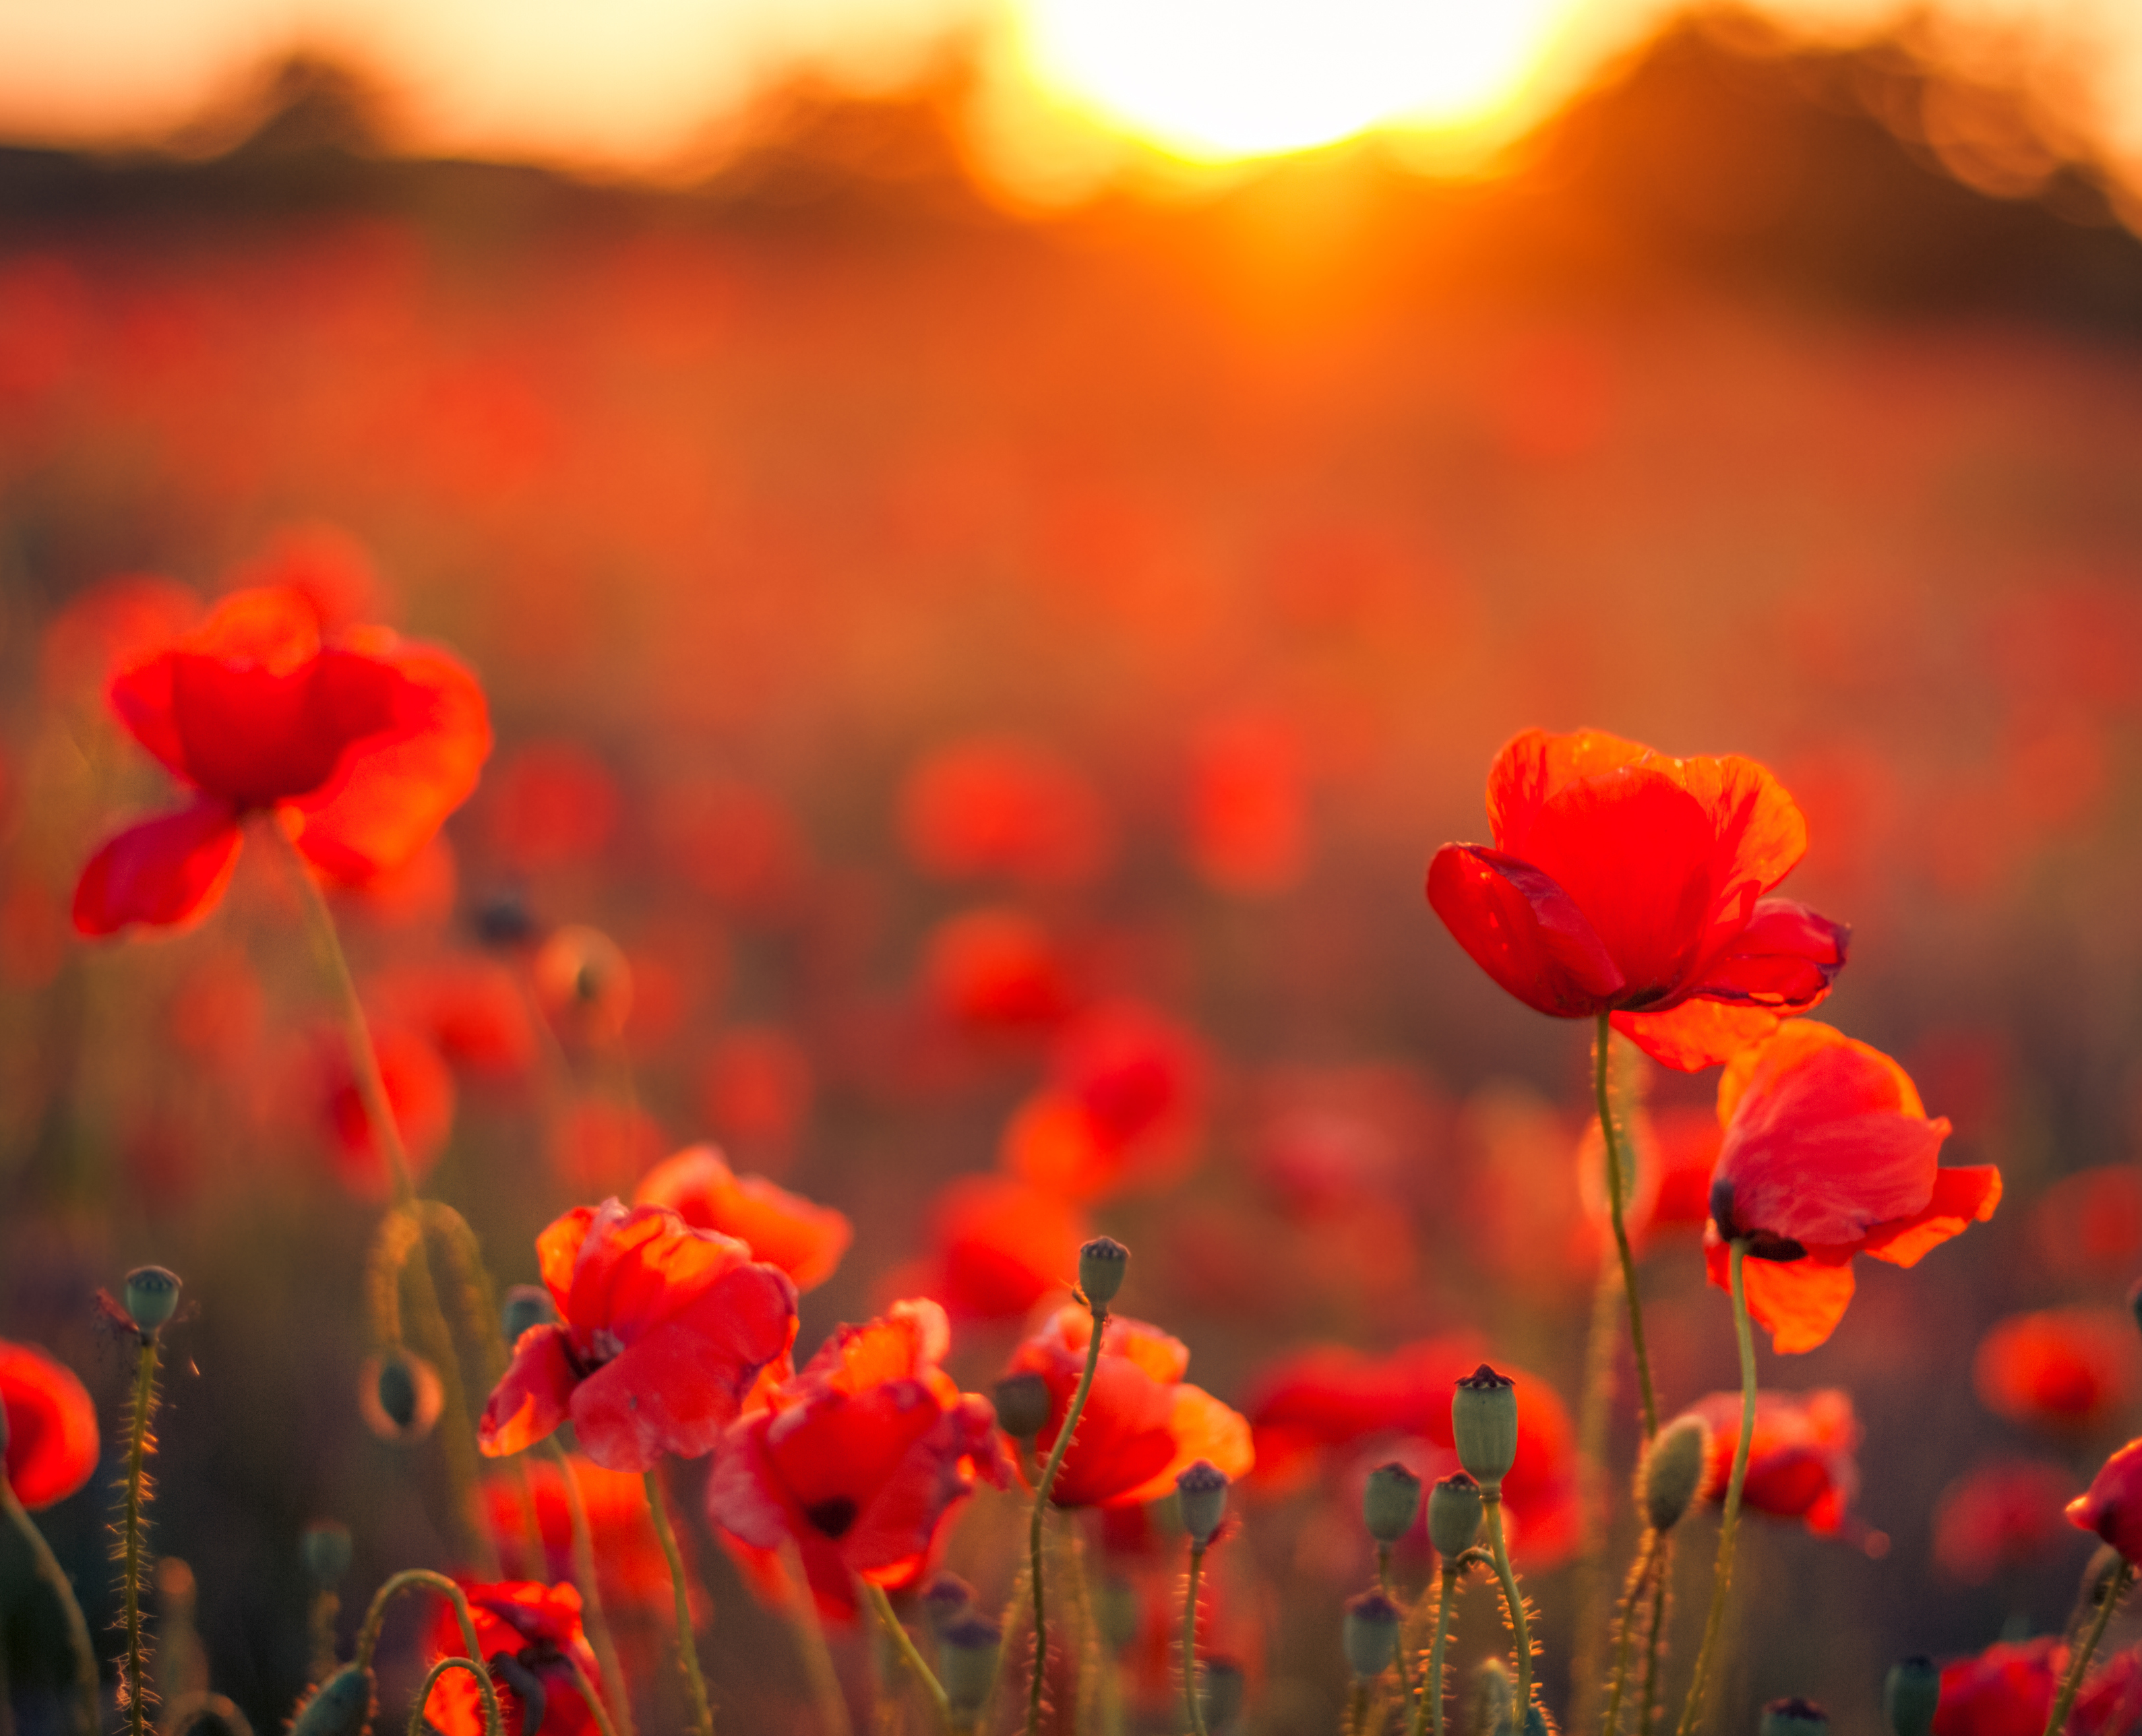
Why do when have remembrance day?
Remembrance day was origianally created after ww1 to remember the fallen soilder of ww1, their families and support servicemen injured as a result of warface.

Slide 3
When did remembrance start?
Remembrance day starter after world war one at 11.00pm on Sunday November 1919.

Slide 4
What is remembrance day?
Remembrance day is when ever one has two minutes of silet.

Slide 5
THE END by deacon

