Slide 1



Language week – worldwide welcomes
Mr. Rees’s Assembly – 03.03.25

Slide 2
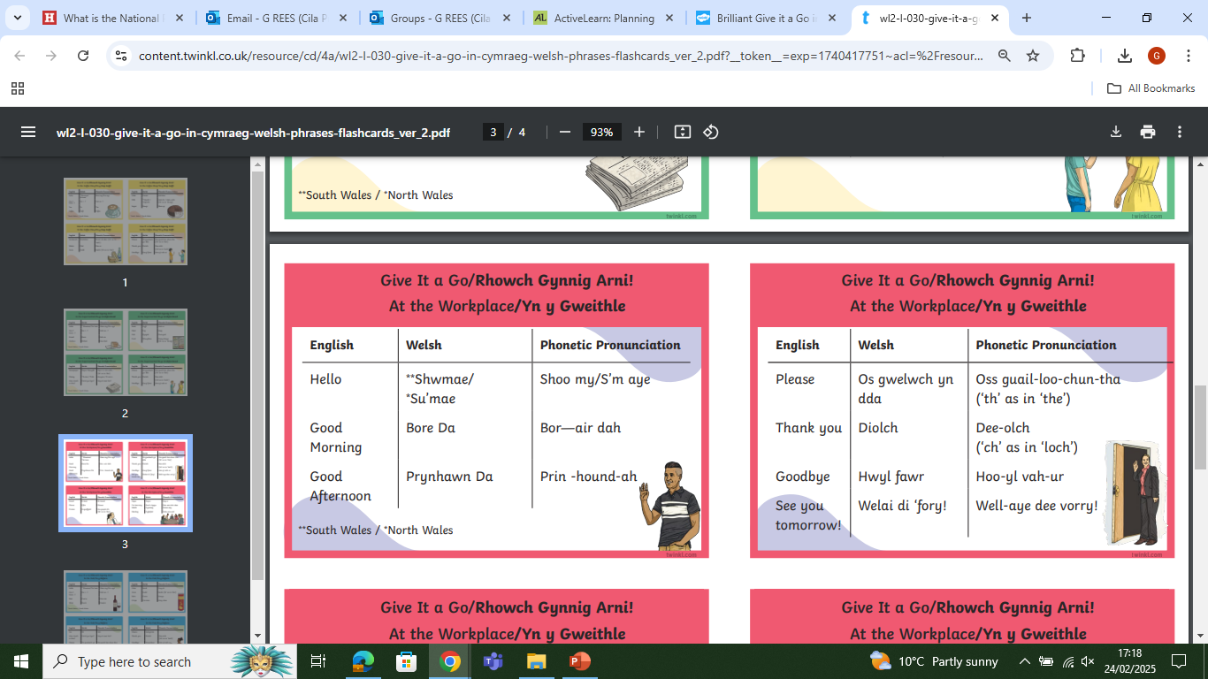

Slide 3


Slide 4
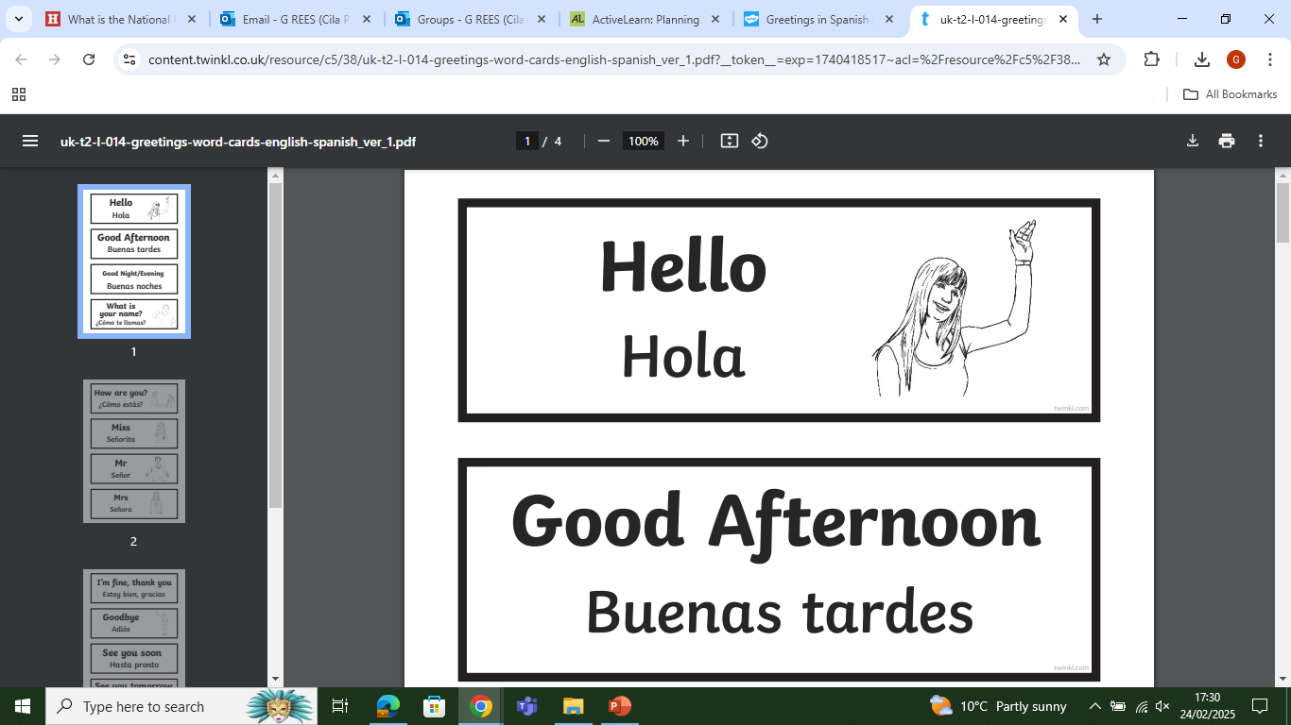

Slide 5
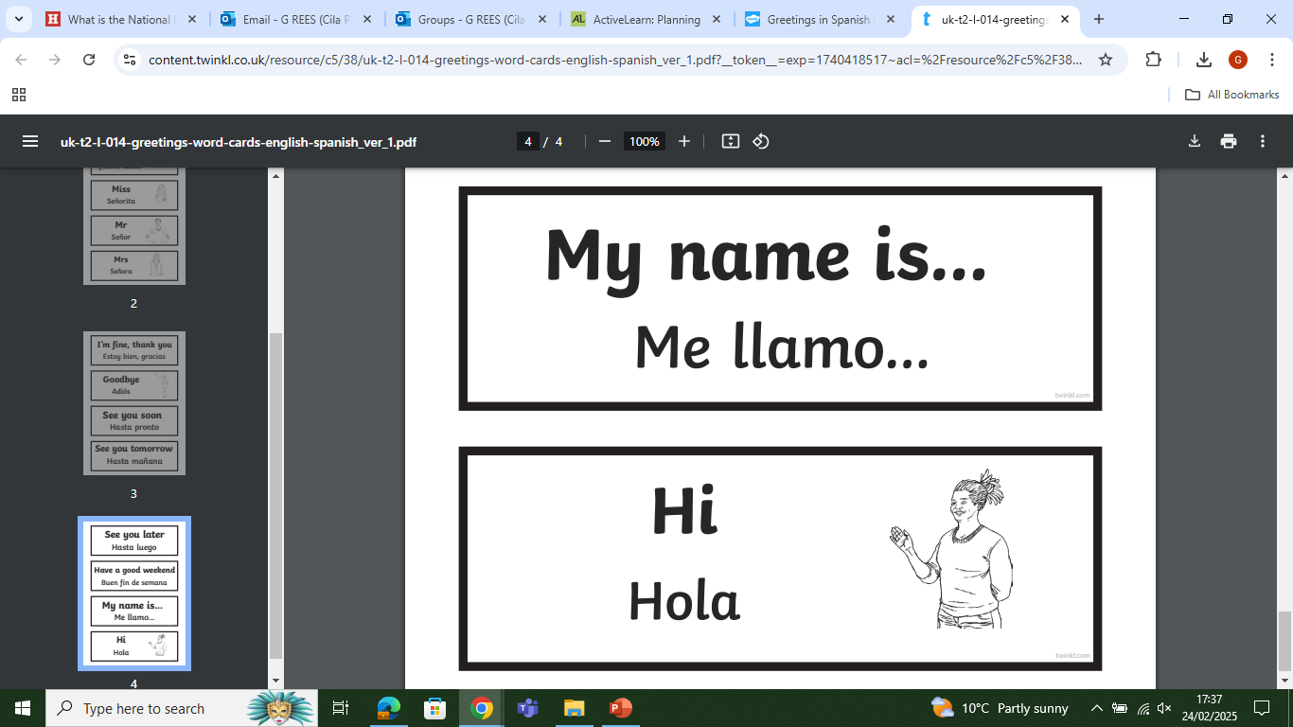

Slide 6
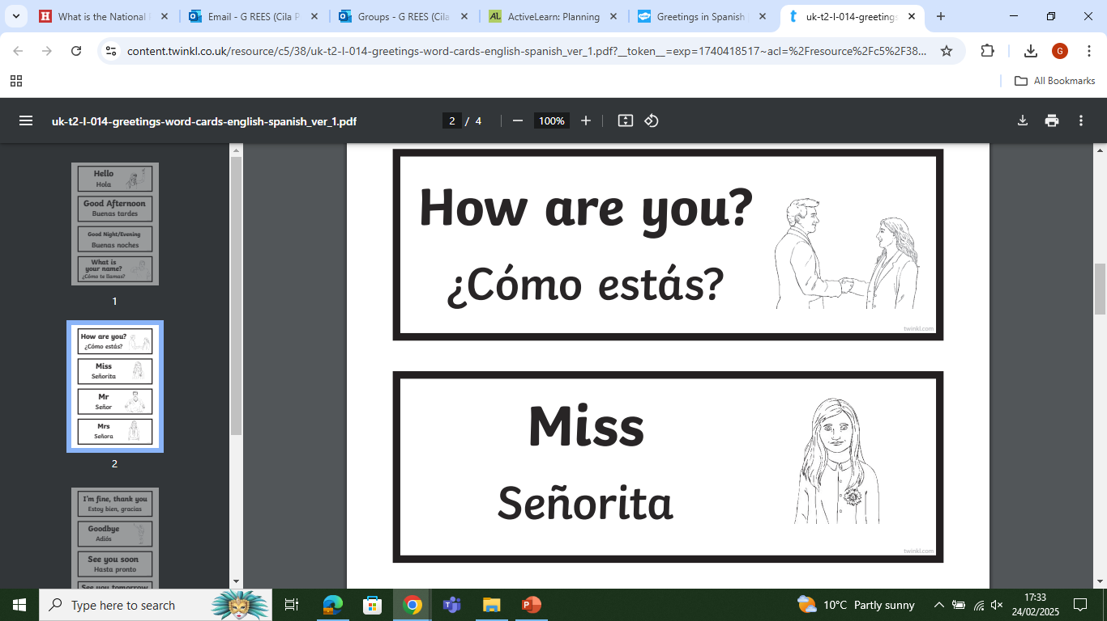
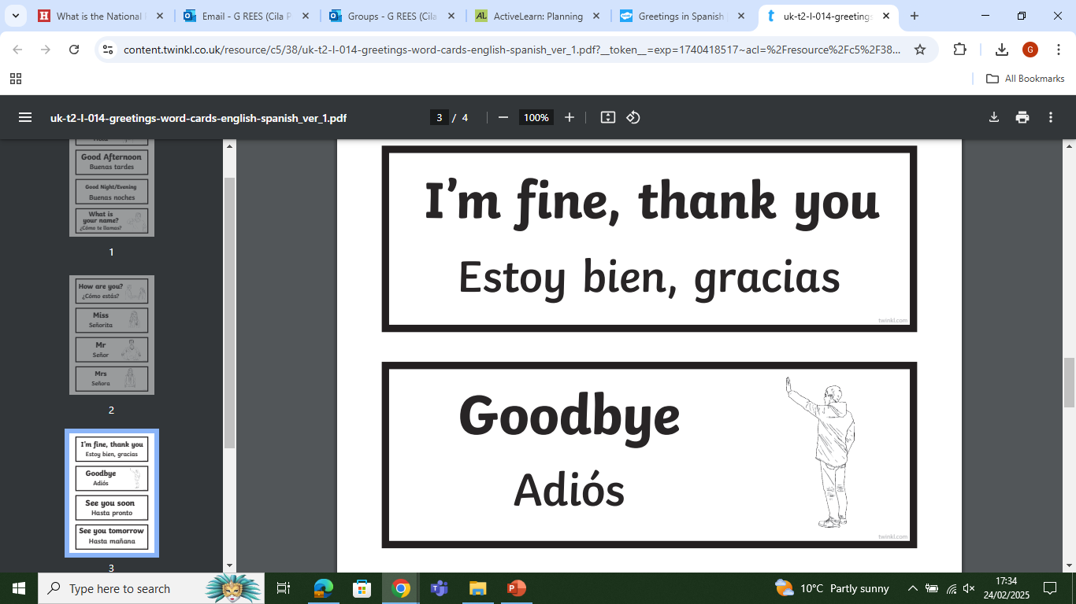

Slide 7


