Slide 1
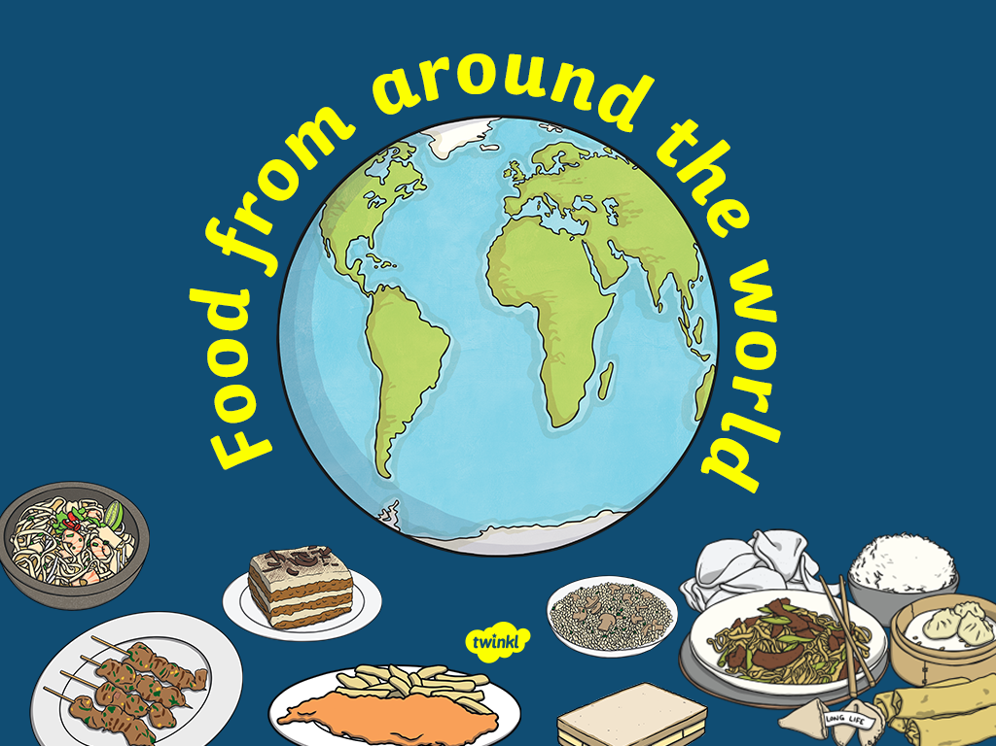

Slide 2

China

Slide 3
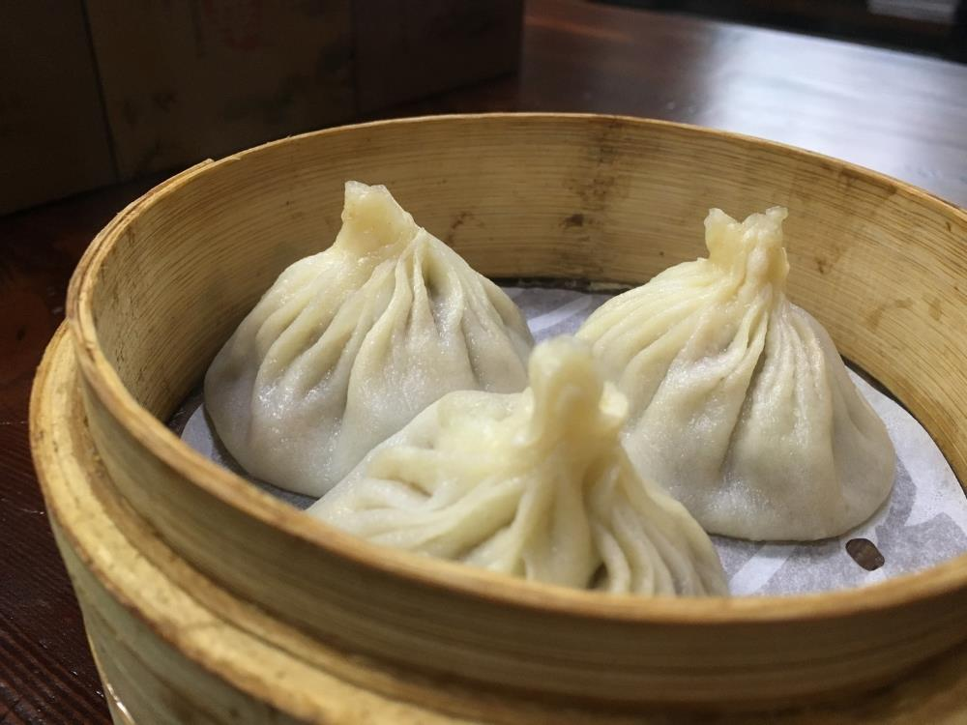
Dumplings

Slide 4
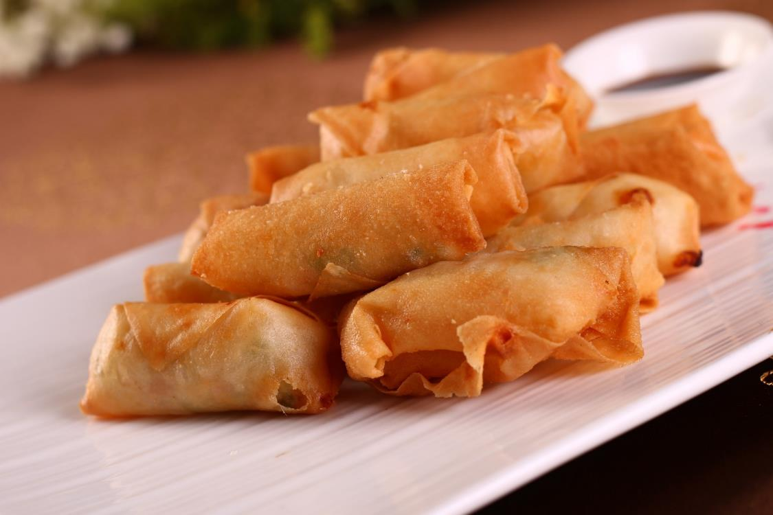
Spring Rolls

Slide 5
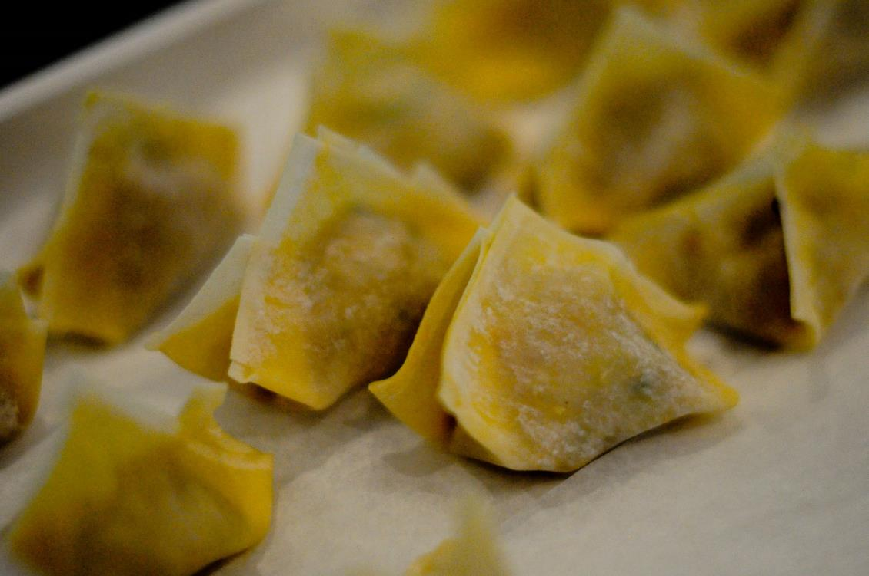
Wontons
Photo courtesy of Natasha d (@flickr.com) - granted under creative commons licence - attribution

Slide 6
Ethiopia

Slide 7
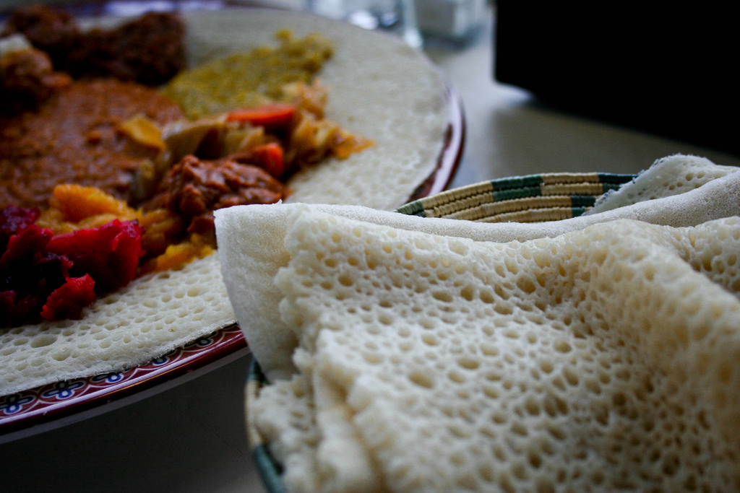
Injera
Photo courtesy of aaaaavry (@flickr.com) - granted under creative commons licence - attribution

Slide 8
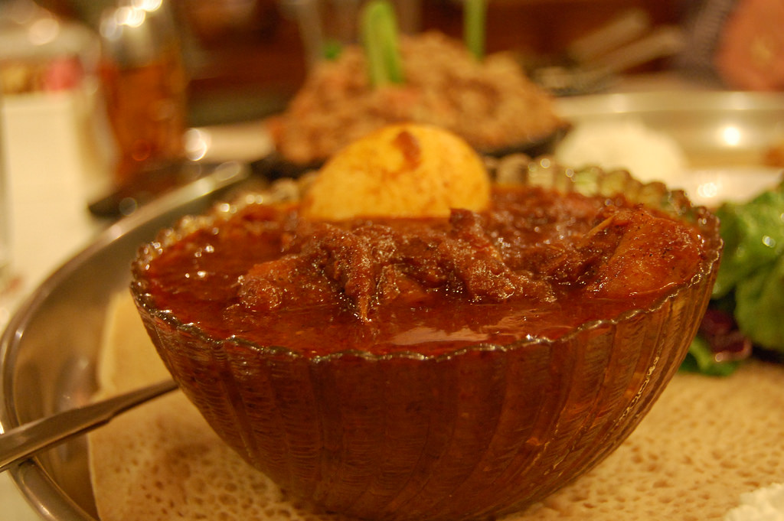
Wat
Photo courtesy of stu_spivack (@flickr.com) - granted under creative commons licence - attribution

Slide 9
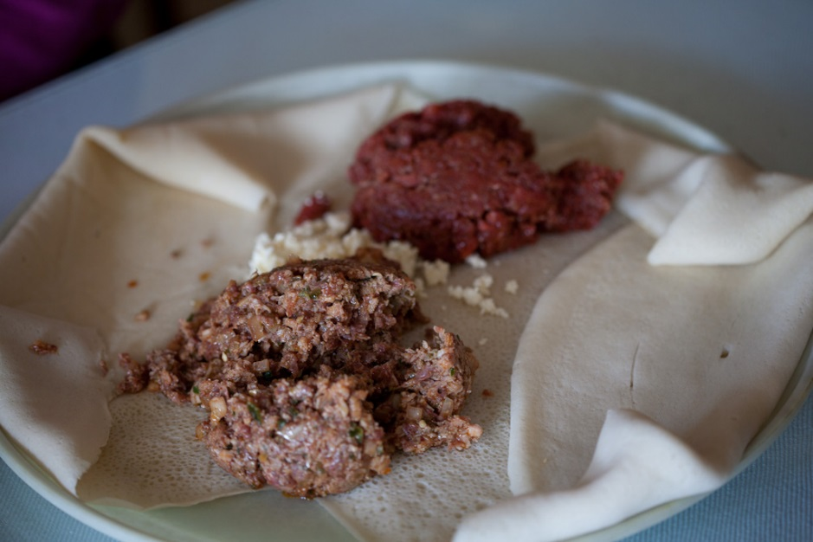
Kitfo
Photo courtesy of Charles Haynes (@flickr.com) - granted under creative commons licence - attribution

Slide 10
Fiji

Slide 11
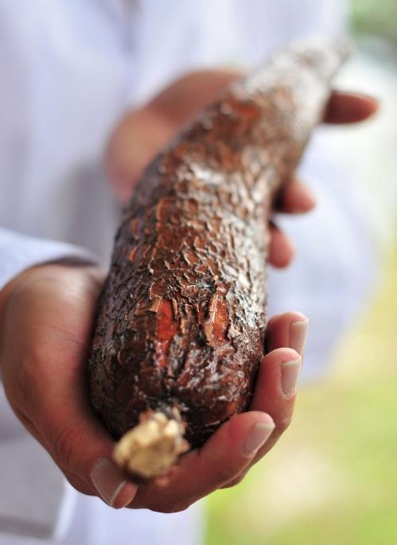
Cassava
Photo courtesy of CIAT International Center for Tropical Agriculture (@flickr.com) - granted under creative commons licence - attribution

Slide 12
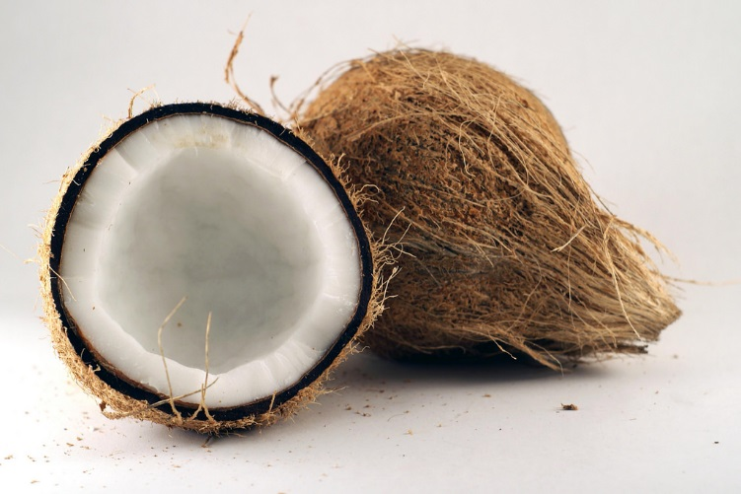
Coconut
Photo courtesy of YIM Hafiz (@flickr.com) - granted under creative commons licence - attribution

Slide 13
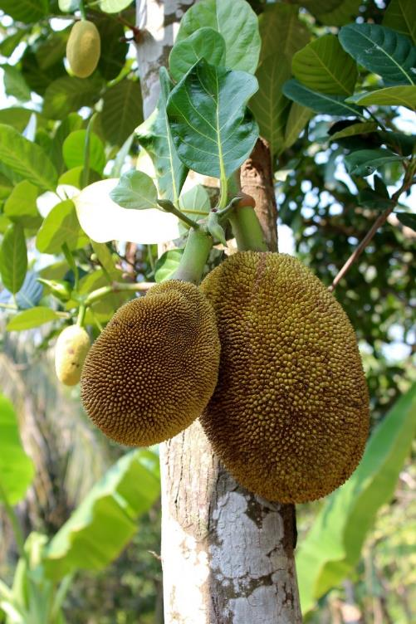
Breadfruit

Slide 14
France

Slide 15
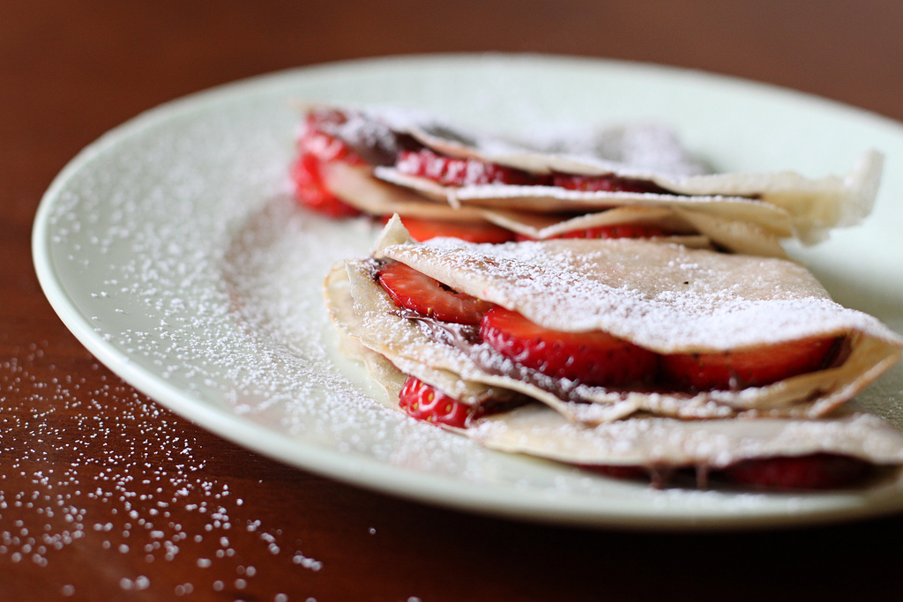
Crepes
Photo courtesy of Vanilla and lace (@flickr.com) - granted under creative commons licence - attribution

Slide 16
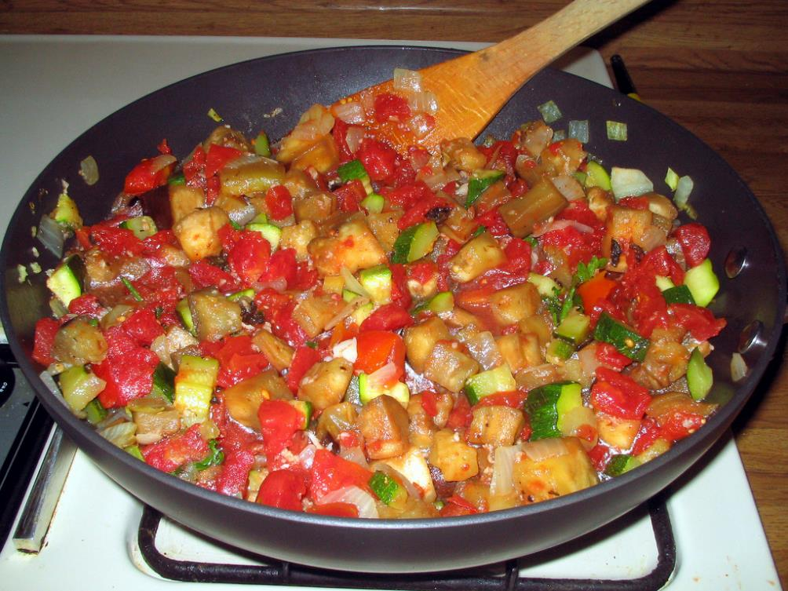
Ratatouille
Photo courtesy of karenandbrademerson (@flickr.com) - granted under creative commons licence - attribution

Slide 17
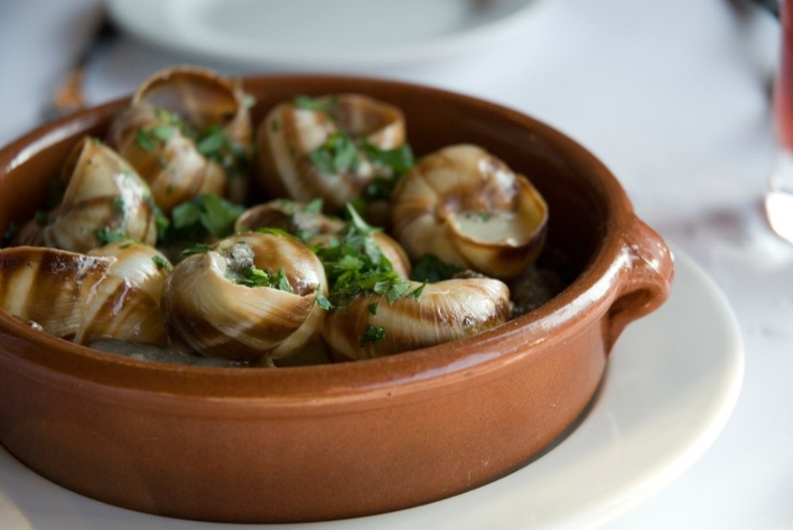
Escargot
Photo courtesy of oliver.dodd (@flickr.com) - granted under creative commons licence - attribution

Slide 18
Germany

Slide 19
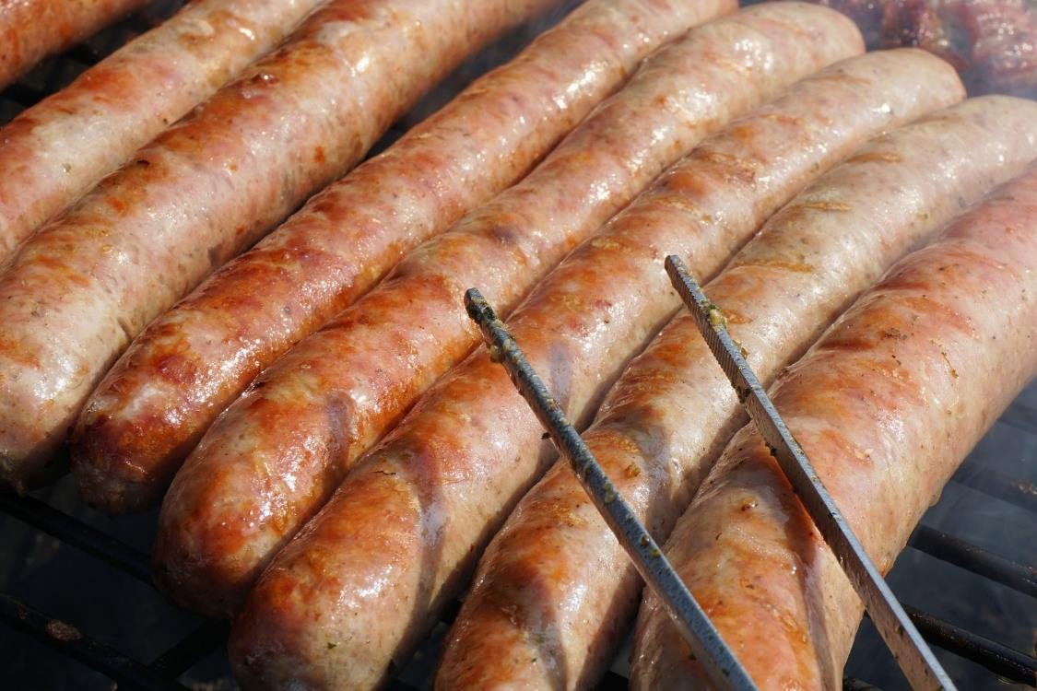
Bratwurst

Slide 20
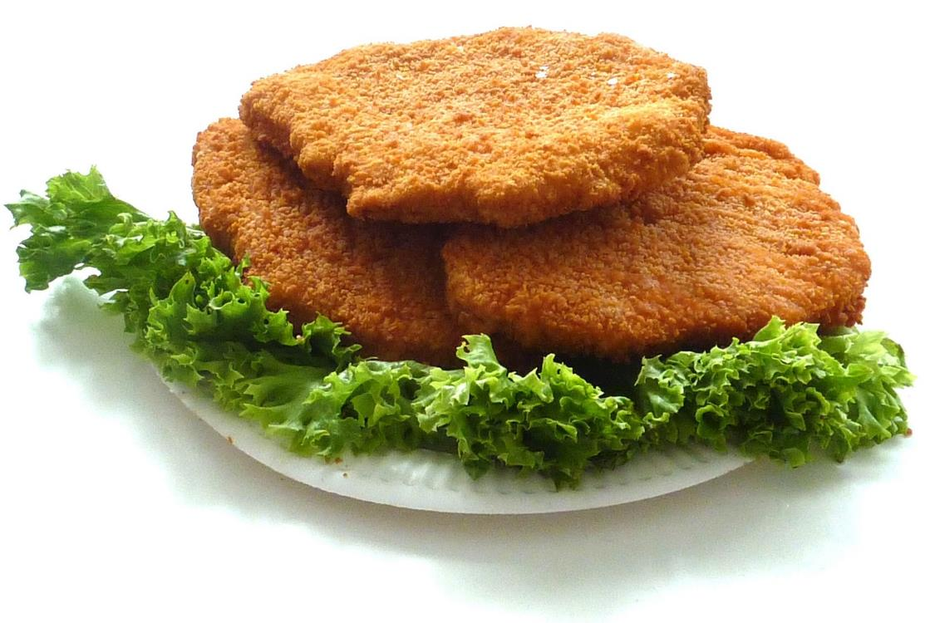
Schnitzel

Slide 21
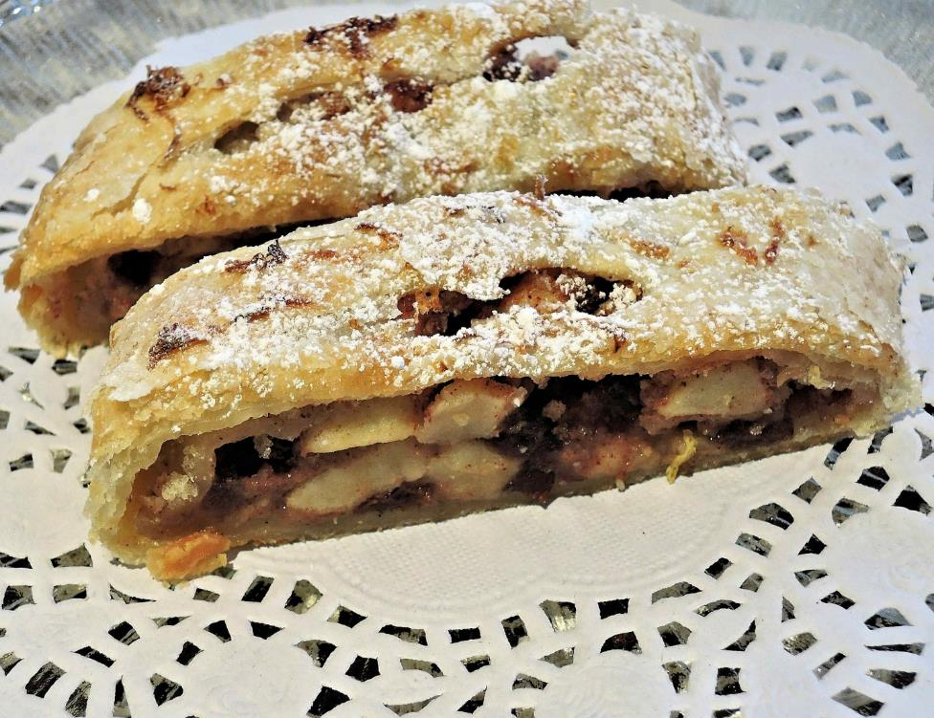
Strudel

Slide 22
India

Slide 23
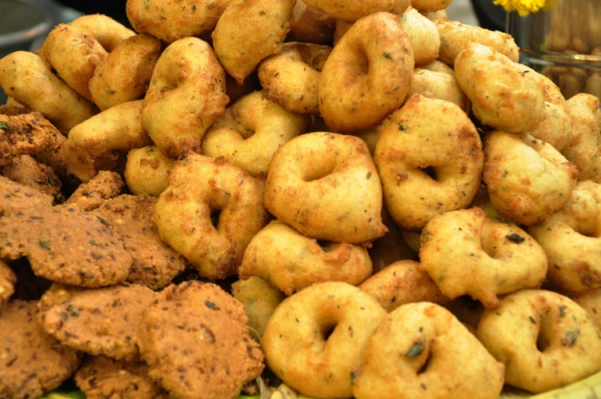
Vada
Photo courtesy of I for Detail (@flickr.com) - granted under creative commons licence - attribution

Slide 24
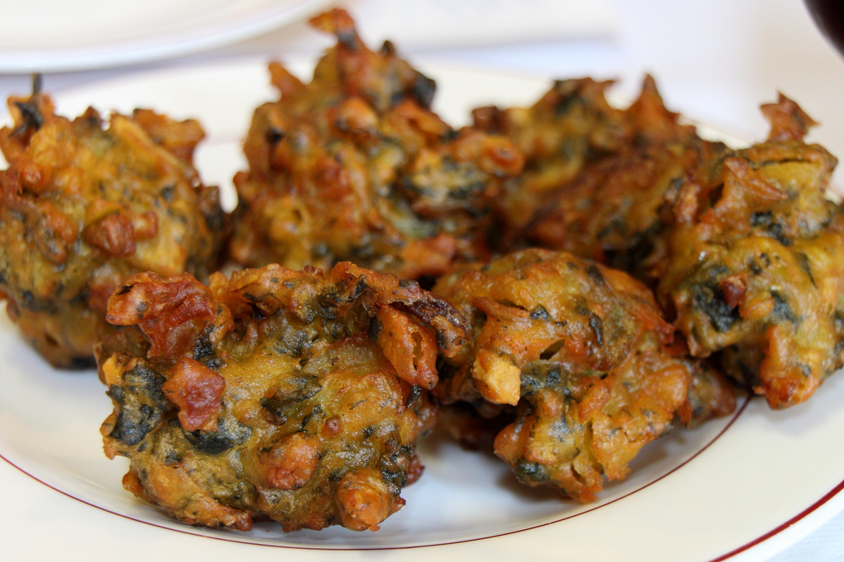
Pakora
Photo courtesy of Mr.TinDC (@flickr.com) - granted under creative commons licence - attribution

Slide 25
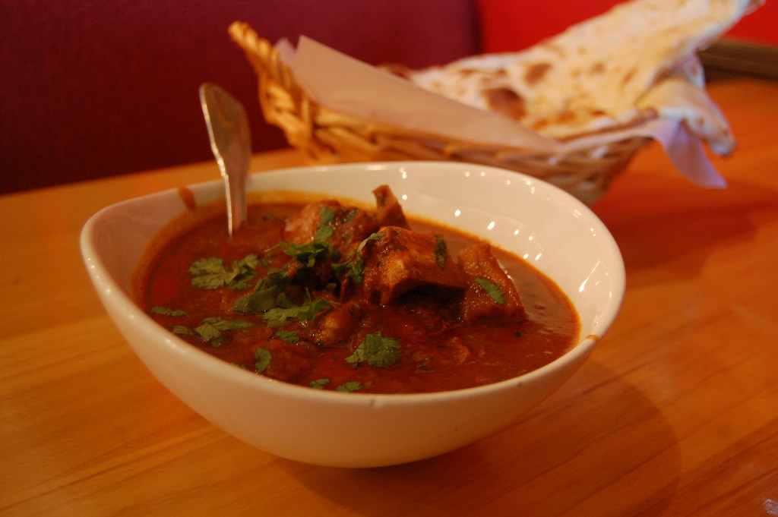
Rogan Josh
Photo courtesy of stu_spivack (@flickr.com) - granted under creative commons licence - attribution

Slide 26
Iran

Slide 27
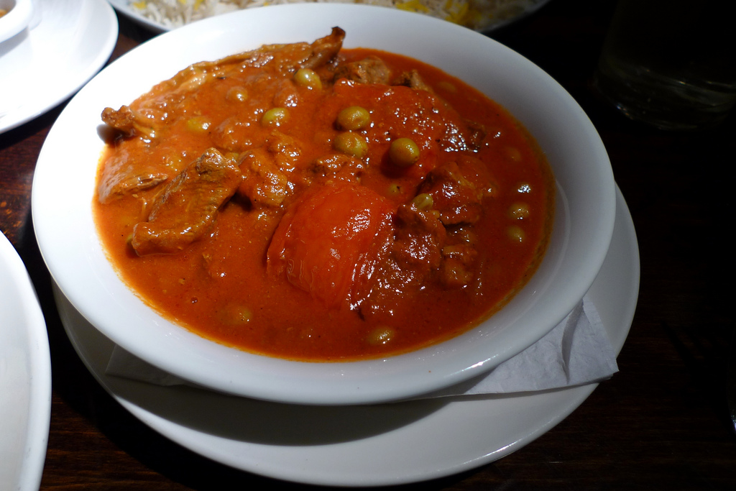
Khoresh
Photo courtesy of Ewan-M (@flickr.com) - granted under creative commons licence - attribution

Slide 28
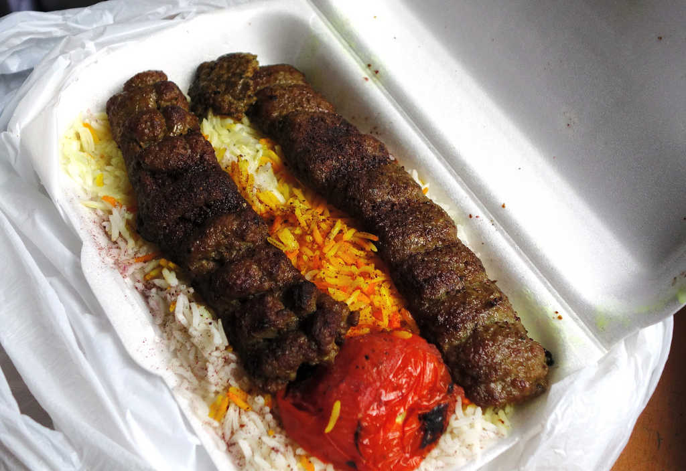
Chelow Kabab
Photo courtesy of bellaphon (@flickr.com) - granted under creative commons licence - attribution

Slide 29
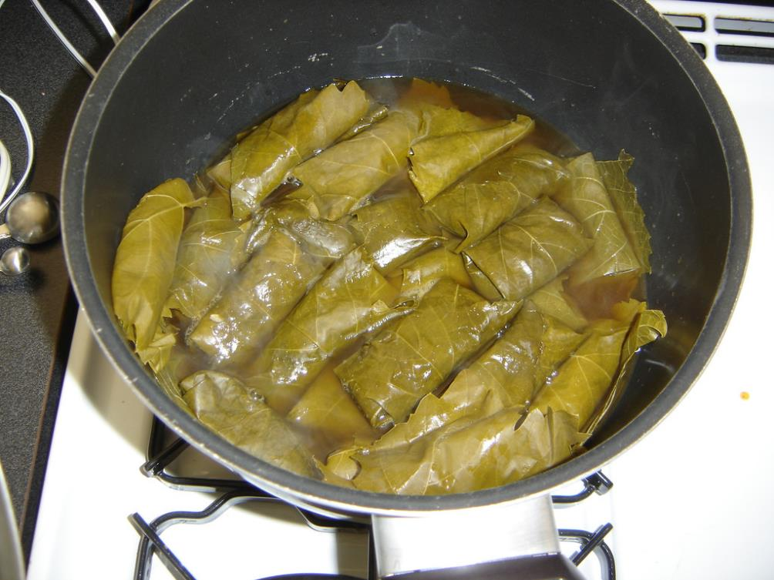
Dolma
Photo courtesy of notphilatall (@flickr.com) - granted under creative commons licence - attribution

Slide 30
Italy

Slide 31
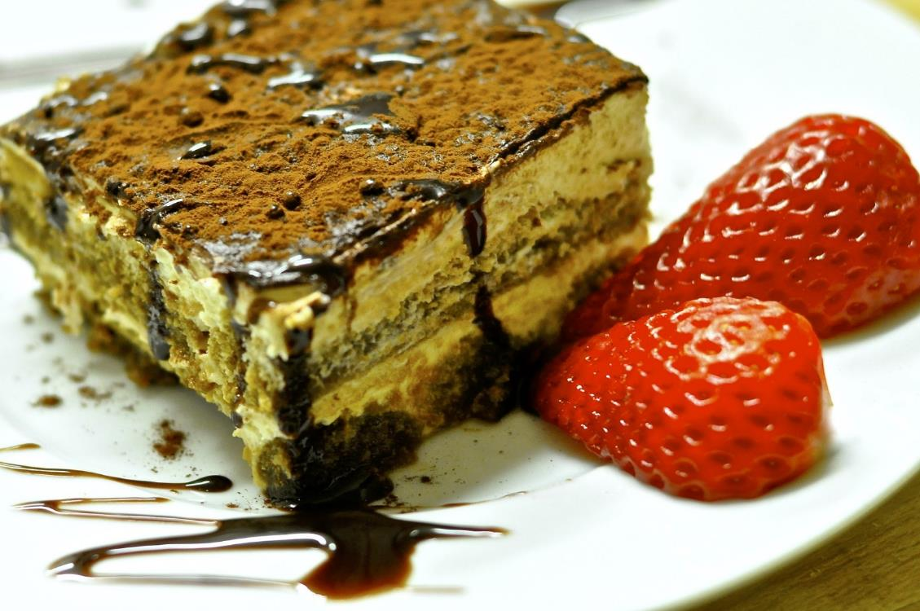
Tiramisu

Slide 32
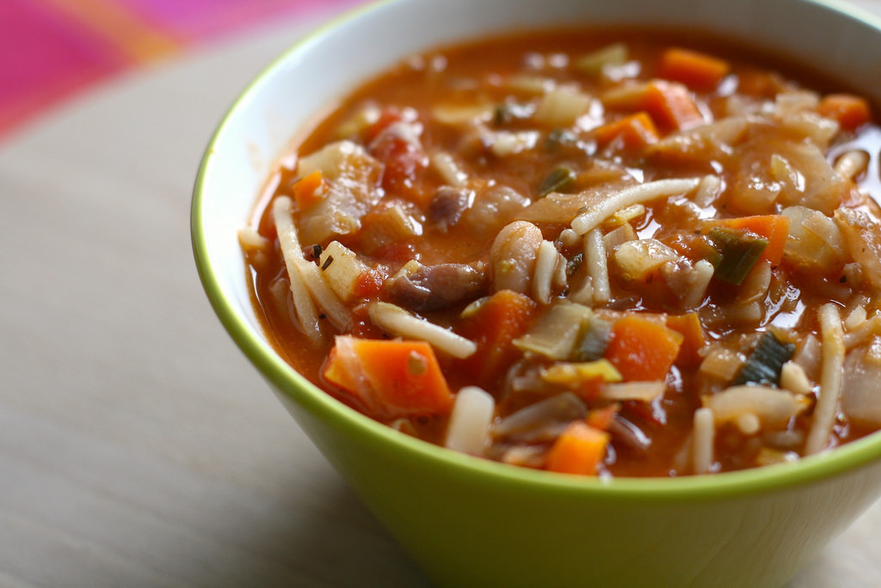
Minestrone Soup
Photo courtesy of Katrin Gilger (@flickr.com) - granted under creative commons licence - attribution

Slide 33
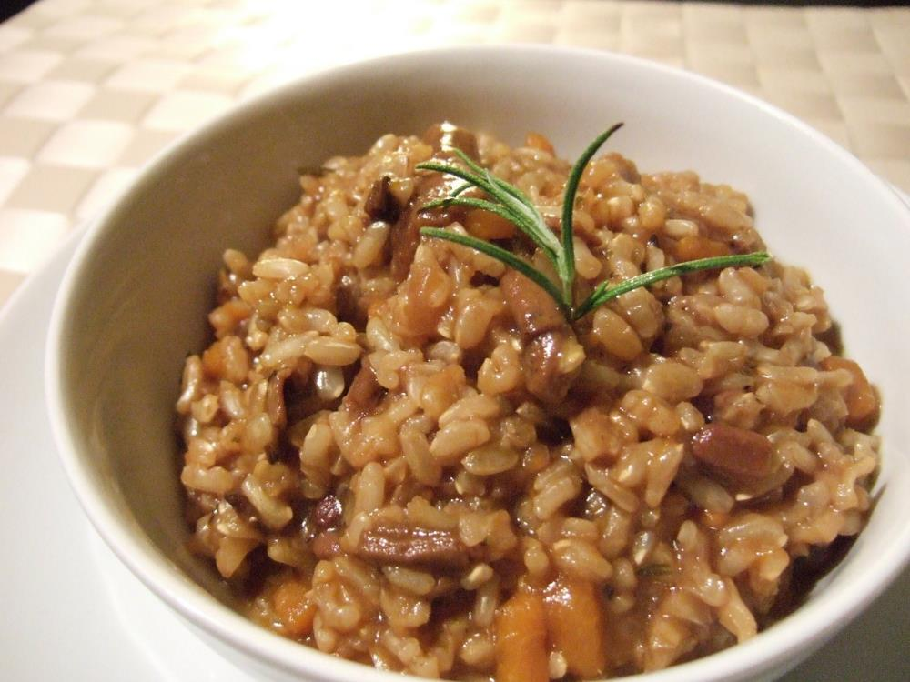
Risotto

Slide 34
Japan

Slide 35
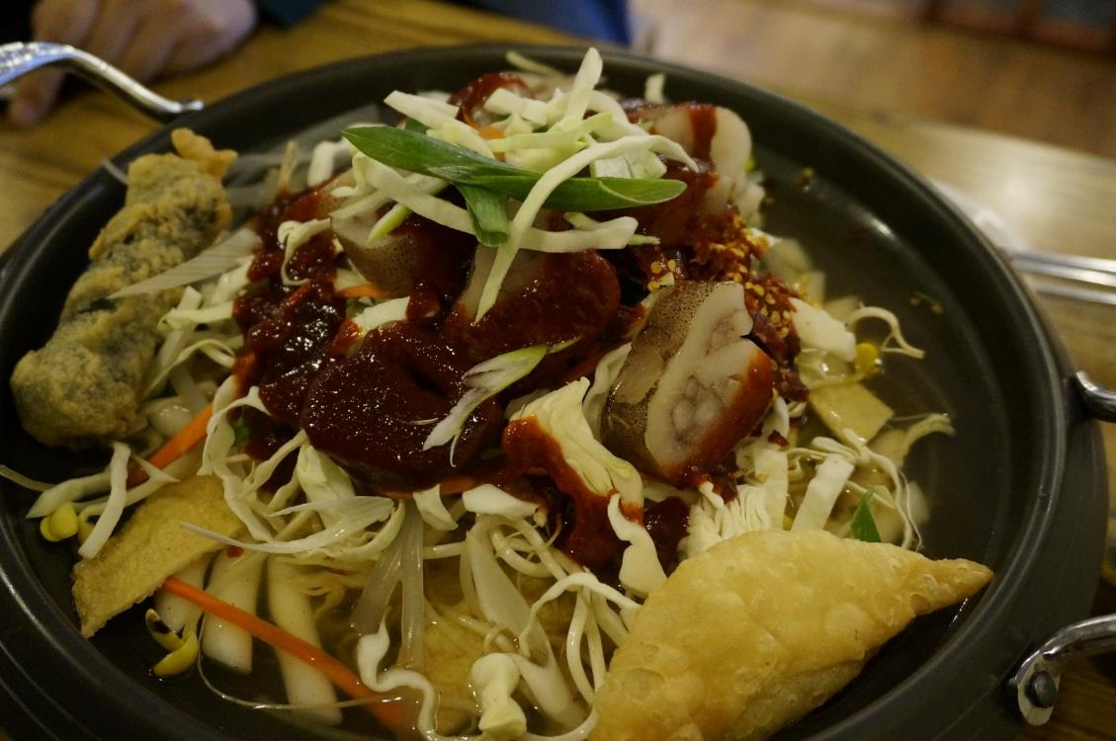
Sukiyaki

Slide 36
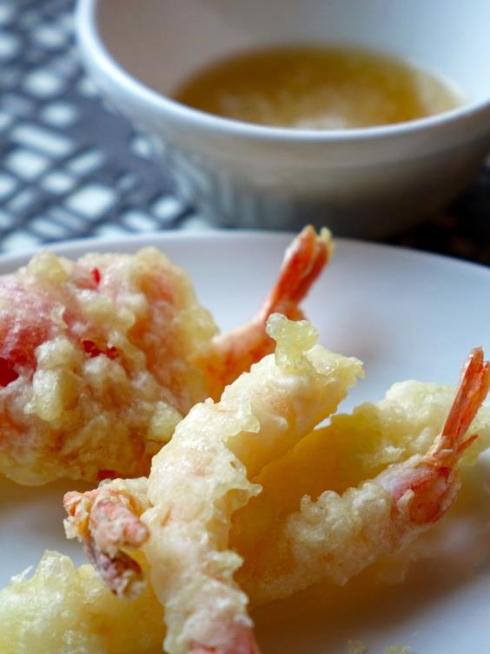
Tempura

Slide 37
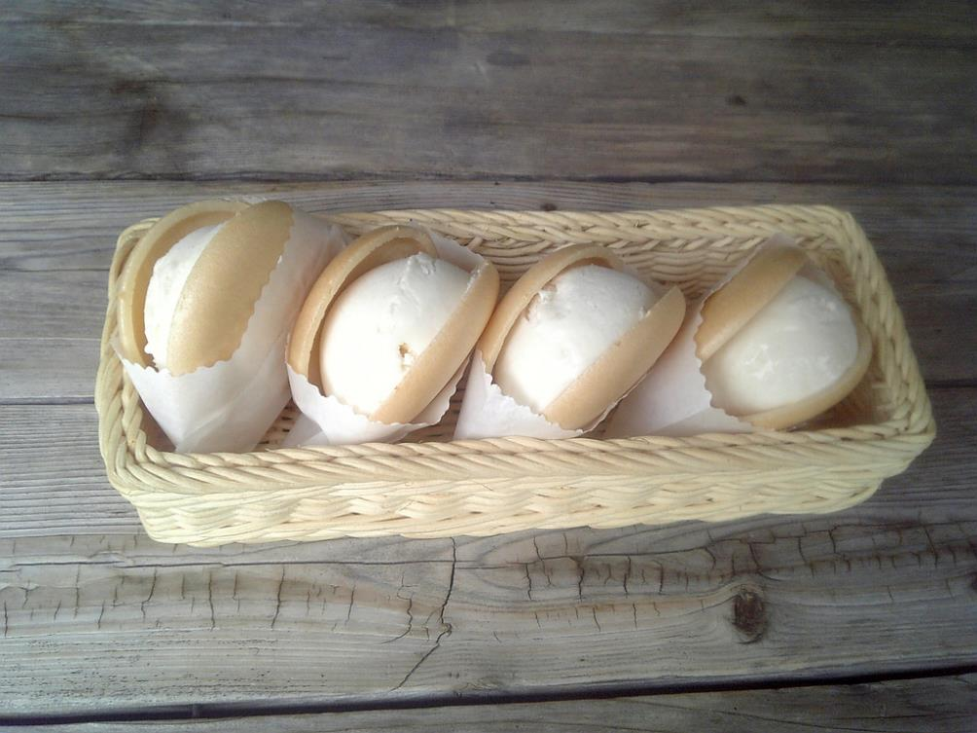
Monaka
Photo courtesy of Tamago Moffle (@flickr.com) - granted under creative commons licence - attribution

Slide 38
Mexico

Slide 39
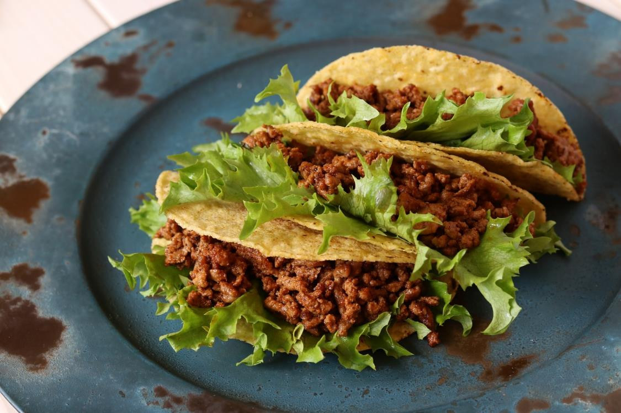
Taco

Slide 40
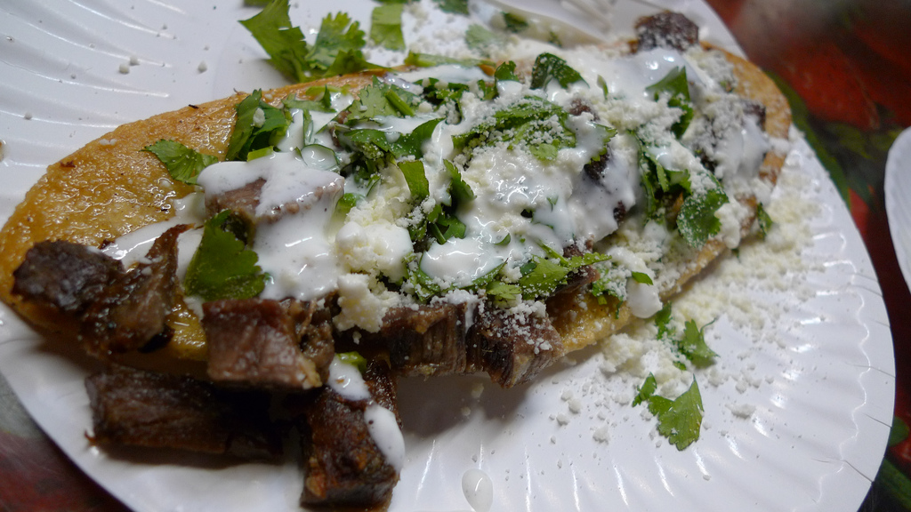
Huarache
Photo courtesy of Ron Dollete (@flickr.com) - granted under creative commons licence - attribution

Slide 41
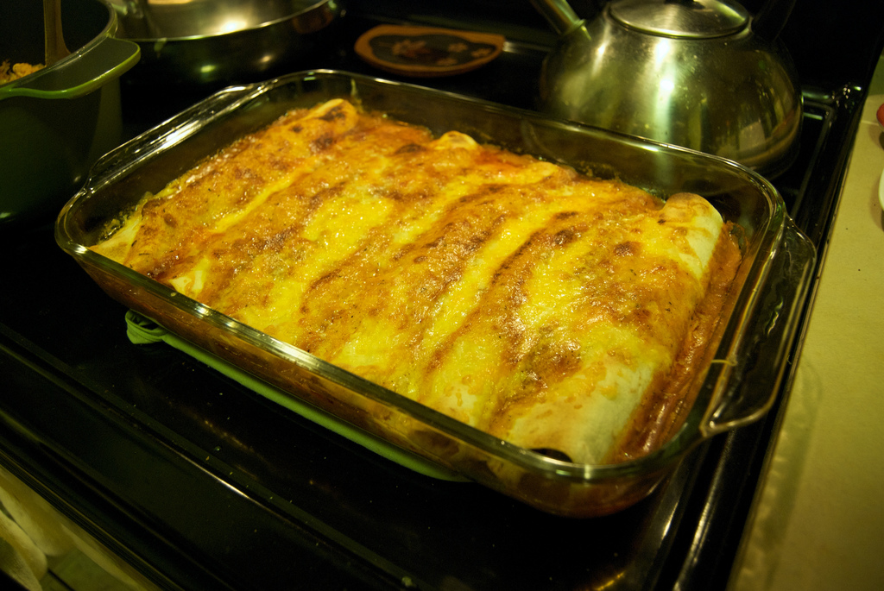
Enchiladas
Photo courtesy of lumachrome (@flickr.com) - granted under creative commons licence - attribution

Slide 42
Morocco

Slide 43
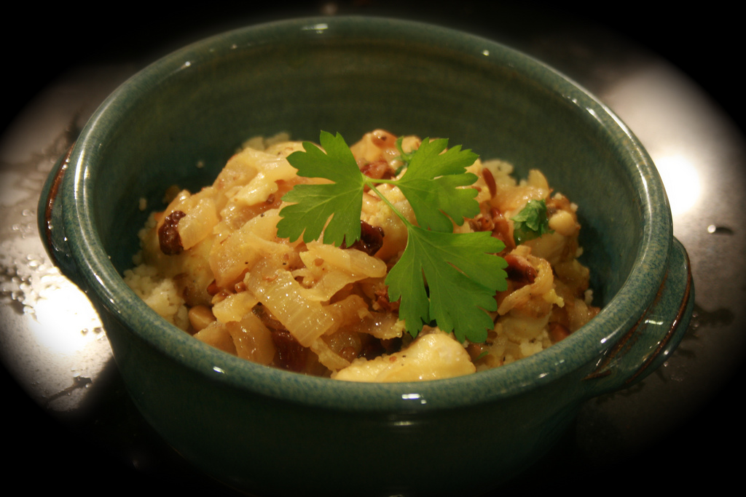
Tagine
Photo courtesy of missy & the universe (@flickr.com) - granted under creative commons licence - attribution

Slide 44
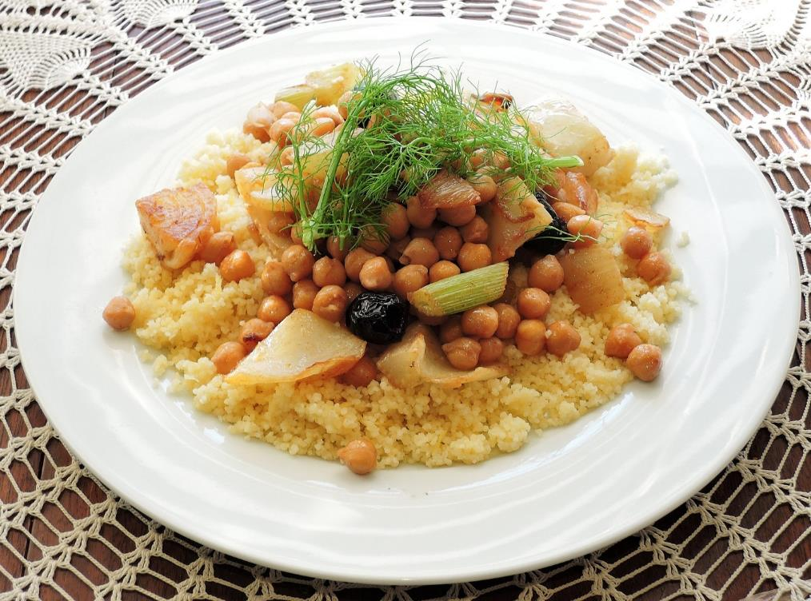
Couscous

Slide 45
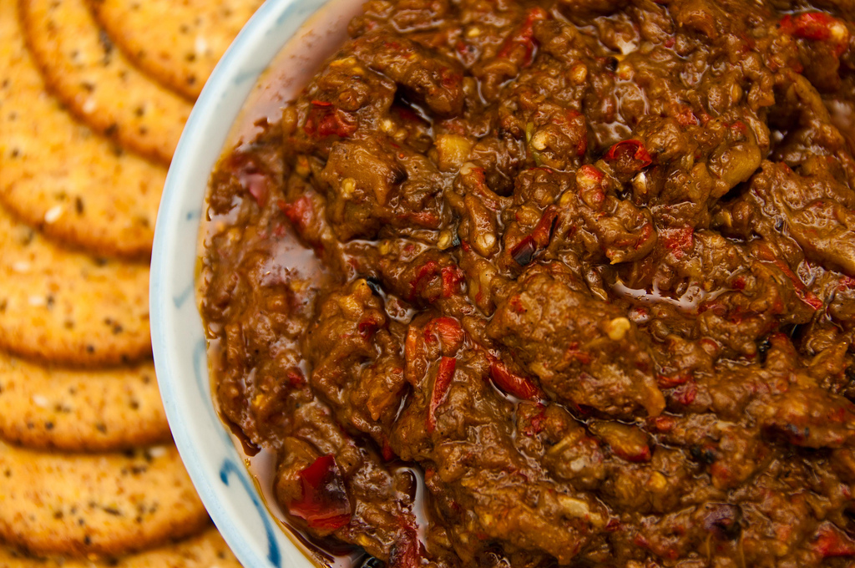
Zaalouk
Photo courtesy of MizGingerSnaps (@flickr.com) - granted under creative commons licence - attribution

Slide 46
Norway

Slide 47
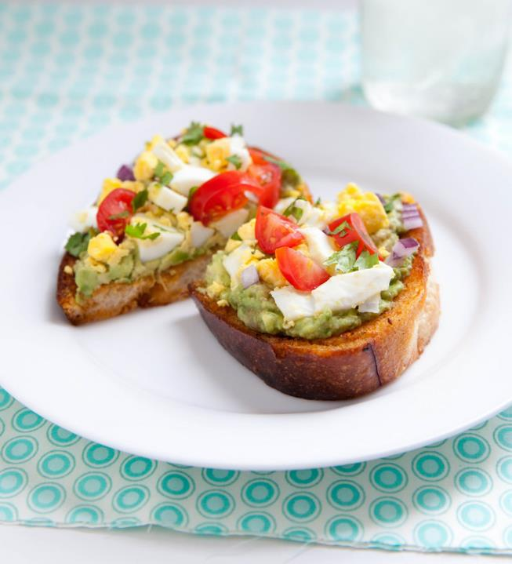
Open Sandwiches
Photo courtesy of annieseats (@flickr.com) - granted under creative commons licence - attribution

Slide 48
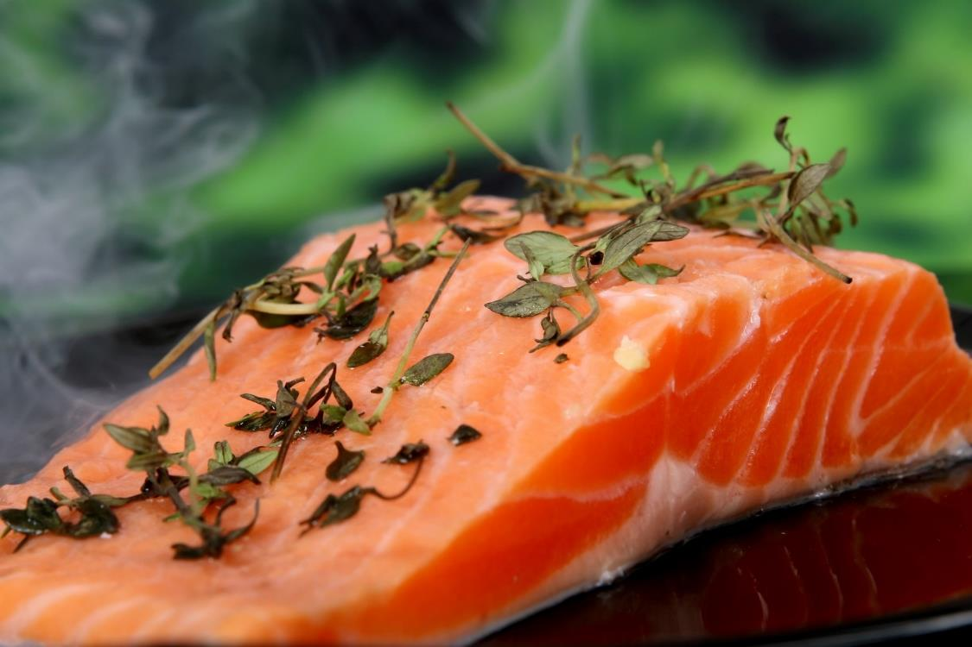
Smoked salmon

Slide 49
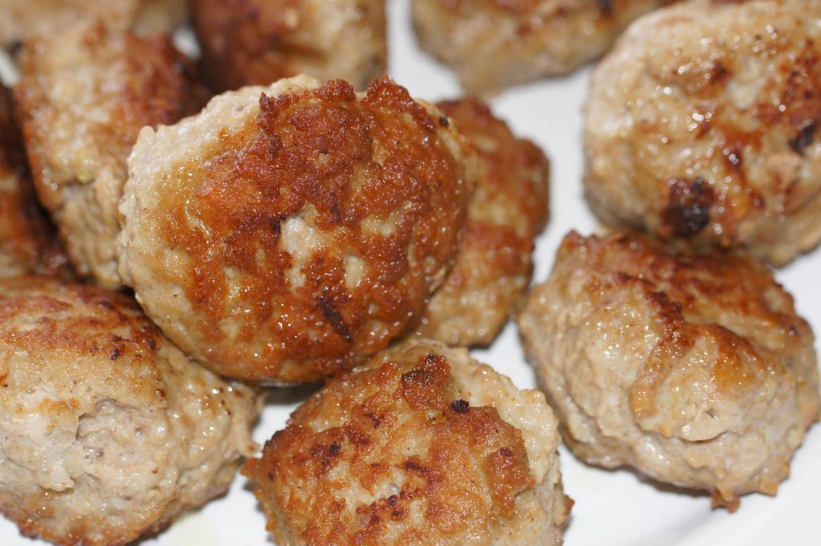
Meatballs

Slide 50
Poland

Slide 51
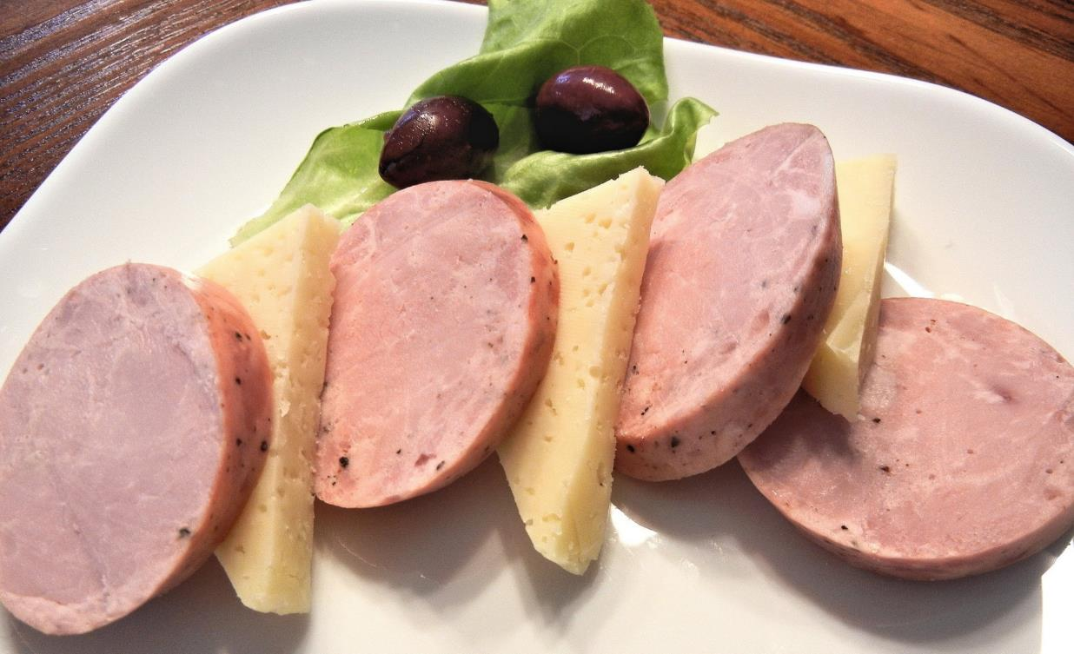
Kielbasa

Slide 52
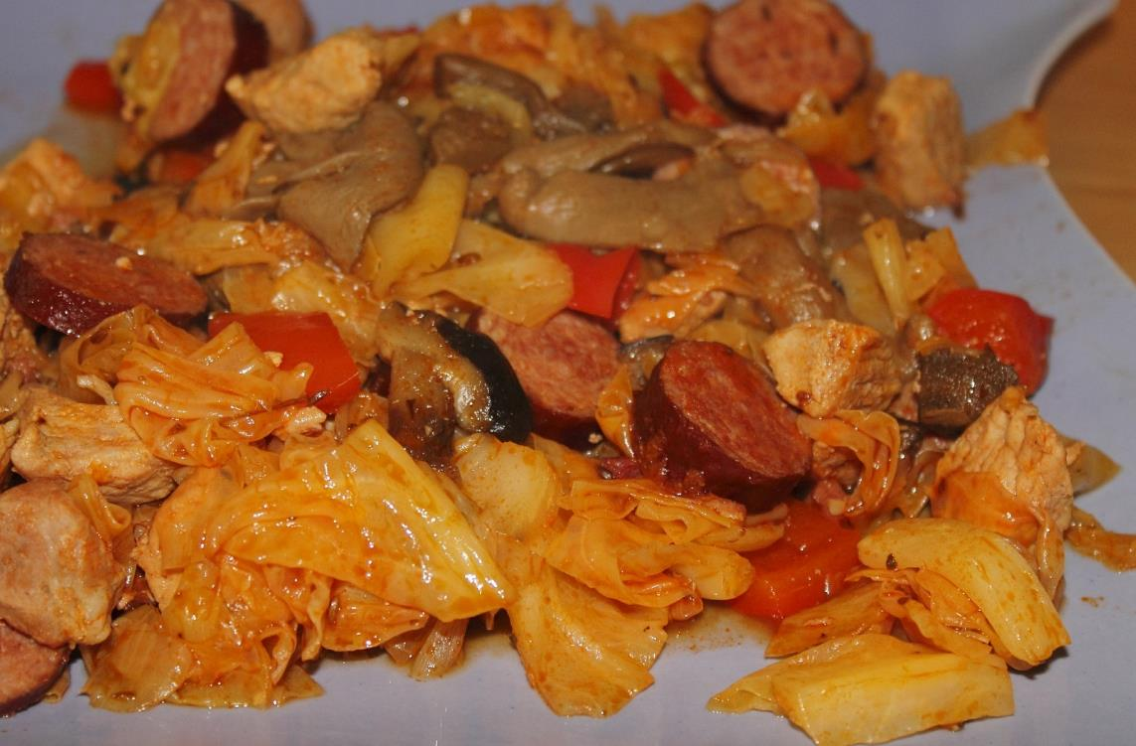
Bigos

Slide 53
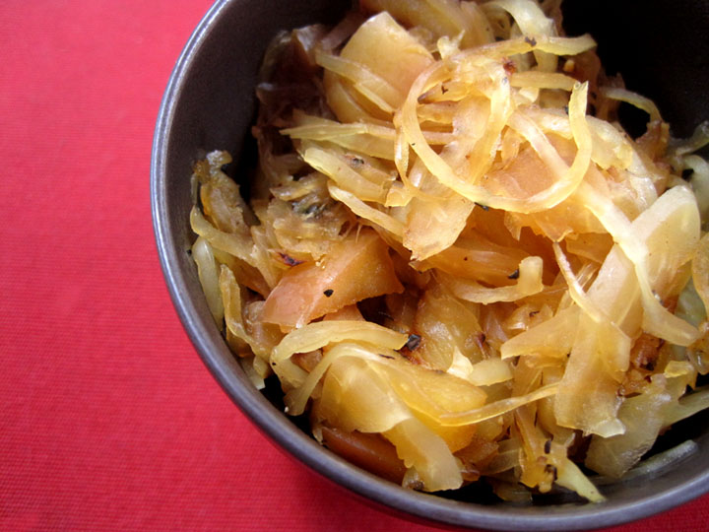
Sauerkraut
Photo courtesy of manray3 (@flickr.com) - granted under creative commons licence - attribution

Slide 54
Russia

Slide 55
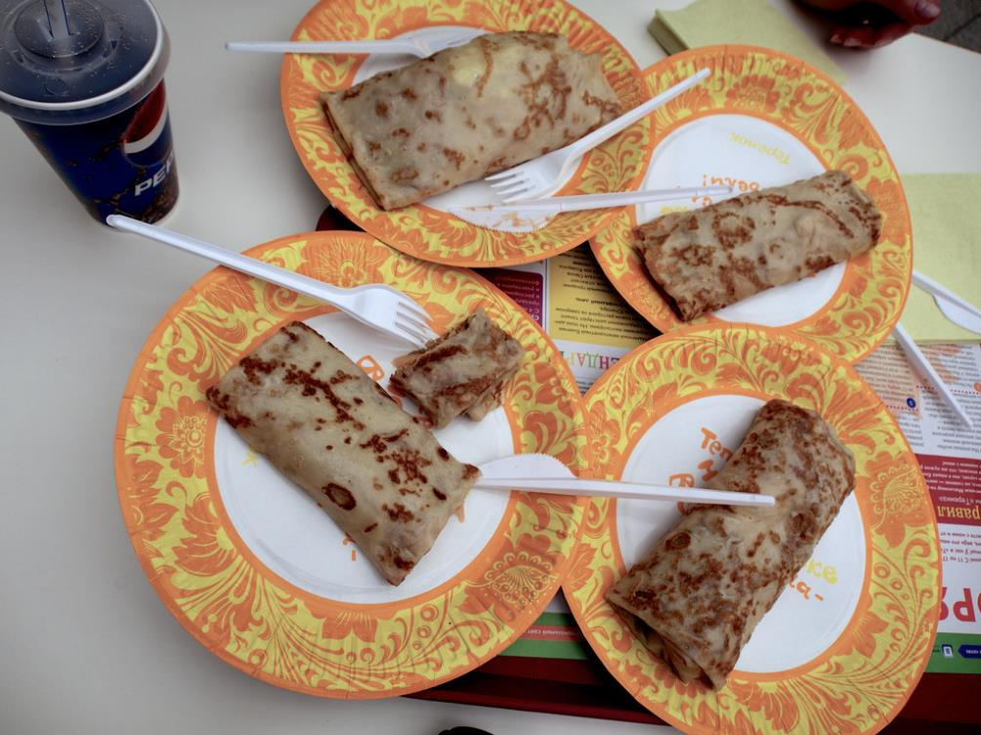
Bliny
Photo courtesy of alfaltendorf (@flickr.com) - granted under creative commons licence - attribution

Slide 56
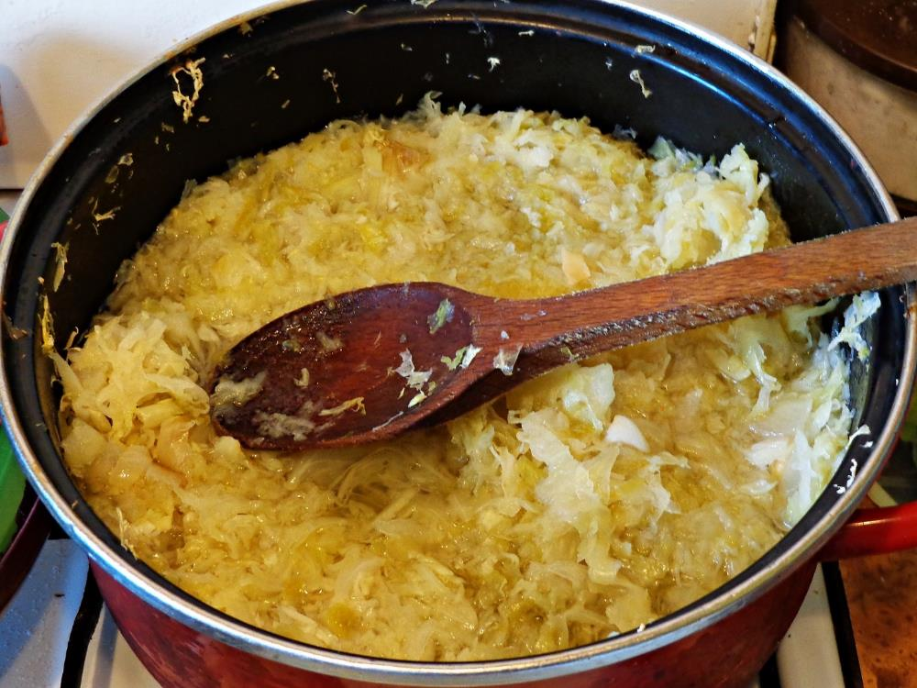
Cabbage Soup

Slide 57
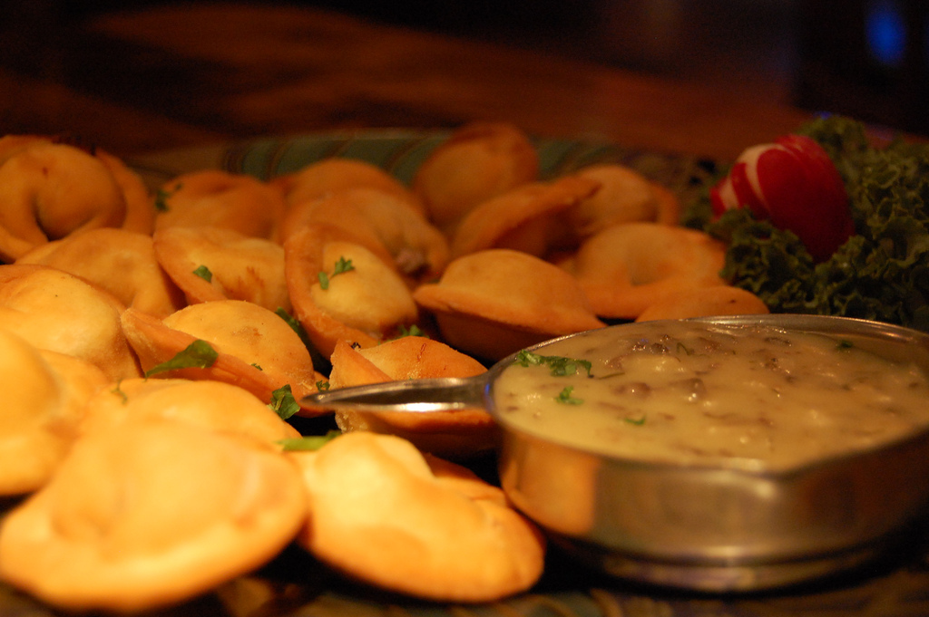
Pelmeni
Photo courtesy of stu_spivack (@flickr.com) - granted under creative commons licence - attribution

Slide 58
Thailand

Slide 59
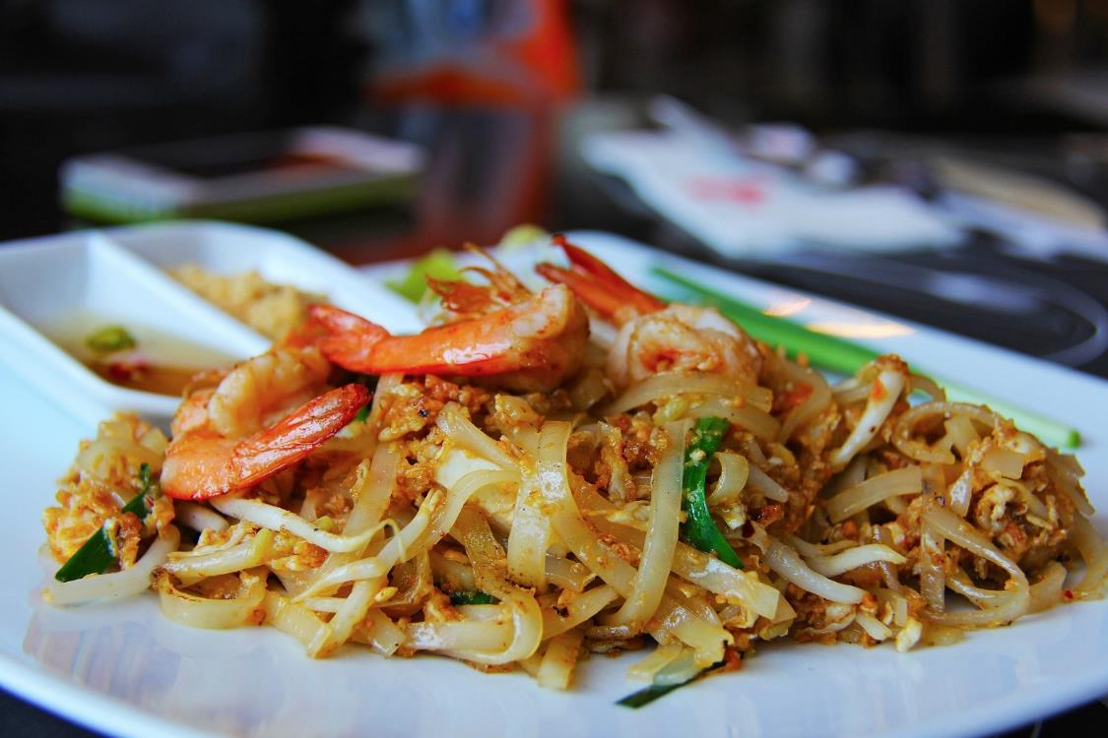
Pad Thai

Slide 60
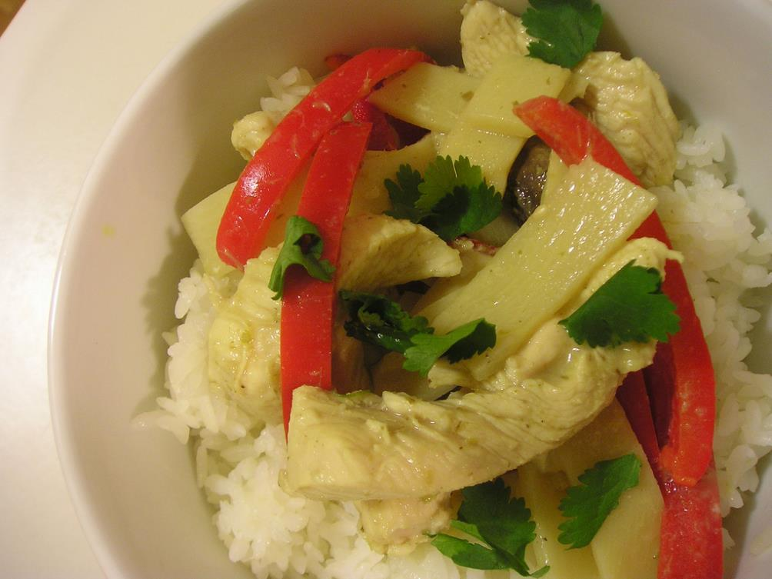
Thai Green Chicken Curry
Photo courteasy of Special Dark (@flickr.com) - granted under creative commons licence - attribution

Slide 61
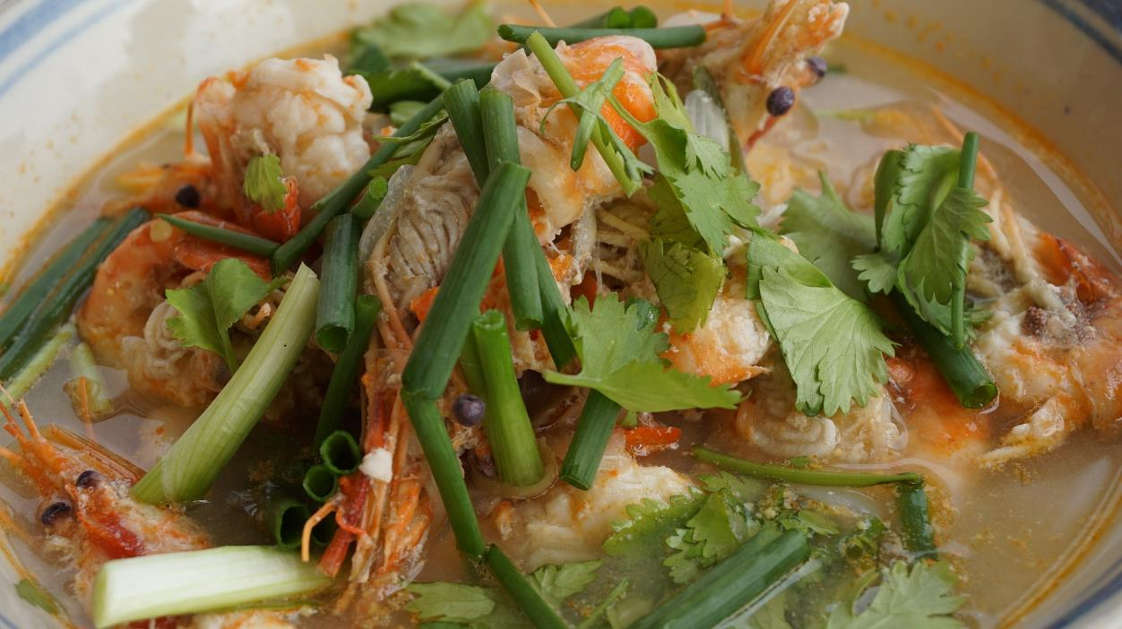
Tom Yum

Slide 62
Trinidad

Slide 63
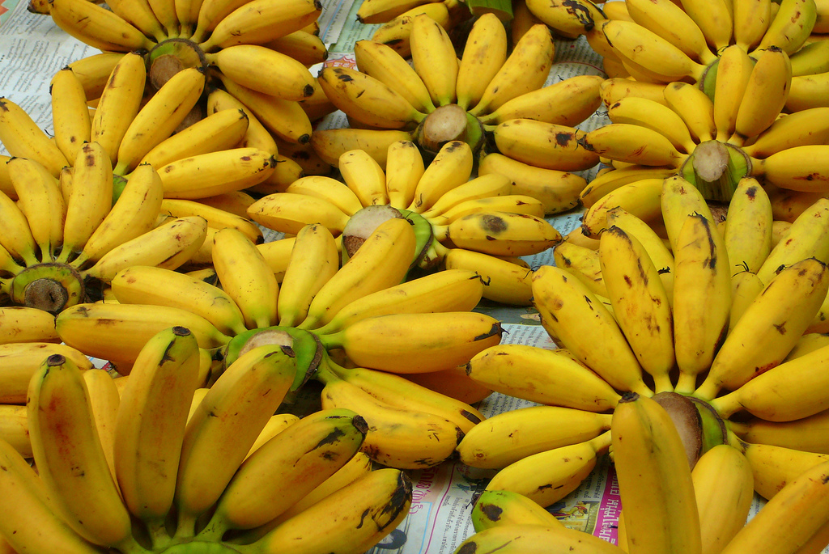
Plantain
Photo courtesy of Slippy Slappy (@flickr.com) - granted under creative commons licence - attribution

Slide 64
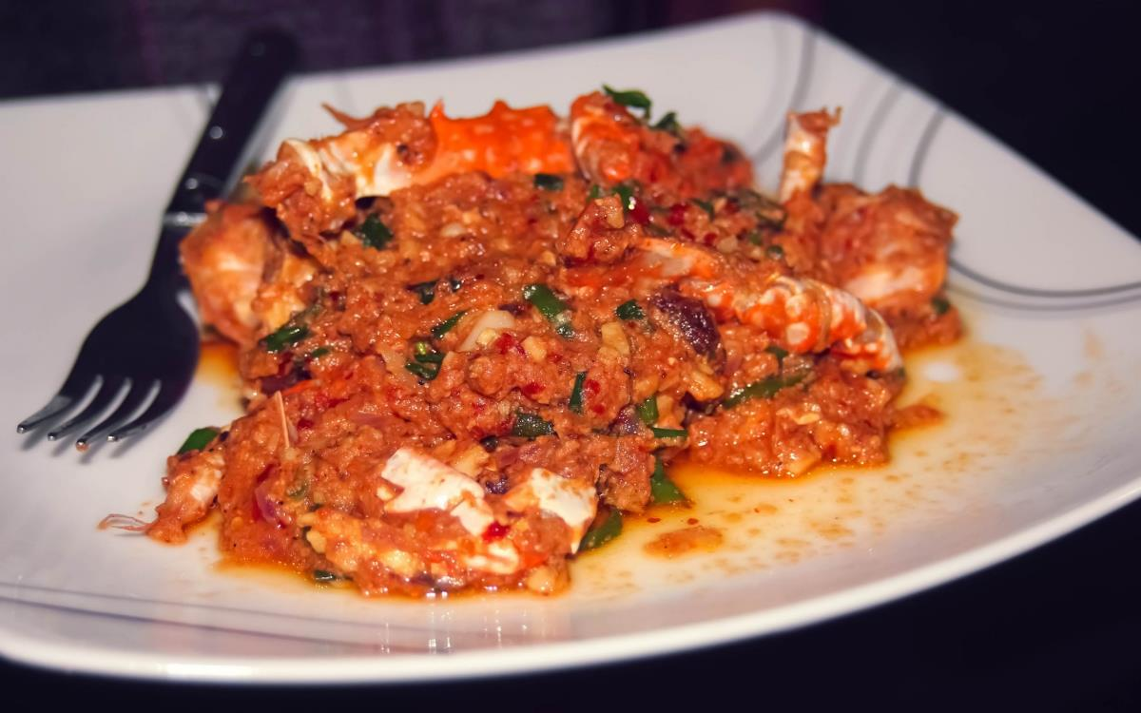
Curried Crab

Slide 65
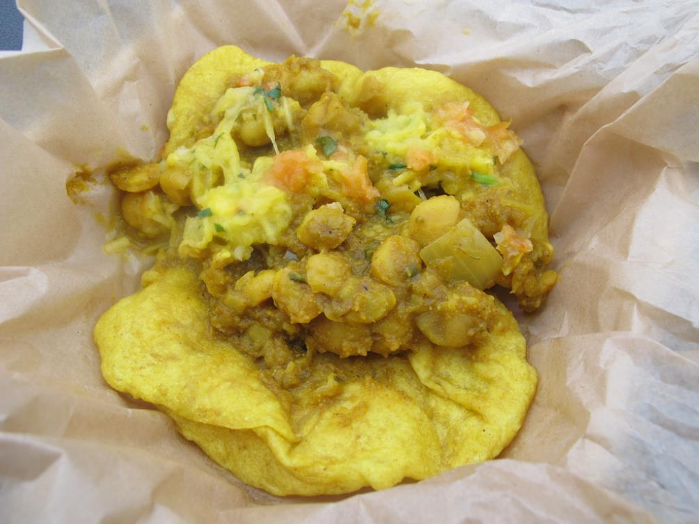
Doubles
Photo courtesy of Gary Soup (@flickr.com) - granted under creative commons licence - attribution

Slide 66
UK

Slide 67
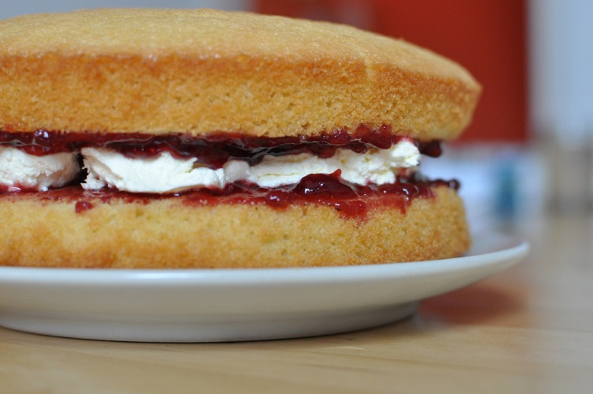
Victoria Sponge Cake
Photo courtesy of gordonplant (@flickr.com) - granted under creative commons licence - attribution

Slide 68

Fish and Chips
Photo courtesy of sstrieu (@flickr.com) - granted under creative commons licence - attribution

Slide 69

Shepherd's Pie
Photo courtesy of crd! (@flickr.com) - granted under creative commons licence - attribution

Slide 70
USA

Slide 71

Pot Roast
Photo courtesy of joannapoe (@flickr.com) - granted under creative commons licence - attribution

Slide 72

Club Sandwich

Slide 73

Barbeque Ribs

Slide 74


