Slide 1
3D drawing
Walt:
Make and draw 3D shapes

Slide 2
How to draw a cube using isometric paper.

Slide 3
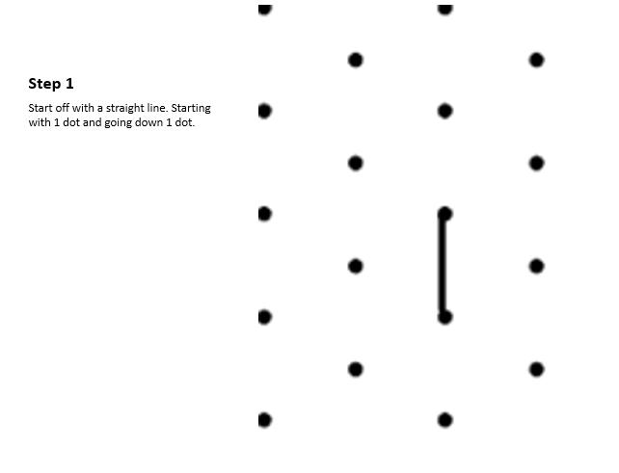

Slide 4
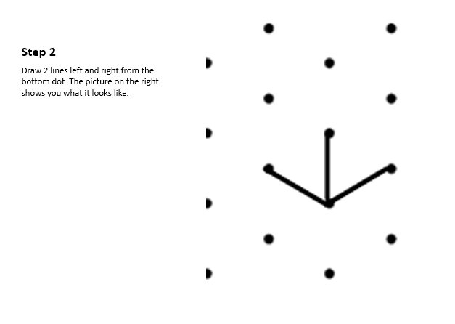

Slide 5
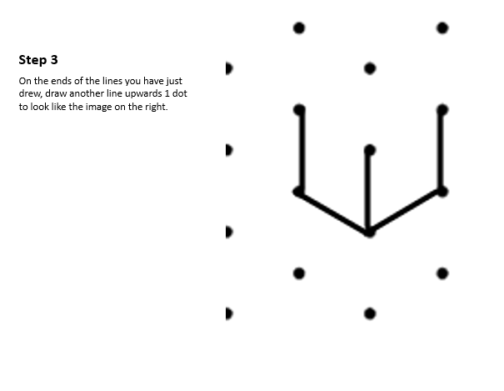

Slide 6
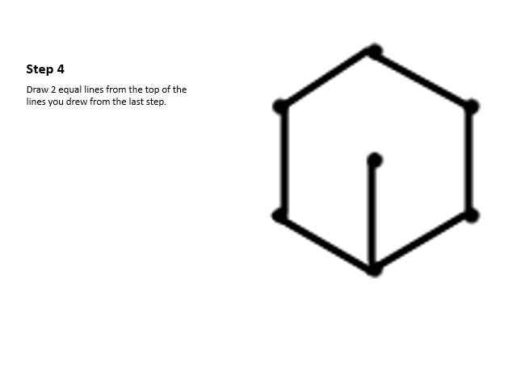

Slide 7
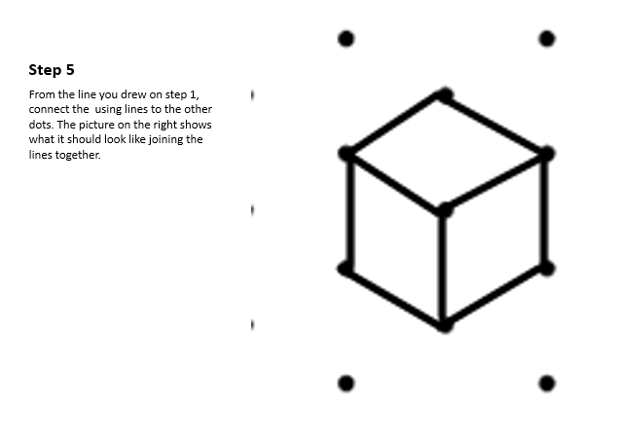

Slide 8
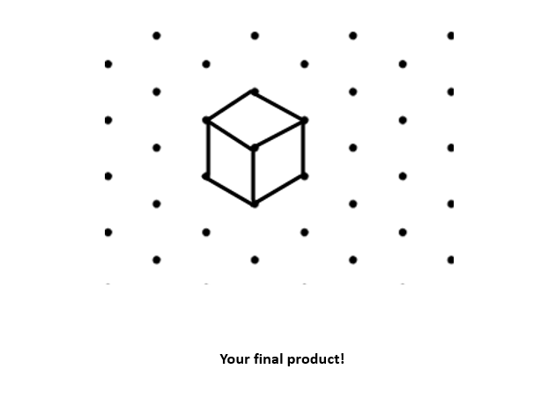

Slide 9
Challenge…
Can you use your isometric paper to draw two cubes sitting side by side?
Can you draw a tower of three cubes?
Can you draw a cuboid?
Can you draw a cube that is 2 x 2 x 2?
Use cubes to draw your own complicated 3D shapes. Can you work out their volumes?

Slide 10
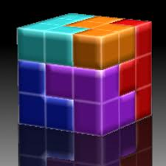
Soma Cube
The SOMA cube is a famous puzzle.
The cube is made up of separate pieces.
The pieces can be assembled to make the large cube , which measures 3 x 3 x 3 (27 blocks)

Slide 11
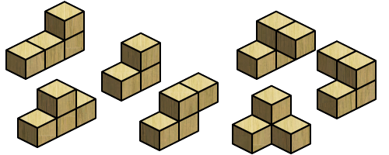
Make these pieces from Multilink then draw them on isometric paper!

Slide 12
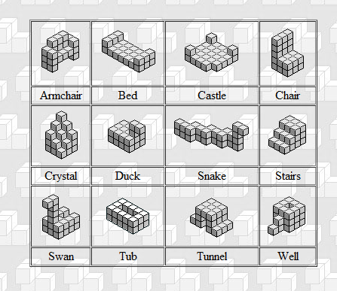
Once you have assembled and drawn the shapes, try these challenges!
Challenge 1:
Without altering the shapes – can you build the cube?
Challenge 2:
Without altering the shapes – can you these shapes?

Slide 13
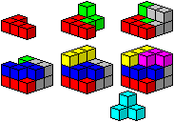
One solution….

Slide 14
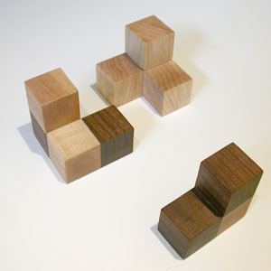
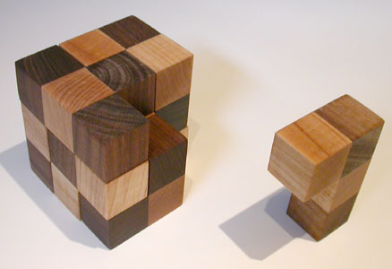
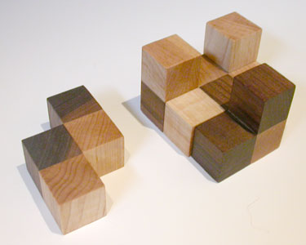
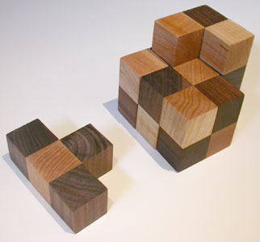
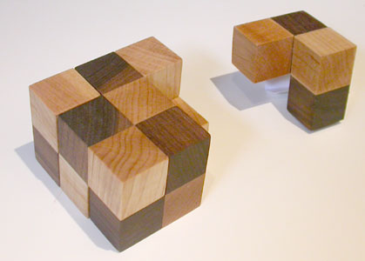

Slide 15
Plenary
Write down your 4 best tips for someone in another class to produce beautiful and accurate drawings on isometric paper

Slide 16
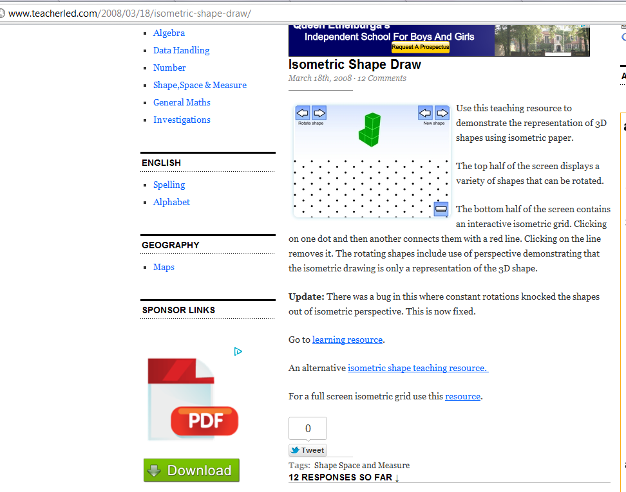
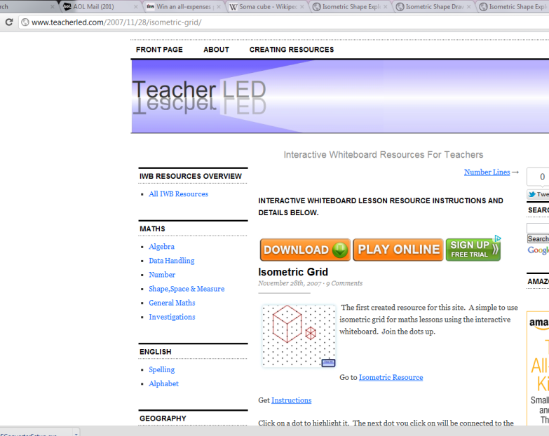
For teacher – where to find the free widgets

Slide 17
Link for free isometric paper….
http://www.waterproofpaper.com/graph-paper/isometric-paper.shtml

