Slide 2
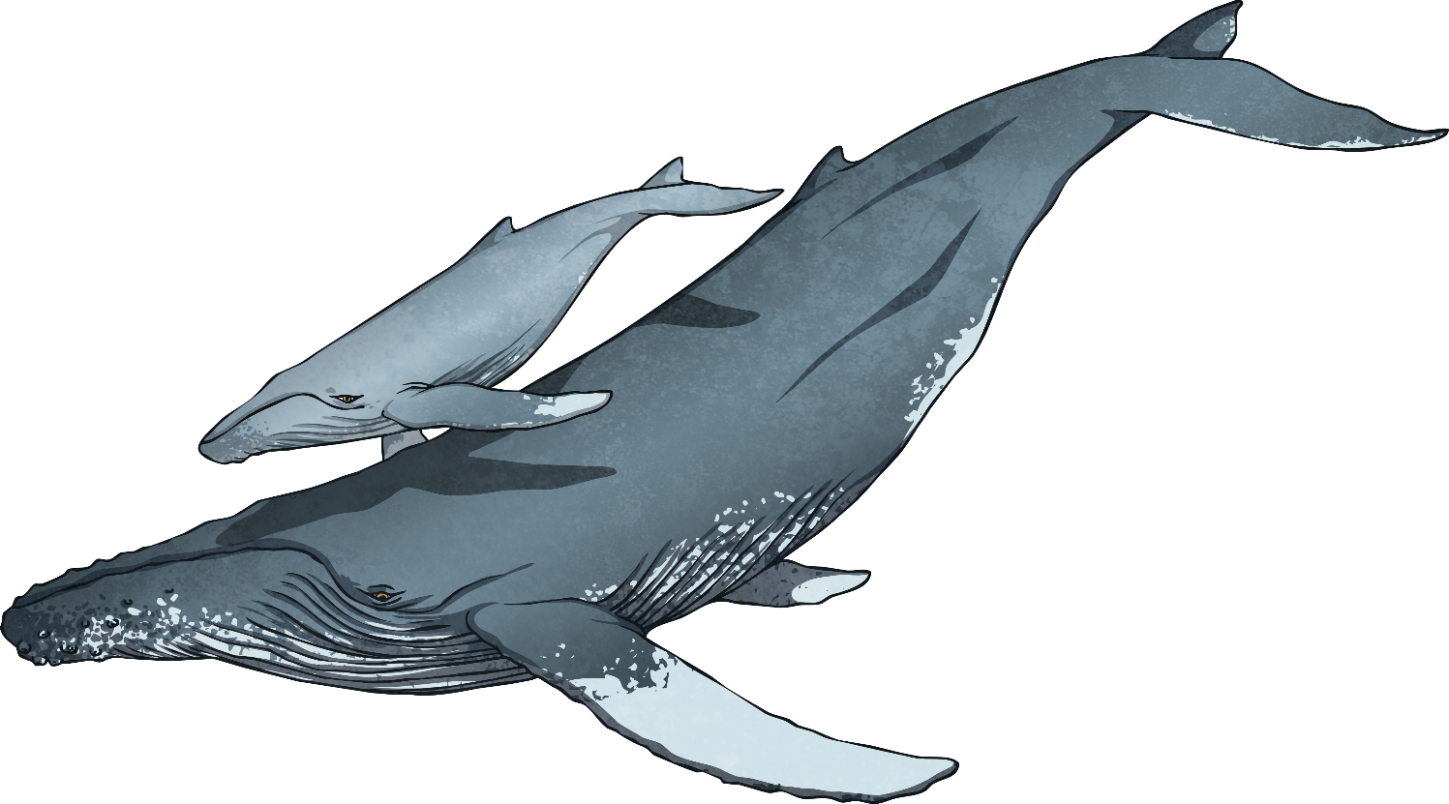
What Are Underwater Animals?
Underwater animals live in the aquatic biome.
A biome is a large region with a specific climate that contains living creatures. The aquatic biome is the largest on our planet, taking up about 75% of its surface.
Other biomes of the world include
desert, forest, grasslands
and tundra.

Slide 3
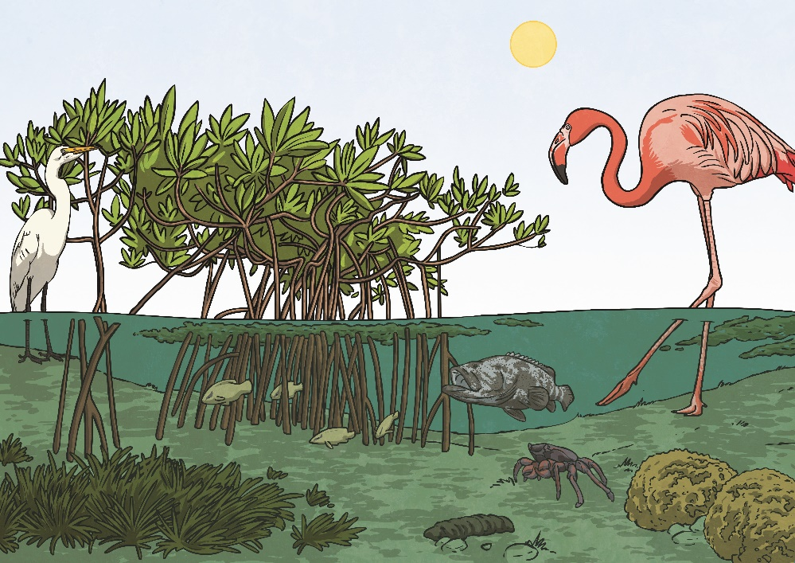
Underwater Habitats
The aquatic biome can be subdivided into two types of habitats:
Freshwater habitats – These have low levels of salt (less than 1%). They include rivers, lakes, streams, ponds, swamps, wetlands, bogs and brackish waters.
Saltwater habitats – These have salt concentrations over 1%. They include oceans, seas and coral reefs.
Did You Know...?
There are also habitats where saltwater and freshwater mix together, such as mudflats, mangroves and salt marshes.

Slide 4
Different Animals, Different Underwater Habitats
In this PowerPoint, you will find out about the following underwater animals and their adaptations:
stonefish
comb
jellyfish
remora
fish
anglerfish
giant
Pacific
octopus
stickleback

Slide 5
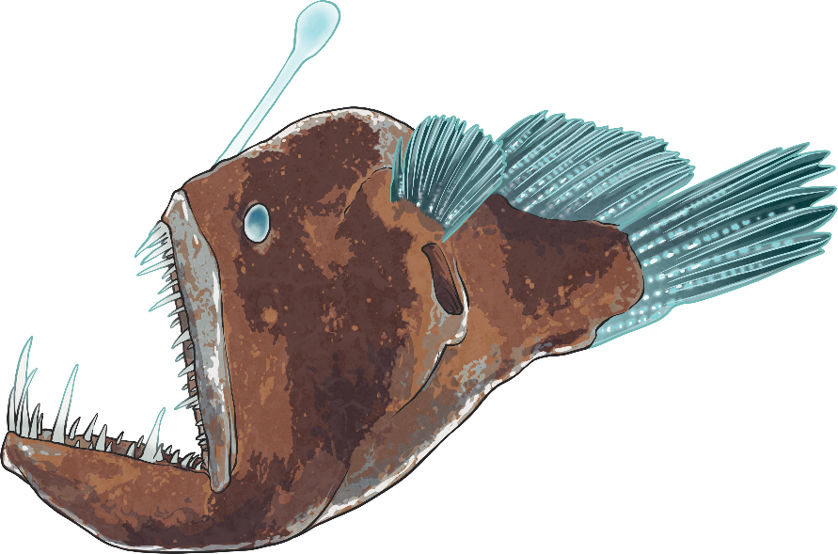
The Anglerfish
back
Habitat:
Saltwater - deep sea
Adaptations:
The deep sea anglerfish has adapted to its environment by means of skin colour. It uses this adaptation to protect itself from predators, as well as to disguise itself when hunting. Anglerfish are famous for the ‘glowing bulb’ that they use to attract prey.
Where on Earth?
There are more than 200 species of anglerfish. Most anglerfish live in the dark depths of the Atlantic and Antarctic oceans.

Slide 6
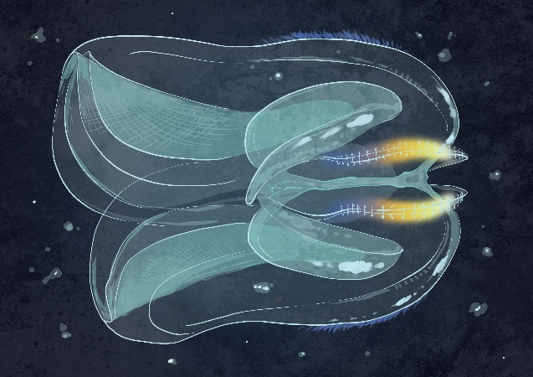
The Comb Jellyfish
back
Habitat:
Saltwater - deep sea
Adaptations:
The comb jellyfish has three main adaptations:
Movement – They swim using little hairs, or 'cilia', that move them through the water.
Communication – They reflect light off their cilia to signal to mates and other jellyfish.
Feeding – They use tentacles to catch prey.
Where on Earth?
They are extremely diverse, living in areas ranging from the equator to the poles and from the ocean surface to below 7,000 metres.

Slide 7
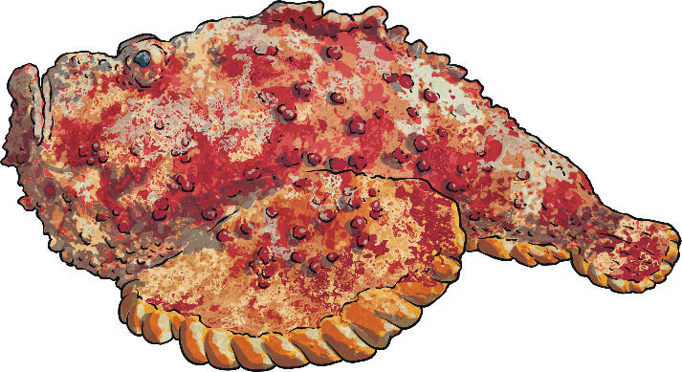
The Stonefish
back
Habitat:
Saltwater - coral reef
Some species adapted to freshwater.
Adaptations:
The stonefish has developed a series of adaptations that help it survive in the coral reef:
Camouflage – Due to its wart-like skin, it can hide next to or under rocks, in reefs or in sandy or muddy bottoms.
Defence – It has a dorsal fin with 13 spines that can inject venom into predators.
Movement – Its pectoral fins help it swim and move around in the sand.
Where on Earth?
Although they prefer saltwater habitats, some species are known to live in rivers.

Slide 8
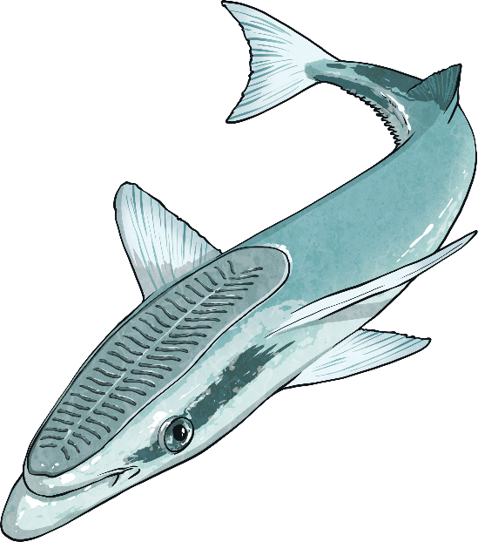
The Remora Fish
back
Habitat:
Saltwater - oceans and seas
Adaptations:
The remora fish has developed a symbiotic relationship (one that benefits both species) with other sea creatures. Their dorsal fin has evolved into an organ that helps them attach themselves to the belly or underside of their host (sharks, whales and manta rays). They then feed off scraps of prey dropped by the host and also parasites on its skin and its mouth.
Where on Earth?
They can usually be found in tropical waters around the world.

Slide 9
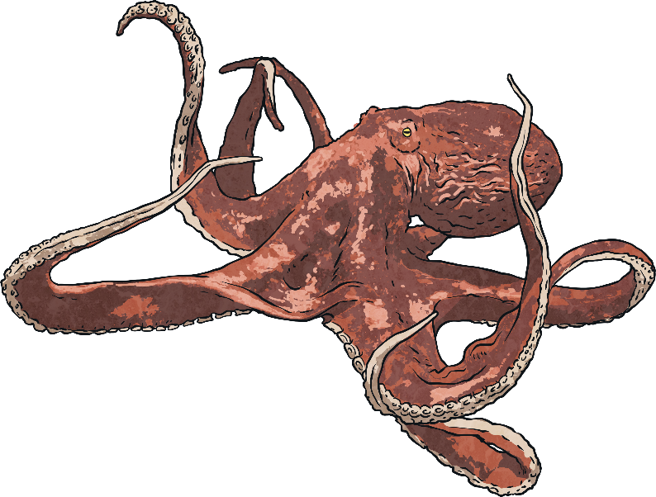
The Giant Pacific Octopus
back
Habitat:
Saltwater - Pacific coast
Adaptations:
The giant Pacific octopus has many
adaptations, including:
Movement – Its two rear arms function as legs that, together with the siphon (an organ it uses for breathing which allows it to eject water in a form of jet propulsion), propel it forward.
Camouflage – It can change colour and even texture (looking either rough or smooth) to blend into its surroundings.
Where on Earth?
These highly intelligent animals are found throughout the waters of the Pacific, ranging from southern California to Japan.

Slide 10
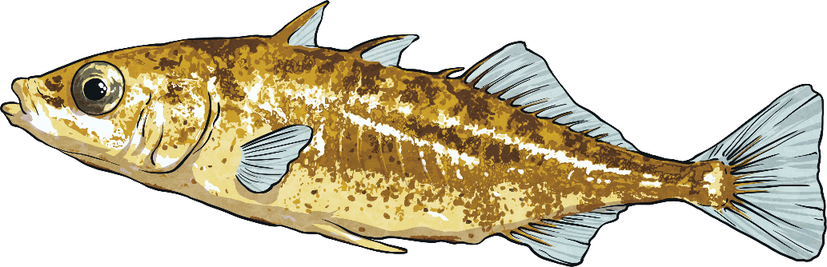
The Stickleback Fish
back
Habitat:
Saltwater and freshwater
Adaptations:
The main adaptation of the stickleback fish is their eyesight. Amazingly, they have shown that they are able to adapt their vision to new environments in less than 10,000 years, which is a very short period for animals to be able to evolve.
Where on Earth?
Sticklebacks are most commonly found in the ocean but some can be found in fresh and brackish waters in the northern hemisphere, as far north as the Arctic.

