Slide 1


Y3
MATHS
Equivalent Masses (kilograms and grams)

Slide 2

Key Information
Equivalent Masses (kilograms and grams)
Mass is the measure of how much matter there is in an object. It is usually measured in grams and kilograms.​
​
Grams (g) is a unit of measure for weight and mass. A gram is equal to a thousandth of a kilogram.​
Kilograms (kg) is a unit of measure for weight and mass. 1kg is equals to 1,000 grams.

Slide 3
Equivalent Masses (kilograms and grams)
Let’s start with a question about measuring mass in kilograms and grams, which is linked to the new learning later in this lesson.

Slide 4
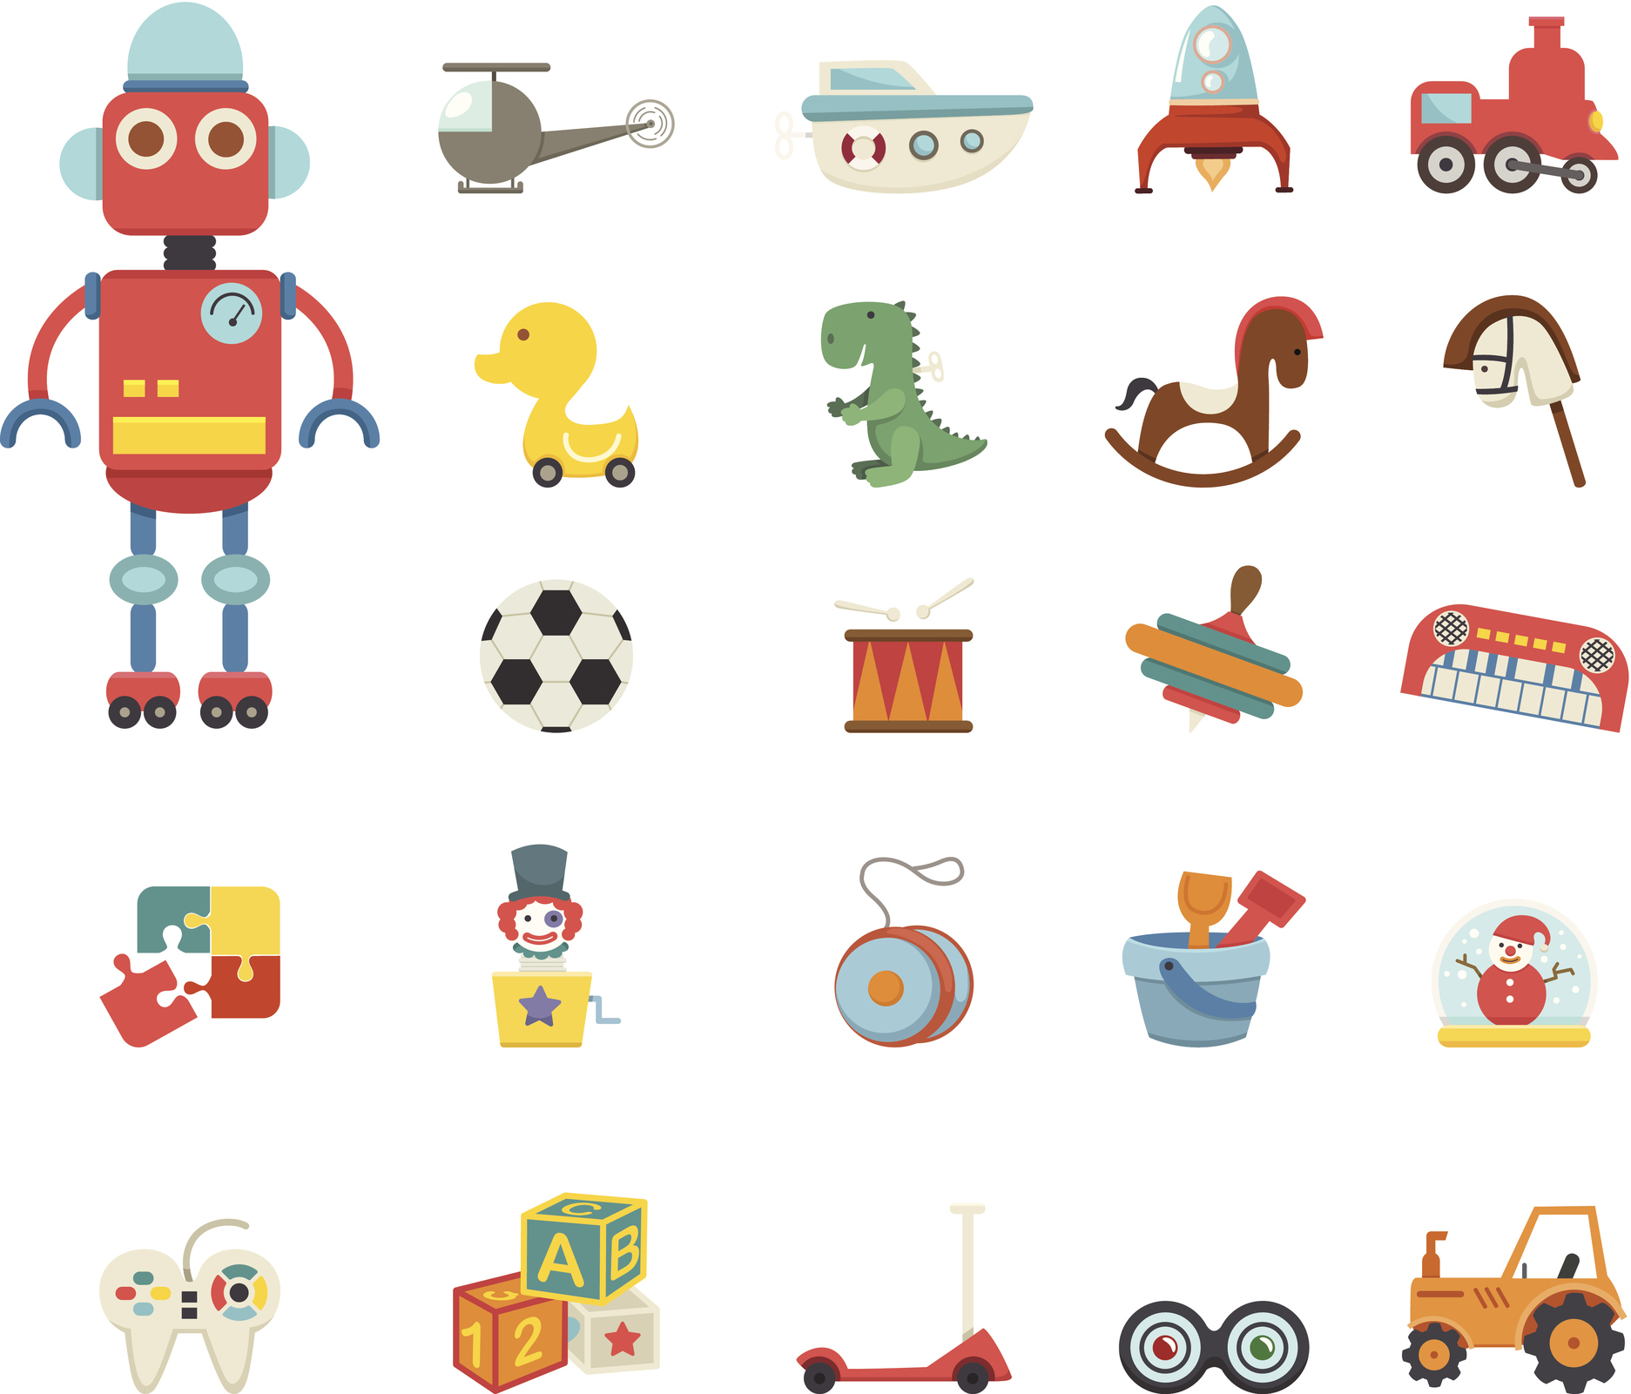
Equivalent Masses (kilograms and grams)
Identify the mass of each toy. Record your answer in grams and kilograms.
3kg
0
200
3kg
0
200
3kg
0
200
800
400
800
400
800
400
600
600
600
600
600
600
400
Kg
800
400
Kg
800
400
Kg
800
200
1kg
200
1kg
200
1kg
2kg
200
2kg
200
2kg
200
800
600
400
800
600
400
800
600
400
_ kg and ___ g
_ kg and ___ g
_ kg and ___ g

Slide 5
Equivalent Masses (kilograms and grams)
Identify the mass of each toy. Record your answer in grams and kilograms.
3kg
0
200
3kg
0
200
3kg
0
200
800
400
800
400
800
400
600
600
600
600
600
600
400
Kg
800
400
Kg
800
400
Kg
800
200
1kg
200
1kg
200
1kg
2kg
200
2kg
200
2kg
200
800
600
400
800
600
400
800
600
400
2 kg and 900 g
1 kg and 600 g
0 kg and 500 g

Slide 6
Equivalent Masses (kilograms and grams)
Now that we are ready to move on, we can learn about equivalent masses for kilograms and grams.

Slide 7
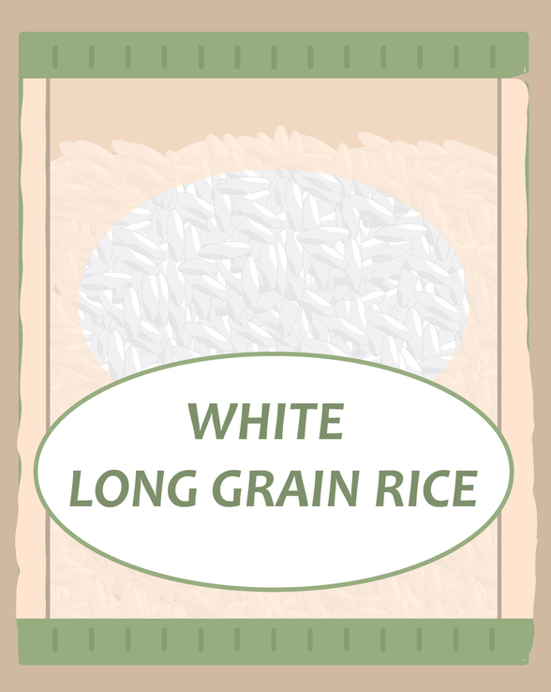
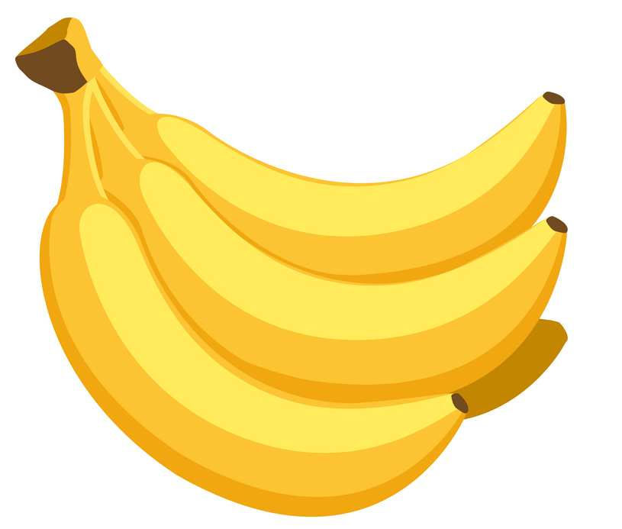
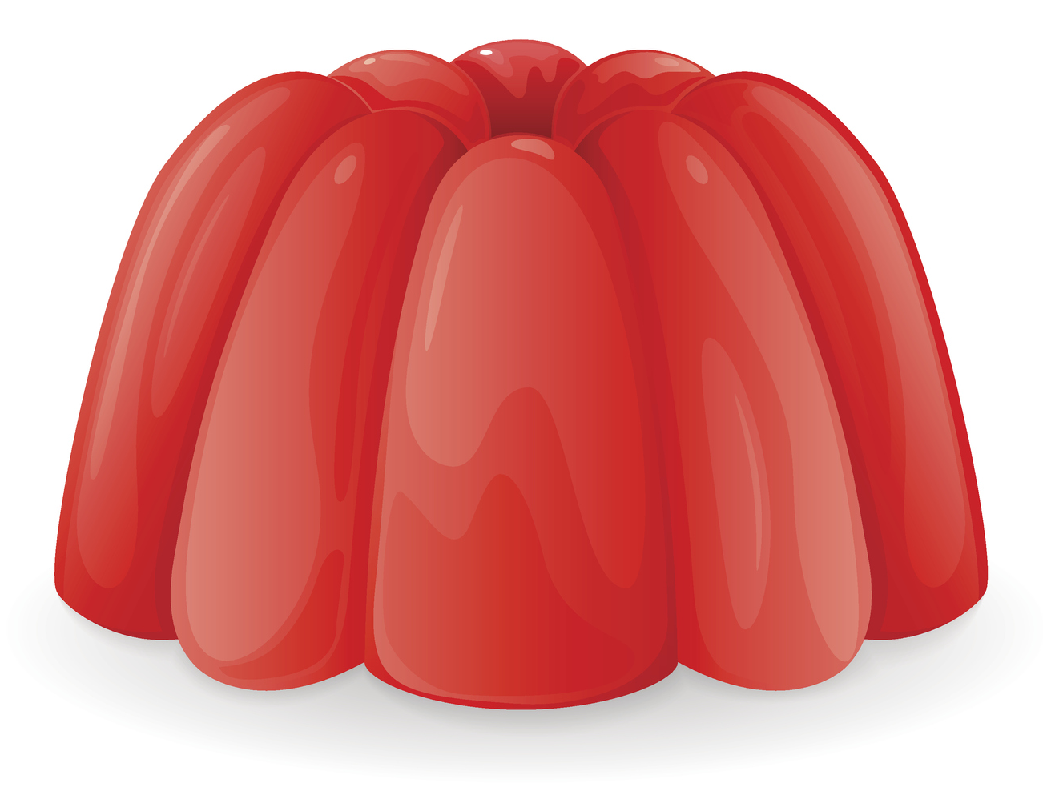
Equivalent Masses (kilograms and grams)
In this lesson, we are going to explore the concept of how many grams are equivalent to 1 kilogram.
300 g
1,000 g
1 kg and 100 g
Let’s begin by identifying objects that are not equivalent to 1 kg.

Slide 8
Equivalent Masses (kilograms and grams)
The jelly and the bananas are not equivalent to 1 kg. The jelly’s mass is less than 1 kg and the bananas’ mass is more than 1 kg.
300 g
1,000 g
1 kg and 100 g
The rice has an equivalent mass to 1 kilogram. 1,000 g is equivalent to 1 kg.

Slide 9
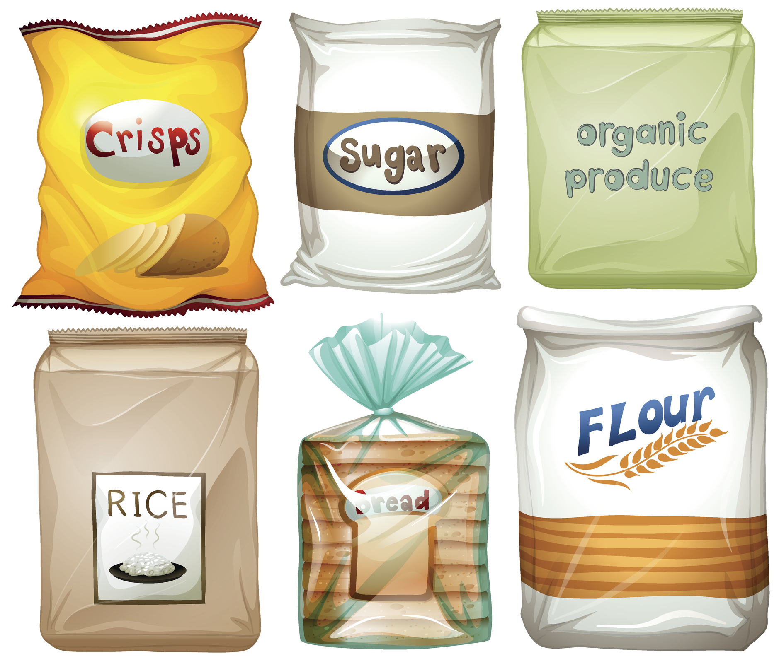

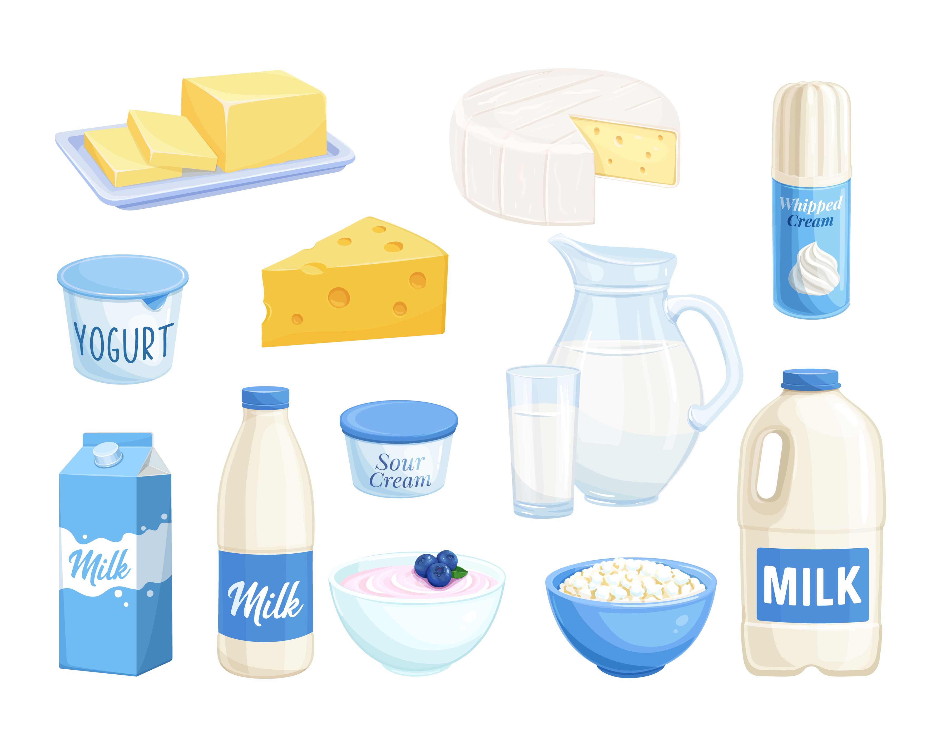
Equivalent Masses (kilograms and grams)
Match the items to the correct labels.
1,000g
750 g
1,000 g
150 g
500 g
1,000 g
Equivalent to 1 kilogram
Not equivalent to 1 kilogram

Slide 10
Equivalent Masses (kilograms and grams)
Match the items to the correct labels.
1,000g
750 g
1,000 g
150 g
500 g
1,000 g
Equivalent to 1 kilogram
Not equivalent to 1 kilogram

Slide 11
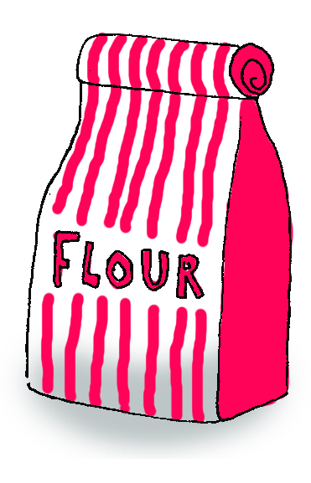
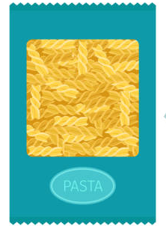
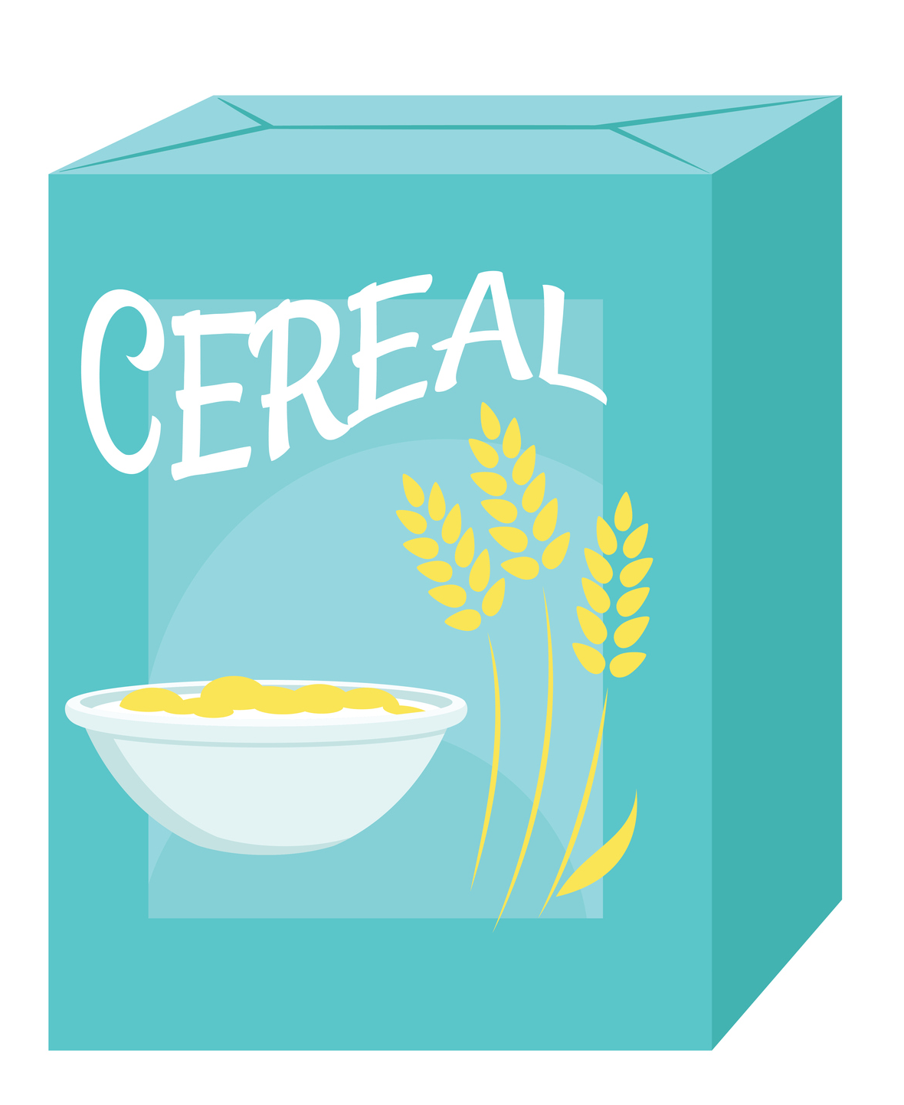


Equivalent Masses (kilograms and grams)
We can use our addition skills to find pairs of objects with a combined mass of 1,000 grams.
250 g
800 g
500 g
750 g
200 g
500 g
Look at the mass of each object. Find three pairs that can be added together to make 1,000 grams each.

Slide 12
Equivalent Masses (kilograms and grams)
The pairs are the flour and the cereal (250 g + 750 g = 1,000 g); the cheese and the Swiss roll cake (800 g + 200 g = 1,000 g); and the pasta and the yoghurt (500 g + 500 g = 1,000 g).
250 g
800 g
500 g
750 g
200 g
500 g
Number bonds to 1,000 are useful in helping us find matching pairs.

Slide 13
Equivalent Masses (kilograms and grams)
We can apply our skills to find missing amounts too. Look at the calculations. Find the missing amount in each calculation:
+
=
+
=
900 g
1,000 g
1,000 g
450 g
+
=
+
=
1,000 g
670 g
1,000 g
520 g

Slide 14
Equivalent Masses (kilograms and grams)
We can apply our skills to find missing amounts too. Look at the calculations. Find the missing amount in each calculation:
+
=
+
=
900 g
1,000 g
1,000 g
100 g
550 g
450 g
+
=
+
=
1,000 g
670 g
1,000 g
520 g
480 g
330 g

Slide 15
You could also solve these calculations using subtraction.
+
=
+
=
900 g
1,000 g
670 g
1,000 g
100 g
330 g
Note
Note
For this question, you would calculate:
1,000 g - 900 g = 100 g
For this question, you would calculate:
1,000 g - 670 g = 330 g

Slide 16
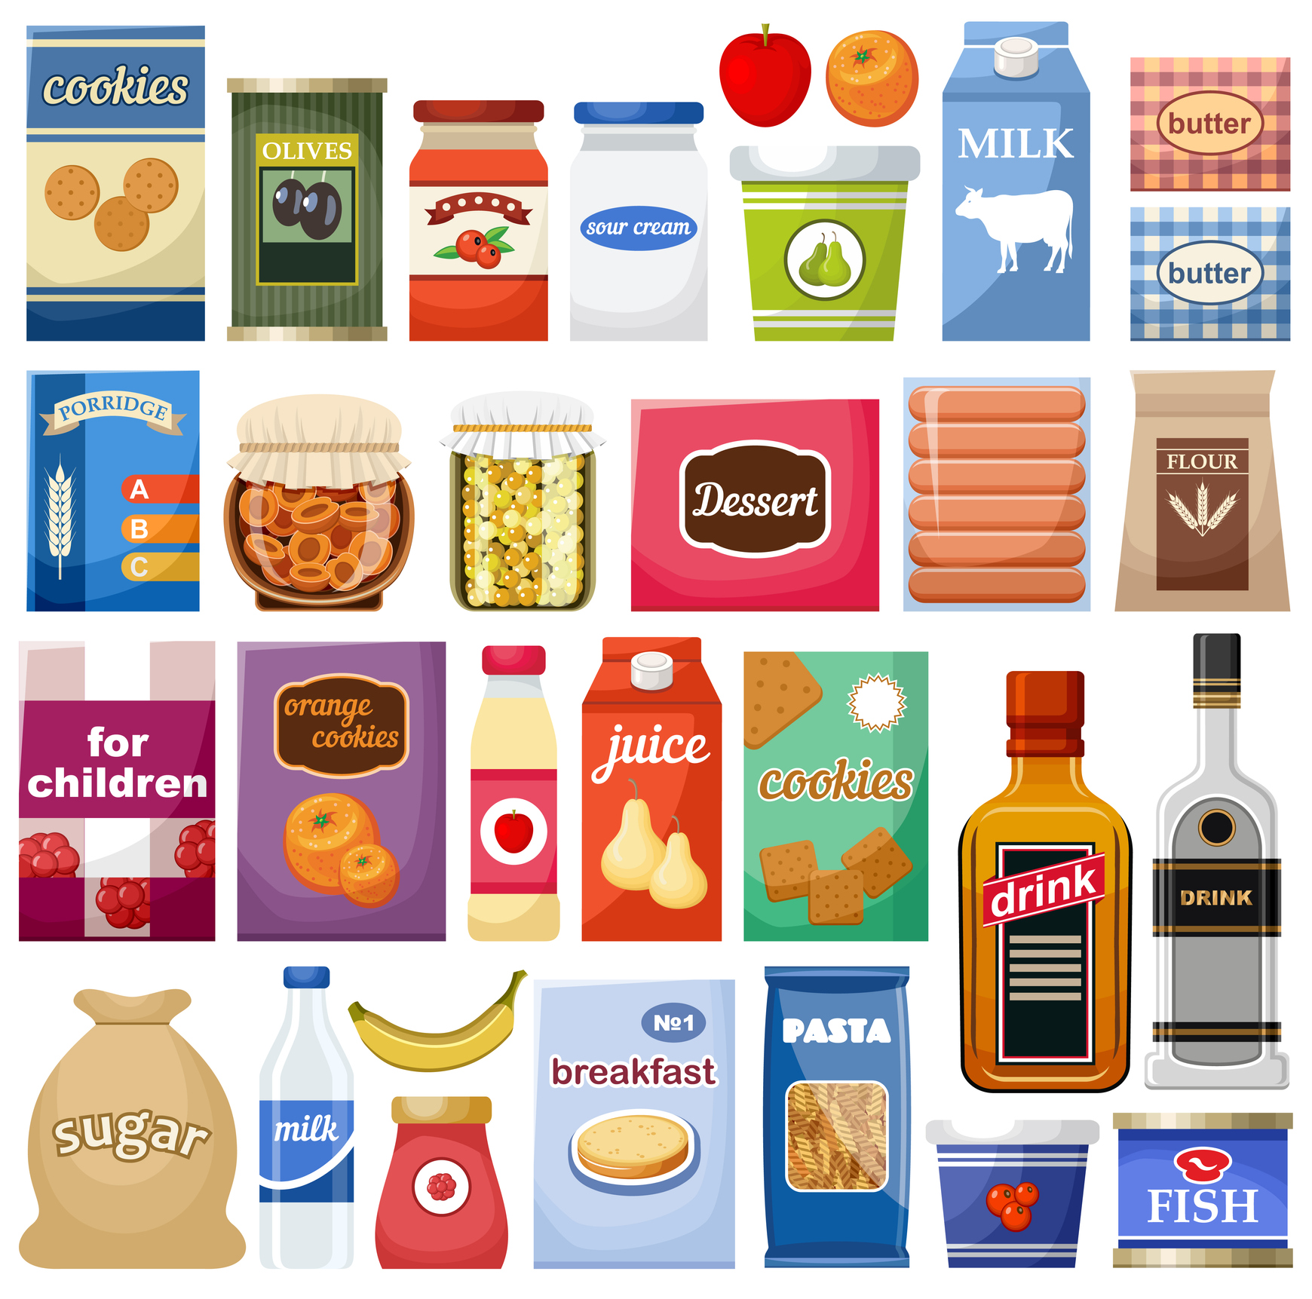

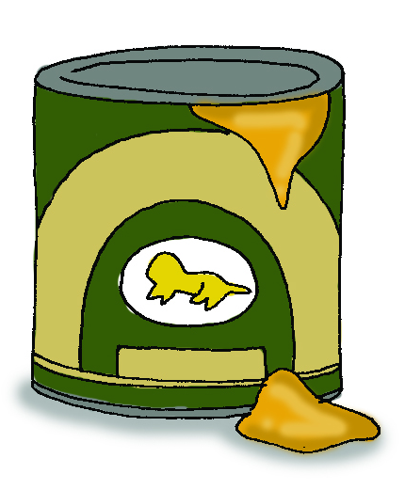
Equivalent Masses (kilograms and grams)
Calculate the missing mass to complete equivalents of 1 kg.
+
=
1,000 g
+
=
1,000 g
440 g
___ g
___ g
280 g
150 g + ___ g = 1,000 g
___ g + 625 g= 1,000 g

Slide 17
Equivalent Masses (kilograms and grams)
Calculate the missing mass to complete equivalents of 1 kg.
+
=
1,000 g
+
=
1,000 g
440 g
560 g
720 g
280 g
150 g + 850 g = 1,000 g
375 g + 625 g= 1,000 g

Slide 18
We can also use fractions to create equivalents of 1 kg too.
How many grams are equivalent to these fractions of a kilogram?
of 1 kg = g
of 1 kg = g
1
4
1
2
of 1 kg = g
of 1 kg = g
1
10
3
4

Slide 19
Equivalent Masses (kilograms and grams)
We can also use fractions to create equivalents of 1 kg too.
How many grams are equivalent to these fractions of a kilogram?
of 1 kg = 250 g
of 1 kg = 500 g
1
4
1
2
of 1 kg = 100 g
of 1 kg = 750 g
1
10
3
4

Slide 20
Equivalent Masses (kilograms and grams)
Now that we can recognise equivalent masses using kilograms and grams, let’s apply our learning to some problem solving and reasoning questions.

Slide 21
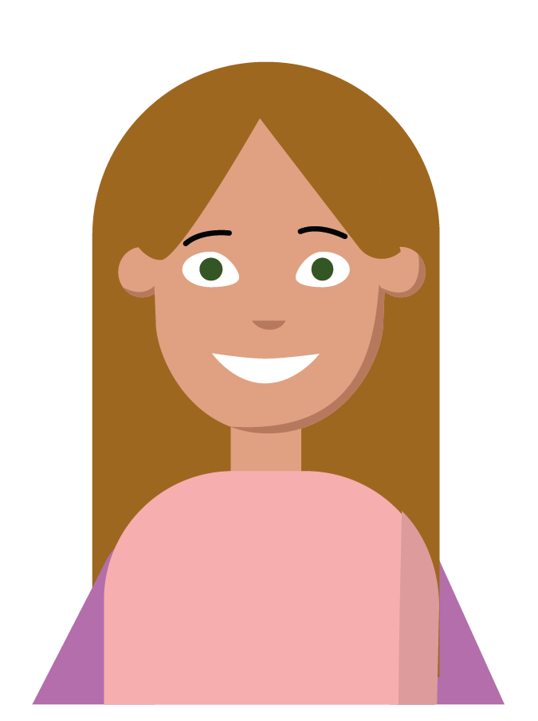

Equivalent Masses (kilograms and grams)
2
10
Ruby and Star are filling up bags of pasta. They both already have of one kilogram in each of their bags. They say,
I think I need to add 800 g of pasta to have a mass equal to 1 kg.
I think I need to add 80 g of pasta to have a mass equal to 1 kg.
Ruby
Star
Who do you agree with? Explain your answer.

Slide 22
Equivalent Masses (kilograms and grams)
2
10
Ruby and Star are filling up bags of pasta. They both already have of one kilogram in each of their bags. They say,
I think I need to add 800 g of pasta to have a mass equal to 1 kg.
I think I need to add 80 g of pasta to have a mass equal to 1 kg.
Ruby
Star
Who do you agree with? Explain your answer.
Ruby is correct because…

Slide 23
Equivalent Masses (kilograms and grams)
2
10
Ruby and Star are filling up bags of pasta. They both already have of one kilogram in each of their bags. They say,
I think I need to add 800 g of pasta to have a mass equal to 1 kg.
I think I need to add 80 g of pasta to have a mass equal to 1 kg.
Ruby
Star
Who do you agree with? Explain your answer.
Ruby is correct because she has identified that of the pasta is equal to 200 g and she needs to add 800 g to make the bag 1,000 g which is equivalent to 1 kg. Star has incorrectly identified as 20 g.
2
10
2
10

Slide 24
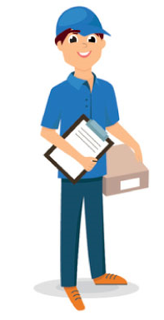
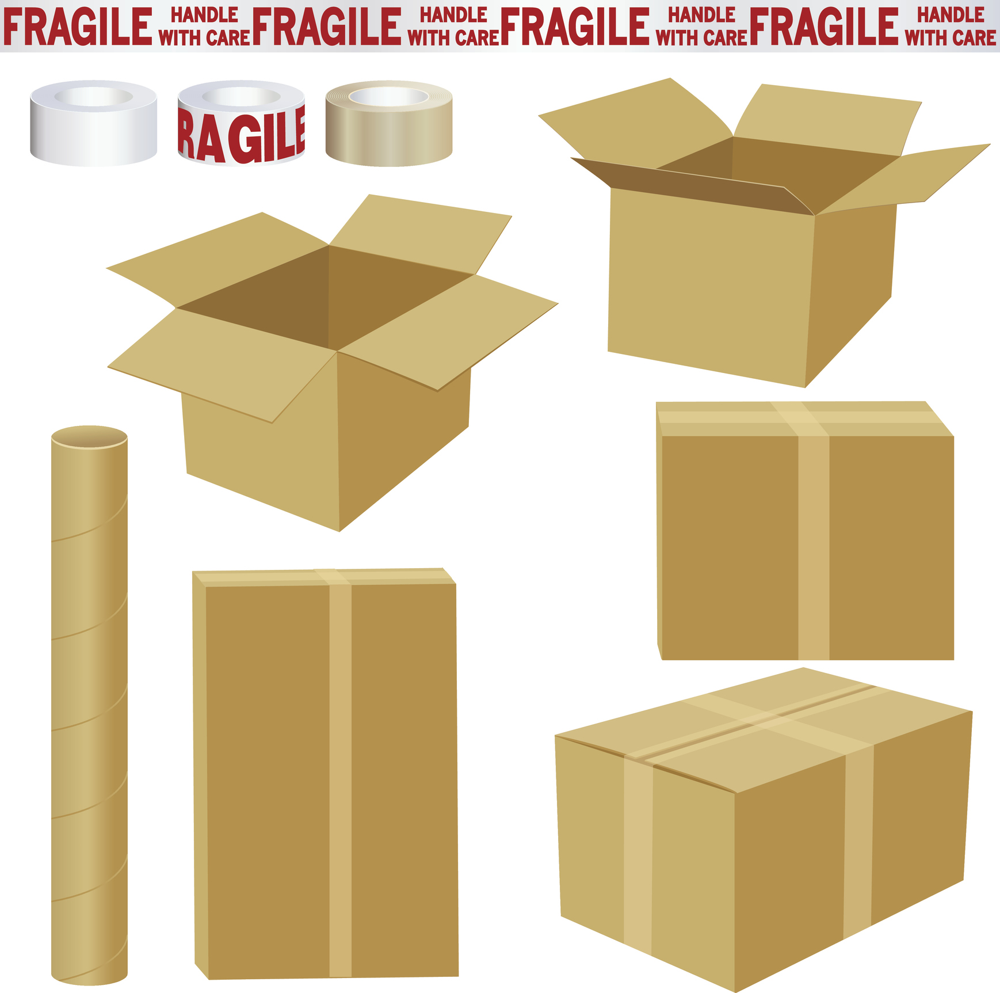

Equivalent Masses (kilograms and grams)
Delivery driver Dave needs help to sort the parcels into the bag. The bag can only have a combined mass equivalent to 1 kg.
A.
B.
C.
D.
350 g
520 g
100 g
750 g
E.
G.
380 g
H.
F.
500 g
250 g
400 g
Find three possible answers for how Dave could sort the parcels.

Slide 25
Equivalent Masses (kilograms and grams)
Delivery driver Dave needs help to sort the parcels into the bag. The bag can only have a combined mass equivalent to 1 kg.
A.
B.
C.
D.
350 g
520 g
100 g
750 g
E.
G.
380 g
H.
F.
500 g
250 g
400 g
Find three possible answers for how Dave could sort the parcels.
Various answers, for example: Parcels A, F and H; or parcels C, E and B; or parcels D and F.

