Slide 1
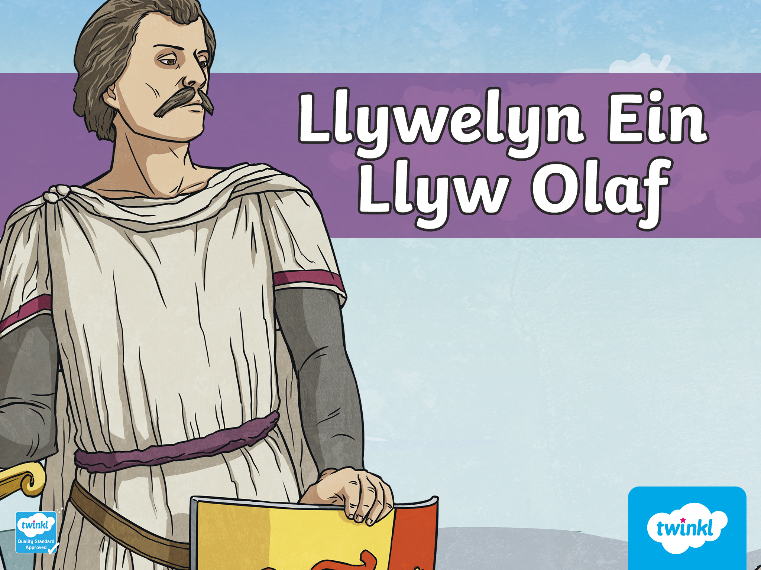

Slide 2
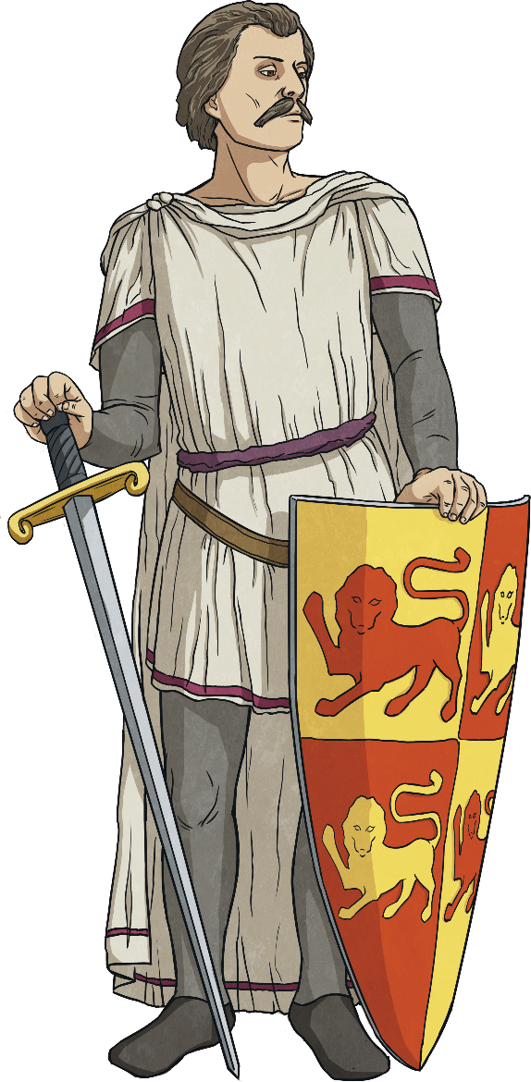
Fact File
Name: Llywelyn ap Gruffudd
Born: Around 1223
Title: Prince of Aberffraw, Lord of Snowdonia and Prince of Wales.
Home: Abergwyngregyn, Gwynedd
Family: Son of Gruffudd ap Llywelyn and Senena, brother to Owain, Dafydd and Rhodri. In 1278 he married Eleanor de Montfort, after coming to an agreement with the King of England. Eleanor died whilst giving birth to their daughter, Gwenllian.
Greatest Achievement: Successfully ruling Wales
Died: Killed on December 11th 1282, in Cilmeri near Builth Wells, by an English soldier.

Slide 3
Llywelyn Ein Llyw Olaf
Llywelyn was a prince that successfully managed to rule Wales around 700 years ago.
Edward I, the King of England, was not happy about this because he wanted to be the King of Wales.
He was unhappy as Llewelyn had refused to come to bow before him in his palace in London.

Slide 4
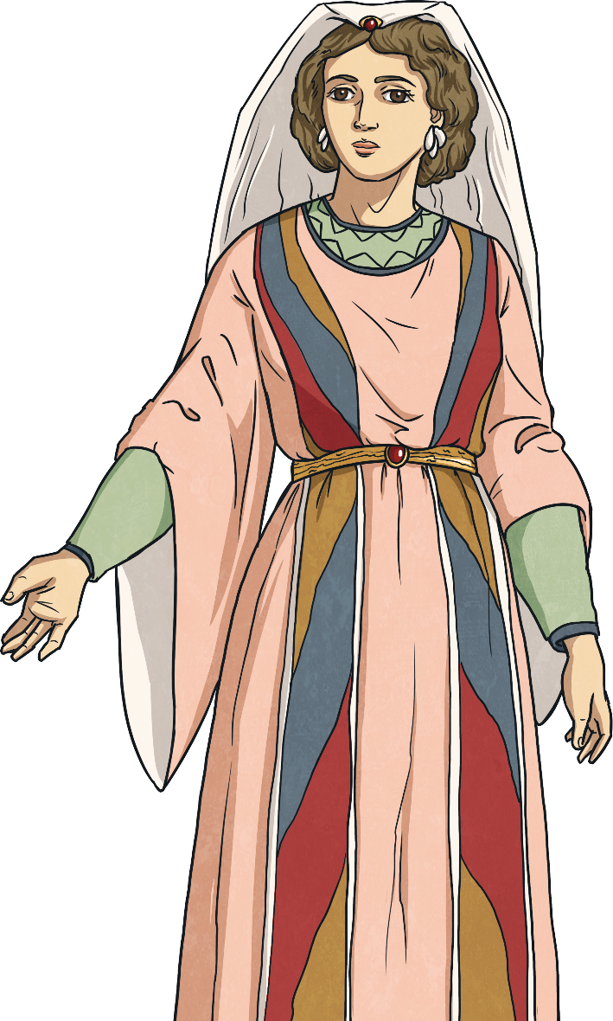
Llywelyn and King Edward
Llywelyn wanted to marry a noblewoman named Eleanor de Montfort, but to punish Llywelyn, Edward placed her in jail.
Despite this, Llywelyn refused to bow before King Edward I.
Edward decided to take an army to Wales to attack Llywelyn. Llywelyn heard of Edward’s plans and so went to his castle in the mountains of Snowdonia. Llywelyn thought that Edward and his army would be tired after making such a long journey and would return to London.

Slide 5
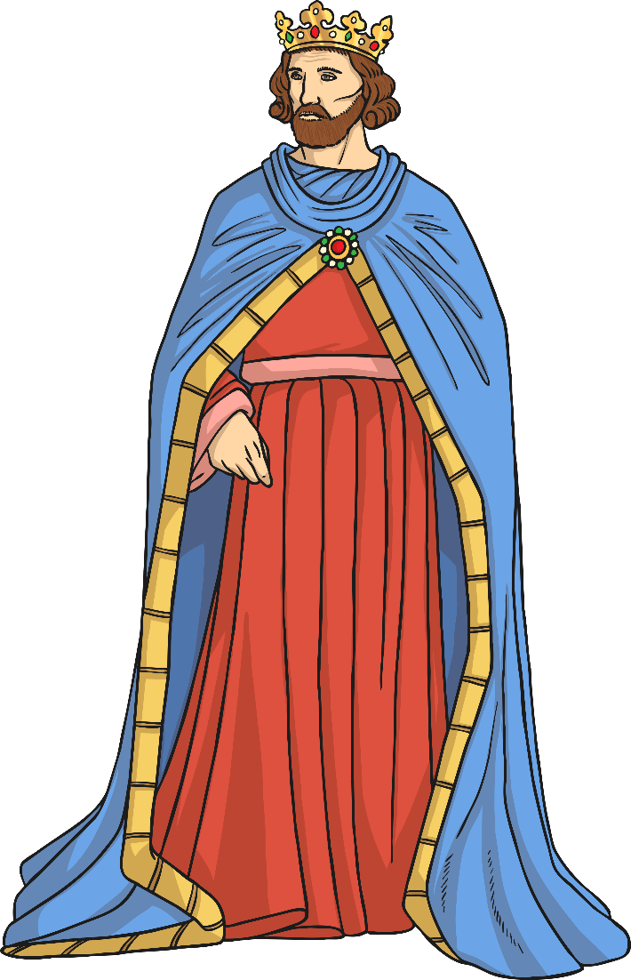
Llywelyn and King Edward
But this plan wasn’t successful. Edward wasn’t tired and he decided to prevent food from reaching Llywelyn and his men.
Eventually, Llywelyn was forced to surrender because he and his men were starving. Then, Llywelyn had to bow before King Edward I.
Edward told Llywelyn that he could be the Prince of Gwynedd but not the prince of the whole of Wales. By now, it was Edward that ruled the rest of Wales.

Slide 6
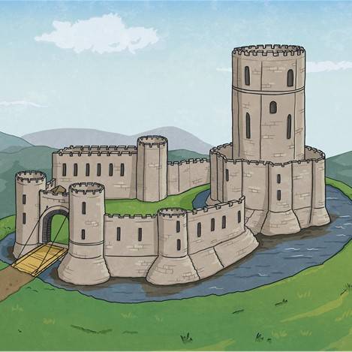
The Conflict Continues
Llywelyn and Eleanor married, and there was peace in Wales, but Llywelyn wasn’t happy.
“I am the Prince of Wales. Edward cannot tell me what to do.”
The Prince of Wales and King Edward I began to fight again. Once again Llywelyn went to his castle in Snowdon and once again Edward prevented food from getting to the castle. But this time, Llywelyn and his soldiers managed to escape.

Slide 7
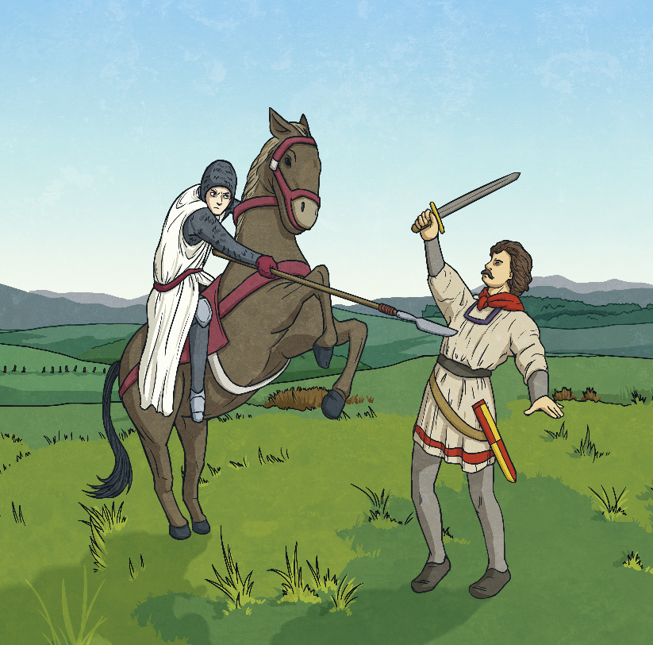
Llywelyn’s Death
Then, one morning Llywelyn and his soldiers were resting by the shore of a river near Builth Wells. Soldiers from England saw him. They didn’t recognise him but they knew he was an enemy.
Llywelyn didn’t have time to react as a soldier on horseback ran towards him and killed him with his spear.
The English soldiers cut Llywelyn's head off and sent it to King Edward I in London. Edward was very happy as he was now the ruler of the whole of Wales and England.

Slide 8
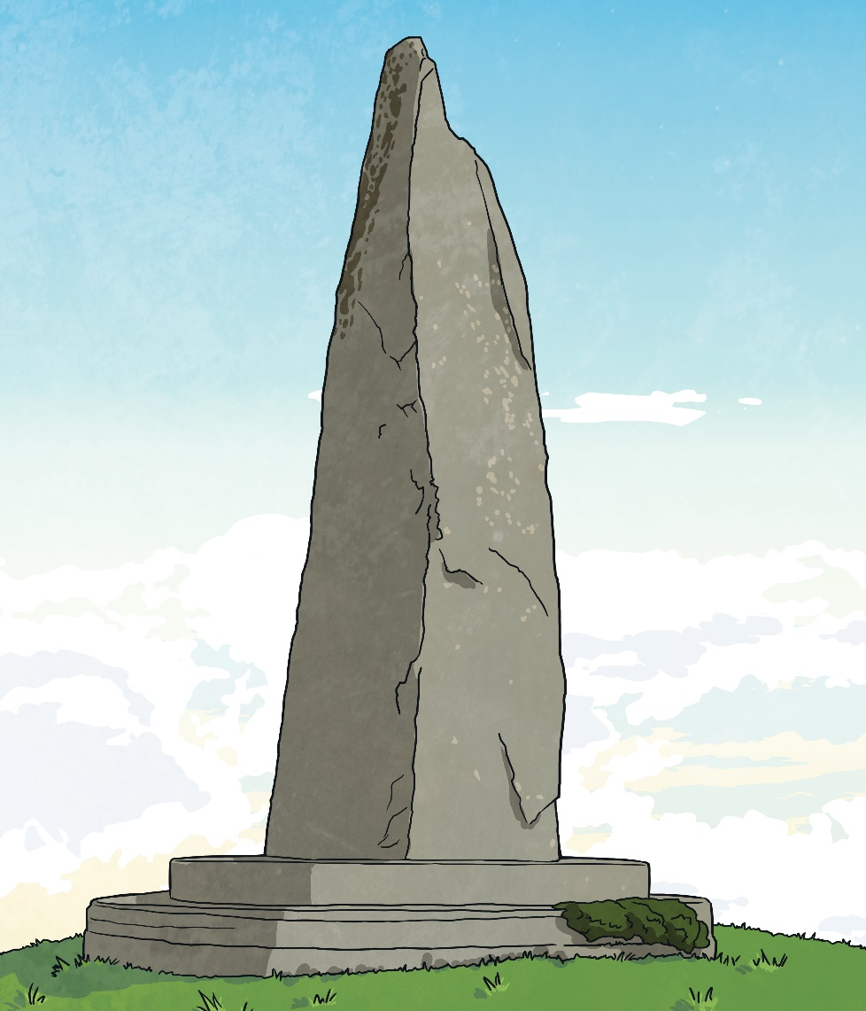
Cilmeri
Today, there is a stone in Cilmeri to show where Llywelyn died. Many people visit this area to remember Llywelyn Ein Llyw Olaf.

Slide 9


