Slide 2
Aim
To recognise the features of cinquain poems.
Success Criteria
I know that cinquains have five lines;
I can count the syllables in each line (2, 4, 6, 8, 2);
I know that cinquains should form approximately a diamond shape;
I understand that cinquains don’t have to rhyme.

Slide 3
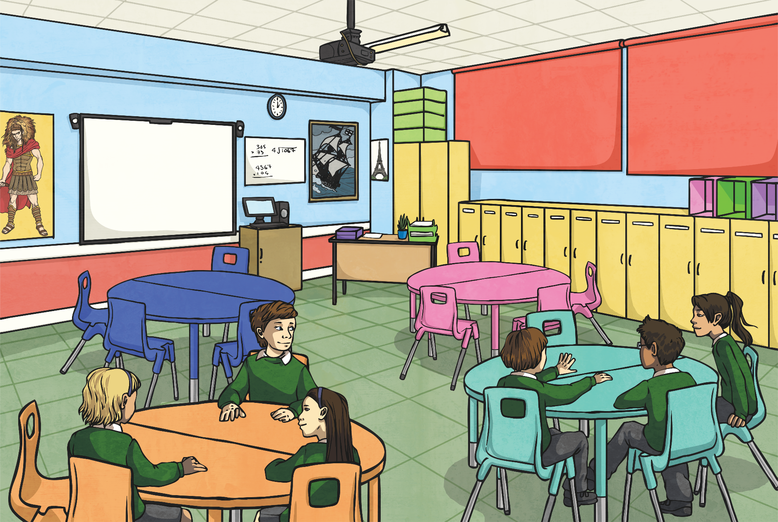
Cinquain Examples
What is each poem about?
Birthday
Happy, fun-filled
Playing, eating, dancing
Come and celebrate it with me
Party!
Summer
Hot and sunny
lazing, slurping ice-creams
Passport, suitcase, boring airport
No school!
My pet
Fluffy, wriggly
Licking faces, chewing
Never stops chasing his own tail!
Puppy

Slide 4
Cinquain Examples
What similarities can you find between the three poems?
Birthday
Happy, fun-filled
Playing, eating, dancing
Come and celebrate it with me
Party!
Summer
Hot and sunny
lazing, slurping ice-creams
Passport, suitcase, boring airport
No school!
My pet
Fluffy, wriggly
Licking faces, chewing
Never stops chasing his own tail!
Puppy

Slide 5
Cinquain Features
What did you notice?
There are always five lines.
Each line of the poem develops the subject of the first word.
Each line follows a general pattern:
subject
description
action
feeling
conclusion
Summer
Hot and sunny
Lazing, slurping ice creams
Passport, suitcase, boring airport
No school!
The lines form the shape (approximately) of a diamond, so these poems are sometimes called diamond or diamante poems.
Lines are always written centred on the page

Slide 6
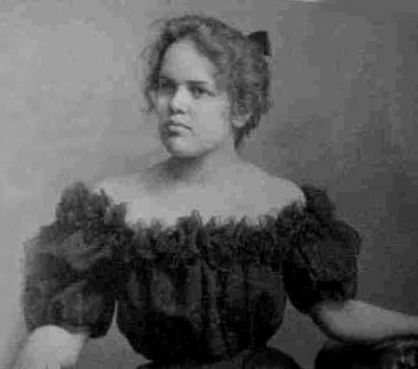
Did you know…?
The cinquain form was invented by the American poet Adelaide Crapsey, in about 1911.
It’s actually pronounced ‘san-cane’ not ‘sin-kwane’.
Every cinquain has 5 lines.
The name comes from the French word ‘cinq’ meaning five.
Photo courtesy of anonymous (@wikipedia.com) - granted under creative commons licence – attribution

Slide 7
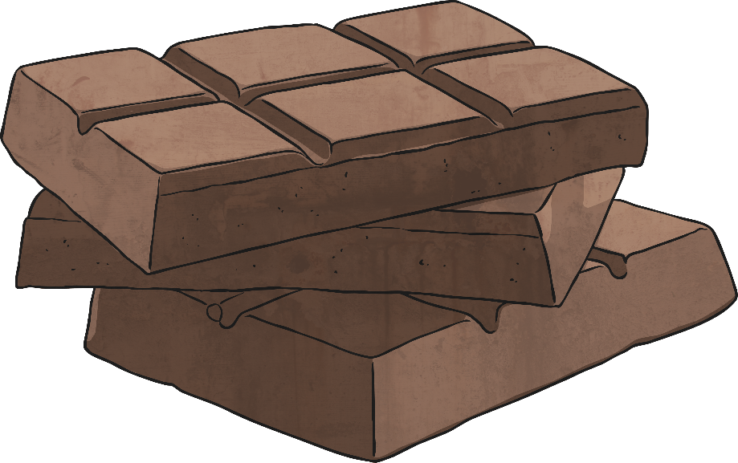
Lets try it!
How can we write a cinquain?
First, think of a theme. Well, lots of people like chocolate, so let’s have that!

Slide 8

Lets try it!
Brainstorm lots of things you know about the theme.
sticky
sweet
melts
delicious
coating
bars
creamy
cake
milk
dark
yummy
oozing
biscuits

Slide 9
Lets try it!
Now we need to fit those ideas into our 5-line frame…
Don’t worry if it doesn’t work at first. If a line doesn’t have the right number of syllables,
you might have to
change it
a little.
2
4
6
8
2

Slide 10
Lets try it!
Now we need to fit those ideas into our 5-line frame…
Chocolate
2
Sweet and sticky
4
Melting, oozing, creamy
6
Dark or milk, coating my biscuits
8
Yummy!
2

Slide 11
Your turn!
Here are some themes for a cinquain. Which one would you choose?
My bedroom
Our pets
Snow
Football
Summer
Chocolate
Friends

Slide 12
Aim
To recognise the features of cinquain poems.
Success Criteria
I know that cinquains have five lines;
I can count the syllables in each line (2, 4, 6, 8, 2);
I know that cinquains should form approximately a diamond shape;
I understand that cinquains don’t have to rhyme.

