Slide 1
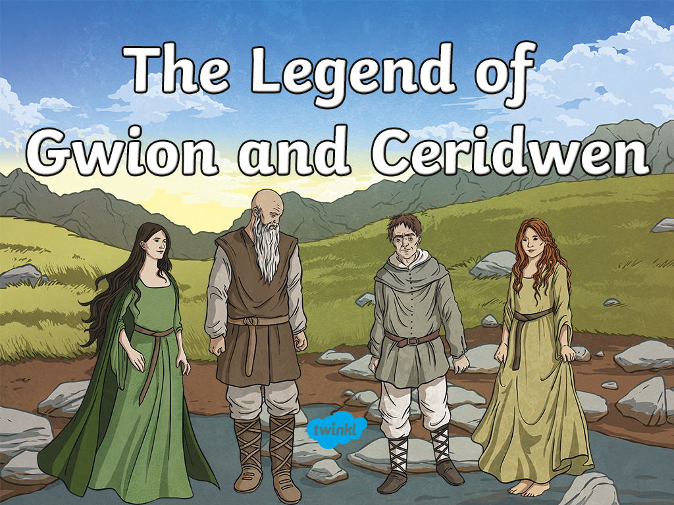

Slide 2
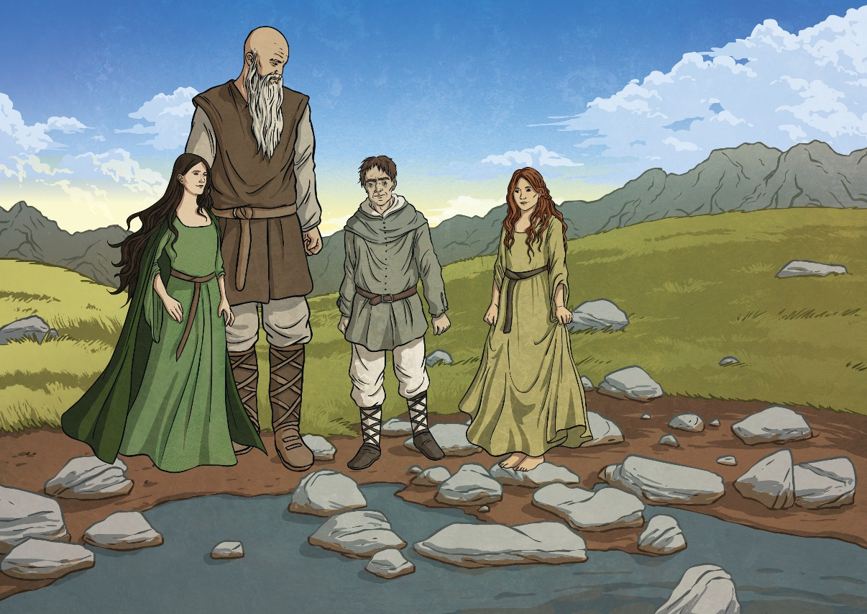
Many hundreds of years ago, on the banks of Bala Lake (Llyn Tegid), there lived a powerful witch called Ceridwen.
Ceridwen was married to the giant, Tegid Foel. Their daughter, Crearwy, was very beautiful, but their son, Morfran, was very stupid and
extremely ugly.

Slide 3
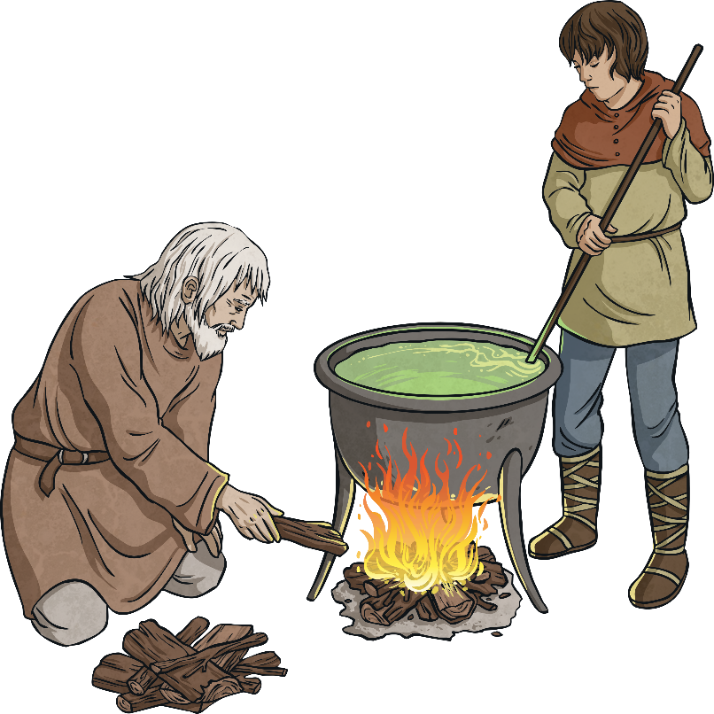
Ceridwen decided to brew a powerful potion in her cauldron to make Morfran handsome and clever.
The potion had to be stirred for a year and a day for the magic brew to work. She told Gwion Bach, her serving boy, to stir the mixture, and Morda, a blind old man, to keep the fire underneath the cauldron alight.
Ceridwen said that the first three drops of the potion would give great wisdom, but the rest would be deadly poisonous.

Slide 4
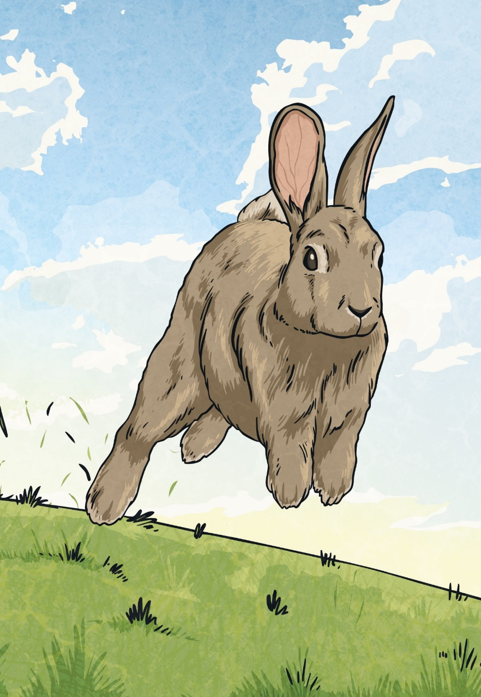
One day, while stirring the potion, three drops splashed onto Gwion’s hand. He quickly licked the drops off his hand, but suddenly realised what he had done!
Fearing that Ceridwen would be very angry to learn what he had done, he decided to run away.
The magic potion had given Gwion the ability to change shape, so he changed into a rabbit to hide from Ceridwen.

Slide 5
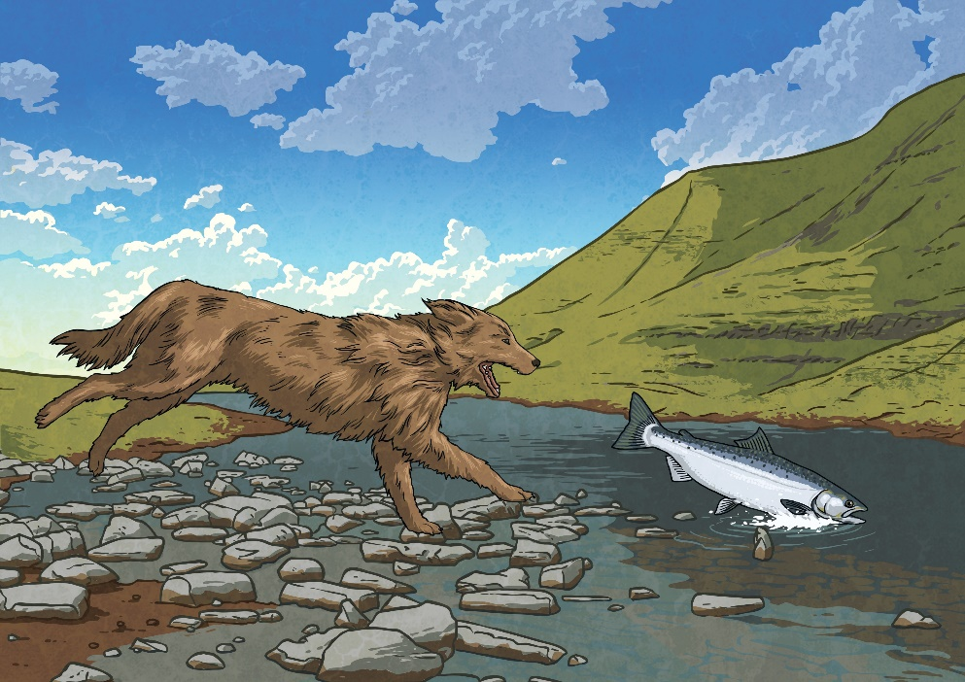
When Ceridwen learned what had happened, she changed herself into a dog and went to chase Gwion, in order to kill him for ruining the potion that was meant for Morfran.
Seeing the dog, Gwion changed into a fish and jumped into the river. But Ceridwen changed herself into an otter, and jumped
into the river after him.

Slide 6
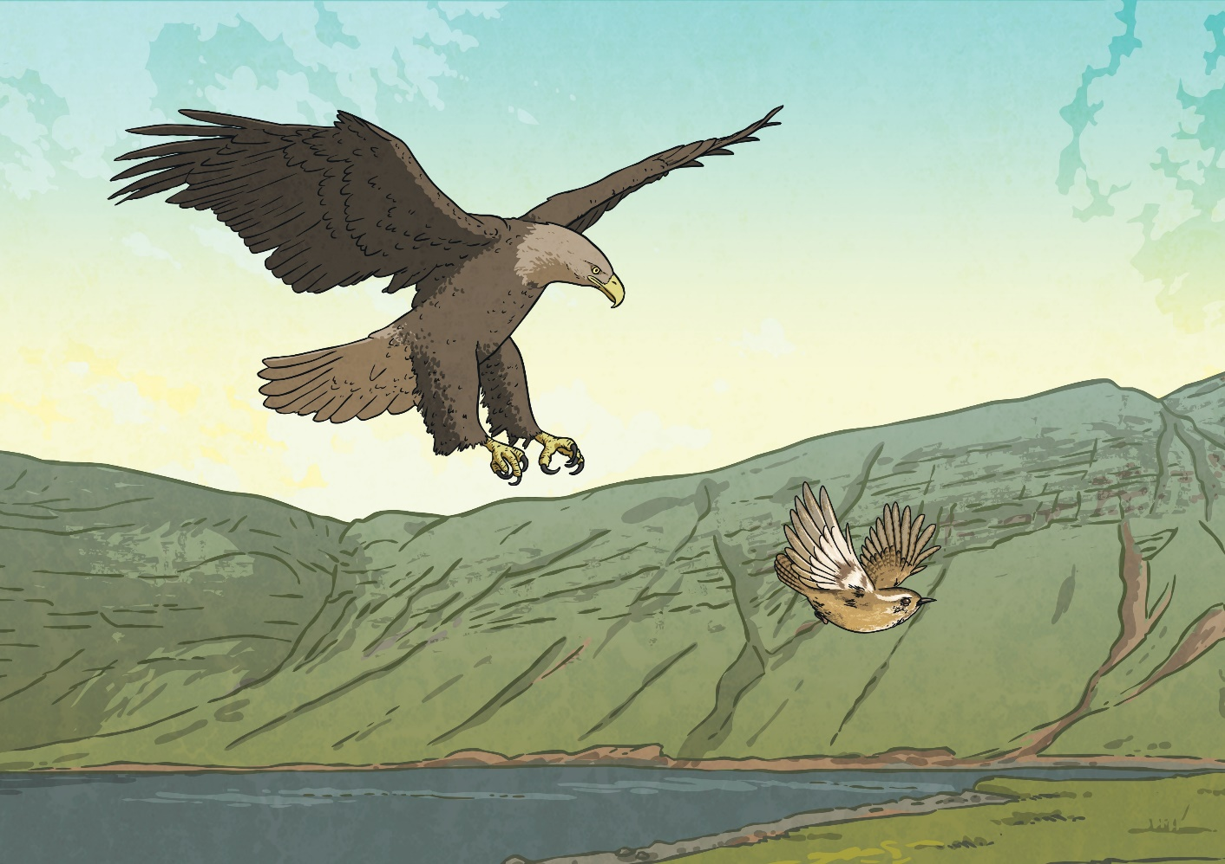
Fearing for his life, Gwion changed into a bird and flew away, but once again Ceridwen changed, this time into a bird of prey, and flew
off in pursuit of Gwion.

Slide 7
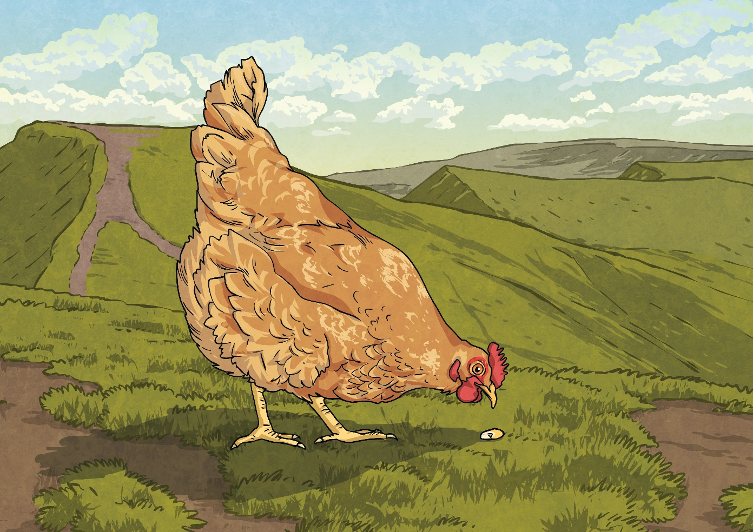
Gwion saw the bird of prey, and changed himself into a grain of corn. Ceridwen then changed from a bird of prey into a hen, and ate the
grain of corn.

Slide 8
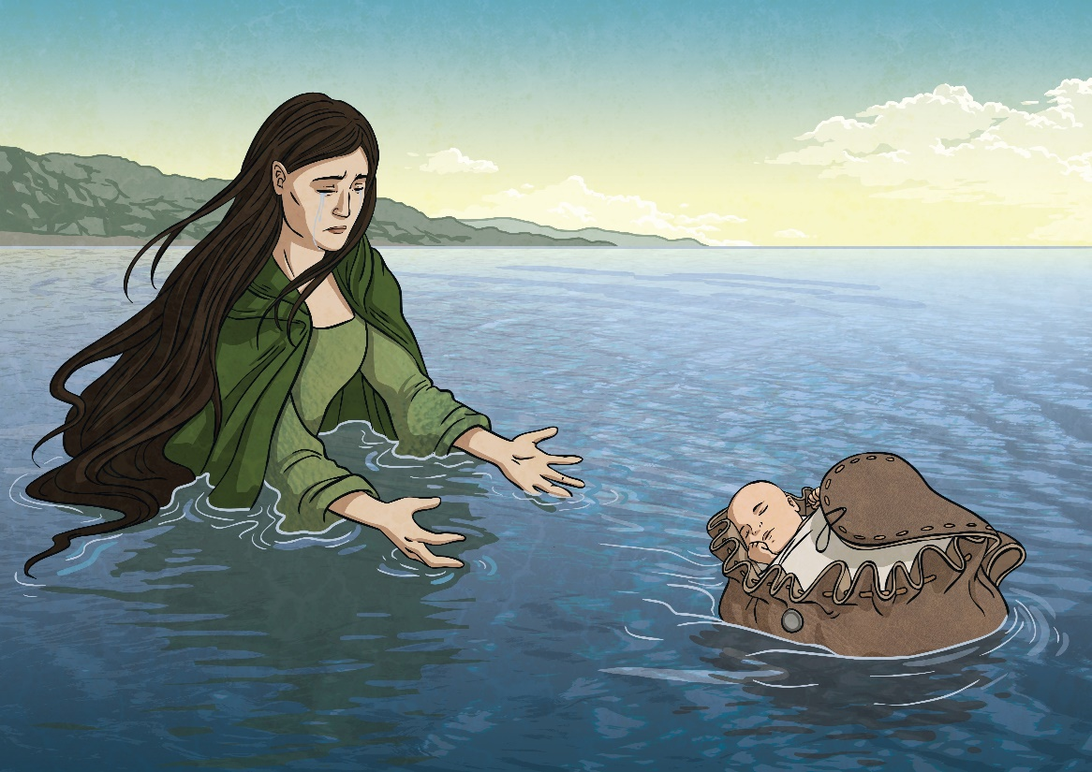
When Ceridwen changed back into a woman, she realised that she was expecting a baby. She knew the baby was Gwion!
She planned to kill the baby, but when he was born, he was so beautiful Ceridwen could not bring herself to kill him. Instead, she placed him in a leather bag and sent him out to sea.

Slide 9
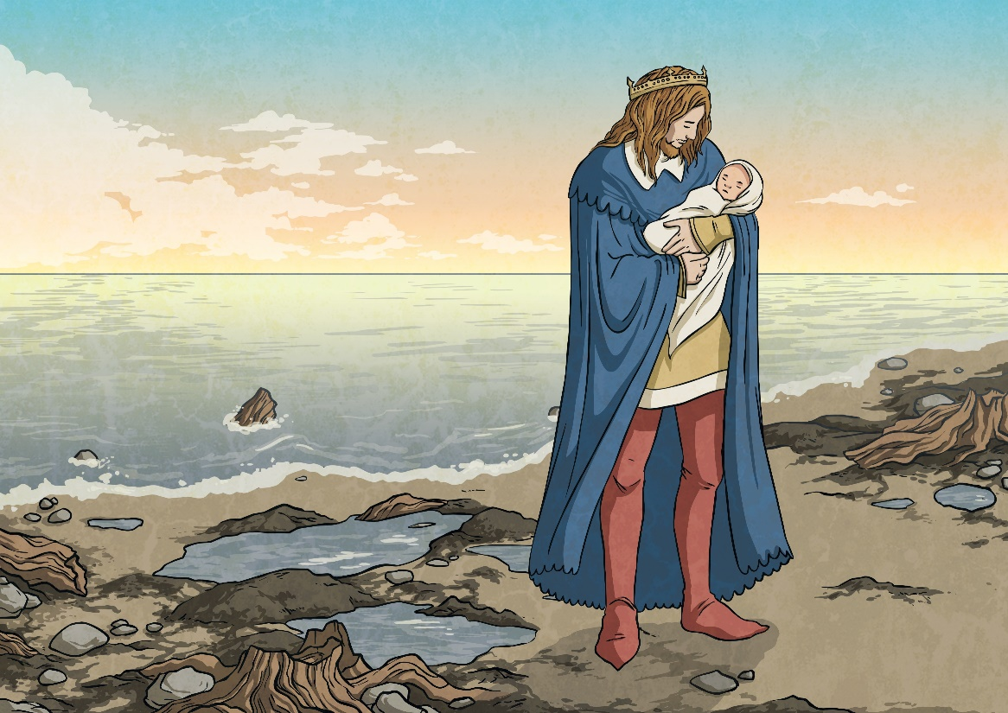
The bag floated on the waves, and drifted down the coast where it was found by Prince Elffin, the son of Gwyddno Garanhir of Cantre’r Gwaelod.
When Prince Elffin opened the bag, he saw the beautiful baby
and named him Taliesin, meaning ‘how radiant his brow is’, and took him back to his palace.

Slide 10
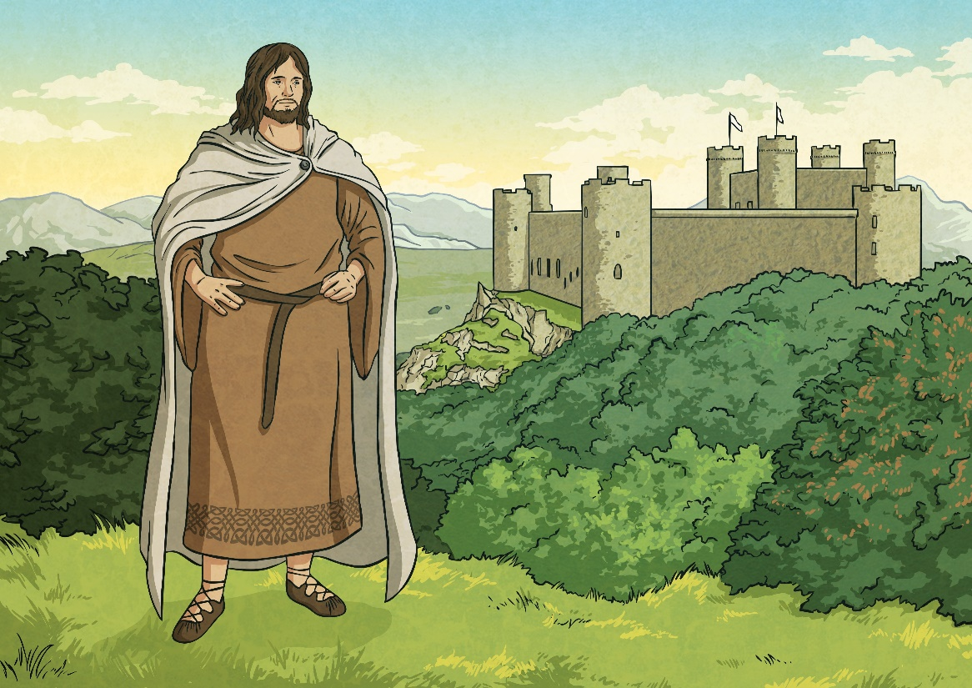
On the journey to the palace, Taliesin began to speak and recite poetry. He told the Prince that he had been sent to protect and guide him. From that day forward, Prince Elffin became famous for defeating
all his enemies in battle.
Taliesin grew up to be the most famous bard in Wales and he was credited for inspiring his Celtic countrymen to defeat the Saxons.

Slide 11
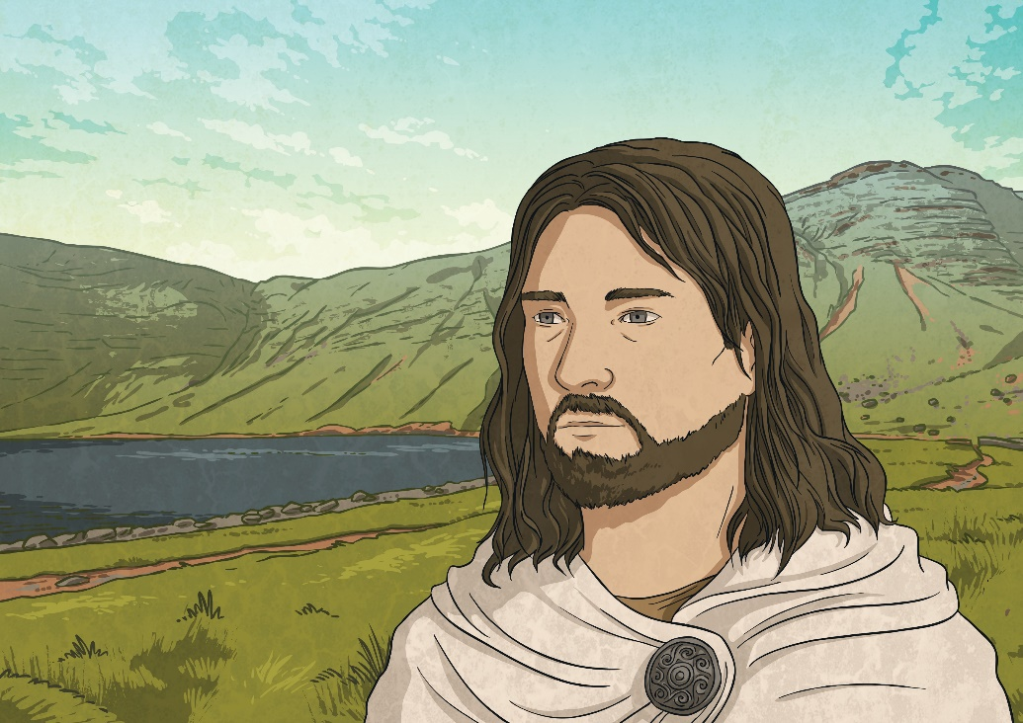
Towards the end of his life, Taliesin made a prediction which still has meaning for Welsh people to this day:
“Their Lord they shall praise,
Their language they shall keep,
Their land they shall lose –
Except wild Wales.”

